Slide 1
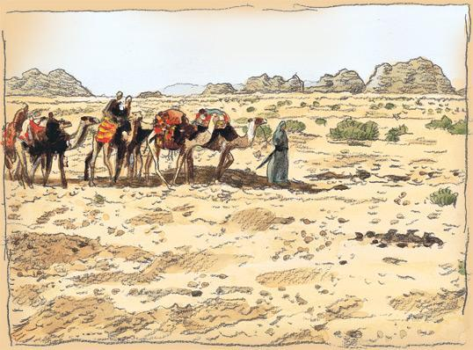
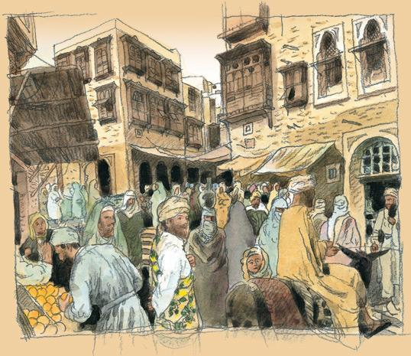
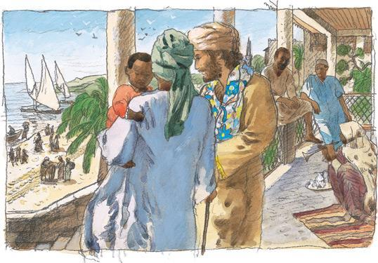
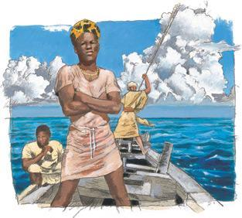
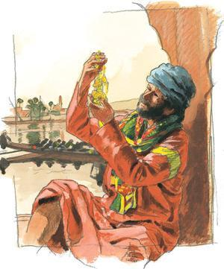
Chapter 7. Commerce & Culture, 500–1500
PART 3: AN AGE OF ACCELERATING CONNECTIONS500–1500

Slide 2
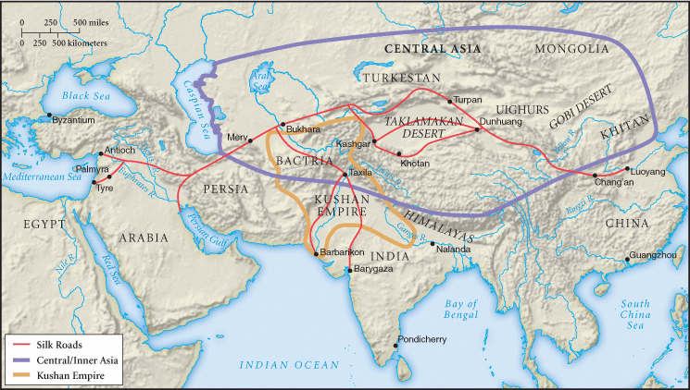
Map 8.1 The Silk Roads
For 2,000 years, goods, ideas, technologies, and diseases made their way across Eurasia on the several routes of the Silk Roads.

Slide 3
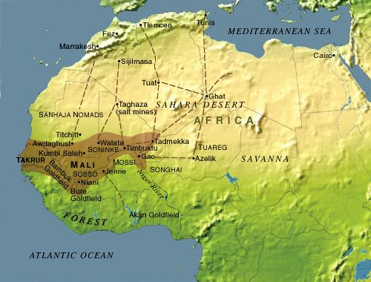
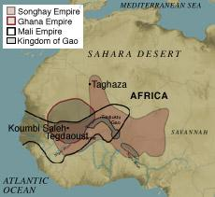

Slide 4
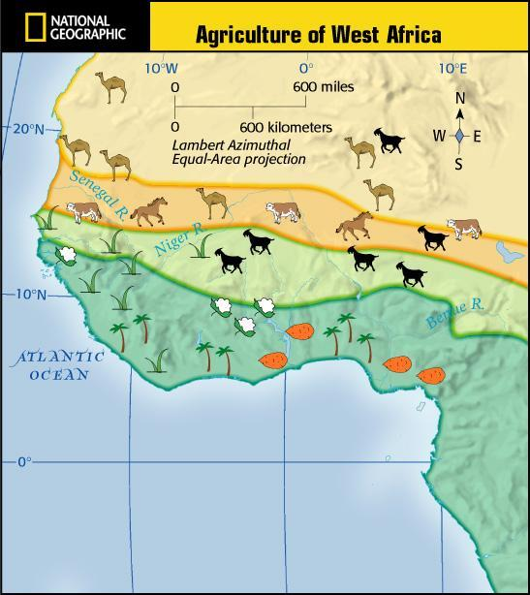
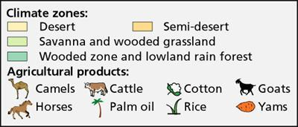

Slide 5
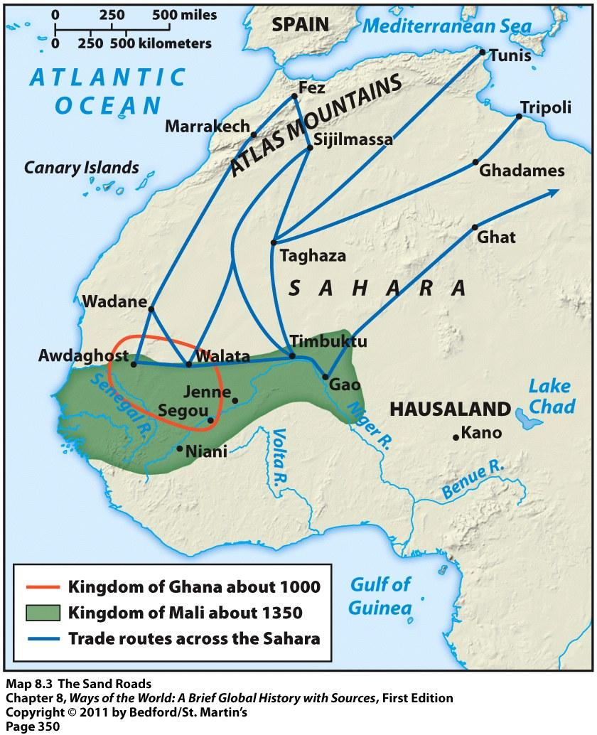
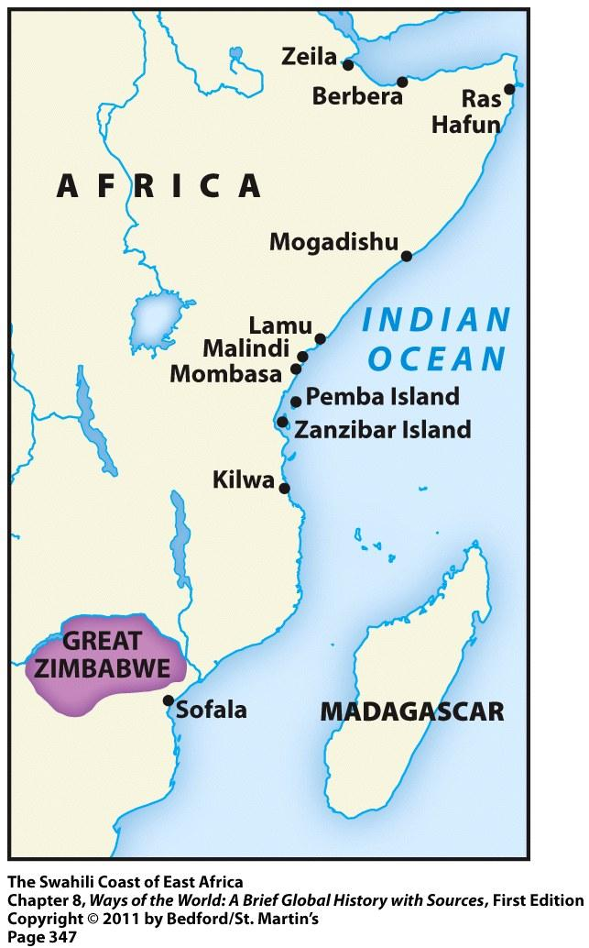

Slide 6
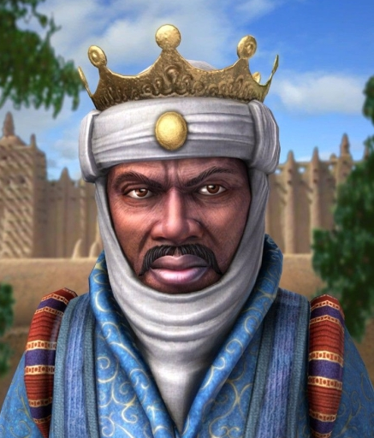
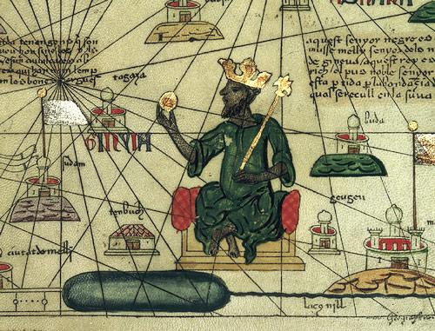
Gold, Salt, & Slaves:
Trade & Empire in West Africa
Introduction of the camel in early centuries c.e. was a turning point
camels can go 10 days without water
made it possible to cross the Sahara
Creation of a series of states in western and central Sudan between 500 and 1600 c.e., including Ghana, Mali, Songhay, Kanem, & Hausa city-states
all were monarchies with elaborate court life and at least some administration and military forces
all had a reputation for great riches
Merchants especially wanted gold from West Africa (along with ivory, kola nuts, slaves)
Sudan received horses, cloth, dates, manufactured goods, salt in return

Slide 7
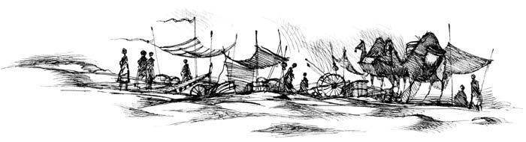
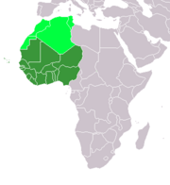
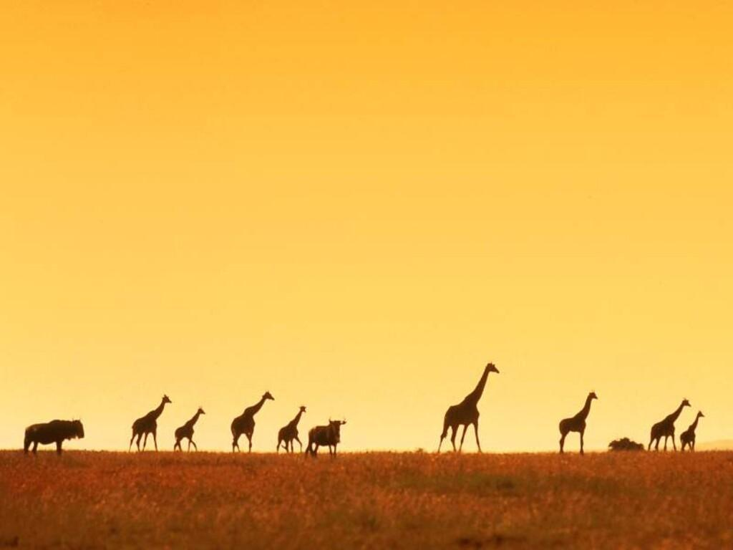
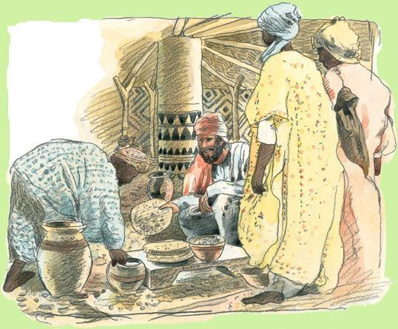
What changes did trans-Saharan trade bring to West Africa?
It provided both incentives and resources for the construction of new and larger political structures, including the city-states of the Hausa people and the empires of Ghana, Mali, Songhay, and Kanem.
These Sudanic states established substantial urban and commercial centers where traders congregated and goods were exchanged. Some also became manufacturing centers, creating finely wrought beads, iron tools, or cotton textiles for trade.
Islam accompanied trade and became an important element in the urban culture of West Africa.

Slide 8
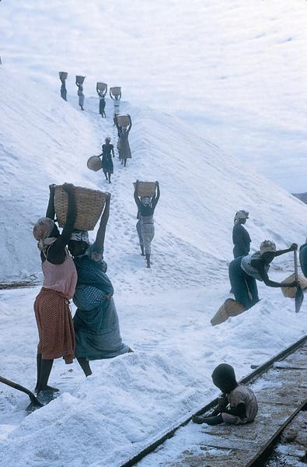
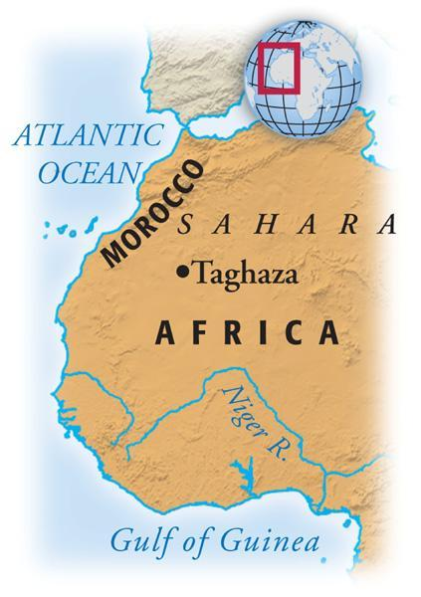
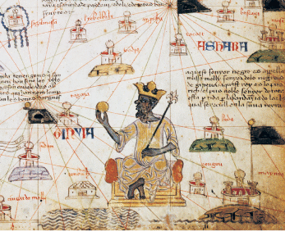
Connections: The two key commodities that drove the trans-Saharan trade were salt mined in the Sahara Desert and gold mined along the Gold Coast in equatorial West Africa.
If these commodities were the main reasons for trade, how can one account for the emergence of powerful kingdoms in West Africa—not in the regions where the commodities were produced but in between?
Model Answer:
• The desert regions in which the salt mines were located had small populations and limited resources. Thus they were a poor environment in which to construct an empire.
• The kingdoms emerged where gold and salt were traded rather than where they were produced, which makes sense because the kingdoms relied on income from trade in the two items, rather than the production of the items themselves.

Slide 9
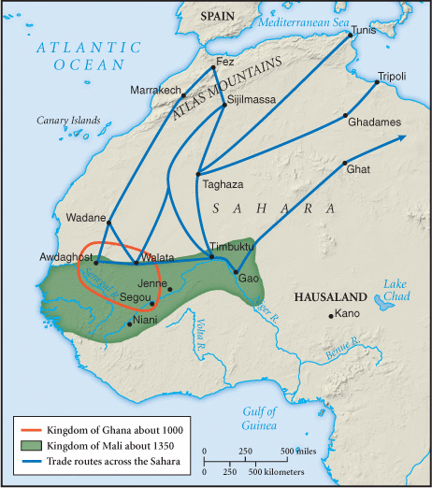
Reading the Map: What might account for the long-term growth of West African Empires to the east and the west?
Model Answer:
There were multiple routes across the Sahara that merchants could take.
The empires of Ghana and Mali depended heavily on taxes from the trans-Saharan trade, so conquering lands along an east/west axis allowed them to control more of the trade routes across the Sahara.

Slide 10
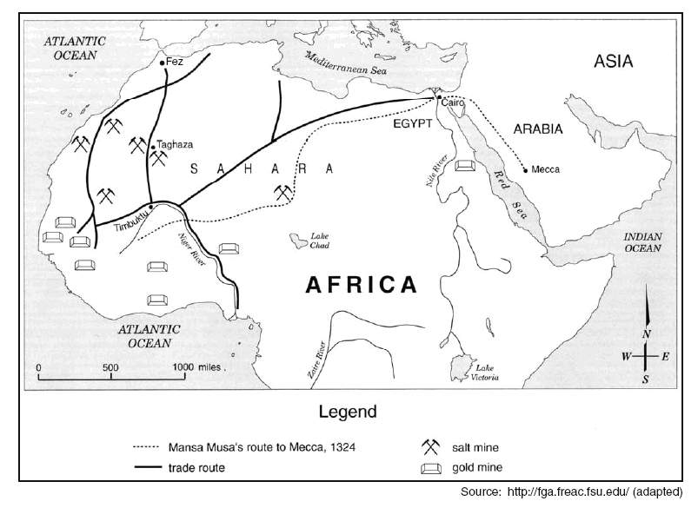
SUDAN

Slide 11
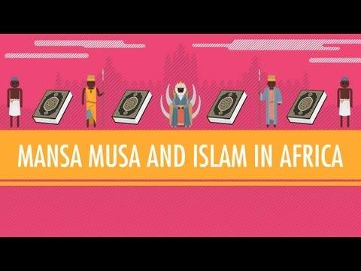
Youtube Video: Mansa Musa & Islam in Africa

Slide 12
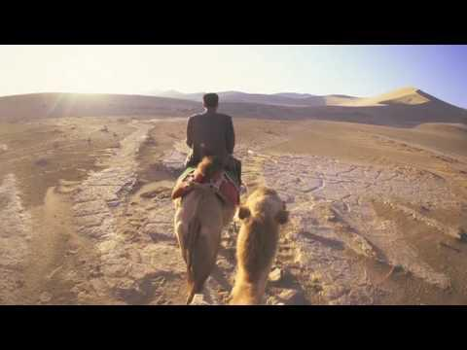
YouTube Vide: The Ancient Silk Road of China

Slide 13
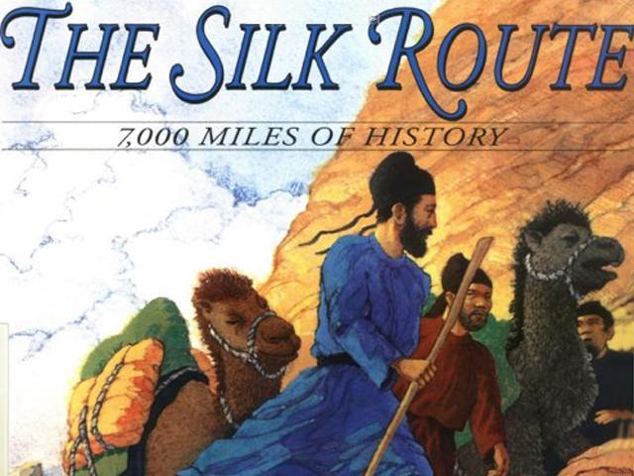
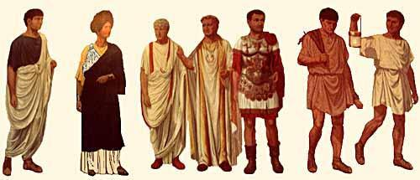
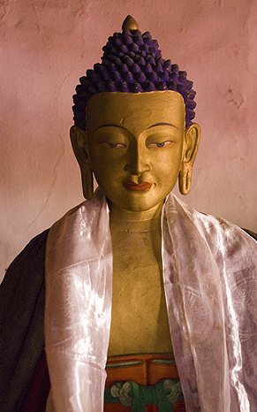

Q. What made silk such a highly desired commodity across Eurasia?
Silk was used as currency and as a means of accumulating wealth in Central Asia.
It became a symbol of high status in China and the Byzantine Empire (Eastern Roman Empire).
It became associated with the sacred in the expanding world religions of Buddhism and Christianity.

Slide 14

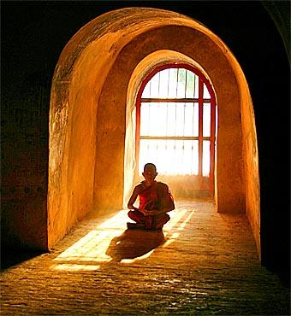
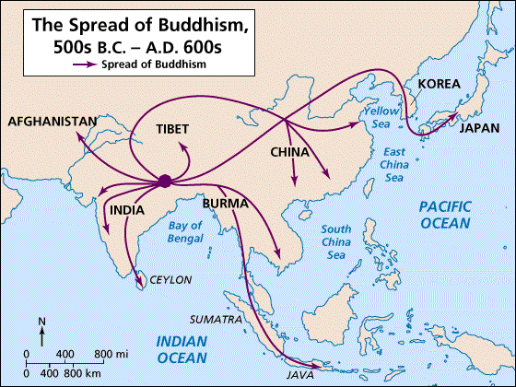
Q. What accounted for the spread of Buddhism along the Silk Roads?
Buddhism appealed to Indian merchants, who preferred its universal message to that of a Brahmin-dominated Hinduism that privileged the higher castes. Many inhabitants of the sophisticated and prosperous oasis cities of Central Asia that engaged in long-distance trade found in Buddhism a link to the larger, wealthy, and prestigious civilization of India. This resulted in many voluntary conversions. Well-to-do Buddhist merchants built monasteries and supported monks to earn religious merit. These monasteries in turn provided convenient and culturally familiar places of rest and resupply for merchants making the trek across Central Asia.

Slide 15
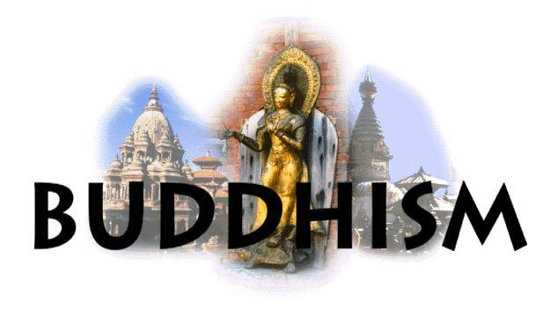
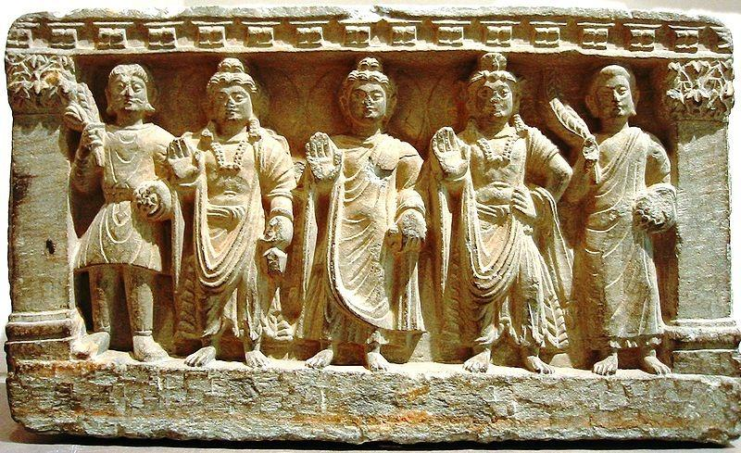
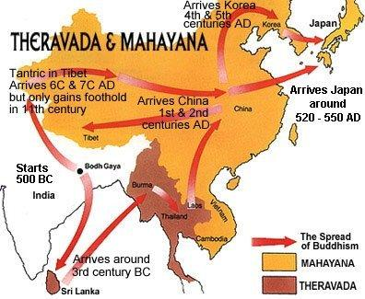
Q. What accounted for the spread of Buddhism along the Silk Roads?
Buddhism progressed only slowly among pastoral peoples of Central Asia. It had its greatest success when pastoralists engaged in long-distance trade or came to rule settled peoples. In China, Buddhism remained for many centuries a religion of foreign merchants or foreign rulers. Only slowly did it become popular among the Chinese themselves. As it spread, Buddhism changed, & some of these changes may have made it more appealing to local populations.
Mahayana form of Buddhism flourished, its emphasis on compassion and the possibility of earning merit making it more appealing than the more austere psychological teachings of the original Buddha. As it spread, Buddhism picked up elements of other cultures, including Greek influences, and the gods of many peoples along the Silk Roads were incorporated into Buddhist practice as bodhisattvas.

Slide 16

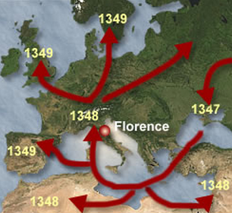

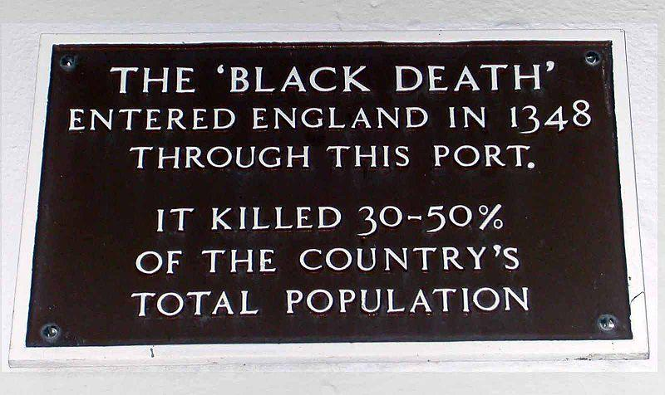
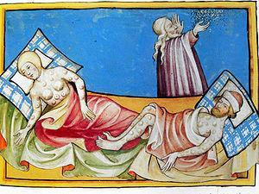
Q. What was the impact of disease along the Silk Roads?
Contact led to peoples being exposed to unfamiliar diseases to which they had little immunity or effective methods of coping.
The spread of some particularly virulent epidemic diseases could lead to deaths on a large scale.
The worst example of this occurred in the fourteenth century, when the Black Death, identified variously with bubonic plague, anthrax, or a package of epidemic diseases, swept away nearly one-third of the population in Europe, China, and the Middle East.
In the long run, the exchange of diseases gave Europeans a certain advantage when, after 1500, they confronted the peoples of the Western Hemisphere, who had little natural protection from the diseases of the Eastern Hemisphere.

Slide 17
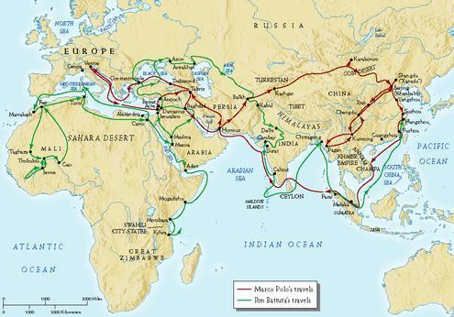
Document Study: Marco Polo & Ibn Battuta’s Travels

Slide 18
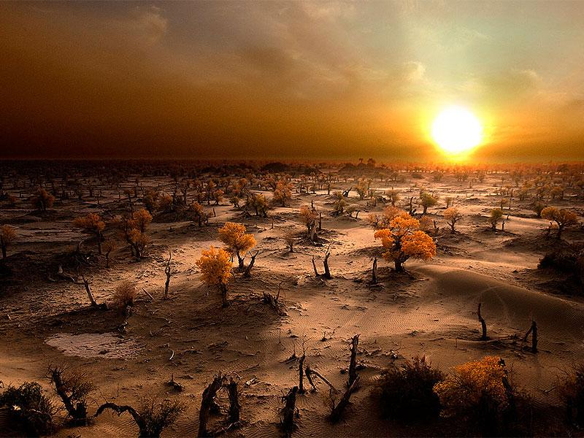
What motivated and sustained the long-distance commerce of the Silk Roads, Sea Roads, and Sand Roads?
The desire of elites for hard-to-find luxury items from distant parts of the Eurasian network, as well as the accumulation of wealth, especially among merchants who participated in the trade, motivated long-distance commerce.
Sustaining the commerce were the support of empires and smaller states that benefited directly from the trade;
the spread of religious traditions, including Islam and Buddhism, that through shared beliefs tied merchants and sometimes whole societies together over wide regions;
and the development of technologies like larger ships and the magnetic compass.

Slide 19
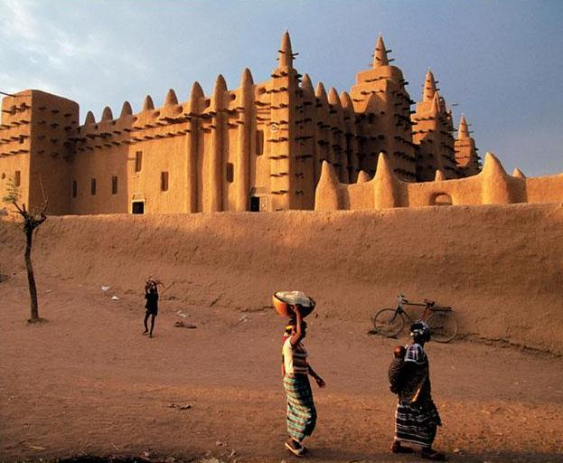
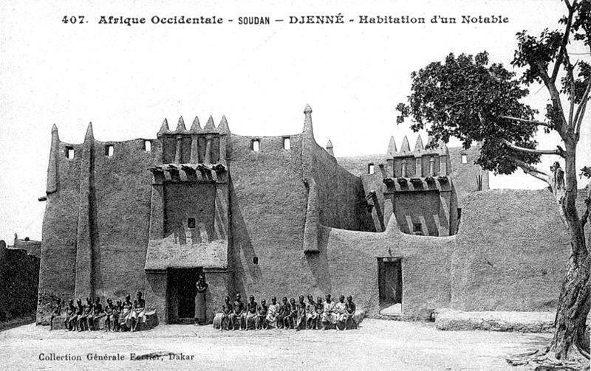
The Great Mosque of Djenné is the largest mud brick or adobe building in the world and is considered by many architects to be the greatest achievement of the Sudano-Sahelian architectural style, with definite Islamic influences. The mosque is located in the city of Djenné, Mali on the flood plain of the Bani River.

Slide 20
Q. What lay behind the emergence of Silk Road commerce, and what kept it going for so many centuries?
One important reason was the exchange of products of the forest and of the semi-arid northern grasslands of inner Eurasia, which were controlled by pastoral peoples, for the agricultural products and manufactured goods of the warmer, well-watered lands of outer Eurasia, including the Mediterranean, the Middle East, India, and China.
Also important were the construction of classical civilizations and their imperial states during the last five centuries b.c.e.; classical civilizations invaded the territory of pastoral peoples, securing sections of the Silk Roads and providing security for merchants and travelers.
The Silk Road had the continued support of later states, including the Byzantine, Abbasid, and Mongol empires, which also benefited from the trade.
There was a continuing demand for hard-to-find luxury goods among elites across Eurasia.

Slide 21
Q. What were the major economic, social, and cultural consequences of Silk Road commerce?
In some regions, long-distance trade profoundly affected the lives of peasant farmers.
For instance, peasants in the Yangzi River delta of southern China sometimes gave up the cultivation of food crops, choosing to focus instead on producing silk, paper, porcelain, lacquerware, or iron tools, much of which was destined for the markets of the Silk Roads.
Favorably placed individuals could benefit enormously from long-distance trade; some merchants accumulated considerable fortunes.

Slide 22
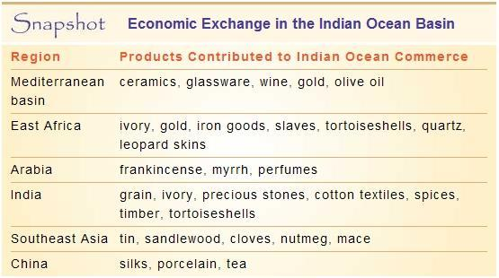
Sea Roads
Some regions relied on dugout canoes or rafts (inherent limitations!)
Which large bodies of water would be most dangerous to sail on?
Indian Ocean is probably the safest, followed by the Mediterranean and then the Pacific; the Atlantic and North seas are pretty nasty
Advantages of sails over rowing
Arab contributions to maritime history – lateen sails
Complexity of shipbuilding (difficulty of making a North Sea–style clinker-built ship compared to the mortise-and-tenon construction of the Mediterranean)
Advantage of rudders compared to steering oars
Inventions that aided navigation (astrolabe, magnetic compass, etc.)
Importance of naval warfare in world history

Slide 23
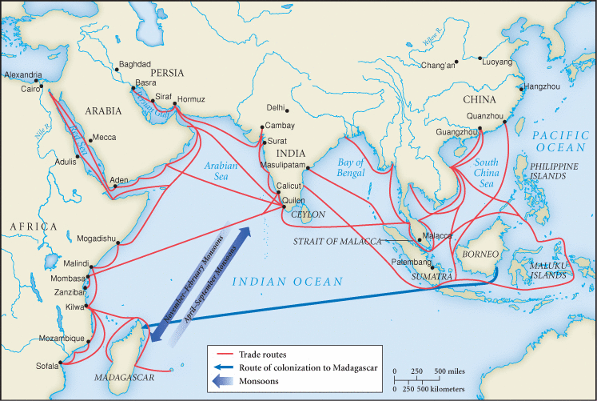
Map 8.2 The Sea Roads
Paralleling the Silk Road trading network, a sea-based commerce in the Indian Ocean basin connected the many peoples between China and East Africa.

Slide 24
How did the operation of the Indian Ocean trading network differ from that of the Silk Roads?
Transportation costs were lower on the Sea Roads than the Silk Roads, because ships could accommodate larger and heavier cargoes than camels.
This meant that the Sea Roads could eventually carry more bulk goods and products destined for a mass market—textiles, pepper, timber, rice, sugar, wheat— whereas the Silk Roads were limited largely to luxury goods for the few.
The Sea Roads relied on alternating wind currents known as monsoons.
India was the center of the Sea Roads but not of the Silk Roads.

Slide 25
What is the relationship between the rise of Srivijaya and the world of Indian Ocean commerce?
Srivijaya emerged from the intense competition between small ports along the Straits of Malacca, the critical choke point of Indian Ocean commerce. It came to dominate the straits, which controlled the key all-sea route between India and China.
Srivijaya’s plentiful supply of gold, its access to the source of highly sought-after spices, and the taxes it levied on passing ships provided the resources to attract supporters, to fund an embryonic bureaucracy, and to create the military and naval forces that brought some security to the area.
Srivijaya monarchs made use of imported Indian political ideas and Buddhist religious concepts (in addition to local beliefs about the magical powers of chiefs) to construct their government.
They employed Indian merchants as advisers, clerks, and officials, even assigning them Sanskrit titles.
The capital city of Palembang was a cosmopolitan city with cultural influences from the Indian Ocean trading network.
The rulers of Srivijaya sponsored the creation of images of the Buddha and various bodhisattvas. Srivijaya ultimately became a major center of Buddhist observance and teaching.

Slide 26
What lay behind the flourishing of Indian Ocean commerce in the postclassical millennium?
One important factor was the economic and political revival of China, especially during the Tang and Song dynasties (618–1279).
China both supplied products for and consumed the products of the Indian Ocean trading network.
China also provided technological innovations, including larger ships and the magnetic compass, which facilitated trade.
Another important factor was the sudden rise of Islam in the seventh century C.E. and its subsequent spread across much of the Afro-Eurasian world.
Islam was friendly to commercial life. The creation of an Arab Empire, stretching from the Atlantic Ocean through the Mediterranean basin and all the way to India, brought together in a single political system an immense range of economies and cultural traditions and provided a vast arena for trade.
Middle Eastern gold and silver purchased pepper, textiles, and gemstones in India.
Merchants from the Arab Empire established communities from East Africa to the China coast.
Opportunities for trade led to the production of sugar and dates in Mesopotamia and stimulated a slave trade from East Africa to provide labor for the growing and refining of these products.
Widespread conversion to Islam among traders in the Indian Ocean underpinned an international maritime culture and also helped to facilitate commercial transactions.

Slide 27
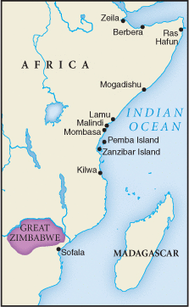
What was the role of Swahili civilization in the world of Indian Ocean commerce?
Economically, Swahili cities provided commercial centers that accumulated goods from the interior of sub-Saharan Africa and exchanged them for the products of the Indian Ocean trading network.
Culturally, Swahili civilization also participated in the larger Indian Ocean world. Most important, Swahili civilization rapidly and voluntarily became Islamic. Moreover, Arab, Indian, and perhaps Persian merchants visited and sometimes permanently settled in Swahili cities.
Swahili rulers often claimed Arab or Persian origins to bolster their authority.
In terms of material culture, Swahili elite dined off Chinese porcelain and dressed in Indian cottons.
The Swahili language was grammatically a Bantu African tongue, but it was written in Arabic script and contained a number of Arabic loan words.
The Swahili Coast of East Africa

Slide 28
What makes trade tick?
societal elite to consume the luxury goods that were traded
relative peace for traders to travel
some sort of accepted system of exchange (coinage, silk as currency, etc.)
camels or other draft animals if trading by land
relatively advanced shipbuilding technology if trading by sea
capital for a trader to start business
system that collects or produces goods and brings them to a central location, where traders can purchase them

Slide 29
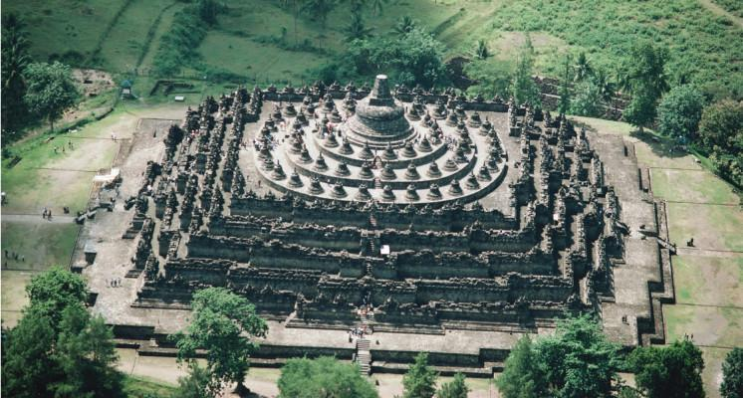
Borobudur
This huge Buddhist monument, constructed probably in the ninth century C.E., was subsequently abandoned and covered with layers of volcanic ash and vegetation as Java came under Islamic influence.
It was rediscovered by British colonial authorities in the early 19th century and has undergone several restorations over the past two centuries.
Although Indonesia is a largely Muslim country, its Buddhist minority (about 1 percent of the country’s population) still celebrates the Buddha’s birthday at Borobudur. (Robert Harding World Imagery/Alamy)

Slide 30
In what ways did networks of interaction in the Western Hemisphere differ from those in the Eastern Hemisphere?
Direct connections among the civilizations and cultures of the Americas were less densely woven than in the Afro-Eurasian region. There was no equivalent in the Western Hemisphere to the long-distance trade of the Silk, Sea, or Sand Roads of the Eastern Hemisphere.
The spread of agricultural products was slower and less pronounced in the Americas than in Eurasia. The north/south orientation of the Americas required agricultural practices to adapt to various and distinct climatic and vegetation zones, whereas the east/west orientation of Eurasia made crop dissemination easier and quicker there.
The Americas had no equivalent to the spread of distinct cultural traditions like Buddhism, Christianity, or Islam that ultimately helped to integrate distant peoples in the Afro-Eurasian web.
Nevertheless, the Americas did have zones of interaction, as reflected in the slow spread of cultural elements.
Commerce did play an important role in regions where contact was possible—for instance, along the river networks of North America, in the Amazon basin, and between the islands of the Caribbean. But the most active and dense networks of communication and exchange lay within, rather than between, the regions that housed the two great civilizations of the Western Hemisphere—Mesoamerica and the Andes.

Slide 31
Why did the Eastern Hemisphere develop long-distance trade more extensively than did the societies of the Western Hemisphere?
The Western Hemisphere did not develop the extensive long-distance trade as did the East for several reasons, including the absence of large domesticated mammals in the Americas and the absence of large oceanic vessels.
The geographical realities of the Americas, especially the narrow bottleneck of Panama, which was largely covered by dense rain forests, made long-distance trade more difficult.
Finally, the north/south orientation of the Americas, which required agricultural practices to move through, and adapt to, quite distinct climatic and vegetation zones, hindered east/west expansion and trading.

Slide 32
