Slide 1
Government in America: People, Politics and Policy
Seventeenth Edition
Chapter 2
The Constitution

Slide 2
Learning Objectives (1 of 2)
2.1 Describe the ideas behind the American Revolution and their role in shaping the Constitution.
2.2 Analyze how the weaknesses of the Articles of Confederation led to its failure.
2.3 Describe the delegates to the Constitutional Convention and the core ideas they shared.
2.4 Categorize the issues at the Constitutional Convention and outline the resolutions reached on each type of issue.

Slide 3
Learning Objectives (2 of 2)
2.5 Analyze how the components of the Madisonian system addressed the dilemma of reconciling majority rule with the protection of minority interests.
2.6 Compare and contrast the Federalists and Anti-Federalists in terms of their backgrounds and their positions regarding government.
2.7 Explain how the Constitution can be formally amended and how it changes informally.
2.8 Assess whether the Constitution establishes a majoritarian democracy and how it limits the scope of government.

Slide 4
Learning Objective 2.1
Describe the ideas behind the American Revolution and their role in shaping the Constitution.

Slide 5
The Origins of the Constitution
The Road to Revolution
Declaring Independence
The English Heritage: The Power of Ideas
The American Creed
Winning Independence
The "Conservative" Revolution
Notes:
The American Revolution was built on the foundation of belief in natural rights, consent of the governed, limited government, the responsibility of government to protect private property, and the equality of citizens. The Constitution written by the Framers incorporated all of these ideas.

Slide 6
The Road to Revolution
Life was good in the colonies
(Slaves excepted, of course)
Self-governing
Irritants
New taxes to finance French and Indian War
Enforcement of trade regulations
No representation in Parliament
Protests and boycotts
First Continental Congress – Sept. 1774
Notes:
Life was good for the British colonists before the Revolution. The colonies were prosperous and the British government generally let them govern themselves as they saw fit. They enjoyed an unusual degree of freedom, equality, and autonomy for that era – assuming, of course, that you were white, male, and reasonably well-off.
But things changed after the French and Indian War, when the Crown decided to recoup costs by imposing a series of taxes on the colonists. Britain also began tightening enforcement of its trade regulations, which were designed to benefit the mother country, not the colonists.
The colonists lacked direct representation in Parliament and resented the legislature imposing taxes without their consent. They protested, including the famous dumping of tea into Boston Harbor, and the British responded with force. The colonists decided to send a delegation to Philadelphia to hold a meeting to discuss relations with Britain.

Slide 7
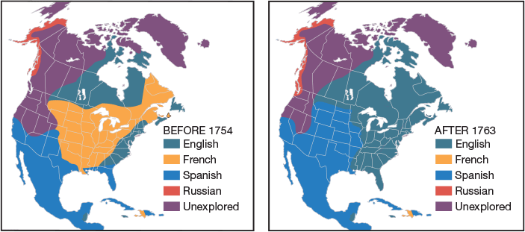
Figure 2.1 European Claims in North American
Notes:
Following its victory in the French and Indian War in 1763, Britain obtained an enormous new territory to govern. To raise revenues to defend and administer the territory, it raised taxes on the colonists and tightened enforcement of trade regulations.

Slide 8
Declaring Independence (1 of 2)
Reconciliation or revolution?
Thomas Paine's Common Sense
Fanned revolutionary sentiments
Notes:
The delegates at the Second Continental Congress gradually shifted their mindset from reconciliation to revolution. Thomas Paine's fiery tract, Common Sense, had an incendiary effect.

Slide 9
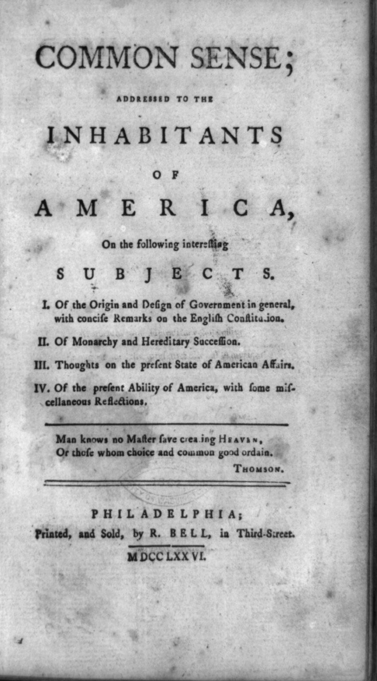
Common Sense
Notes:
Thomas Paine’s Common Sense encouraged the colonists to declare independence from Britain.

Slide 10
Declaring Independence (2 of 2)
Declaration of Independence
Thomas Jefferson
Justified revolution
Revolutionaries needed foreign assistance
Notes:
The delegates at the Second Continental Congress formed a committee to compose a declaration of independence. Thomas Jefferson became the primary author. The Declaration listed the ways that the king had abused the colonists.
Their audience was not just their fellow colonists or British citizens back home; they would need foreign assistance to mount a successful revolution against the most powerful country in the world, particularly from Britain's historic enemy, France.

Slide 11
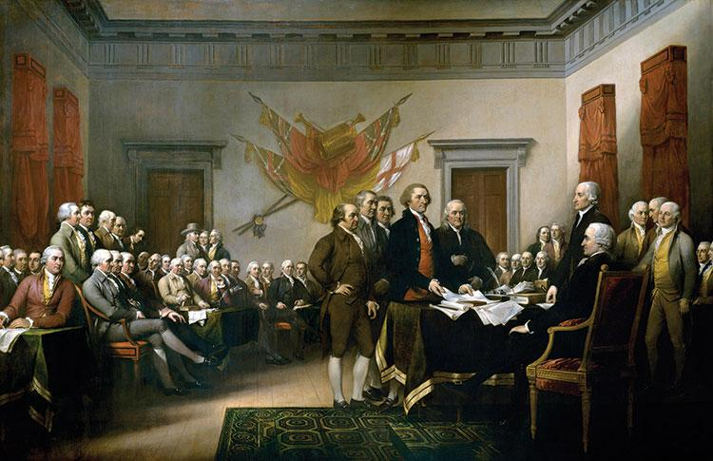
Delegates in Philadelphia
Notes:
John Adams (from right), Roger Sherman, Robert R. Livingston, Thomas Jefferson, and Benjamin Franklin submit the Declaration of Independence to Continental Congress President John Hancock. Legend has it that Hancock remarked, “We must be unanimous; there must be no pulling different ways; we must hang together,” to which Franklin replied, “We must indeed all hang together, or, most assuredly, we shall hang separately.”

Slide 12
The English Heritage: The Power of Ideas
John Locke
Natural rights
Life, liberty, property
Purpose of government is to protect
Consent of the governed
Limited government

Slide 13
Table 2.1 Locke and the Declaration of Independence: Some Parallels (1 of 2)
Locke | Declaration of Independence
Natural Rights
“The state of nature has a law to govern it" | “Laws of Nature and Nature’s God”
“life, liberty, and property” | “life, liberty, and the pursuit of happiness”
Purpose of Government
“to preserve himself, his liberty, and property” | “to secure these rights”
Equality
”men being by nature all free, equal, and independent” | “all men are created equal”
Consent of the Governed
“for when any number of men have, by the consent of every individual, made a community, with a power to act as one body, which is only by the will and determination of the majority. | “Governments are instituted among men, deriving their just powers from the consent of the governed.”
Notes:
Let's look at the wording of the Declaration and see how it reflects the ideas of Locke.
Some of the text of the Declaration would be considered plagiarism if Jefferson had been writing a paper for school.

Slide 14
Table 2.1 Locke and the Declaration of Independence: Some Parallels (2 of 2)
Locke | Declaration of Independence
Limited Government
“Absolute arbitrary power, or governing without settled laws, can neither of them consist with the ends of society and government.” | “The history of the present King of Great Britain is a history of repeated injuries and usurpations.”
“As usurpation is the exercise of power which another has a right to, so tyranny is the exercise of power beyond right, which nobody can have a right to.”
Right to Revolt
“The people shall be the judge.... Oppression raises ferments and makes men struggle to cast off an uneasy and tyrannical yoke.” | “Prudence, indeed, will dictate that Governments long established should not be changed for light and transient causes.... But when a long train of abuses and usurpations, pursuing invariably the same Object evinces a design to reduce them under absolute Despotism, it is their right, it is their duty, to throw off such Government.”

Slide 15
American Creed, Winning Independence, and the “Conservative Revolution”
Individualism
Rule by the people
New ideas incubated in a unique environment
Winning independence not easy
A conservative revolution?
Notes:
The ideas in the Declaration of Independence, that all men are created equal, have value as individuals, and the right to rule instead of be ruled by a hereditary monarch, had been articulated by philosophers but never put into practice in a real government.

Slide 16
Learning Objective 2.2
Analyze how the weaknesses of the Articles of Confederation led to its failure.

Slide 17
The Government That Failed: 1776–1787
The Articles of Confederation
Changes in the States
Economic Turmoil
The Aborted Annapolis Meeting
Notes:
The Articles of Confederation established a government dominated by the states, without a permanent executive or national judiciary. A weak central government could not raise sufficient funds to support a national defense, regulate commerce to encourage trade, protect property rights, or take action without the unanimous consent of the states. It was doomed to failure from the start, although it took the colonists some years to accept this.

Slide 18
The Articles of Confederation
State-dominated government
League of friendship amongst states
Unicameral legislature
No judiciary
No executive
No power to tax
No power to regulate commerce
Feared strong central government
Notes:
The Articles established a government dominated by the states. The United States, according to the Articles, was a confederation, a "league of friendship and perpetual union" among 13 states. The Articles established a national legislature with one house in which each state had one vote, regardless of size. There was no president and no national court. Most authority rested with the state legislatures because the new nation's leaders feared that a strong central government would become as tyrannical as British rule.

Slide 19
Table 2.2 Key Provisions of the Articles of Confederation
Feature of National Government | Provision
Central Government | Weak
Executive | None
Legislature | One chamber with one vote per state
Courts | None
Regulation of commerce | None
Taxation | No power of direct taxation
Amendment | Required unanimous consent
National defense | Could raise and maintain an army and navy
Power over States | None
Notes:
As we can see in this chart, the national government was weak and devoid of almost all power.

Slide 20
Changes in the States
Increases in liberty, democracy
If you were a white male
New middle class
Artisans
Farmers
Elite power threatened
Legislatures held governmental power
Controlled governors
Notes:
States were liberalizing requirements for voting. This gave less affluent white males, who would previously have been excluded from the franchise by property requirements, a say in state government. The new middle class became the majority voting power in states such as New York, threatening the power of elites.

Slide 21
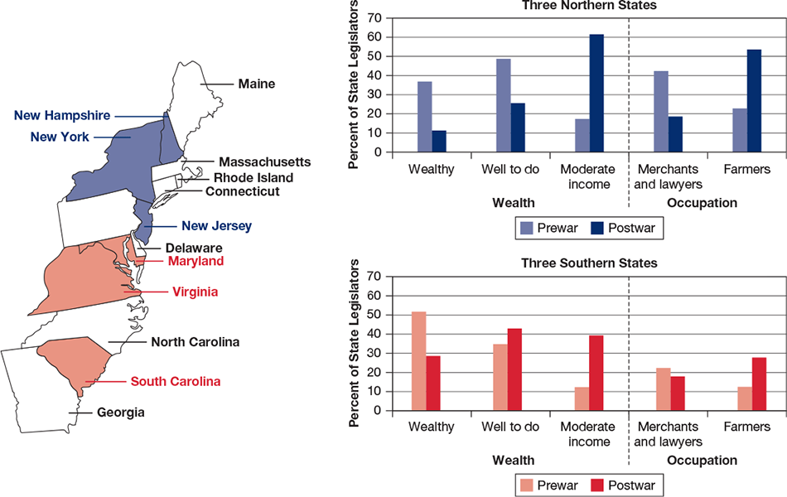
Figure 2.2 Power Shift: Economic Status of State Legislators Before and After the Revolutionary War
Notes:
After the Revolution, power in the state legislatures shifted from the hands of the wealthy to those with more moderate incomes and from merchants and lawyers to farmers. This trend was especially evident in the northern states.

Slide 22
Economic Turmoil
Postwar economic depression
Shays' Rebellion (1786)
Farmers attack courthouses to prevent foreclosures
Neither national nor state government could respond
Elites privately put down rebellion
Notes:
A postwar economic depression left small farmers unable to pay their mortgages. As we just noted, the middle class was gaining control of state legislatures. They used their new power to pass laws friendlier to the debtors than the creditors. These policies did not please the economic elite, who formed the creditor class and formerly had control of state governments.

Slide 23
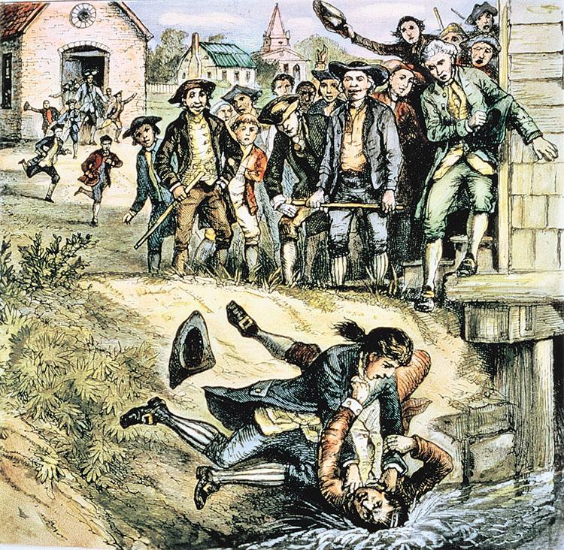
Shays’ Rebellion
Notes:
Shays’ Rebellion, in which farmers physically prevented judges from foreclosing on farms, helped spur the birth of the Constitution. News of the small rebellion spread quickly around the country, and some of the Philadelphia delegates thought a full-fledged revolution would result. The event reaffirmed the Framers’ belief that the new federal government needed to be a strong one.

Slide 24
The Aborted Annapolis Meeting
Annapolis meeting leads to Constitutional Convention
Notes:
Shays' Rebellion helped spur the birth of the Constitution. Delegates from five states met in Annapolis, Maryland, in September 1786 and quickly decided to hold a full-scale meeting of all the states in Philadelphia in May 1787 to revise the Articles.

Slide 25
Learning Objective 2.3
Describe the delegates to the Constitutional Convention and the core ideas they shared.

Slide 26
Making a Constitution
Gentlemen in Philadelphia
Philosophy into Action

Slide 27
Gentlemen in Philadelphia and Philosophy in Action
Who attended Constitutional Convention?
55 delegates from 12 states
Wealthy planters, lawyers, merchants
High principles versus self-interest
Human nature
Political conflict
Purpose of government
Nature of government
Notes:
Fifty-five delegates from 12 states assembled in Philadelphia. These were not average men but the wealthy, educated elite of their respective states. They ignored their instructions to revise the Articles and set about designing a new government. They shared the view expressed by philosopher Thomas Hobbes that humans are self-interested so a strong ruler is necessary to restrain man's warlike tendencies, but they preferred Locke's idea of limited government.

Slide 28
Learning Objective 2.4
Categorize the issues at the Constitutional Convention and outline the resolutions reached on each type of issue.

Slide 29
Critical Issues at the Convention
The Equality Issues
The Economic Issues
The Individual Rights Issues
Notes:
Conflicts over equality of representation led to the Connecticut Compromise, the three-fifths compromise, and the decision to leave the issue of voting rights to the states. The greatest inequality of all, slavery, was so contentious an issue that the Framers simply avoided addressing it.

Slide 30
The Equality Issues
Representation of the states
New Jersey Plan
Virginia Plan
Connecticut Compromise
Slavery
Equality in voting
Notes:
The small states and large states disagreed about how states should be represented in Congress. The small states, in the New Jersey Plan, proposed equal representation, while the large states, in the Virginia Plan, suggested that representation would be more equitable based on population. A solution, the Connecticut Compromise, created a bicameral legislature with representation in one chamber by population and in the other by two senators from each state. Can you explain how this compromise gave more power to smaller states?

Slide 31
Table 2.3 How the Constitution Resolved Three Issues of Equality
Problem | Solution
Representation of the States Should states be represented equally (the New Jersey Plan) or in proportion to their population (the Virginia Plan)? | Both, according to the Connecticut Compromise. States have equal representation in the Senate but representation in the House is proportionate to population.
Slavery Should slavery be abolished? How should slaves be counted in determining representation in the House of Representatives? | No. Congress was permitted to stop the importing of slaves after 1808. States were required to return runaway slaves from other states. Three-fifths of slaves in a state should be counted.
Equality in Voting Should the right to vote be based on universal manhood suffrage, or should it be restricted? | Let the states decide qualifications for voting.
Notes:
This table shows the compromises that resolved debates about equality in representation, slavery, and voting.

Slide 32
The Economic Issues
State of the postwar economy
Interstate tariffs
Worthless paper money
Congress could not raise revenue
Congress given economic power
Limited economic interference of states
New government must repay debts of $54 million
Notes:
It was important to the Framers that the new government preserve certain individual rights, although they had designed a limited government with checks and balances, and state constitutions already protected individual rights.

Slide 33
Table 2.4 Economic Issues in the Constitution (1 of 3)
Powers of Congress
1. Levy taxes
2. Pay debts
3. Borrow money
4. Coin money and regulate its value
5. Regulate interstate and foreign commerce
6. Establish uniform laws of bankruptcy
7. Punish piracy
8. Punish counterfeiting
9. Create standard weights and measures
10. Establish post offices and roads
11. Protect copyrights and patents
Notes:
Let's take a closer look at the powers given to Congress. Congress could raise revenue through taxing and borrowing. Having sound currency and paying off the national debt would encourage free enterprise.
Table continued over three slides

Slide 34
Table 2.4 Economic Issues in the Constitution (2 of 3)
Prohibitions and Obligations of the States
States could not …
1. Coin money or issue paper money
2. Tax imports or exports from abroad or from other states
3. Pass laws impairing the obligations of contracts
4. Require payment of debts in paper money
States were to …
1. Respect civil court judgments and contracts made in other states
2. Return runaway slaves from other states

Slide 35
Table 2.4 Economic Issues in the Constitution (3 of 3)
Other Key Provisions
The new government assumed the debt contracted under the Articles of Confederation
2. A republican form of government was guaranteed

Slide 36
The Individual Rights Issues
Preserving individual rights a priority
Personal freedoms in the Constitution
Suspension of habeas corpus prohibited
Bills of attainder prohibited
Ex post facto laws prohibited
Religious qualifications for office prohibited
Strict rules for what constitutes treason
Right to trial by jury
Notes:
It was important to the Framers that the new government preserve certain individual rights, although they had designed a limited government with checks and balances, and state constitutions already protected individual rights.

Slide 37
Learning Object 2.5
Analyze how the components of the Madisonian system addressed the dilemma of reconciling majority rule with the protection of minority interests.

Slide 38
The Madisonian System
Thwarting the Tyranny of the Majority
The Constitutional Republic
The End of the Beginning
Notes:
The Founders reconciled majority rule with minority interests by constraining both the majority and the minority. The Madisonian system did this primarily by dispersing power among separate branches of government, each with a somewhat different constituency. It also gave them shared powers so that each branch had a check on the others.

Slide 39
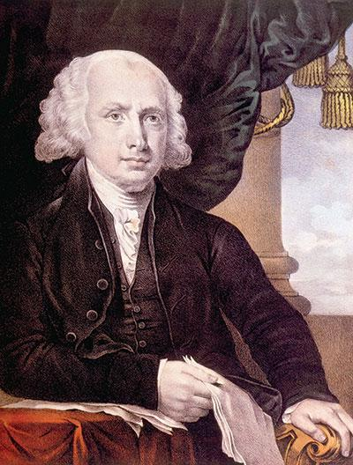
James Madison
Notes:
James Madison was the key figure in writing the Constitution. His views on checking power remain at the core of the structure of American government.

Slide 40
Thwarting the Tyranny of the Majority
Limiting majority control
James Madison's system
Separating powers
Creating checks and balances
Establishing a federal system
Notes:
Madison devised a system to prevent the tyranny of factions in the government. To thwart tyranny of the majority, much of the government's power was kept beyond its reach. Only members of the House of Representatives were directly elected by the people.

Slide 41
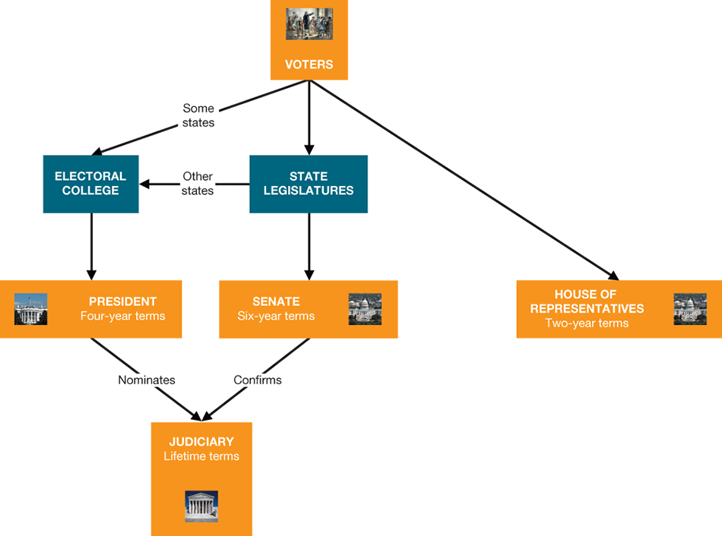
Figure 2.3 The Constitution and the Electoral Process: The Original Plan
Notes:
Under Madison’s plan, which was incorporated in the Constitution, voters’ electoral influence was limited. Voters directly elected only the House of Representatives. Senators and presidents were indirectly elected—senators by state legislatures, and presidents by the electoral college, whose members, depending on the state, were chosen by state legislatures or by voters; the president nominated judges. Over the years, Madison’s original model has been substantially democratized. The Seventeenth Amendment (1913) established direct election of senators by popular majorities. Today, the electoral college has become largely a rubber stamp, voting the way the popular majority in each state votes.

Slide 42
The Constitutional Republic and the End of the Beginning
Creating a republic
Direct democracy not feasible
Representative democracy
Separating powers and checks and balances make change slow
Is policymaking inefficient?
10 states vote in favor, then dinner
Notes:
The Framers valued the idea of government by the people. They also knew direct democracy, in which all the people vote on every issue, was neither feasible nor desirable. Instead they created a republic, in which representatives act on behalf of the people.
This system favored the status quo. Since each branch could check the other, it was much easier to prevent new policy than to pass it.
Ben Franklin argued that the policymaking process was too cumbersome to enable the government to respond effectively to pressing matters. What do you think?
Ten of the twelve states present voted in favor of the Constitution and all but three of the remaining delegates signed it. Then everyone adjourned to a tavern.

Slide 43
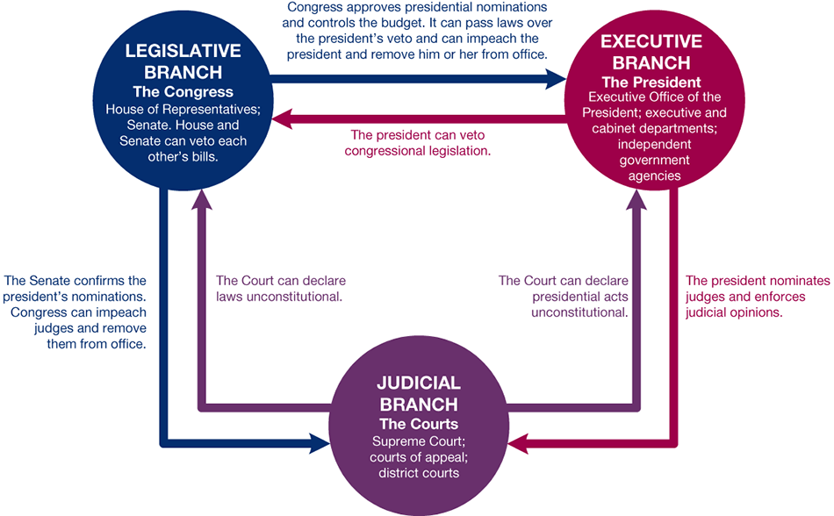
Figure 2.4 Separation of Powers and Checks and Balances in the Constitution
Notes:
The doctrine of separation of powers allows the three branches of government to check and balance one another. Judicial review—the power of courts to hold executive and congressional policies unconstitutional—was not explicit in the Constitution but was soon asserted by the Supreme Court in Marbury v. Madison.

Slide 44
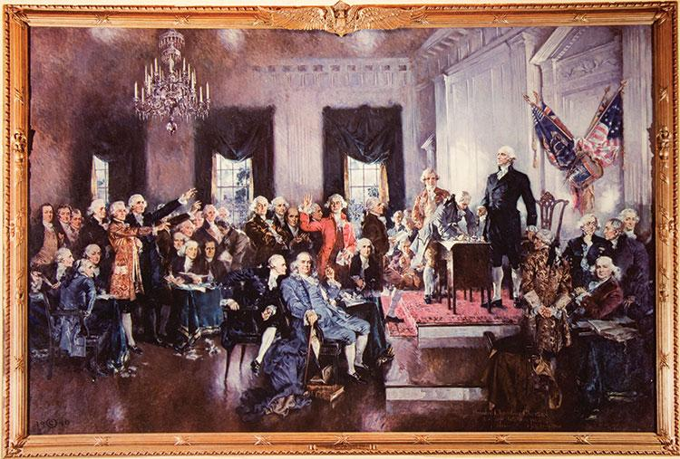
Signing the Constitution
Notes:
George Washington presides over the signing of the Constitution. "The business being closed," he wrote, "the members adjourned to the City Tavern, dined together and took cordial leave of each other."

Slide 45
Journal Prompt 2.4: Critical Issues at the Convention
Is representation in the Senate fair?

Slide 46
Learning Objective 2.6
Compare and contrast the Federalists and Anti-Federalists in terms of their background and their positions regarding government.

Slide 47
Ratifying the Constitution
Federalists and Anti-Federalists
Ratification
Notes:
Ratification of the Constitution was not a foregone conclusion. The Federalists, who were largely from the economic elite, supported a strong national government. They preferred to insulate public officials from public opinion.

Slide 48
Federalists and Anti-Federalists
Federalists
Supported Constitution
Federalist Papers
Alexander Hamilton, James Madison, John Jay
Anti-Federalists
Opposed Constitution
No protection for civil liberties
States' power would weaken
Notes:
Before the Constitution could replace the Articles of Confederation as the supreme law of the land, it had to be ratified by 9 of the 13 states. This was by no means a sure thing. Federalists, who favored ratification, were in a minority compared to the Anti-Federalists who opposed it. Three prominent Federalists wrote a series of 85 essays for New York newspapers that argued strenuously in favor of ratification. These essays did little to influence the New York delegates but they remain for us as a record of the Framers' thinking.

Slide 49
Table 2.5 Federalists and Anti-Federalists Compared
Anti-Federalists | Federalists
Backgrounds
Small farmers, shopkeepers, laborers | Large landowners, wealthy merchants, professionals
Government Preferred
Stronger state government | Weaker state governments
Weak national government | Strong national governments
Direct election of officials | Indirect election of officials
Shorter terms | Longer terms
Rule by the common man | Government by the elite
Strengthened protections for individual liberties | Expected few violations of individual liberties
Notes:
Do you see any links between the background and government preferences of the Federalists and Anti-Federalists?

Slide 50
Table 2.6 The Bill of Rights (Arranged by Function) (1 of 3)
Protection of Free Expression
Amendment 1: | Freedom of speech, press, and assembly
 | Freedom to petition government
Protection of Personal Beliefs
Amendment 1: | No government establishment of religion
 | Freedom to exercise religion
Protection of Privacy
Amendment 3: | No forced quartering of troops in homes
Amendment 4: | No unreasonable searches and seizures
Notes:
The protections in the Bill of Rights fall into several categories of civil liberties.
Continued over three slides

Slide 51
Table 2.6 The Bill of Rights (Arranged by Function) (2 of 3)
Protection of Defendants’ Rights
Amendment 5: | Grand jury indictment required for serious crime
 | No second prosecution for the same offense
 | No compulsion to testify against oneself
 | No loss of life, liberty, or property without due process of law
Amendment 6: | Right to a speedy and public trial by a local, impartial jury
 | Right to be informed of charges against oneself
 | Right to legal counsel
 | Right to compel the attendance of favorable witnesses
 | Right to cross-examine witnesses

Slide 52
Table 2.6 The Bill of Rights (Arranged by Function) (3 of 3)
Protection of Defendants’ Rights
Amendment 7: | Right to jury trial in civil suit where the value of controversy exceeds $20
Amendment 8: | No excessive bail or fines
 | No cruel and unusual punishments
Protection of Other Rights
Amendment 2: | Right to bear arms
Amendment 5: | No taking of private property for public use without just compensation
Amendment 9: | Unlisted rights are not necessarily denied
Amendment 10: | Powers not delegated to the national government or denied to the states are reserved for the states or the people

Slide 53
Ratification
Ratification by special convention
Got around state legislatures
Delaware first to approve
New Hampshire made it official
New York and Virginia critical
North Carolina and Rhode Island hold out
Notes:
The Federalists knew they lacked support in state legislatures so they specified that the Constitution be ratified by special conventions in each of the states.

Slide 54
Learning Objective 2.7
Explain how the Constitution can be formally amended and how it changes informally.

Slide 55
Changing the Constitution
The Formal Amending Process
The Informal Processes of Constitutional Change
The Importance of Flexibility
Notes:
Constitutional change, both formal and informal, continues to shape and alter the letter and the spirit of the Madisonian system. The formal amendment process, requiring supermajorities in both houses of Congress and among the states, poses difficult hurdles. However, judicial interpretation, changing political practices, technology, and the increasing demands on policymakers have also changed the constitutional system in fundamental ways, providing a valuable flexibility.

Slide 56
The Formal Amending Process
Proposal
Two-thirds vote in each house
National convention called by Congress
Ratification
Legislatures of three-fourths of states
Special state conventions
Notes:
There are two ways of proposing amendments to the Constitution, and two ways of ratifying them. All but one of the successful amendments to the Constitution have been proposed by Congress and ratified by the state legislatures. The exception is the Twenty-first Amendment which repealed Prohibition and was approved by special state conventions.

Slide 57
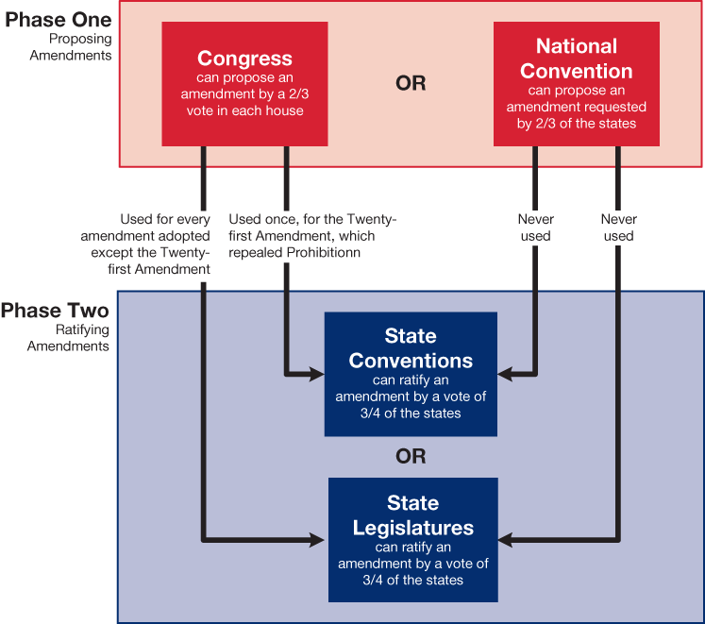
Figure 2.5 How the Constitution Can Be Amended
Notes:
The Constitution sets up two alternative routes for proposing amendments and two for ratifying them. One of the four combinations has been used in every case but one.

Slide 58
The Informal Processes of Constitutional Change
Most changes have been informal
Judicial interpretation
Marbury v. Madison (1803)
Changing political practice
Technology
Increased demands for new policies
Notes:
Most changes to the Constitution have been informal. The U.S. has a two-party system that the Framers never anticipated. The electors of the Electoral College follow the popular state vote. Television influences the policy agenda and the president is now the driving force in policymaking.

Slide 59
The Importance of Flexibility
Constitution meant to be flexible
Many decisions left up to Congress
Flexibility key to survival
World's oldest Constitution
Notes:
The Constitution is a brief document considering its scope and purpose. It left a lot of the details up to Congress and future generations. Regarding the federal courts, for example, the Constitution simply authorizes Congress to create them as needed.

Slide 60
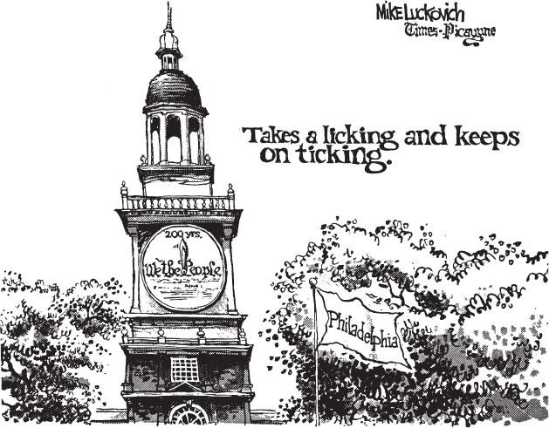
The Constitution: A Short Document
Notes:
The Constitution is a short document that has survived for more than 200 years, in large part because of its adaptability to the needs of new generations.

Slide 61
Journal Prompt 2.7: Changing the Constitution
Some people think the Constitution should only be changed by amending it. Others think it is better if the Constitution is viewed as more flexible. What do you think?

Slide 62
Learning Objective 2.8
Assess whether the Constitution establishes a majoritarian democracy and how it limits the scope of government.

Slide 63
Understanding the Constitution
The Constitution and Democracy
The Constitution and the Scope of Government
Notes:
The Constitution did not create a majoritarian democracy. Majorities do not always rule in America. Nevertheless, there has been a gradual democratization of the Constitution. The right to vote has expanded, direct election of senators has been instituted, electors have become agents of political parties, and technology has facilitated direct, two-way communication between office holders and the public.

Slide 64
The Constitution and Democracy
Original Constitution not very democratic
Created a republic
Representative government
Voting and Participation
No original guidelines
More people now vote for more offices
Technology has made government closer
Notes:
The authors of the Constitution were distrustful of majorities and the possibility of majority tyranny. The anti-democratic nature of the Constitution reflects those fears.
The Constitution created a representative form of government modeled after the Lockean tradition.
The original Constitution offered no guidelines on voting eligibility. Five of the 17 Amendments passed since the Bill of Rights focus on expanding suffrage. Now more people are eligible to vote and the can vote for more offices than ever before. The advent of new technology has enhanced the connection between citizens and their govenrment.

Slide 65
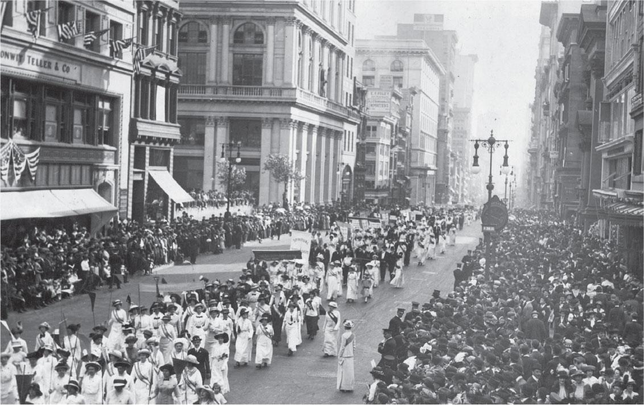
Suffragettes Marching
Notes:
Amending the Constitution to give women the right to vote was an important step in the women’s rights movement. Here suffragettes march for the right to vote, in New York City in 1913.

Slide 66
The Constitution and the Scope of Government
Constitution designed to limit government and protect liberties
Broad participation possible
Effects of separation of powers
All groups can be heard
Encourages stalemate
Effects of checks and balances
Gridlock or ineffective policy
Notes:
The original Constitution was not democratic by modern standards, nor was it designed to be. The Framers believed that, as Alexander Hamilton said, the "rich, well-born, and able" were best suited to govern. But the republic they created had the potential to become more democratic over time. As the franchise has been gradually expanded, the American political system has moved from an elitist model to a pluralist model.

Slide 67
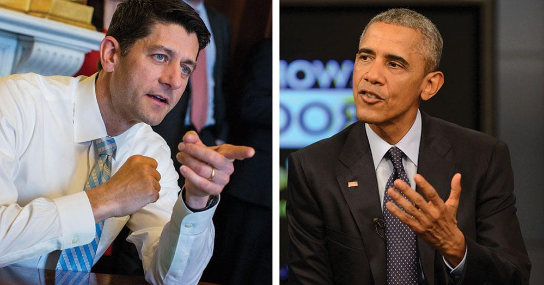
Ryan and Obama
Notes:
Because the Constitution decentralizes power, officials usually must negotiate to pass legislation. This often involves meetings between the Speaker of the House and the president.

Slide 68
Shared Writing 2
Does the Constitution’s system of checking and balancing make it too difficult for the national government to make decisions about pressing problems?

Slide 69
Photo Credits
Chapter 2
027, top right: Library of Congress Prints and Photographs Division [LC-USZ62-10658]; 027, bottom left: World History Archive/Newscom; 033: Scribner ’s Popular History of the US, 1897/Pearson Education; 034: National Gallery of Art, Washington; 035: North Wind Picture Archives/Alamy Stock Photo; 037: Library of Congress Prints and Photographs Division [LC-DIG-ds-05506]; 040: Everett Historical/ Shutterstock; 041, center and far right: Library of Congress Prints and Photographs Division [LC-DIG-highsm-01908]; 041, far left: Library of Congress Prints and Photographs Division [LC-DIG-highsm-04961]; 041, bottom: Library of Congress Prints and Photographs Division [LC-DIG-highsm-11889]; 041, top: North Wind Picture Archives/Alamy Stock Photo; 043: Charles Phelps Cushing/ClassicStock/Alamy Stock Photo; 051: Mike Luckovich/Creators Syndicate; 053: Paul Thompson/Topical Press Agency/Hulton Archive/Getty Images; 054, left: Al Drago/CQ Roll Call/Newscom; 054, right: DOD Photo/Alamy Stock Photo

