Slide 1
Government in America: People, Politics and Policy
Seventeenth Edition
Chapter 18
National Security Policymaking

Slide 2
Learning Objectives
18.1 Identify the major instruments and actors in making national security policy.
18.2 Outline the evolution of the major issues in American foreign policy through the end of the Cold War.
18.3 Explain the major obstacles to success in the war on terrorism.
18.4 Identify the major elements of US defense policy.
18.5 Analyze the evolving challenges for US national security policy.
18.6 Assess the role of democratic politics in making national security policy and the role of national security policy and expanding government.

Slide 3
Learning Objective 18.1
Identify the major instruments and actors in making national security policy.

Slide 4
American Foreign Policy: Instruments, Actors, and Policymakers
Instruments of Foreign Policy
Actors on the World Stage
The Policymakers
Notes:
Foreign policy is as much a part of the president's day as domestic policy. Every morning, the president receives a confidential intelligence briefing covering the latest international developments of which he should be aware. As you learned in previous chapters, the president has more freedom in foreign policy than in domestic policy.
In this first section, we'll learn about some of the actors and instruments that feature in foreign policy decision making.

Slide 5
Instruments of Foreign Policy
Military
War, threat of war
Economic
Almost as important as war
Sanctions, tariffs, regulations
Diplomatic
Treaties, summit talks
First option
Notes:
War, and the threat of war, have been called "politics by other means." Employing force, or threatening to do so, is one of the main foreign policy instruments employed by the White House.
With globalization, economic instruments have become nearly as important as war in foreign policy. Economic instruments include trade regulations, tariff policies, monetary policies, and economic sanctions.
Force and economic sanctions are usually only employed when diplomacy fails. Diplomacy is the delicate art of negotiation. The stakes are high in international diplomacy, whether in summit talks or treaty negotiations.

Slide 6
Actors on the World Stage
International organizations
United Nations
Regional organizations
NATO
Multinational corporations
Nongovernmental organizations
Terrorists
Individuals
Notes:
125 nations have emerged since 1945, but they aren't the only actors on the world stage. Many organizations are so large and powerful that they exceed the power of some countries. Nation-states are the main actors, but the presence of these other actors complicates relations.
The United Nations is a large international organization comprised of 193 member nations. It was formed after World War II as a forum for international negotiations, with the aim of preventing armed conflict. It facilitates peacekeeping operations in volatile areas, albeit with mixed success. There's no means of supranational enforcement. so the UN relies on the voluntary cooperation and compliance of its members. There are other major international organizations, such as the International Monetary Fund and the World Trade Organization.
Two of the most significant regional organizations are NATO, which formed as a military alliance in opposition to the Soviet Union during the Cold War, and the European Union, or the EU.
The EU is a transnational governing body for its member states. The EU serves mainly economic purposes.
Enriched by globalization, multinational corporations have become as powerful as many countries on the international stage. They tend to use their power to persuade governments to overthrow other governments that present an obstacle to their markets and profits.
Nongovernmental organizations such as Greenpeace and Amnesty International have also become fixtures on the world stage, making an effort to influence governments on environmental, human rights, and other issues.
Terrorists, unfortunately, have to be acknowledged as increasingly important non-state actors. They sometimes receive support from hostile government regimes. They don't participate formally in organizations or diplomacy, but make their presence felt using violence.
Individuals are international actors, too, when they travel to foreign lands as tourists, students, or immigrants.

Slide 7
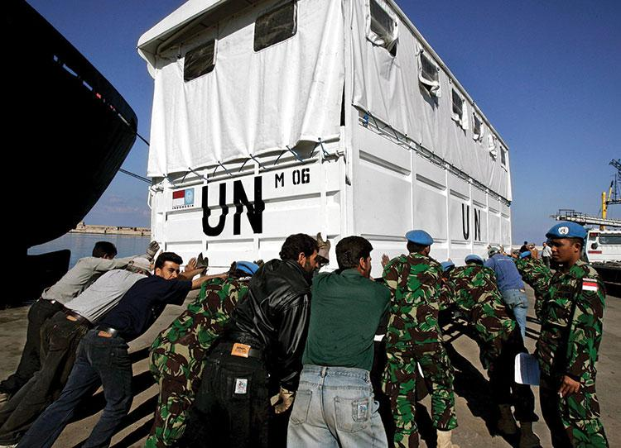
U.N. Health Programs
Notes:
The most prominent international organization is the United Nations. In addition to its efforts to keep the peace, it supports important programs in economic development and health, education, and welfare.

Slide 8
The Policymakers
The president
Chief diplomat/Commander in chief
Treaties, executive agreements
The diplomats
State Dept./Secretary of State
Bureaucratic and intransigent
The national security establishment
Secretary of Defense
Joint Chiefs of Staff
CIA
Congress
Notes:
As you saw in the chapter on the presidency, the president is both the chief diplomat and commander in chief of the armed forces, which together make him the main government actor in U.S. foreign policy. Presidents appoint and receive ambassadors, and sign treaties and executive agreements. Executive agreements have become more popular with modern presidents, as they don't require Senate ratification.
The president receives assistance from the State Department. The Secretary of State, whom he appoints, is his main foreign policy adviser. The State Department operates foreign embassies and consulates. Although the president is technically in charge, in reality he can find the State Department bureaucratic and intransigent.
The president also receives foreign policy assistance from the branches of the military, housed in the Department of Defense. Like the Secretary of State, the Secretary of Defense is an important foreign policy adviser to the president. The Joints Chiefs of Staff comprises the heads of each of the branches of the military. The Central Intelligence Agency plays an important role in gathering information.
Congress plays a less visible role in foreign policy making than domestic policy making, but it has the power to declare war, and the Senate must ratify treaties and confirm presidential appointments. Congress also appropriates funds for all foreign policy endeavors.

Slide 9
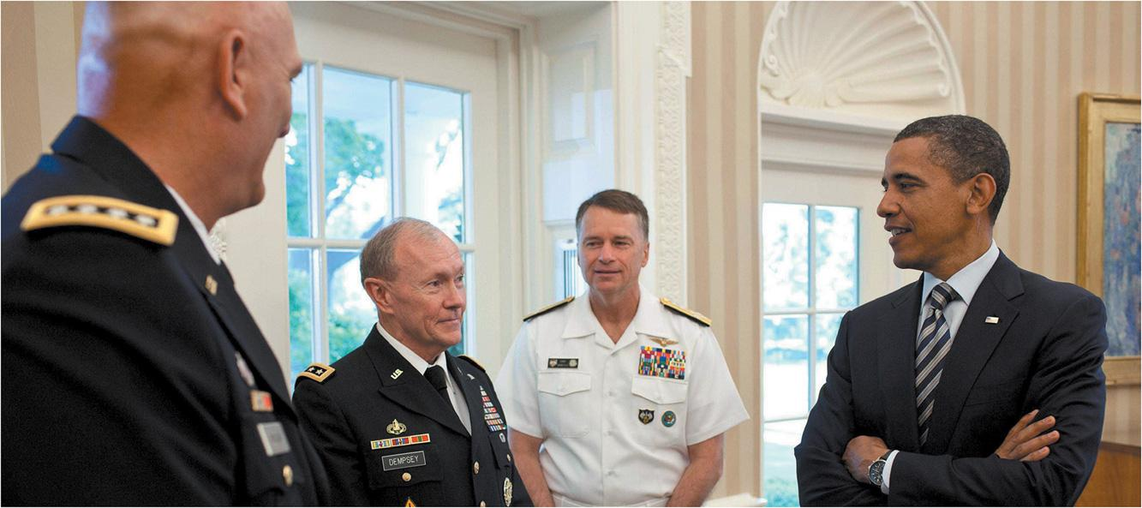
Foreign Policymakers
Notes:
Diplomatic, defense, and intelligence officials are key players in the national security establishment.

Slide 10
Learning Objective 18.2
Outline the evolution of major issues in American foreign policy through the end of the Cold War.

Slide 11
American Foreign Policy Through the Cold War
Isolationism
The Cold War
Notes:
Before World War II, the United States maintained a much more isolationist foreign policy than it has today. In this section, we'll take a historical tour of American foreign policy through the Cold War.

Slide 12
Isolationism
Foreign policy doctrine until World War II
Washington’s Farewell Address
Monroe Doctrine
Refusal to join the League of Nations
World War II ends isolationism
Notes:
With some exceptions, the United States stayed out of other nation's conflicts until World War II. The only exception to this practice of isolationism was for Latin America. President James Monroe told European countries that the United States would stay out of European affairs and European nations were to stay out of Latin America.
After World War I, President Wilson tried to get the United States to join the new League of Nations, a predecessor to the UN, that he had created. But the Senate refused to ratify the treaty because it violated the principle of isolationism.
World War II changed this attitude permanently, and the United States became a founding member of the UN, even putting its headquarters in New York City.

Slide 13
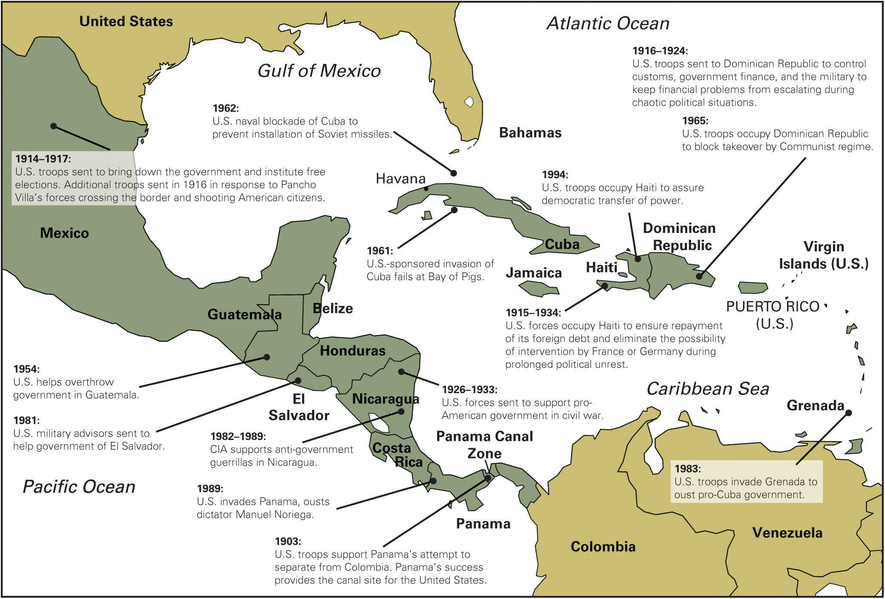
Figure 18.1
Notes:
The United States has taken a broad view of protecting its interests, especially those close to home. It has intervened militarily many times in Central America and the Caribbean since early in the twentieth century.

Slide 14
The Cold War (1 of 2)
Containment
Stop spread of communism
Brinkmanship
Arms race/MAD
Notes:
After World War II, the United States invested a lot of money in rebuilding Western Europe. It also sought to secure peace through its special status of being the only nuclear power.
How did the Cold War begin? It started with the desire of the United States to isolate the Soviet Union to prevent the spread of communism. As China and North Korea, despite U.S. military intervention in the latter case, fell to communism, and the Soviet Union developed a nuclear arsenal, fear of war between East and West grew.
The United States pursued a policy of brinkmanship, in which it was always prepared to use its nuclear weapons to deter the Soviet Union and China from aggression. By the 1950s, the arms race was gaining such momentum that each side had the ability to completely annihilate the other if attacked, a situation known as mutually-assured destruction.

Slide 15
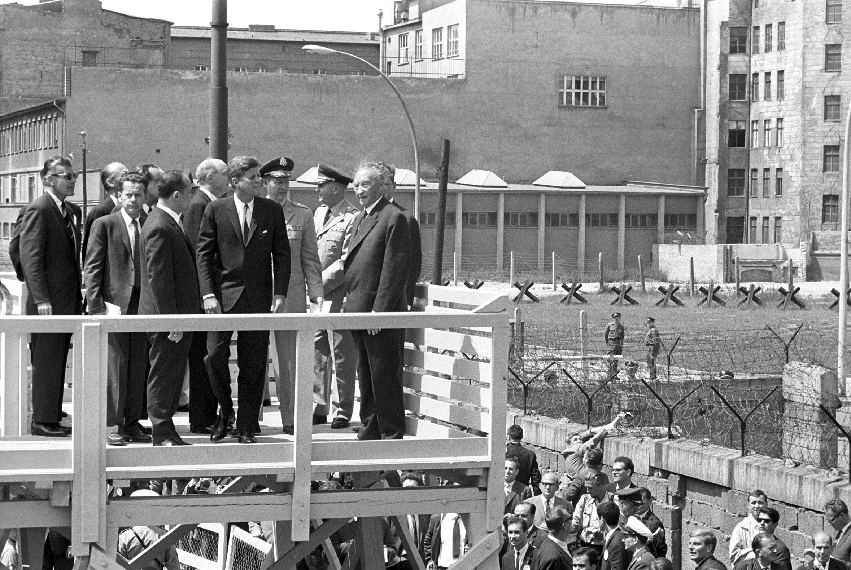
The Berlin Wall
Notes:
The Soviet Union built the Berlin wall to separate communist East Berlin from the western sectors of the city. Here President John F. Kennedy looks over the wall in 1963 shortly before delivering a rousing anti-Communist speech to the citizens of West Berlin.

Slide 16
The Cold War (2 of 2)
The Vietnam War
The era of détente
The Reagan rearmament
The final thaw in the Cold War
Notes:
In the 1950s, the United States became concerned with preventing the spread of communism in Asia. After communist forces took over North Vietnam, the United States refused to accept the division of the country and sent military assistance to the South. As the war dragged on and U.S. casualties mounted, support for the war waned. North Vietnamese communists gained control of the entire country in 1975.
In the 1970s, the Nixon Administration began a new strategy of détente to replace brinkmanship. This new attitude signaled a willingness to use diplomacy and economic instruments rather than the threat of force, under the assumption that both the United States and the Soviet Union had an interest in global stability. The arms race slowed down and the United States recognized the Chinese government diplomatically for the first time since the communist revolution.
When President Reagan took office, he believed that disarmament left the U.S. vulnerable and he increased defense spending and proposed building new high-tech weapons.
When Bush Senior succeeded Reagan he began a policy of integrating the Soviet Union into the world community. But his efforts proved unnecessary as the Soviet Union abruptly collapsed in 1989.

Slide 17
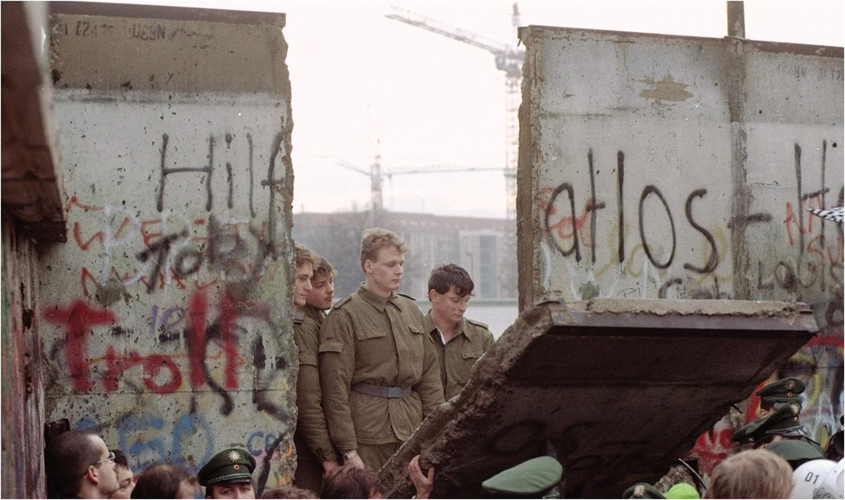
Berlin Wall Falls
Notes:
Beginning in 1989, communism in the Soviet Union and Eastern Europe suddenly began to crumble. The Berlin wall fell, and the threat of nuclear war between the superpowers diminished. Over, the thaw in the Cold War left a host of difficult new national security issues.

Slide 18
Learning Objective 18.3
Explain the major obstacles to success in the war on terrorism.

Slide 19
American Foreign Policy and the War on Terrorism
The Spread of Terrorism
Afghanistan and Iraq
Notes:
The end of the Cold War brought a sense of relief, of fear lifted. People thought that an era of peaceful economic growth was sure to follow. But as we'll see in this section, the terrorist attacks of September 11, 2001, shattered that dream.

Slide 20
The Spread of Terrorism
9/11 not first attack
Difficult to defend against in open society
Stealth, surprise, willingness to die
Improved security and intelligence
Clash with civil liberties
Notes:
The September 11th terror attacks weren't the first terrorist attacks on U.S. soil or against U.S. targets, but the scope and scale of the attack was unprecedented.
The nature of terrorist attacks makes it difficult to defend against them. The perpetrators use stealth and surprise, and a willingness to die, to their advantage. The United States has improved its domestic security and intelligence gathering mechanisms, but there is a continual conflict between security and civil liberties.

Slide 21
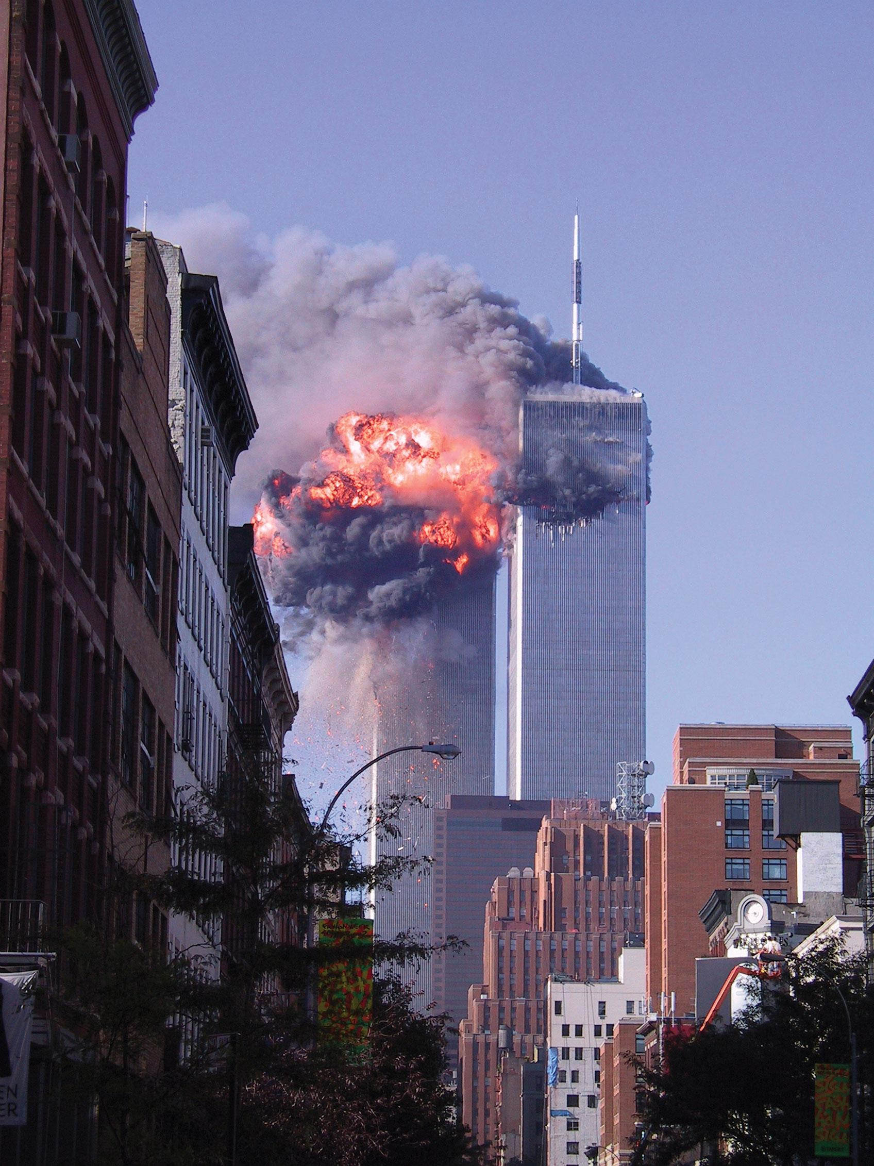
9/11 Terror Attack in New York
Notes:
Perhaps the most troublesome issue in national security is the spread of terrorism. The attacks on September 11, 2001, redirected U.S. foreign policy toward ending terrorism, including launching wars in Iraq and Afghanistan.

Slide 22
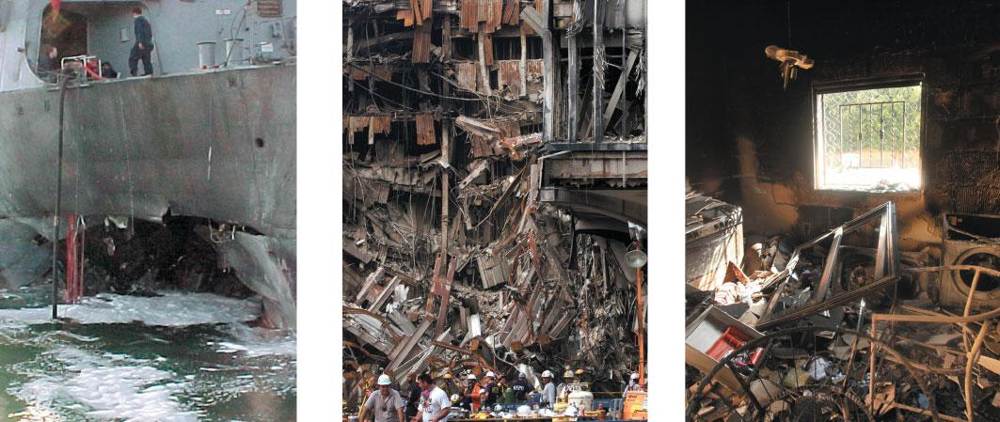
Terrorism Takes Many Forms
Notes:
Terrorism takes many forms, including the bombing or other destruction of buildings and ships. Shown here are the results of terrorist attacks on the USS Cole in Yemen in 2000, the World Trade Center in New York in 2001, and the American consulate in Benghazi, Libya, in 2012.

Slide 23
Afghanistan and Iraq
U.S. declares war on terrorism
Axis of evil
Iran, Iraq, North Korea
Nation building
Poor planning for postwar Iraq
Troop surge and drones
The fight against IS
Notes:
Immediately after 9/11, President Bush declared war on terrorism, a more difficult proposition than declaring war on a single nation-state. But as the Al Qaeda terrorist network that masterminded the attacks was being supported by the Taliban regime in Afghanistan, Bush first set out to topple the Taliban regime and install a more pro-Western government in Afghanistan. Next he declared the three states of Iran, Iraq, and North Korea an "axis of evil." In 2003, the United States invaded Iraq and toppled the regime of Iraqi dictator Saddam Hussein.
President Bush had warned of the difficulties of "nation building," that is, installing the institutions of government in a country. But the United States set out to do just that in both Afghanistan and Iraq. A far cry from its isolationist past, the United States now spoke of its responsibilities on the world stage to institute democracy and markets. But nation building has proven far more difficult than anticipated, as the dissolution of hard line regimes has exposed ancient tribal conflicts in these regions. As American involvement, expense, and casualties mounted, the popularity of these wars declined. The invasion of Iraq lacked strong domestic and international support to start with, and the U.S. occupation stirred up anti-American sentiment, making the threat of terrorist attacks against U.S. targets more, not less, likely.
The war against terror has been complicated five weak or failed governments, notably in Yemen, Syria, Libya, Nigeria, and Iraq, which provide an environment conducive to the emergence of extremist radicalism and violence. The United States is currently working to address the problem of the rise of extremist radical violence, in particular the Al Qaeda splinter group, the Islamic State.

Slide 24
Learning Objective 18.4
Identify the major elements of U.S. defense policy.

Slide 25
Defense Policy
Defense Spending
Personnel
Weapons
Reforming Defense Policy
Notes:
In this section, we turn to the politics behind the defense budget. Defense remains a significant expense for U.S. taxpayers. A strong defense is arguably necessary to ensure national security, but how much money is spent, and what it's spent on, is politically contentious.

Slide 26
Defense Spending
Guns vs. butter
Is there a trade-off?
Ideological disputes
Where the real guns vs. butter battle takes place
Peace dividend vs. jobs
Notes:
Since there's a limited amount of tax revenue to be divided among different government spending priorities, there are inevitable trade-offs. Money spent on defense isn't available for health, education, or transportation. This tension has put pressure on the government to reduce defense spending in peacetime, a so-called peace dividend. But the defense industry employs a lot of workers. It's a powerful industry, with a lot of political weight.
A bigger obstacle to cutting defense spending is the ideological commitment of conservatives to a strong military as a deterrent. Liberals prefer investing in health and education.
The conservative viewpoint is bolstered whenever there's a credible threat, and the liberal stance has the upper hand in peacetime. After the end of the Cold War, defense spending declined until September 11, 2001, when it increased again. The United States currently spends more on defense than the next 15 to 20 countries combined.

Slide 27
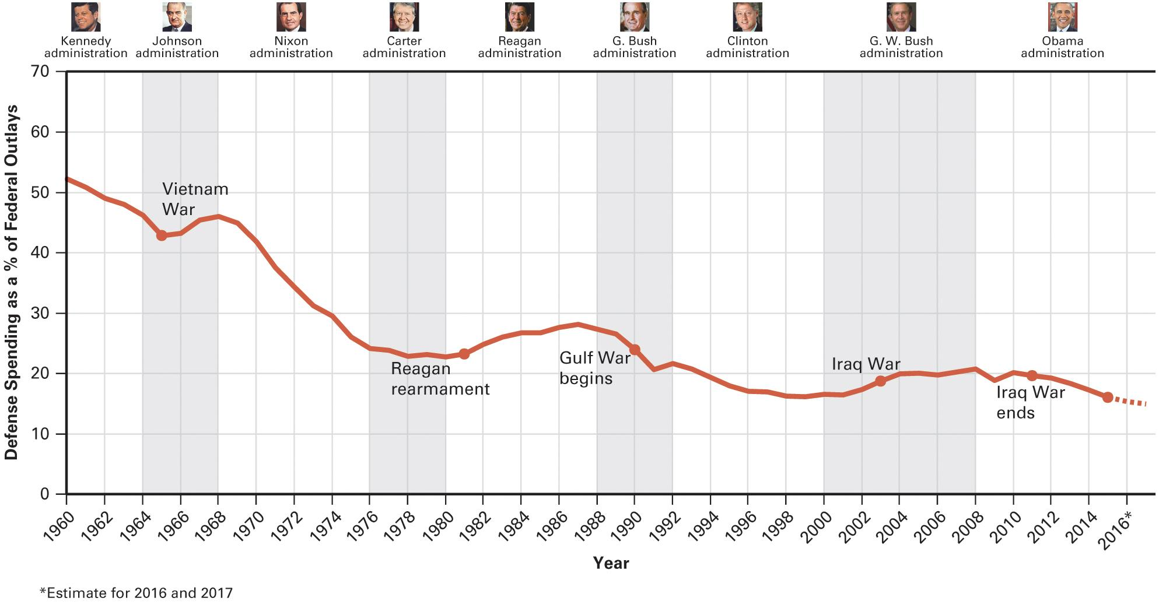
Figure 18.2 Trends in Defense Spending
Source: Office of Management and Budget, Budget of the United States Government, Fiscal Year 2017: Historical Tables (Washington, DC: U.S. Government Printing Office, 2016), Table 3.1.
Note: Data for 2016 and 2017 are estimates.
Notes:
John F. Kennedy took office in 1961 at the height of the Cold War. National Defense was the dominant public policy for the U.S. government; it accounted for half of all the money that the government spent ("outlays”) that year. Things have changed dramatically since then, however. Although defense spending continued to increase until the 1990s, spending on other policies increased even more. As a result, defense spending is now only about one-fifth of the budget. Still at more than $600 billion per year through 2015, it remains a significant sum, one over which battles continue to be fought in Congress.

Slide 28
Journal Prompt 18.4: Defense Spending
Most people prefer spending public funds on domestic policies rather than on national defense. But the United States exists in a dangerous world. How should we determine how much to spend on defense? What domestic expenditures, if any, would you be willing to give up in order to strengthen national defense?

Slide 29
Personnel
Large standing military
1.3 million active duty
801,000 National Guard and reserves
150,000 deployed abroad
National Guard maintains national security
Notes:
The United States maintains an active-duty force of 1.3 million, plus an additional 801,000 standing by in the National Guard and reserve units. Since the war on terrorism began, there have been upwards of 150,000 U.S. troops deployed abroad, mainly in Afghanistan and Iraq, but also at military bases around the globe. This deployment is expensive, and it leaves the National Guard and reserve units to maintain national security at home.

Slide 30
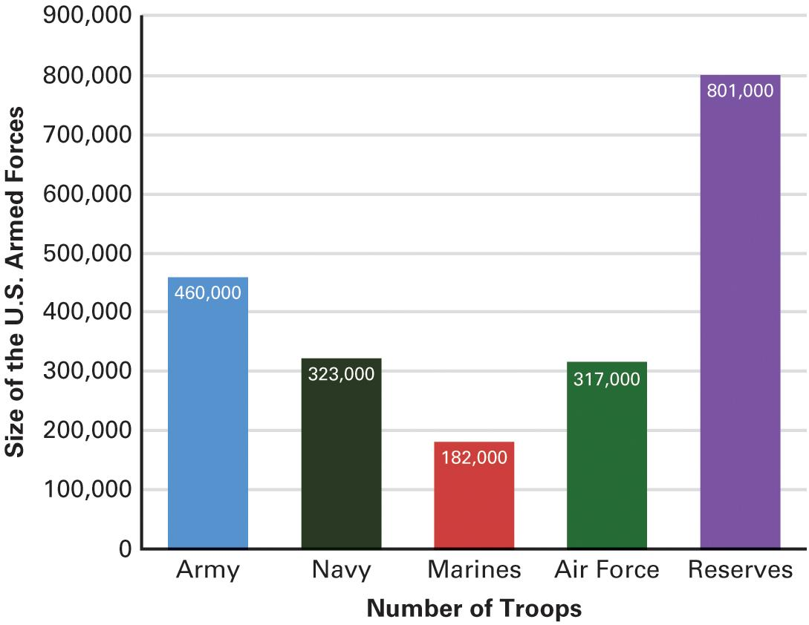
Figure 18.3 Size of the U.S. Armed Forces
Source: Office of Management and Budget, “Appendix,” Budget of the United States Government, Fiscal Year 2017 (Washington, DC: U.S. Government printing office, 2016), 223–224.
Note: Data are estimates for 2017.
Notes:
Crucial to the structure of America's defense is a large standing military force.

Slide 31
Weapons
Nuclear weapons
ICBMs
Submarine-launched ballistic missiles
Strategic bombers
Weapons are expensive
$2 billion to build a stealth bomber
$5.5 trillion
Arms reduction treaties
Notes:
The United States has an immense arsenal of both nuclear and conventional weapons. The nuclear arsenal includes intercontinental ballistic missiles, submarine-launched ballistic missiles, and strategic bombers.
These weapons are incredibly expensive. It costs $2 billion to build one stealth bomber. The total cost of maintaining nuclear weapons is $8.5 trillion.
As the Cold War wound down in the 1980s, the United States and the Soviet Union began to enter into arms reduction treaties. After the collapse of the Soviet Union, those treaties have continued with Russia.

Slide 32
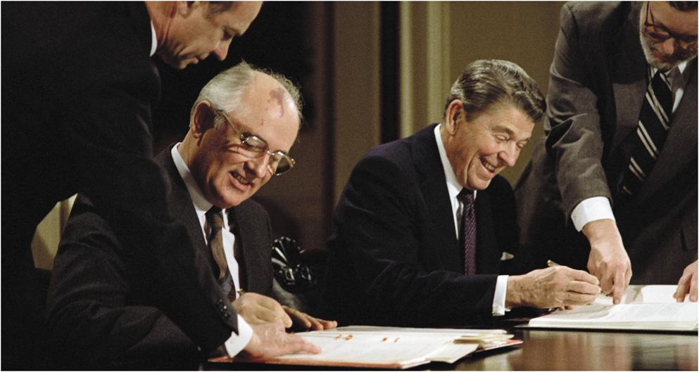
INF Treaty
Notes:
President Reagan and Soviet President Mikhail Gorbachev signed a treaty eliminating intermediate-range nuclear missiles from Europe. The INF treaty marked the first time an American president had agreed to reduce current levels of nuclear weapons.

Slide 33
Reforming Defense Policy
Changing nature of threats
Lighter, faster, more flexible
Better intelligence
Increased use of Special Forces
Notes:
The changing nature of threats has prompted a rethinking of national security policy. The military is increasingly fighting elusive non-state opponents—that is, terrorists. This is causing changes in strategies and tactics. The armed forces are becoming lighter, faster, and more flexible, and relying more on intelligence obtained by high-tech means. There's an increasing use of Special Forces and specialized, elite units, rather than conventional soldiers.

Slide 34
Learning Objective 18.5
Analyze the evolving challenges for U.S. national security policy.

Slide 35
The New National Security Agenda
The Changing Role of Military Power
Nuclear Proliferation
The International Economy
Energy
Foreign Aid
Notes:
In this section we will see how America's national security agenda is evolving. Both globalization and terrorism have changed the role of the military and of international economic issues. The rise of China and India as global economic powers, and the financial problems of the European Union, have all had repercussions for the national security agenda.

Slide 36
The Changing Role of Military Power
Soft power versus hard power
Humanitarian interventions
Increasingly necessary
Violate sovereignty
Can cost American lives
Economic sanctions
Influence behavior without force
Cut off aid, trade embargoes
Mixed record of success
Notes:
Military strength has limited utility in modern foreign policy. It didn't win the Vietnam War, nor prevent the 9/11 terrorist attacks. Superior military force can't be used to obtain favorable trade agreements or achieve other economic foreign policy goals. Soft power is becoming more important than hard power in international relations, yet America's position as the only remaining superpower does mean that other countries often turn to us for military assistance.
Humanitarian intervention is becoming more common when civil wars create humanitarian crises. The United States has, for example, used force to help distribute food in Somalia when warlords were battling for control and displacing refugees. But such intervention is controversial because it violates another country's sovereignty within its own borders and American lives may be lost on the mission. Some use of the military for humanitarian intervention is linked to natural disasters rather than manmade violent conflicts, such as when the military helped with distributing food and medical care in Haiti after the earthquake.
Economic sanctions are used to influence a country's behavior without the use of military force. Cutting off aid and trade affect the economy of the country being pressured, and create internal calls for changes in policy.
Sanctions have a mixed record of success. They were instrumental in bringing an end to apartheid in South Africa but they have failed to deter Iran from continuing its nuclear weapons program. Sanctions need broad international support to succeed and they can also provoke a nationalist backlash against the countries imposing them.

Slide 37
Nuclear Proliferation
9 nuclear powers
United States, Russia, Britain, France, China, India, Pakistan, North Korea, Israel (undeclared)
How to prevent more?
Special concerns about Iran, North Korea, Pakistan
Notes:
Eight countries currently admit to having nuclear weapons: the United States, Russia, the United Kingdom, France, China, India, Pakistan, and North Korea. Israel certainly has but has not officially declared their nuclear capabilities. Some countries, such as South Africa, have given them up. Some countries, such as Iran, are seeking to acquire them. One of the biggest national security policy challenges for the United States is preventing more countries from obtaining nuclear weapons.
Currently, policymakers are most concerned about North Korea and about Iran, which is actively developing nuclear weapons capabilities. Iran and North Korea have both ignored sanctions and rebuffed negotiations aimed at getting them to stop their development of nuclear weapons.

Slide 38
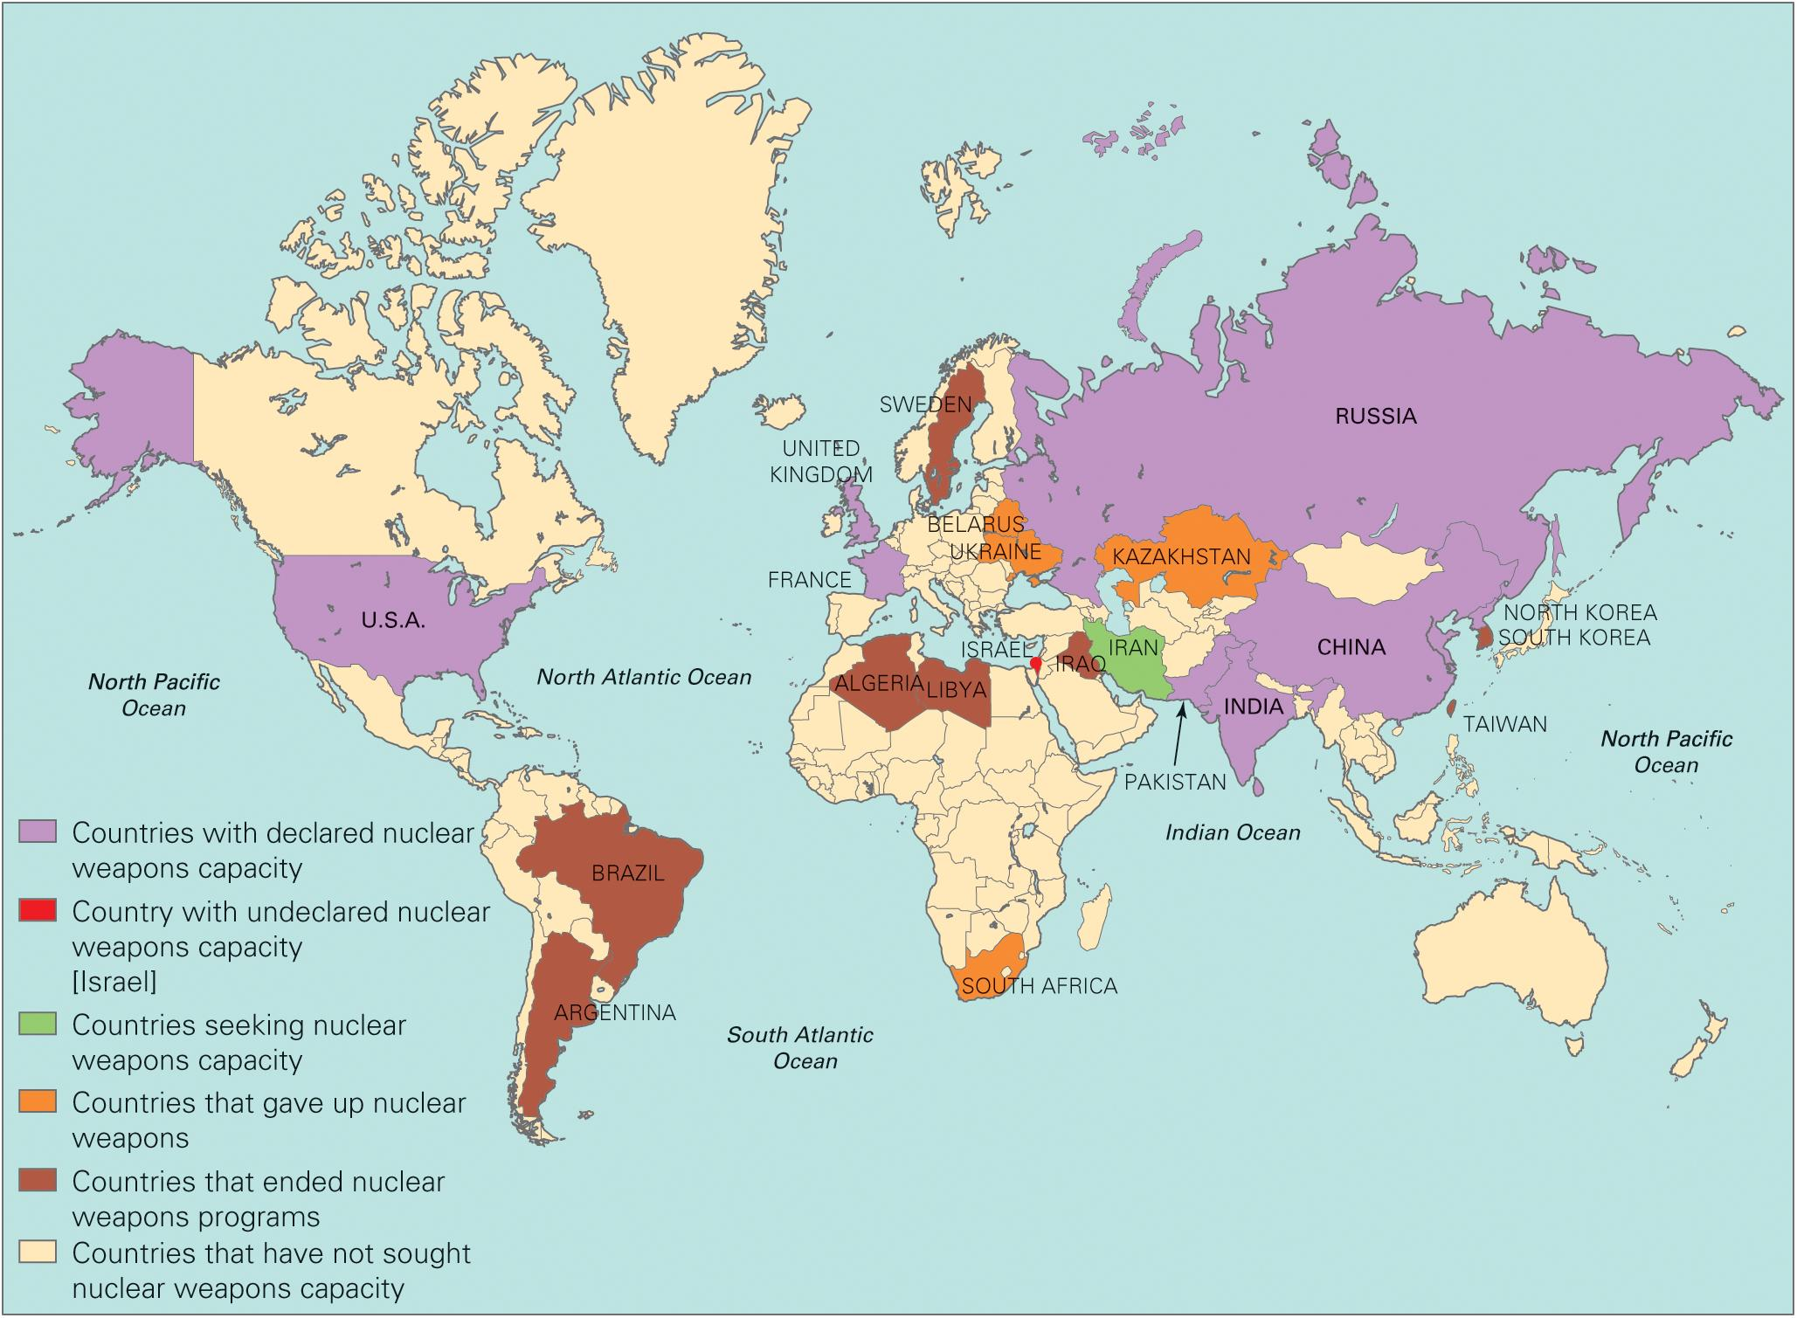
Figure 18.4 The Spread of Nuclear Weapons
Notes:
Most nations have never had nuclear weapons; a few have ended their nuclear weapons program; and a few have given up their nuclear weapons. Nevertheless, the number of countries with nuclear weapons is growing. Eight countries now have declared nuclear capacity.

Slide 39
The International Economy
Interdependency
International trade
Globalization of financial markets
Nontariff barriers to trade
Balance of trade
What we buy from them versus what they buy from us
$500 billion deficit in 2015
Notes:
Nations are increasingly economically interdependent. Building high barriers to prevent foreign products from competing with domestic ones is no longer a viable strategy for most countries, who depend upon foreign markets for their own products.
U.S. exports have increased dramatically since World War II. Grain, computer hardware and software, airplanes, movies, construction equipment and services, and accounting and consulting services are major U.S. exports. The U.S. receives revenue from foreign tourists and students at U.S. colleges and universities.
But the globalization of financial markets is even more instrumental in creating economic interdependence than the growth of trade. A decline on Wall Street is likely to send the Japanese stock market tumbling, too.
Countries have been imposing fewer tariffs on imported goods because other countries would simply retaliate with their own tariffs. The world's been moving toward a free-trade model. But nontariff barriers to trade—such as quotas, subsidies, and quality specifications—still exist.
The balance of trade is the ratio of what we as a country pay for imports to what we earn from exports. If we buy more than we sell, we have a trade deficit. In 2015, the U.S. had a trade deficit of $500 billion. Does this matter? What are the pros and cons of a trade deficit?

Slide 40
McDonaldization
Notes:
International trade is a controversial subject. Opponents believe that it undermines U.S. laws that protect the environment and workers’ rights, cost some employees their jobs, and encourages exploitation of foreign workers. Proponents argue that everyone benefits from increased trade. US companies, such as McDonald's, aggressively seek to expand international sales.

Slide 41
Energy
OPEC has us over a barrel (of oil)
Dependence on foreign oil
Trade embargo
Middle East controls world's oil reserves
Saudi Arabia 25%
Kuwait 10%
Notes:
America's dependence on foreign oil can create frustrating foreign policy situations. If countries that sell oil to us, such as Arab countries, do not like our policies toward their enemies, such as Israel, they can set up a trade embargo, as the Organization of Petroleum Exporting Countries did in 1973.
The Middle East holds about half of the world's oil reserves. Saudi Arabia alone controls 25%, and the U.S. response to Iraq's invasion of Kuwait is directly attributable to the fact that Kuwait produces about 10% of the world's oil. The U.S. has some oil of its own, but many European countries and Japan have none. The Middle East can be a politically unstable region. The need to stay on its good side so as not to impede the supply of oil frequently bumps up against human rights concerns. Should we support a brutal regime that supplies us with oil? What do you think?

Slide 42
Foreign Aid
Developing world
Humanitarian
Stabilization
Access to raw materials
Forms of foreign aid
Grants, credits, loans, loan forgiveness
Military assistance
Agricultural assistance
Medical care
Unpopular
Notes:
Most foreign aid is given to the developing world. Some of it's given for humanitarian reasons, but stabilization of regimes friendly to the United States and access to raw materials located in these regions are both common motivations.
Foreign aid takes a variety of forms. It can be given as a grant or a loan or in the form of forgiveness for previous loans or preferential trade agreements. Military assistance is given to countries of strategic significance to the United States, such as Israel, Egypt, Turkey, and Greece. Aid can also be given in a variety of practical ways, such as help with modernizing agricultural irrigation systems or providing medical care.
Foreign aid is unpopular with citizens, who greatly overestimate the amount spent on it. The United States gives more than any other country, but it gives a smaller percentage of its GDP to foreign economic development than any other developed nation, only 1%.

Slide 43
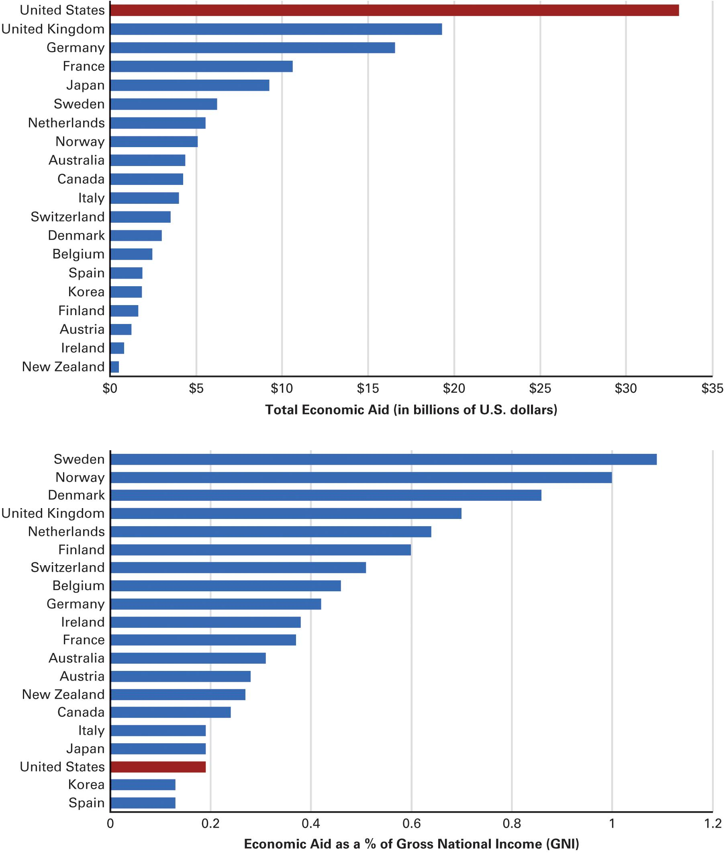
Figure 18.5 Ranking Largess
Source: Organization for Economic Cooperation and Development, OECD Factbook 2015–2016: Economic, Environmental and Social Statistics (Paris: OECD Publishing, 2016), 195.
Notes:
The United States is the largest donor of foreign aid, but it ranks lower than most industrialized nations in the percentage of its gross national income (GNI) it spends on economic development aid for needy nations. American private giving, which is not reflected these figures, is substantial, however, and is typically much greater than private giving from other nations.
Which is the more informative measure of the nations giving, total aid or percent of GNI?
Should the United States be giving more aid to underdeveloped nations?

Slide 44
Journal Prompt 18.5: Foreign Aid
Should the U.S. be more generous with its foreign aid?

Slide 45
Learning Objective 18.6
Assess the role of democratic politics and making national security policy and the role of national security policy in expanding government.

Slide 46
Understanding National Security Policy
National Security Policymaking and Democracy
National Security Policymaking and the Scope of Government
Notes:
Now we'll look at national security policymaking as it relates to democracy and the scope of government.

Slide 47
National Security Policy and Democracy
Are international relations undemocratic?
Citizens not as interested or knowledgeable
Decision makers unelected
Policymakers responsive in long run
Democracies rarely go to war
Congress holds purse strings
Pluralism is pervasive
Notes:
Because unelected military leaders and presidential appointees play such a prominent role in national security policymaking, there is a common perception that it's one of the most undemocratic areas of policy. And it doesn't help that citizens are less informed about or interested in foreign policy than in domestic policy.
But citizens do make their wishes known in the area of foreign policy, and Congress listens. Congress still controls the purse strings, and has the power to ratify treaties and appointments. Pluralism is also as pervasive in foreign as in domestic policy. Jewish citizens, for example, guide policy toward Israel, and Cuban Americans influence policy toward Cuba. Arms manufacturers lobby for more defense money and contracts, and environmental groups urge sanctions against countries that harm the environment.

Slide 48
National Security Policymaking and the Scope of Government
Superpower status
War on terror
World's policeman
Globalization
Global warming
2 million employed in Department of Defense
Notes:
America's unique status as the world's richest superpower ensures that it has its hands in every global pie. We serve as the world's policeman, and we occupy a significant place in the international global economy. Problems such as global warming can't be solved without participation from the United States.
All of these factors together increase the scope of government immensely. The Department of Defense alone employs more than 2 million people.

Slide 49
Shared Writing 18
There are many trouble spots around the world, several of which call on the United States to intervene in situations far from America’s shores. When should we intervene? To fight declared enemies, to aid those who are suffering, or for some other purposes?

Slide 50
Photo Credits
Chapter 18
537: Nabil Mounzer/epa european pressphoto agency b.v./Alamy Stock Photo; 540: John Cole/Cagle Cartoon; 541: SIPA USA/SIPA/Newscom; 545: Dpa picture alliance/Alamy Stock Photo; 548, top: Lionel Cironneau/ AP Images; 548, bottom: Laperruque/Alamy Stock Photo; 549, right: Esam Al-Fetori/Reuters; 549, center: STR New/ Reuters; 549, left: U.S. Navy/Getty Images News/Getty Images; 554: Bettmann/Getty Images; 561: Zhang peng/ Imaginechina/AP Images

