Slide 1
Government in America: People, Politics and Policy
Seventeenth Edition
Chapter 17
Policymaking for Health Care, the Environment, and Energy

Slide 2
Learning Objectives
17.1 Outline the problems of health care in America and the role of the government in health care.
17.2 Analyze the conflicts between economic growth and environmental protection, and identify the major national environmental protection policies.
17.3 Evaluate the advantages and disadvantages of each of the principal sources of energy in the United States.
17.4 Assess the role of democratic politics in making health care, environmental, and energy policy and the effect of these policies on the scope of government.

Slide 3
Learning Objective 17.1
Outline the problems of health care in America and the role of the government in health care.

Slide 4
Health Care Policy
The Cost of Health Care
Access to Health Care
The Role of Government in Health Care
Notes:
The United States ranks top in the world in health care spending but lags behind other developed countries in measures of human health, such as life expectancy and infant mortality. If we spend the most, why aren't we getting the best results?
As we will see in this section, the answer lies in how the U.S. health care system is structured and funded.

Slide 5
The Cost of Health Care
$3 trillion per year
18% of GDP
Spends most, covers least
All other developed countries have universal health care
One-quarter of federal budget
Why is spending so high?
Incentives
No single payer
Competition
Notes:
U.S. health care costs amount to a staggering $3 trillion per year, or about 18% of GDP. Americans spend far more on health care than any other country, and health care spending accounts for one-fourth of the federal budget, yet the United States is the only developed country that does not have universal health care. Why is spending so high?
The answer lies in inefficiencies in our health care system, specifically the incentives each participant faces. There is no single payer of health care expenses; instead, costs are divided between the government, private insurance companies, and the individual. So there is no single point of accountability to press for lower costs.
There is also a lot of competition between health care providers in the private market. Wait a minute, you are thinking, doesn't competition keep costs down? Wouldn't a health care monopoly get to charge whatever it wanted for services?
The thing is, health care does not work like other markets. For one thing, the cost of setting up redundant infrastructures must be recouped with higher fees. There is also the issue of access to health care services, which we will also discuss.

Slide 6
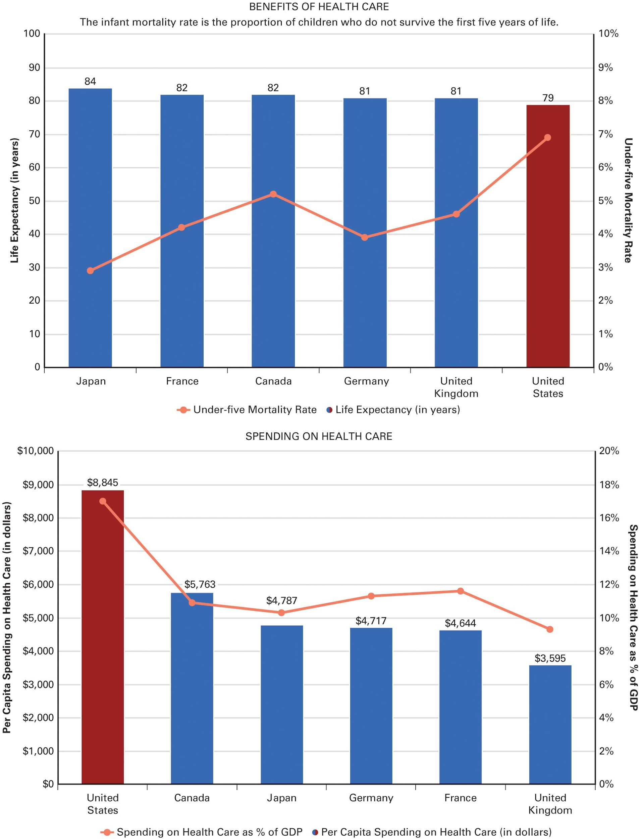
Figure 17.1 The Costs and Benefits of Health Care
Source: World Health Statistics 2015 (Geneva, Switzerland: World Health Organization, 2015), 43–53, 142–149.
Note: Data are for 2012 and 2013
Notes:
The figures compare the costs and benefits of health care spending across countries.

Slide 7
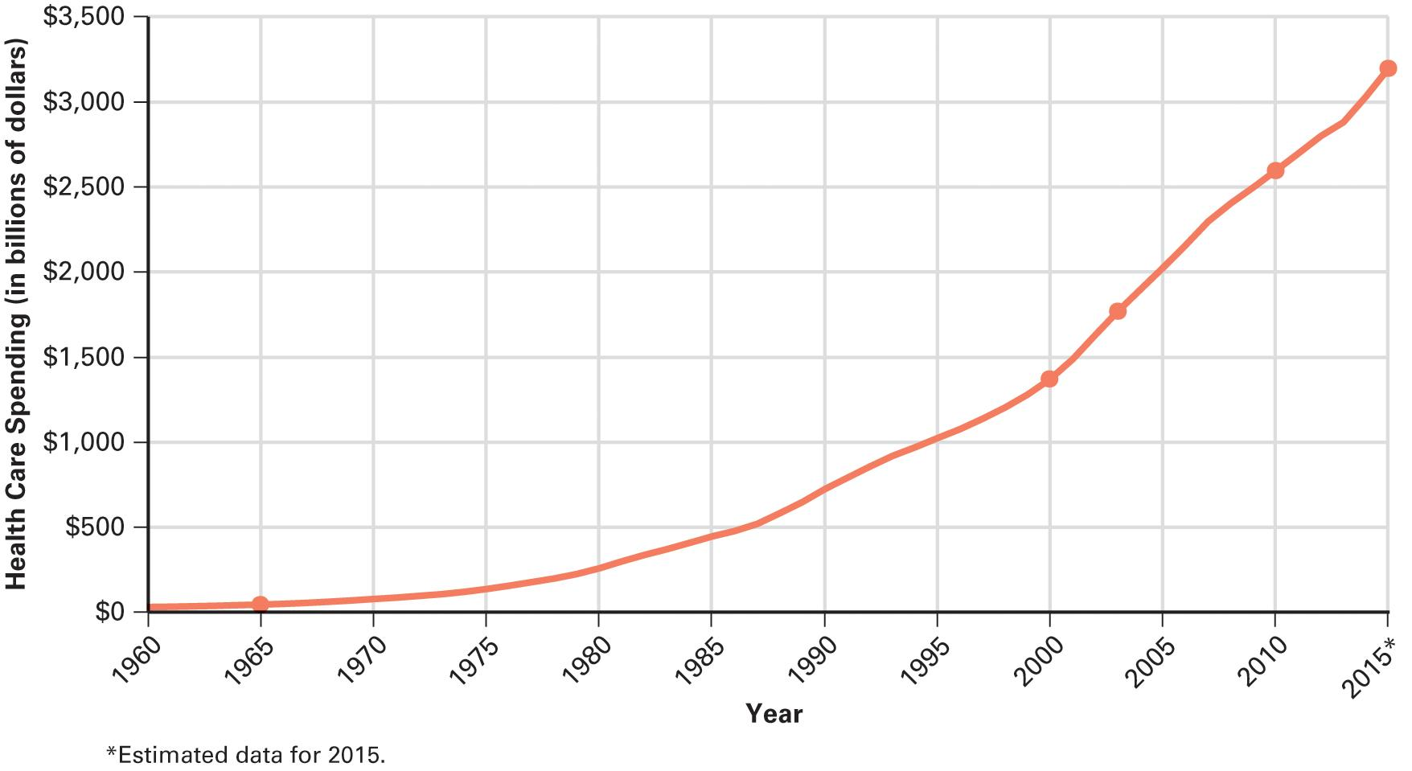
Figure 17.2 The Rising Costs of Health Care
Source: Centers for Medicare and Medicaid Services, 2016.
Notes:
The United States spends an enormous amount on health care, and these expenditures have risen rapidly over the past 50 years. Getting health care expenditures under control is one of the greatest challenges of both government and the health care industry.

Slide 8
Access to Health Care (1 of 2)
Quality of care varies
How do Americans access health care?
55 percent get insurance from the workplace
Medicare (65 and older)
Medicaid (poor people)
CHIP (poor children)
Individual health insurance
Notes:
Employers started providing health insurance as a benefit after World War II but many can no longer afford to provide it, especially small businesses. Part-time workers are usually not eligible for company-provided insurance but most of the uninsured are employed full-time.
The government provides health insurance to the elderly and the poor via Medicare, Medicaid, and the Children's Health Insurance Program, all of which will be discussed later in the chapter.

Slide 9
Access to Health Care (2 of 2)
The uninsured
33 million uninsured (2014)
Disproportionately young citizens
Racial and ethnic disparities
Life expectancy for whites is longer than African Americans
African American infant mortality is twice that of whites
Notes:
There are over 33 million uninsured Americans as of 2014, or 11% of the population. This figure does NOT include those who are underinsured – that is, those whose insurance provides grossly inadequate coverage for health care expenses.
The uninsured are disproportionately young. They include 4.8 million children and 5.2 million young adults.
Uninsured people must pay the full cost of any medical treatment they receive out-of-pocket at the time of service. Most of the uninsured lack coverage because their employer does not provide it and they cannot afford to purchase it individually.
The high cost of medical care means that people with no insurance, or with inadequate coverage, are likely to postpone seeing a doctor until a medical condition becomes an emergency. The lack of care at an earlier stage of illness drives up the cost and reduces productivity. Uninsured Americans are more likely to die from treatable illnesses than those with insurance.
Wealthy people in the U.S. have access to the best health care in the world but the poor do not have access to the same level of care because the U.S. lacks universal health care.
How do Americans gain access to health care? About two-thirds of Americans have private insurance through their employer or that they have purchased individually. Individual policies are much more expensive so people who do not have insurance via their employer sometimes can't purchase it on their own.
Most private insurance works on a fee-for-service basis. The more tests and treatments doctors provide, the more money they make. As a way to contain costs, network health programs called health maintenance organizations, or HMOs for short, were developed. Members of an HMO must see doctors within the network, and must designate a primary care provider (PCP), who must pre-approve all specialist consultations. Over half of all Americans are now enrolled in HMO-type plans.

Slide 10
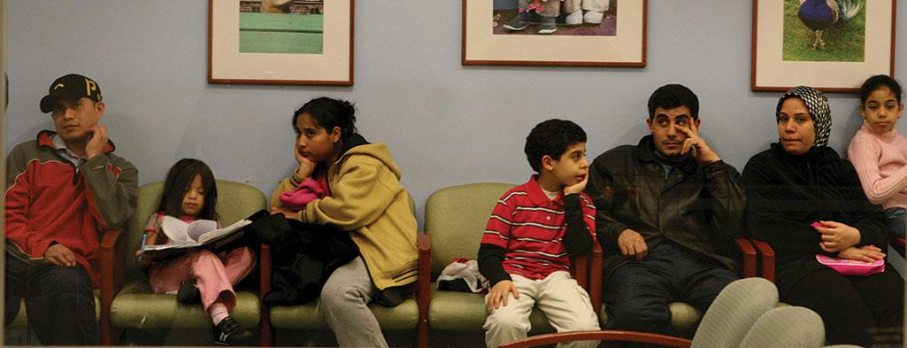
Disparities in Health Care access
Notes:
There are substantial disparities in access to health care in America. Those with less access are likely to live shorter and less healthy lives than those with more access.

Slide 11
The Role of Government in Health Care (1 of 3)
Government pays for 40% of health care
Tax breaks to employers
Public hospitals
NIH-funded research
Armed forces
Notes:
Despite our lack of single-payer universal health care, the government pays 40% of all U.S. health care costs. It pays in the form of tax breaks to employers who provide health insurance.
It also pays by the funding of public hospitals, via research grants given by the National Institute of Health, and by providing care to the armed forces.
It also pays for the Medicare and Medicaid programs.

Slide 12
The Role of Government in Health Care (2 of 3)
Medicare (1965)
64 million (20%)
$605 billion (15% of federal budget)
Medicaid (1965)
66 million
$386 billion fed/$220 billion states
Notes:
The Medicare program was created in 1965 to provide health insurance for the elderly. Just like with Social Security, a specific payroll deduction funds this program, not general tax revenues.
And just like with Social Security, expenses are in danger of exceeding revenues. Medicare costs were $605 billion in 2017, or about 15 % of the federal budget.
But when the government caps Medicare reimbursement, doctors simply refuse to accept Medicare patients. What is the solution?
Medicaid was created at the same time as Medicare to provide health coverage to the poor, regardless of age. It serves about the same number of Americans as Medicare.
The current cost of the program is $386 billion at the federal level and $220 billion for the states, and climbing.

Slide 13
The Role of Government in Health Care (3 of 3)
The Affordable Care Act (2010)
Increased coverage
Allows young citizens to stay on parents’ insurance
Mandates everyone have health insurance
18 million previously uninsured are now insured
Ended discrimination for preexisting conditions
Other ACA reforms
Notes:
The Affordable Care Act of 2010 (ACA) increased health insurance coverage to American citizens. Despite opposition from some states, some 18 million previously uninsured citizens now have insurance.
The ACA also included a host of reforms to help people maintain and fully benefit from insurance coverage.

Slide 14
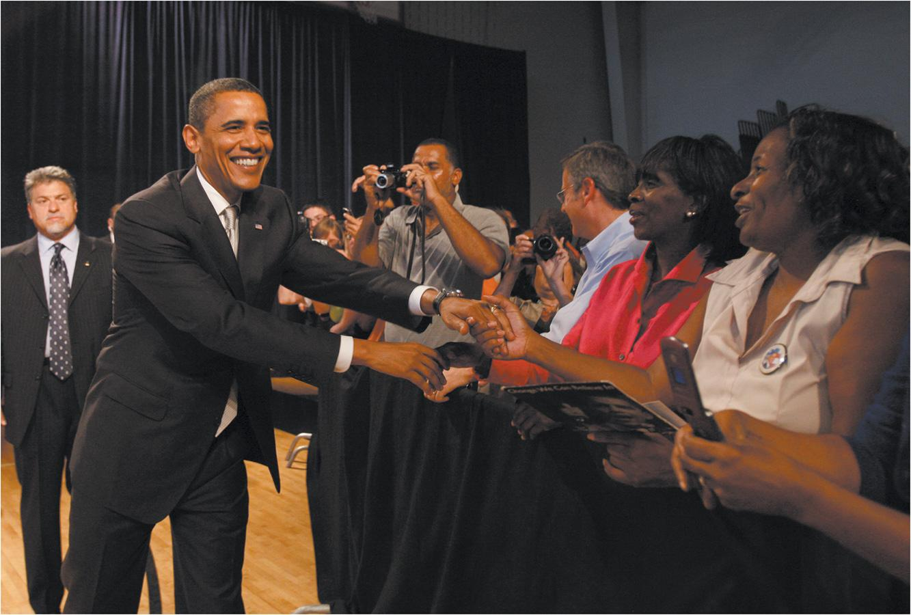
Barack Obama’s Health Care Reform
Notes:
President Obama made reforming health care a top priority, but he faced widespread resistance. Here he speaks for reform shortly before the final congressional vote on his plan.

Slide 15
Journal Prompt 17.1: Health Care Policy
The United States spends more on health care than any other nation. Why do you think Americans are not healthier than the citizens of other economically developed countries?

Slide 16
Learning Objective 17.2
Analyze the conflicts between economic growth and environmental protection, and identify the major national environmental protection policies.

Slide 17
Environmental Policy
Economic Growth and the Environment
Environmental Policies in America
Global Warming
Notes:
In this section we will talk about the issues that complicate environmental policymaking, specifically the conflict between a desire to protect human health and the environment but a reluctance to impose any costs on businesses.
Americans are in favor of environmental policy in the abstract—who could be against clean air or clean water? But Americans tend to oppose specific policies, such as taxes on gasoline or limits on sprawl.

Slide 18
Economic Growth and the Environment
Environment vs. jobs
Pollution inevitable byproduct of growth?
Environmental movement of 1960s
Explosion of environmental groups
Science/growth of support
Backlash
Notes:
As the industrial revolution, urbanization, and population growth destroyed some wilderness and fouled the rest, Americans at first accepted pollution as an inevitable byproduct of economic growth. As forests were felled, Americans thought that the country was so large that there would always be more trees or more fish or more of whatever resource was being depleted.
But slowly a movement to halt pollution and environmental destruction developed. It gained momentum in the 1960s, a decade which saw the growth of environmental groups. As their memberships increased, these groups played a role in lobbying lawmakers and educating citizens about environmental problems. As science shed more light on the effects of pollution and unmitigated environmental destruction, public support for environmental policy grew.
But environmental policies led to a backlash by businesses, property owners, and employees of companies engaged in environmental destruction. These groups opposing stronger environmental regulations are politically powerful and they have successfully prevented more stringent regulations from being passed, as well as weakened the enforcement of existing laws.

Slide 19
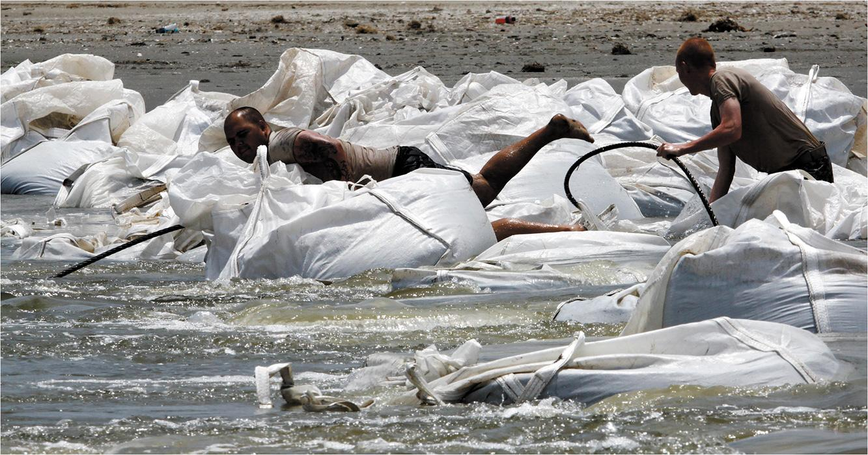
BP Oil Spill
Notes:
Coastal states often desire the jobs provided by offshore drilling. Yet they may also find their coast lines covered with oily sludge, and their tourism and fishing industries adversely affected when catastrophe strikes. In 2010, an explosion on the Deepwater Horizon oil rig released millions of gallons of oil into the Gulf of Mexico, forcing U.S. Army National Guard troops to build a barrier of giant sandbags around delicate marshland near Port Fourchon, Louisiana. For years afterward popular beaches and fishing spots were still undergoing restoration.

Slide 20
Environmental Policies in America (1 of 2)
EPA (1970)
Environmental impacts
NEPA (1969)
Government agencies must file statements
Clean air
Clean Air Act of 1970
Notes:
The Environmental Protection Agency was created by President Nixon in 1970. The National Environmental Policy Act of 1969 requires federal agencies to file environmental impact statements with the EPA when they propose to undertake projects, such as construction of dams, roads, ports, or airports, that are potentially disruptive to the natural environmental. Environmental groups are then able to object to the project if they find it will harm the environment unacceptably. This does not mean the project will not go forward, but it may be modified to lessen its environmental impact.
The Clean Air Act of 1970 is a landmark piece of environmental legislation that has made a significant difference in the quality of the nation's air. The chief opponent of the Act is the auto industry, which has fought to weaken fuel emission standards.

Slide 21
Environmental Policies in America (2 of 2)
Clean water
Wilderness preservation
Endangered species
Toxic wastes
Superfund
Nuclear waste
Notes:
The Water Pollution Control Act of 1972 has been instrumental in cleaning up the nation's waterways. But it only regulates point source pollution, not runoff.
The National Park System, created in 1916, helps to preserve wilderness but tourism strains these parks, and the government faces pressure from logging and mining interests to open more and more public lands up to extraction rather than preservation. Preservation is one area of environmental policy that has failed completely.
Loss of wilderness means loss of species. The Endangered Species Act of 1973 was supposed to require the government to actively preserve endangered species regardless of economic consequence. But the Act was gutted under the Reagan administration and has never really regained public or governmental support.
What do we do about toxic waste that was dumped before environmental legislation was enacted? What do we do if the companies that polluted are no longer in business? In 1980, Congress established a Superfund to clean up old toxic waste sites that were causing new health problems.
The law was unique in how it established liability. A polluting company was liable for clean-up costs even if the dumping had been legal when it was done, and even if many other companies had dumped on the same site. So far, over 1,100 sites have been cleaned up, mostly at taxpayer expense as it has been impossible to force companies to pay in most cases.
The disposal of nuclear waste is another political problem. No states or localities want the waste, which must be monitored for millennia, in their backyard. Yet, if we are to use nuclear power, the waste must go somewhere. Currently, U.S. nuclear waste is stored in temporary locations because no agreement has been reached on a permanent storage facility.

Slide 22
Global Warming
Potential effects
Sea levels rise
Severe weather
Shift in agricultural zones
Reduce effects by reducing greenhouse gas emission
Potential economic loss
Not everyone agrees that Earth is warming
Paris conference sets new goals
Notes:
The burning of fossil fuels causes increased carbon dioxide to be stored in the earth's atmosphere. This atmospheric carbon dioxide warms the earth, in an effect similar to a greenhouse.
The increase in global temperature is slight but it is enough to melt polar ice. This causes sea levels to rise, displacing coastal residents. It also affects weather patterns and agricultural zones.
The 2015 Paris Conference reached an agreement for both the developed and developing countries to limit their carbon emissions.

Slide 23
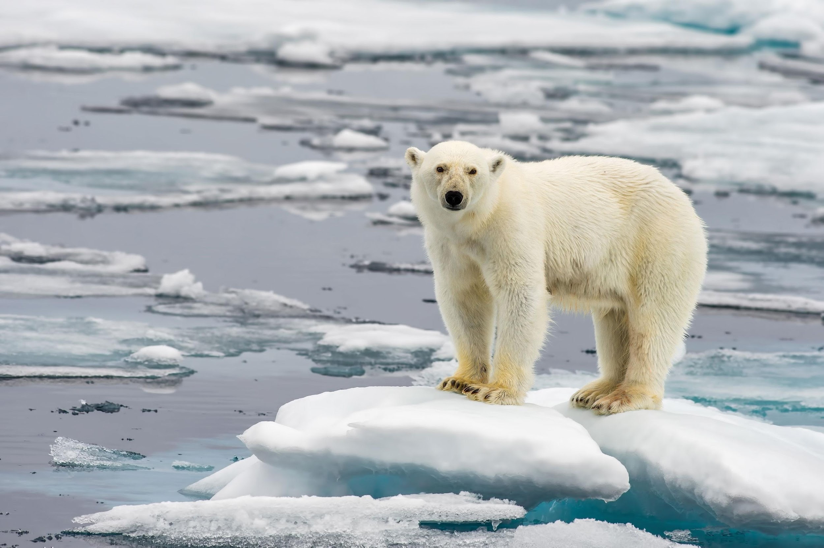
Polar Bear and Global Warming
Notes:
Global warming has many consequences, including the melting of polar ice. As a result, polar bears are losing their access to seals, a primary source of food.

Slide 24
Journal Prompt 17.2: Global Warming
What should the United States do about global warming?

Slide 25
Learning Objective 17.3
Evaluate the advantages and disadvantages of each of the principal sources of energy in the United States.

Slide 26
Energy Policy
Coal
Petroleum and Natural Gas
Nuclear Energy
Renewable Sources of Energy
Notes:
It is appropriate that we turn in this next section to energy policy since it is closely linked to environmental policy. Americans need abundant energy to fuel our modern lifestyle, but the consumption of fossil fuels pollutes the environment. Renewable energy is being developed slowly but 81% of U.S. energy comes from fossil fuels. One thing Americans have made clear to politicians is that we are not willing to make any sacrifices to achieve greater energy efficiency.

Slide 27
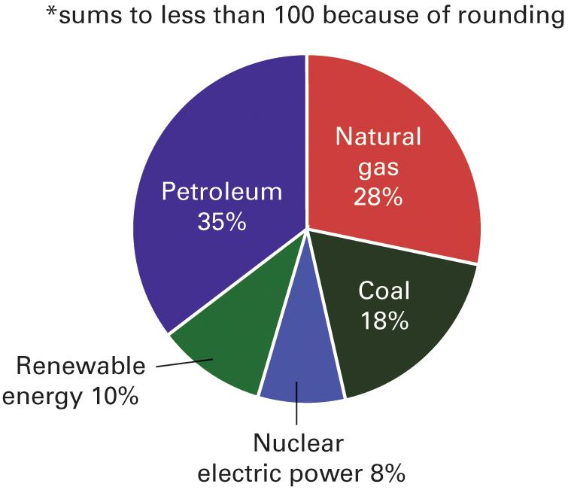
Figure 17.3 Sources of America’s Energy
Source: U.S. Energy Information Agency, 2016.
Notes:
Despite the technological advances of society, America still relies on traditional sources for its energy: coal, oil, and natural gas. Coal generates nearly 20 percent of our electricity; oil fuels our cars, trucks, and planes. Only 10 percent of our energy comes from renewable sources, mainly hydroelectric, wind, and biomass (wood, agricultural crops and wastes, and municipal wastes) power.

Slide 28
Coal
Coal
90% of fuel reserves
18% of energy/39% of electricity
Dirtiest fuel
Notes:
Coal is America's most abundant fuel. It comprises 90% of our fuel reserves; we have enough coal to last for hundreds of years. Currently coal provides 18% of the nation's energy, including 39% of electricity generation. But coal is also our dirtiest fuel, responsible for blackening buildings and lungs, and producing greenhouse gases and acid rain.

Slide 29
Petroleum and Natural Gas
Petroleum
35% of energy/automobiles
One-fourth imported
Maintain domestic supply
Natural gas
28% of energy
Notes:
Oil provides 35% of U.S. energy, including virtually all automobile fuel. About one-fourth of the oil we use is imported, which is a problem because most of the world's oil reserves are located in hostile countries. Our dependence on foreign oil puts us at the mercy of some brutal regimes that are serious violators of human rights.
Natural gas provides about 28% of our energy. Both oil and gas are slightly cleaner than coal but they still contribute greenhouse gases and obtaining them causes severe environmental damage. Drilling for oil and gas is the subject of intense political debate because of the environmental destruction it causes.

Slide 30
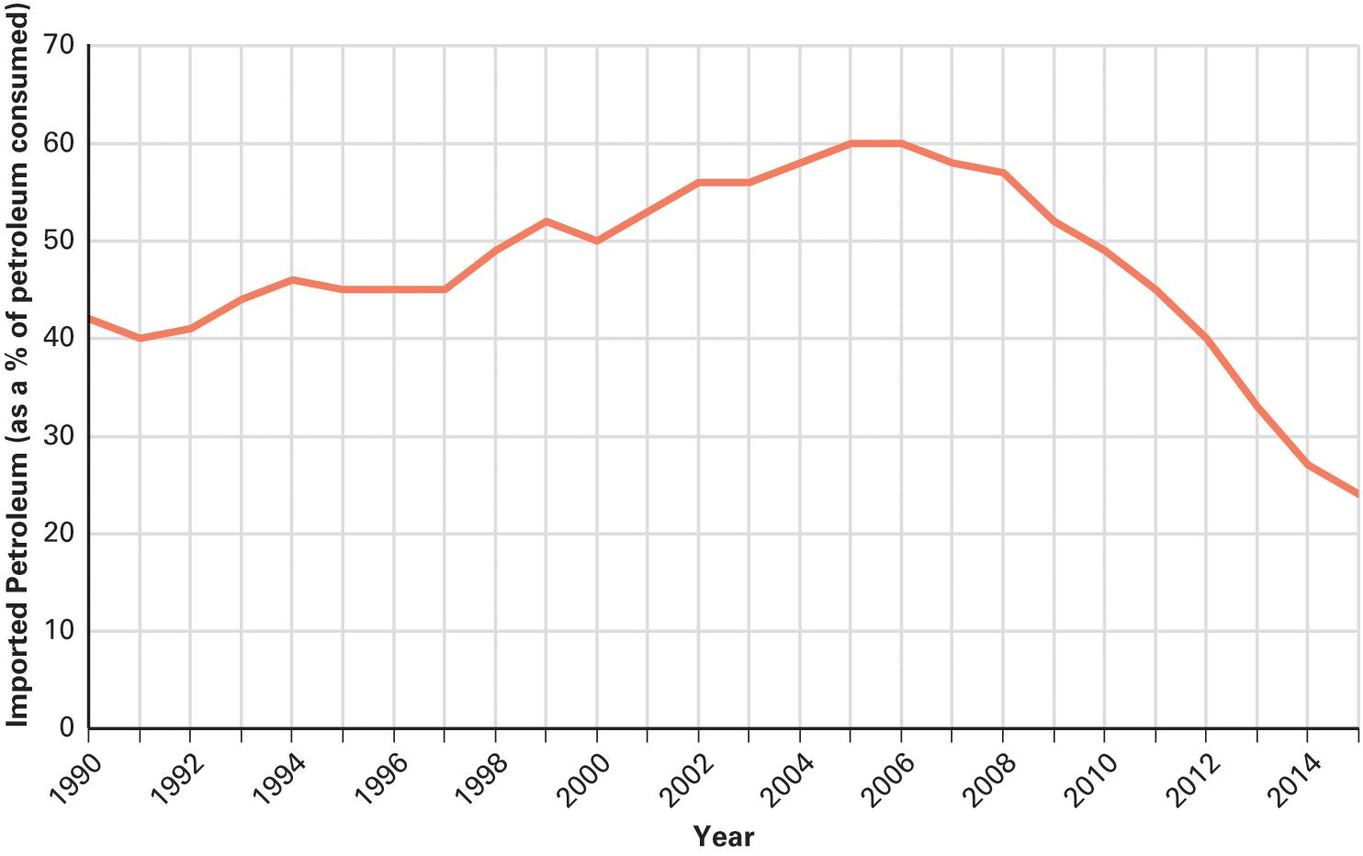
Figure 17.4 Importing Petroleum
Source: U.S. Energy Information Administration, 2016.
Notes:
In a single generation, the United States moved from supplying most of its petroleum needs to importing 60 percent and then back to importing less than a third of its petroleum and petroleum products.

Slide 31
Nuclear Energy
Nuclear energy
19% of energy
Controversial
Safety concerns
Fukushima
Notes:
About 19% of U.S. energy needs are met by nuclear power but this energy source is even more controversial than fossil fuels. Its usage does not produce pollution or greenhouse gases but spent fuel remains radioactive for thousands of years, and accidents at power plants, though rare, have the potential to be catastrophic.

Slide 32
Renewable Sources of Energy
Renewable sources of energy
10 percent of energy
Water
Wind
Sun
Biomass
Notes:
Renewable energy sources combined only produce about 10% of U.S energy. A variety of sources of renewable energy are in use on a very small scale, including hydroelectric power, solar power, wind power, and geothermal and biomass power. Wind is one of the fastest growing sources of power.

Slide 33
Learning Objective 17.4
Assess the role of democratic politics in making health care, environmental, and energy policy and the effect of these policies on the scope of government.

Slide 34
Understanding Health Care, Environmental, and Energy Policy
Democracy, Health Care, and Environmental Policy
The Scope of Government and Health Care, Environmental, and Energy Policy
Notes:
We have seen that health care, environmental, and energy policy have all increased the scope of government. These policy areas are extremely important to all citizens yet they are highly technical, which makes ordinary citizens as well as elected officials ill-equipped to make good policy.
In this final section, we will consider how sound policy making in these policy areas meshes with democratic government.

Slide 35
Democracy, Health Care, and Environmental Policy
Technologically complex decisions
Can citizens participate effectively?
Democracy is a messy business
Ill-informed opinions
Interest groups help
Notes:
Given the technical nature of decision making in health care and environmental policy, can citizens participate effectively?
Whether their opinions are ill-informed or not, Americans do not hesitate to express them to elected officials. Interest groups can help by providing critical information about the impact of policies to both citizens and elected officials.

Slide 36
The Scope of Government and Health Care, Environmental, and Energy Policy
Scope of government expanded in health care policy
Medicare and Medicaid
Tax breaks to employers
Yet system is mostly private
Environmental protection has expanded federal government
Notes:
Health care policies such as Medicare and Medicaid, as well as tax breaks for employers who provide health insurance to their employees, have greatly expanded the scope of government. Yet the U.S. is unique in having mainly a private health care system when most other countries have a public one.
The public complains about the size and scope of government yet we expect the government to protect us from the health effects of pollution, to protect our fuel sources, even to the point of going to war with other countries, and to subsidize the energy industry to reduce fuel costs.

Slide 37
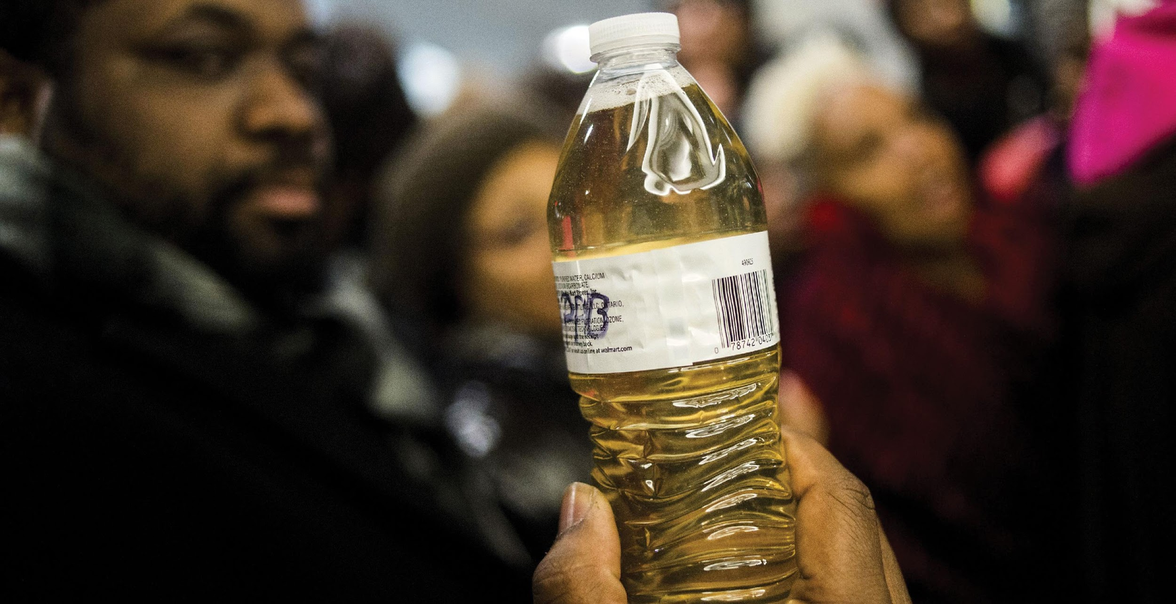
Flint Water Supply
Notes:
No one likes regulations—until they need them. In 2016, the public learned what residents of Flint, Michigan, already knew: their drinking water was dangerously polluted. Protestors took their grievances to the state capital in Lansing and demanded government action to clean up their water supply.

Slide 38
Shared Writing 17
Every other economically developed nation has some form of national health insurance covering all its citizens. The United States does not have such a system. Even with reforms, some people lack effective access to health care. What, if anything, should we do about this lack of access?

Slide 39
Photo Credits
Chapter 17
514: Enid Alvarez/New York Daily News/Getty Images; 516: Jason Reed/Reuters; 518: Rick Wilking/Reuters; 524: FloridaStock/Shutterstock; 528: Chris Britt/Creators Syndicate; 529: Jake May/AP Images

