Slide 1
Government in America: People, Politics and Policy
Seventeenth Edition
Chapter 16
Economic and Social Welfare Policymaking

Slide 2
Learning Objectives
16.1 Identify the main policy tools that American government can employ to address economic problems, and contrast Keynesian and supply-side economics.
16.2 Compare and contrast entitlement and means-tested social welfare programs.
16.3 Assess the extent of economic inequality in American and the role of government in lessening it.
16.4 Trace the changes over time in major federal welfare programs.
16.5 Outline how America’s Social Security program works and the challenge of keeping it financially solvent in the coming years.
16.6 Distinguish American social welfare policy from that of other established democracies.
16.7 Assess the impact of economic and social welfare policies on democracy and the scope of government in America.

Slide 3
Learning Objective 16.1
Identify the main policy tools that American government can employ to address economic problems, and contrast Keynesian and supply-side economics.

Slide 4
Economic Policymaking
Two Major Worries: Unemployment and Inflation
Policies for Controlling the Economy
Why It Is Hard to Control the Economy
Notes:
Bill Clinton's 1992 campaign slogan, "It's the economy, stupid," summed up how voters make choices at the ballot box. Economic conditions are the best single predictor of voters' evaluation of how the president is doing his job. When the economy is good, the incumbent party is rewarded with reelection. When the economy is bad, voters tend to throw out the incumbents and give the opposition party a chance.

Slide 5
Two Major Worries: Unemployment and Inflation
Unemployment rate
Underemployment rate
Tracked by Bureau of Labor Statistics (BLS)
Inflation
Rise in price of goods and services
Consumer price index (CPI)
Averages 4%
Notes:
The unemployment rate tells us the percentage of Americans who are looking for work but are unable to find it. The unemployment rate varies by demographic characteristics such as age, race, and education level. Of course, the unemployment rate does not capture unemployed people who have become so discouraged that they have given up looking for work, nor those who are employed part-time but are looking for full-time work. So, the Bureau of Labor Statistics is now releasing an underemployment rate as well.
Inflation is a rise in the price of goods and services. The BLS also tracks how much the cost of buying the same set of basic goods and services rises over time. Inflation currently averages about 4%.

Slide 6
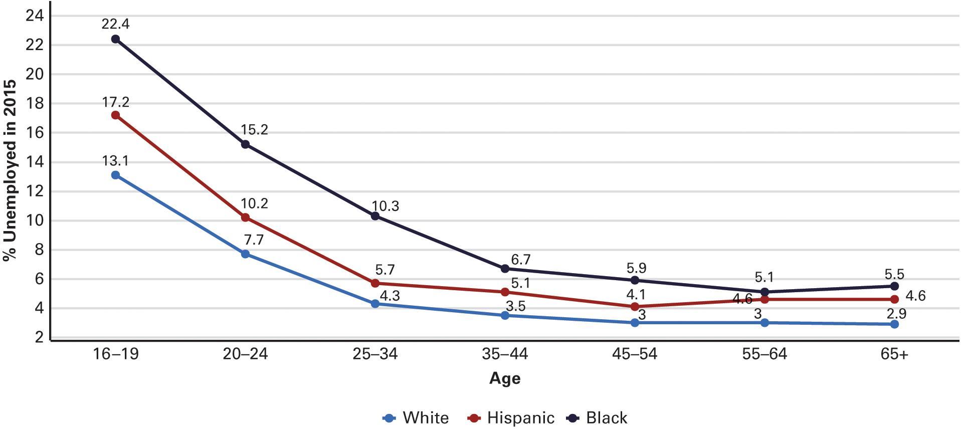
Figure 16.1 Unemployment Rates by Age/Ethnicity
Source: Bureau of Labor Statistics
Notes:
The unemployment rate is one of the nation’s most important economic indicators and a political issue as well. Although Americans sometimes think of unemployment as mainly a problem for middle-aged people, in actuality unemployment rates are much higher for young Americans aged 16 to 24. Young blacks and Hispanics face a double whammy in their search for a job, as you can see by their very high unemployment rates shown in the graph.

Slide 7
Policies for Controlling the Economy (1 of 2)
Laissez-faire
Monetary policy and the “Fed"
Federal Reserve Board
Meets in secret; not accountable to Congress
Manipulating the amount of money
Notes:
The principle that the government should not meddle at all in the economy is known as laissez-faire. Conservatives still espouse this principle, but it has never really existed in any nation-state, certainly not in modern times. Since the stock market crash of 1929, the federal government's intervention in the U.S. economy has grown. The government has two main tools with which to steer the economy: monetary and fiscal policy.
Monetary policy is determined by the Federal Reserve Board, known as the "Fed." The chairman is one of the most important U.S. officials. Like the bureaucracy, the Fed has no direct democratic accountability. It meets in secret and can act without first getting permission from elected officials. The Fed manipulates the amount of money in circulation, which affects inflation and economic growth. Too much money leads to inflation, too little leads to economic stagnation. It is a difficult balance to strike.

Slide 8
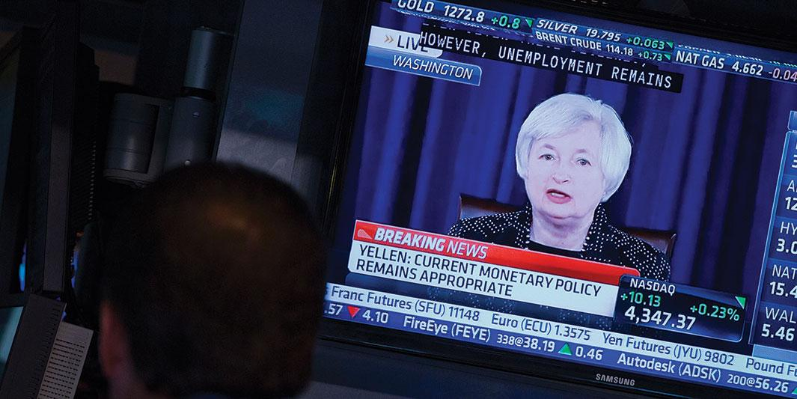
Chairman of the Fed, Janet Yellen
Notes:
When the head of the Federal Reserve Board speaks, the financial industry listens intently for every clue as to how the Fed may act regarding interest rates. Here, traders on the floor of the Chicago Board of Trade monitor Fed Chairman Janet Yellen's news conference following a Fed meeting.

Slide 9
Policies for Controlling the Economy (2 of 2)
Fiscal policy: Keynesian vs. supply-side economics
Taxing, spending, borrowing
Keynesian economic theory
Supply-side economics
Notes:
The other tool for influencing the economy is fiscal policy—that is, how much the government taxes, spends, and borrows. There are two positions on fiscal policy. One was proposed by English economist John Maynard Keynes during the Great Depression. Keynes thought that the government should spend money to stimulate the economy, and provide jobs if the private sector was unable or unwilling to do so, the idea being that when consumers have money, they buy goods and services, which is essential to getting the economy rolling again. This was the strategy followed by FDR and most Democrats.
A competing theory espoused by Republicans is known as supply-side economics. Government should cut taxes to provide an incentive for people to work harder. If they get to keep more of what they earn, they will try to earn more, and have more to spend. Supply-siders believe that the government will actually collect more revenue by cutting taxes because the amount of taxable income will increase when people start working harder and longer. They also believe that cutting regulations will stimulate the supply of goods.
Which side is correct?

Slide 10
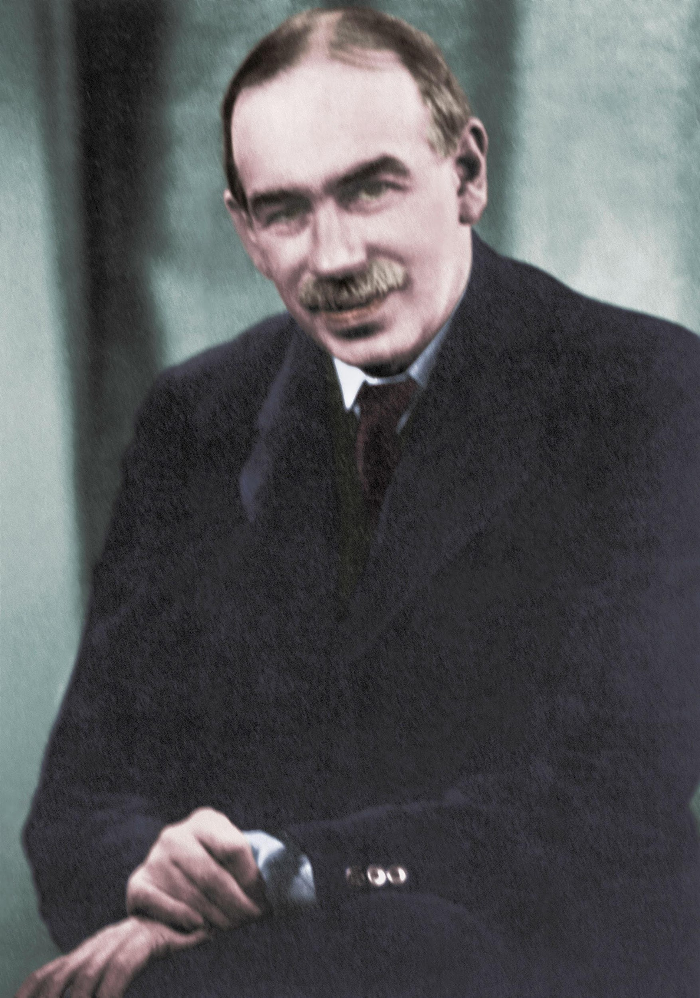
John Maynard Keynes
Notes:
The economic theories elaborated by John Maynard Keynes, shown in this photo, have influenced the Democratic Party's policymakers for nearly 100 years. When President Obama signed the $787 billion economic stimulus bill soon after coming into office it was a direct application of Keynes’ theory of how government should increase spending in order to create more economic demand during economic hard times.

Slide 11
Why It Is Hard to Control the Economy
"Political business cycle"
Presidents control economy to win elections
Not easy to do
Private sector dominates economy
Federal government is one-quarter of GDP
Impact of government policies gradual
Notes:
Some people believe that presidents can manipulate the economy to win elections, offering a tax cut or stimulus to win favor with voters just before they go to the polls. If it were that easy for presidents to manipulate the economy, we would never have high at election time. As economist Robert Samuelson points out, “If presidents could create jobs, the unemployment rate would rarely exceed 3.5 percent.”
The decisions of the private sector are much more critical to the economy than government efforts because the private sector accounts for three-fourths of GDP. Also, the impact of government policies is not felt immediately. It takes time to design, pass, and implement new policies, and the effects can take years to be felt.

Slide 12
Learning Objective 16.2
Compare and contrast entitlement and means-tested social welfare programs.

Slide 13
Types of Social Welfare Policies
Entitlement programs
Social Security, Medicare
Largest and most expensive
Means-tested programs
Food stamps, Medicaid
Fear of dependency
Notes:
Entitlement programs, such as Social Security and Medicare, are not funded out of general tax revenue. Working people and their employers contribute to them, and everyone over a certain age is eligible to receive benefits. Entitlement programs are the largest and most expensive public policies administered by the federal government.
Means-tested programs, such as food stamps and Medicaid, are available to people whose income is below a certain level. They are much more controversial than entitlement programs because they are supported by general tax revenue.
Liberals tend to view the poor as victims of circumstances beyond their control, and they see these policies as providing assistance to people in difficult situations.
Conservatives view the poor as lazy and see their poverty as a consequence of their own irresponsibility. They see these policies as fostering dependency. Your view on these programs will largely depend upon your perception of poverty – it is the fault of the poor or not?

Slide 14
Learning Objective 16.3
Assess the extent of economic inequality in America and the role of the government in lessening it.

Slide 15
Income, Poverty, and Public Policy
Who's Getting What?
Who's Poor in America?
How Public Policy Affects Income
Notes:
The United States has one of the world's highest per capita incomes. In 2015, the median household income was $56,516. Yet the United States also has the widest gap between rich and poor of any developed country, and income inequality is increasing.
The myth of the American dream, the idea that someone can start from anywhere on the socioeconomic ladder and work their way up, is less true today than ever. Social mobility is more limited than in other developed countries, and the main conflict between liberals and conservatives is over distribution of income.

Slide 16
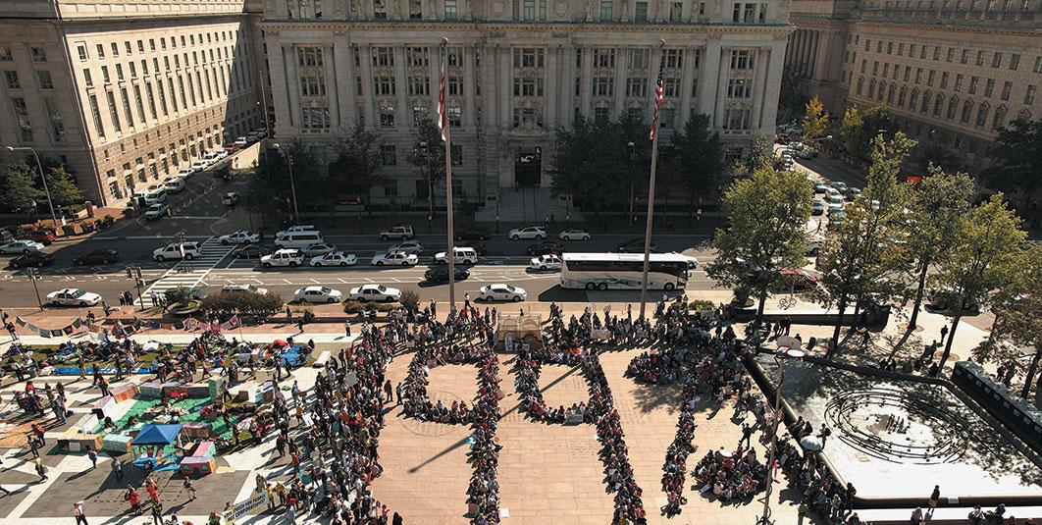
The “99%”
Notes:
One of the goals of the original Occupy movement was to draw attention to inequality in the distribution of income. In the photo below, Occupy supporters gathered and formed a large “99%” in the middle of Freedom Plaza, in Washington DC. Checking slogans like “We are the 99%,” the Occupy movement tried to point out the growing income gap between the top 1 percent and the rest of Americans.

Slide 17
Who’s Getting What?
Income distribution
Sense of justice and equality in a democracy
Relative deprivation increasing
Wealth versus income
Income is amount collected in given time
Wealth is value of assets
1/3 of wealth held by 1%
1/3 held by 90%
Notes:
The income distribution in a democratic country goes to the heart of its sense of justice and equality. In recent decades, the rich have gotten richer but the poor have not seen their incomes increase. This income stagnation for the poor and middle class has led to a situation of relative deprivation.
When we speak of income distribution, we are usually referring to the amount of money collected in a given time period. But there is even more inequality in America when wealth is considered instead of income. Wealth is the value of assets, such as stocks, bonds, bank accounts, property, etc. One-third of America's wealth is held by the wealthiest 1% of the population. The next third is held by 9% and the remaining third is held by 90%.

Slide 18
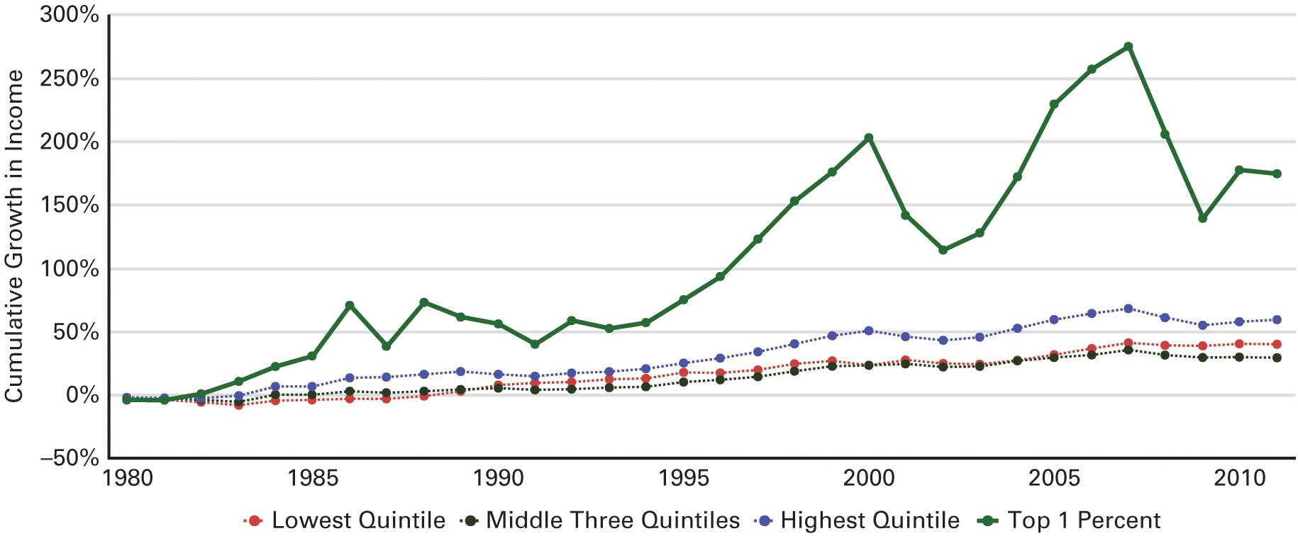
Figure 16.2 The Increase in Economic Inequality and the Rise of the Top 1 Percent
Source: From data underlying figures in Congressional Budget Office, The Distribution of Household Income and Federal Taxes, 2011, November 2014, 21, fig. 11.
Notes:
The following graph demonstrates how much income from various groups rose cumulatively from 1979 to 2011, adjusting for inflation. People below the 80th percentile saw their real income rise just 30–40 percent during this period. Those in the 81st through 99th percentile's did somewhat better, with their income rising about 60 percent. The major games for reserved for just the top 1 percent during this period, which saw its real income go up a whopping 275 percent by 2007. The great recession hit this group hard, but by 2011 their average income was clearly bouncing back strongly. Economist expect that the gains in the stock market since 2011 should result in this figure’s continuing to increase once data from the post-2011 period become available.

Slide 19
Who’s Poor in America?
Poverty line
$12,331 in 2015
43.1 million Americans poor in 2015
13.5% of population
Demographics of poverty
Feminization of poverty
Notes:
Poverty is a relative concept. The percentage of Americans considered impoverished is determined by the income threshold set by the Census Bureau. The poverty line was established in the 1960s by taking the cost of a bare subsistence diet and multiplying it by three, under the assumption that the poor spend 1/3 of their income on food. The poverty threshold for a single adult in 2015 was $12,331. It is widely agreed that the existing measurement tool is outdated as other costs, such as housing, are more significant in a person's budget than food today.

Slide 20
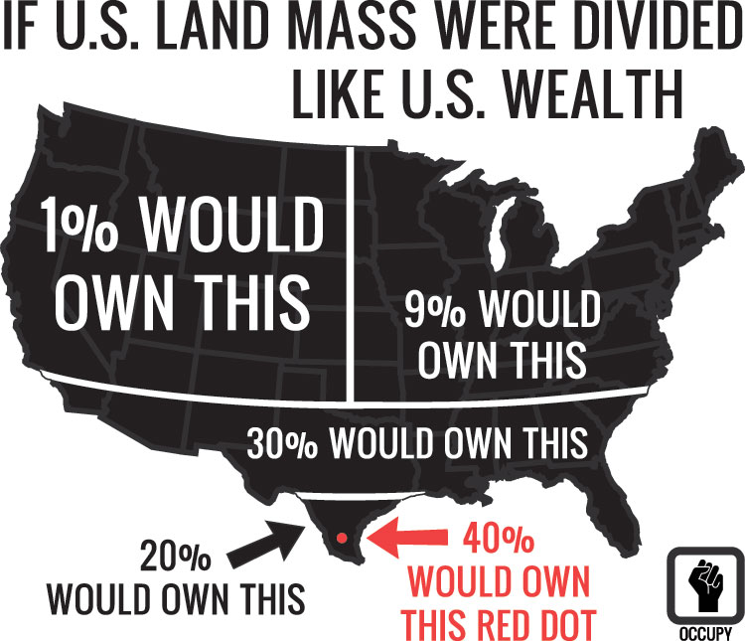
If Land Were Divided Like U.S. Wealth
Notes:
This graphic was designed and distributed by the Occupy movement as part of their campaign against the concentration of wealth in America. Others view inequality as inevitable in a system of capitalism and believe that it results in large part from individual variations in effort and talent.

Slide 21
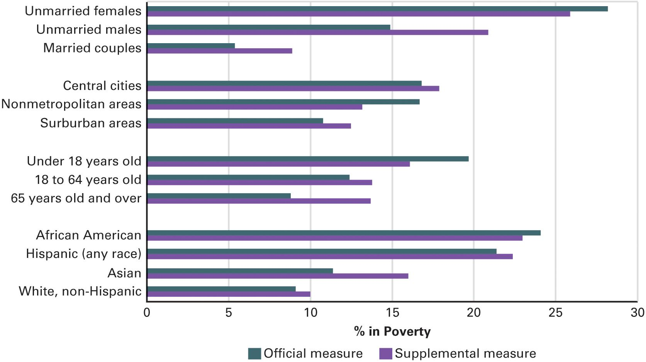
Figure 16.3 Poverty Rates For Persons with Selected Characteristics: A Comparison of the Official and Supplemental Measures
Source: U.S. Census Bureau, “The Research Supplemental Poverty Measure: 2015,” September 2016.
Notes:
In the following chart, you can see the poverty rates for various groups as determined by surveys conducted by the Census bureau in 2015, based on both the traditional, official measure of poverty and the new, supplemental measure which the Obama Administration added. The differences between the two measures are due to two extra considerations that the new measure takes into account. first, the new measure takes into account the benefits from government programs such as food stamps and the national School Lunch Program; this explains why it finds a significantly lower level of poverty among children. Second, it takes into account differences between groups in various cost of living factors, such as medical care; this explains why the new measure finds a much higher percentage of poverty among the elderly.

Slide 22
How Public Policy Affects Income
Taxation
Progressive
Proportional
Regressive
Government expenditures
Transfer payments
Social security, unemployment benefits, food stamps, etc.
Notes:
Some people believe that the government should ensure a minimum level of income for all. But income is linked to how hard people work, what jobs are available where they live, and what kind of education they can afford. Government affects income mainly via taxing and spending.
There are three types of taxes: progressive, proportional, and regressive. A progressive tax charges the rich a higher percentage of their income than the poor. A proportional tax takes the same proportion from everyone, and a regressive tax takes a higher proportion of the poor's income than the wealthy's income. Sales tax is an example of a regressive tax. Do you see why sales taxes hit those with lower income harder? The federal income tax is progressive.
The government makes payments to individuals according to various calculations of need. The unemployed may receive unemployment compensation, and the poor may receive various benefits such as Medicaid and food stamps.
Poverty among the elderly has been significantly reduced since Social Security was introduced. Food stamps have curbed malnutrition among the poor. Over 90% of black children receive food stamps before age 20.

Slide 23
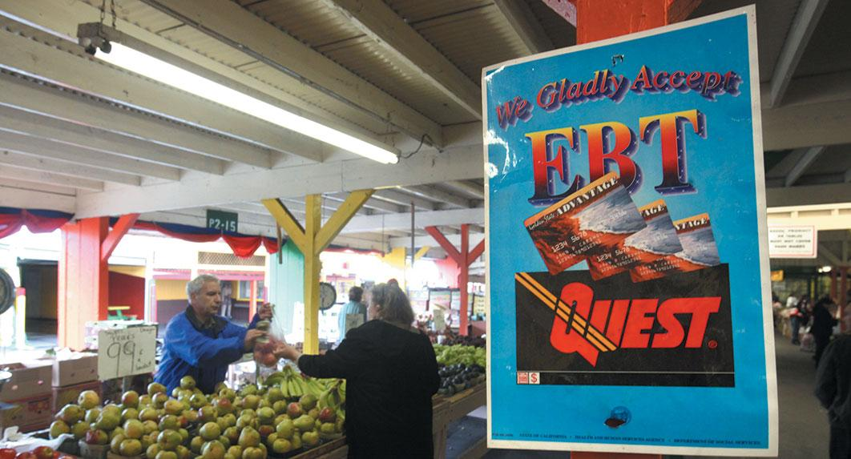
EBT at Farmer’s Market
Notes:
A sign at a farmers market in Northern California announces the acceptance of Electronic Benefit Transfer (EBT) cards, which food stamp recipients can use to buy groceries. In 2012, fewer than a quarter of the nation's farmers markets were set up to use the EBT system. The federal government has allocated $4 million to provide wireless "point of sale" equipment, which enabled more of these markets to use EBT cards.

Slide 24
Table 16.1 The Major Social Welfare Programs (1 of 3)
Program | Description | Beneficiaries | Funding
Entitlement Programs—”Social Insurance”
Social Security | Monthly payments | Retired or disabled or widowed and surviving members of their families | Payroll tax on employees and employers
Medicare (Part A) | Partial payment of cost of hospital care | Retired and disabled people | Payroll taxes on employees and employers
Medicare (Part B) | Voluntary program of medical insurance (pays physicians) | Persons 65 or over and disabled Social Security beneficiaries | Beneficiaries pay premiums
Unemployment Insurance (UI) | Weekly payments; benefits vary by state | Workers who have been laid off and cannot find work | Taxes on employers; states determine benefits
Notes:
This table shows the biggest entitlement and means-tested programs and describes their beneficiaries and funding.

Slide 25
Table 16.1 The Major Social Welfare Programs (2 of 3)
Program | Description | Beneficiaries | Funding
Means-Tested Programs
Medicaid | Medical and hospital aid | The very poor | Federal grants to state health programs
Food stamps | Debit cards that can be used to buy food | People whose income falls below a certain level | General federal revenues
Temporary Assistance for Needy Families (TANF) | Payment | Families with children, either one-parent families, or, in some states, two parent families in which the breadwinner is unemployed | Paid partly by states and partly by the federal government
Notes:
This table shows the biggest entitlement and means-tested programs and describes their beneficiaries and funding.

Slide 26
Table 16.1 The Major Social Welfare Programs (3 of 3)
Program | Description | Beneficiaries | Funding
Means-Tested Programs
Supplemental Security Income (SS() | Cash payments | Elderly, blind, or disabled people whose income is below a certain amount | General federal revenue
Children’s Health Insurance Program (CHIPs) | Subsidies for insurance | Poor families with children | Federal and state revenue
Notes:
This table shows the biggest entitlement and means-tested programs and describes their beneficiaries and funding.

Slide 27
Journal Prompt 16.3: How Public Policy Affects Income
These days one hears a lot in the news about the rich getting richer. To what extent do economic policies in America affect income distribution? What specific economic policies do the most to help provide a safety net for those who are the least well off?

Slide 28
Learning Objective 16.4
Trace the changes over time in major federal welfare programs.

Slide 29
Helping the Poor? Social Policy and the Needy
"Welfare" as We Knew It
Ending Welfare as We Knew It: The Welfare Reform of 1996
Notes:
Until the Great Depression in the 1930s, government played a very small role in social welfare. Families were expected to care for each member, and the poor and destitute had to rely on the largesse of private charities. The life of the poor prior to government social welfare programs was grim beyond our imagining.

Slide 30
“Welfare” as We Knew It
FDR's New Deal programs
Social Security Act of 1935
AFDC
Johnson's War on Poverty
Food stamps
Notes:
FDR's New Deal social welfare programs, such as Social Security and Aid to Families with Dependent Children, were initiated not only to alleviate crushing poverty during the Great Depression but to assure that poor Americans, such as the elderly and women with children, would have a permanent safety net.
In the 1960s, President Johnson's "War on Poverty" expanded this safety net for the poor with new programs, such as food stamps.
These social welfare programs did what they were designed to do in alleviating the worst deprivations of poverty but they did nothing to address the causes of poverty.

Slide 31
Ending Welfare as We Knew It: The Welfare Reform of 1996
Personal Responsibility and Work Opportunity Reconciliation Act (PRWORA)
States would run their own programs
Two-year limit for benefits
Lifetime maximum of five years
From AFDC to TANF
Reforms were effective
Benefit dollar amounts declined
Number of recipients declined
Notes:
Welfare reform was achieved under a Democratic president, albeit a relatively conservative Southern Democrat, working with Republicans in Congress. The 1996 welfare reform bill, officially called the Personal Responsibility and Work Opportunity Reconciliation Act, had three main provisions.
First, states would receive a fixed amount of federal money to run their own welfare programs, resulting in benefit levels that varied substantially by state. Second, there was a two-year limit for receiving benefits, during which time the recipient was supposed to undertake job training and find work. Finally, there was a lifetime maximum of five years for benefits. The AFDC program was re-named Temporary Assistance to Needy Families.
Welfare reform was extremely effective. With states administering their own unique programs, benefit levels dropped to an average of $363 per month, and the number of recipients declined dramatically, as Figure 16.4 will show you.

Slide 32
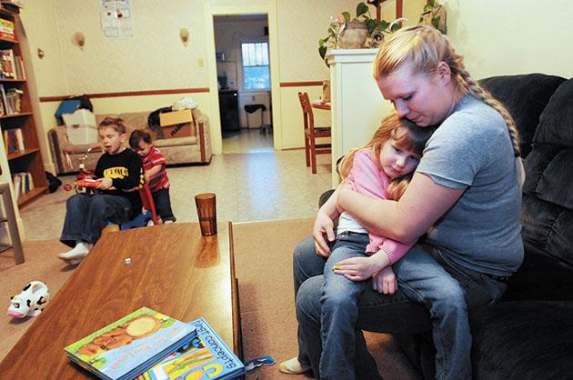
Climb Wyoming
Notes:
Since 1996, welfare reform policies have tried to reduce the welfare rolls and get recipients to work. The young single pictured here said that she had gained new hope from the Climb Wyoming job training program that she was enrolled in while temporarily receiving welfare payments. You can find out about this program for single mothers at www.climbwyoming.org.

Slide 33
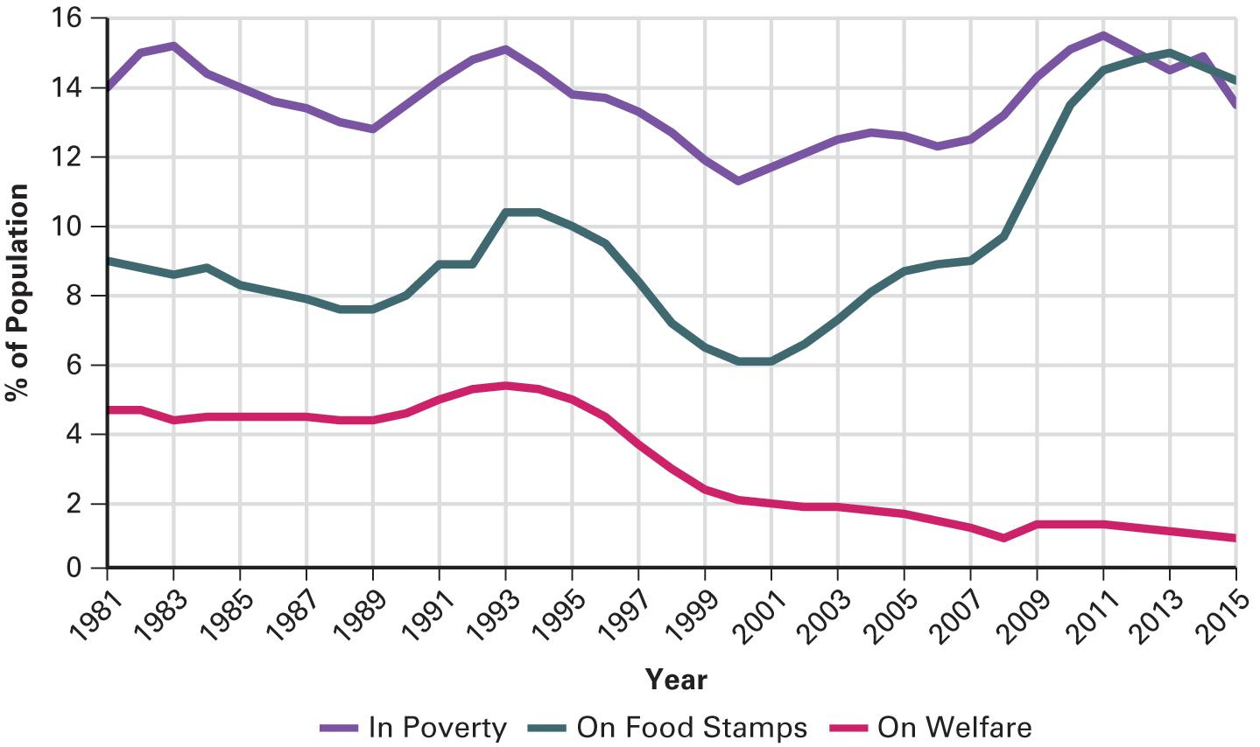
Figure 16.4 How Welfare Reform Drastically Reduced the Welfare Rolls
Source: “Indicators of Welfare Dependence,” U.S. Department of Health and Human Services, Annual Report to Congress, 2008. Updated by the authors based on welfare caseload data reported by the U.S. Department of Health and Human Services’ Administration For Children and Families, poverty statistics reported by the U.S. Census Bureau, and caseload data for food stamps as reported by the Department of Agriculture.
Notes:
Prior to the adoption of the welfare reform bill of 1996, the percentage of the population receiving welfare and food stamps fluctuated in sync with the poverty level. Whenever more people were in poverty, more people qualified for them and hence received benefits; the reverse was of course true whenever times were good and the poverty rate declined. however, once welfare reform was enacted the fact that states now had only a fixed amount of money to dole out under Temporary Aid to Needy Families (TANF) restricted their ability to expand the distribution of welfare benefits during economic hard times. Thus, even during the severe recession that began in 2008 the percentage of the population receiving welfare increased only slightly. In contrast, the percentage receiving food stamps went up markedly, as there were no such restrictions on this program.

Slide 34
Journal Prompt 16.4: Ending Welfare as We Knew It: The Welfare Reform of 1996
What are the pros and cons of the welfare reform bill signed into law by President Clinton in 1996? Some members of Congress think Food Stamps should be reformed along the same lines. What do you think of this idea?

Slide 35
Learning Objective 16.5
Outline how America’s Social Security program works and the challenge of keeping it financially solvent.

Slide 36
Social Security: Living on Borrowed Time
The Growth of Social Security
Reforming Social Security
Notes:
Americans have money withheld from their paychecks to contribute to Social Security. When they retire, they will receive benefits based on their lifetime earnings. But the number of people retiring is rising in relation to the number who are working and paying into the program, and retiree are living many more years than they used to. The program is going to have to be reformed to avoid running out of funds after the Baby Boom generation retires.

Slide 37
The Growth of Social Security
Popular program
Modest benefits
Average $1,341/month
Most expensive public policy
But fiscally sound
Surplus depleting since 2010
What is the solution?
Notes:
Social Security is one of the most popular government programs, despite the fact that its benefits are modest. The average recipient receives only $1,341 per month. Yet the program has been crucial to reducing poverty amongst the elderly and disabled.
Social Security is the most expensive federal government policy but, until recently, it was fiscally sound. Contributions from workers exceeded benefits being paid out to retirees, giving the program a surplus. But since 2010, payouts have exceeded income. The surplus will be depleted unless benefits are cut or the withholding rate increased. Neither of these solutions is popular with voters, but something must be done. What do you think is the best solution?

Slide 38
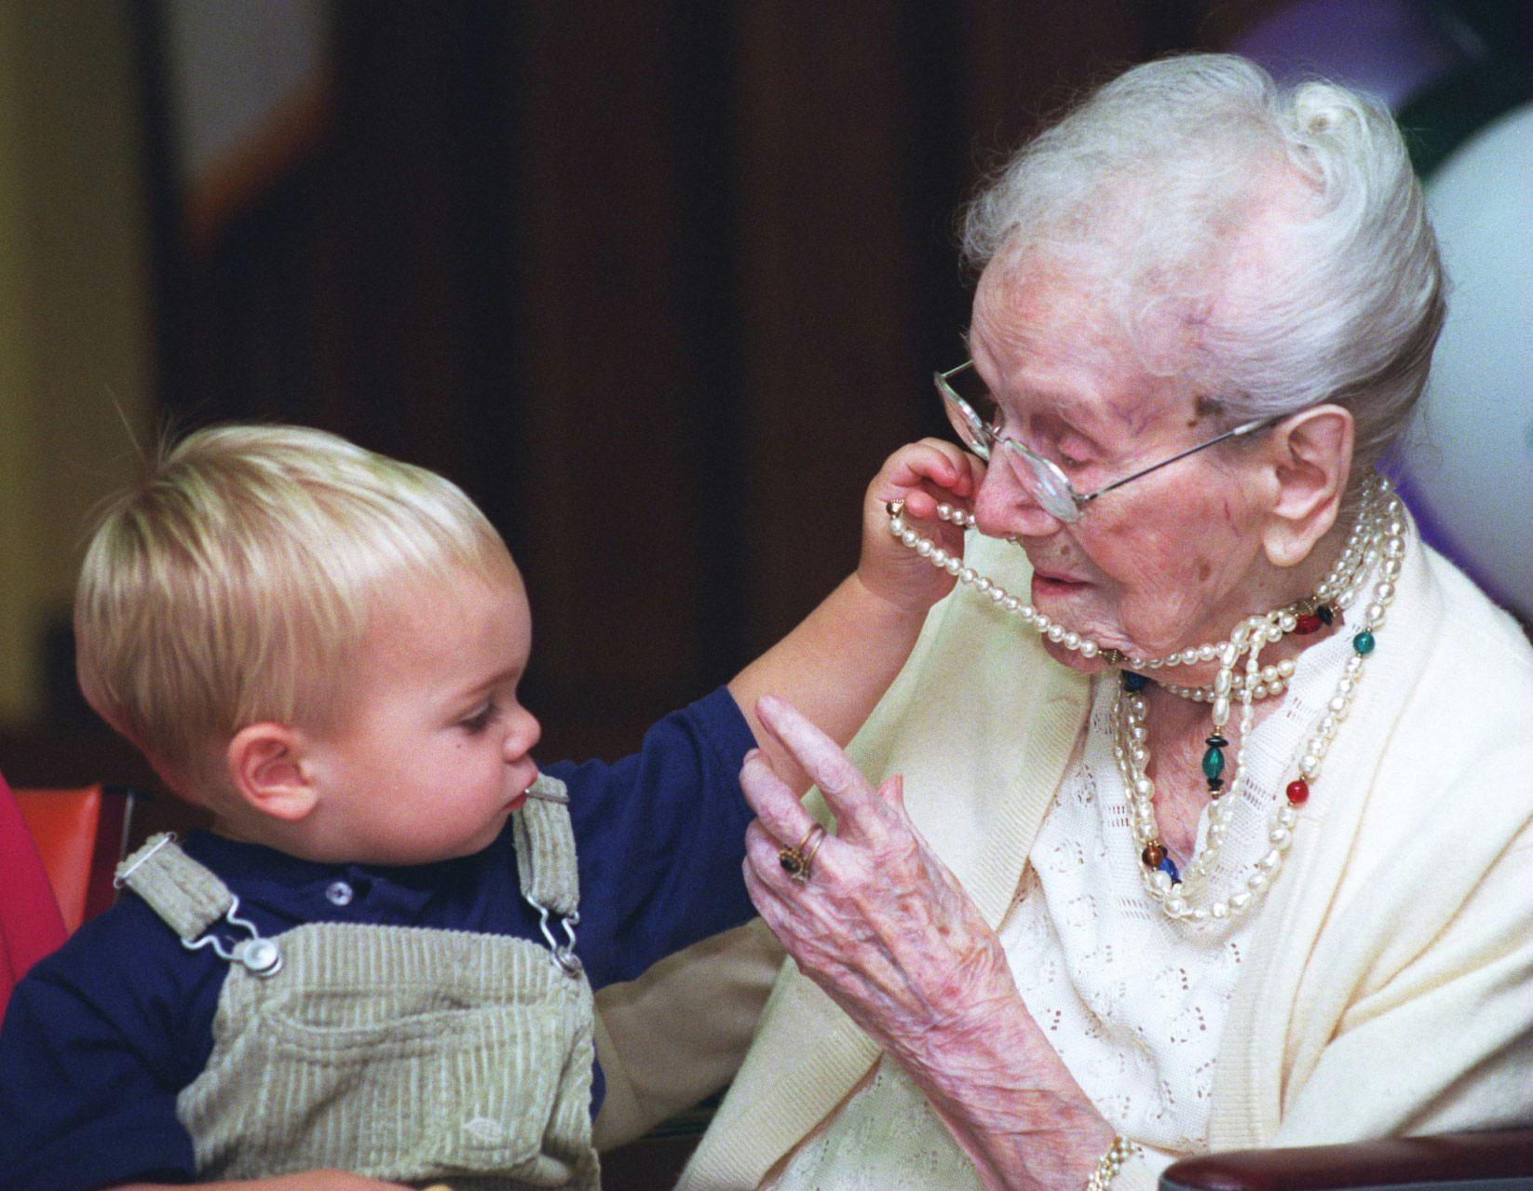
Social Security Recipient Sarah Knauss
Notes:
The Social Security system is going to face challenges in the foreseeable future as the average lifespan lengthens and the typical retiree draws Social Security benefits for longer than ever before. This photo shows the oldest person ever in the history of the United States—Sarah Knauss— celebrating her 117th birthday with her great-great-great grandson. By the time Sarah Knauss passed away at the age of 119 she had been collecting Social Security benefits for an amazing 54 years.

Slide 39
Reforming Social Security
Politically difficult
Older Americans have high voting rate
Reform proposals
Bush: Put one-third into private investments
Obama
Increase age to receive benefits
Lower inflation raises
Reduce benefits for wealthy recipients
Raise contribution amounts
Notes:
Social Security is difficult for the president and Congress to reform because older Americans vote at higher rates than any other group. But presidents have proposed some ideas for reform. Bush suggested diverting a third of Social Security funds into private investments. But the possibility that people could lose money in the stock market did not appeal to the electorate, especially during a period when stocks were slumping. Also, removing money from Social Security would hasten its bankruptcy rather than save it. In fact, many Democrats believed that was the ultimate goal of the plan to privatize Social Security.
Obama has proposed a combination of reforms to keep the program fiscally solvent, including increasing the age to receive benefits, lowering the cost of living increase, reducing benefits for people who have other sources of income, and raising contribution amounts.

Slide 40
Learning Objective 16.6
Distinguish American social welfare policy from that in other established democracies.

Slide 41
Social Welfare Policy Elsewhere
The European welfare state
Taxes and benefits
Individual vs. government responsibility
Notes:
Other developed countries are more generous with social welfare programs than the United States. Americans are often shocked when they find out the types of policies that are the norm in other countries, such as free day care, paid parental leave, free college tuition, and universal health care. But they are even more shocked by the taxes that support these welfare states. Europeans pay for their benefits with tax rates that can exceed 50% of income.
Americans and Europeans have a fundamentally different perspective on poverty and social welfare. Americans see them as an individual responsibility, and tend to distrust government. 71% of Americans believe that poverty is the fault of the poor person and within their control. Europeans, on the other hand, believe that government has the primary responsibility for the welfare of its citizens. They trust their governments more than Americans do. Only 40% of Europeans believe that a poor person could lift him or herself out of poverty if they worked hard enough.

Slide 42
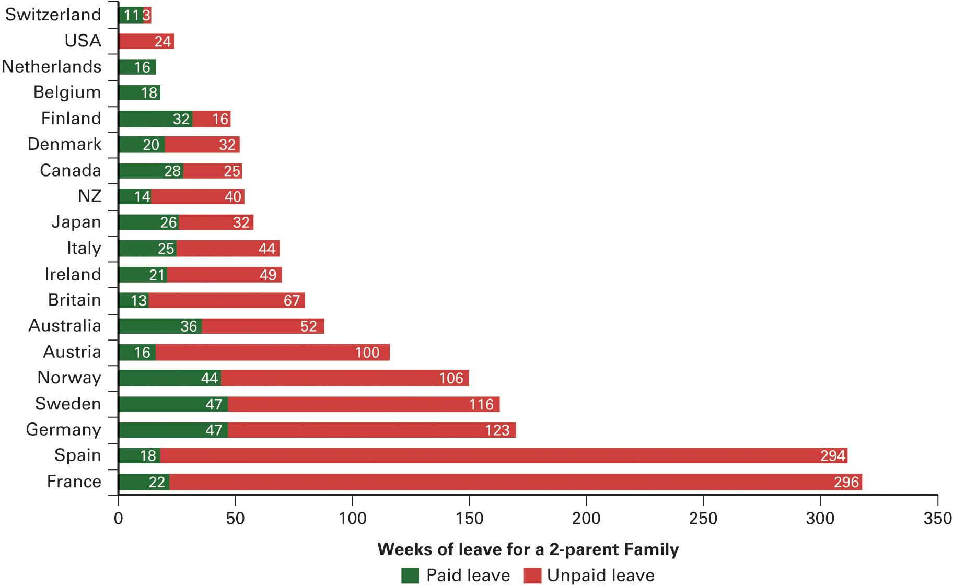
Figure 16.5 Parental Leave Policy: A Comparison
Source: Rebecca Ray et al., “Parental Leave Policies: Assessing Generosity and Gender Equality,” Report of the Center for Economic and Policy Research, June, 2009, p. 6. Updated by the authors.
Notes:
All established democracies, except for the United States, provide for at least 10 weeks of paid leave for a two-parent family to care for a new child and most allow unpaid leave that greatly exceeds what American law provides for.

Slide 43
Learning Objective 16.7
Assess the impact of economic and social welfare policies on democracy and the scope of government in America.

Slide 44
Understanding Economic and Social Welfare Policymaking
Democracy and Economic and Social Welfare Policies
Economic and Social Welfare Policies and the Scope of Government
Notes:
No issue divides liberals and conservatives more sharply than social welfare policy. The view that the playing field is level and that anyone can succeed with individual initiative and hard work and that social welfare policies encourage and reward laziness is diametrically opposed to the view that systematic inequalities prevent some people from having an equal chance at success and necessitate a helping hand in a civilized society.
Even if liberals and conservatives both believed that the playing field was level for the able-bodied, there would remain disagreement over how much, if any, assistance to provide to people unable to compete due to age or disability.

Slide 45
Democracy and Economic and Social Welfare Policies
Problems of free enterprise addressed via democracy
Government regulation demanded
Limits to economic freedom
Groups unequal in political resources
Policy inertia
Notes:
No issue divides liberals and conservatives more sharply than social welfare policy. The view that the playing field is level and that anyone can succeed with individual initiative and hard work and that social welfare policies encourage and reward laziness is diametrically opposed to the view that systematic inequalities prevent some people from having an equal chance at success and necessitate a helping hand in a civilized society.
Even if liberals and conservatives both believed that the playing field was level for the able-bodied, there would remain disagreement over how much, if any, assistance to provide to people unable to compete due to age or disability.

Slide 46
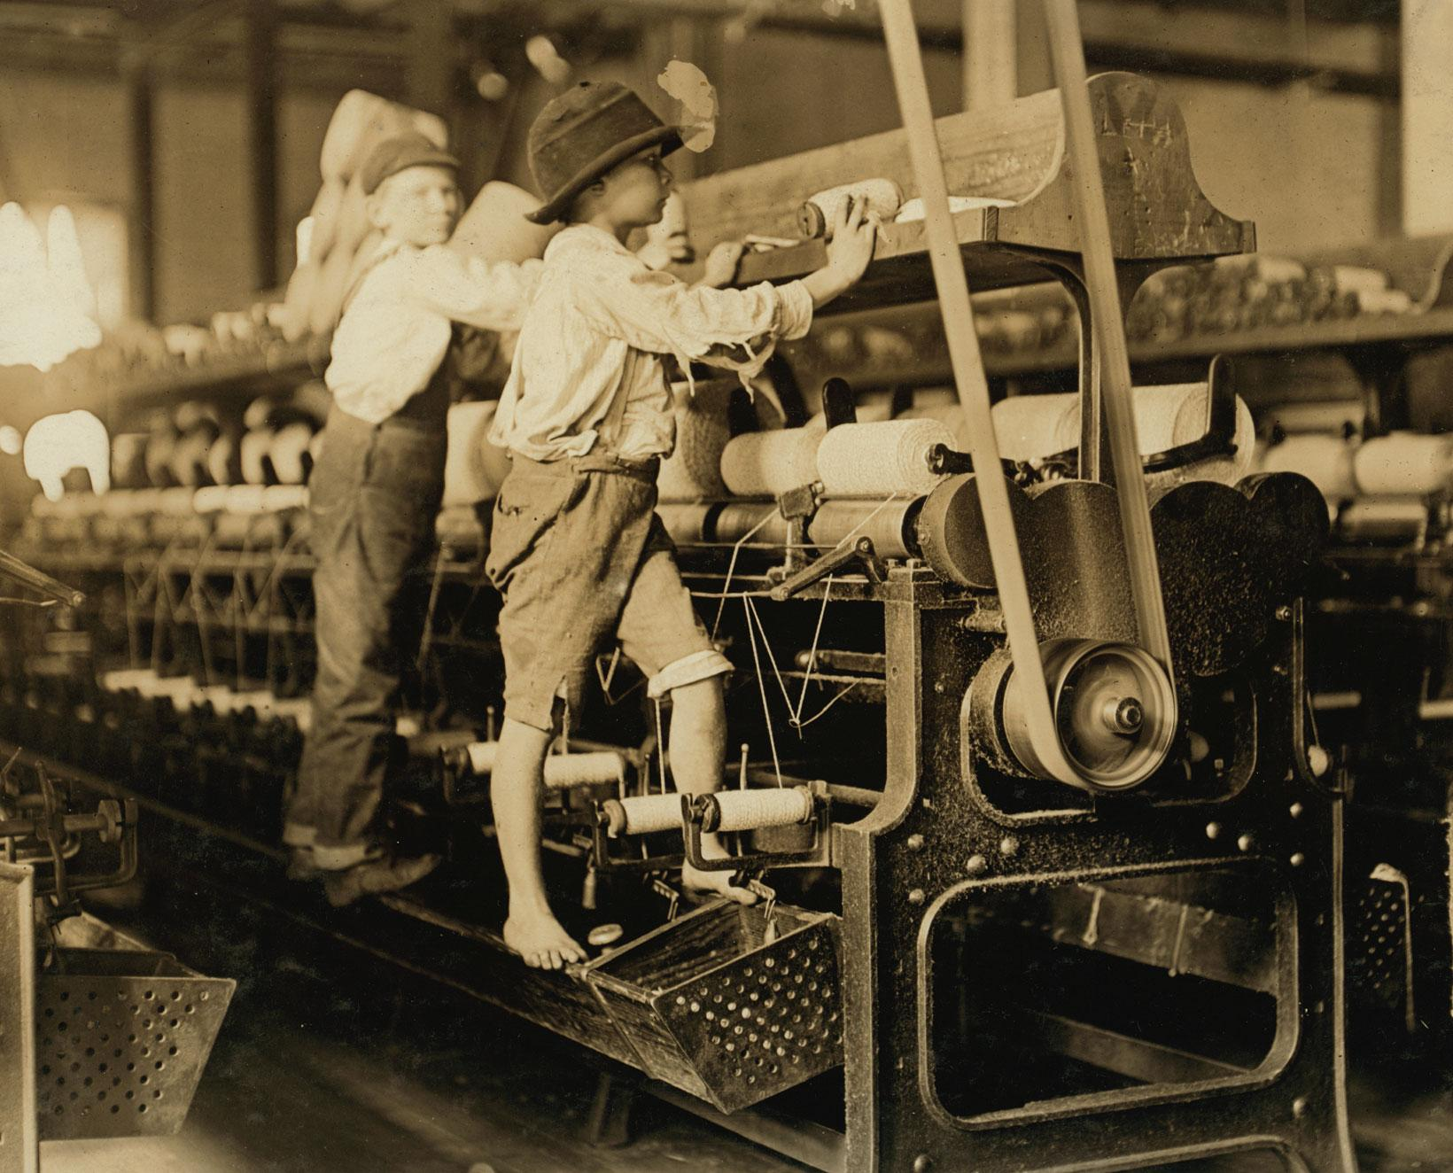
Child Labor
Notes:
As American workers have gained more political power, they have demanded government action to improve working conditions and regulate business practices. No longer can children be found working in factories, as did these boys in Macon, Georgia in 1909.

Slide 47
Economic and Social Welfare Policies and the Scope of Government
Liberals and conservatives disagree
Liberals advocate more government intervention
Conservatives want less
Welfare state too big or too small?
Depends which side you are on
Notes:
The scope of government involvement in the economy is hotly debated by liberals and conservatives. Liberals see government intervention as a way to fix imperfections in the market whereas conservatives see imperfections in government as standing in the way of markets.
In the realm of social welfare policy, conservatives see the poor as underserving of government assistance and liberals see them as deserving. Whether you think the welfare system is too big or too small depends upon your perspective on the causes of poverty.

Slide 48
Shared Writing 16
What are some of the key differences between Keynesian economic policy and supply-side economics? Examine some stories in the news recently about economic policy and write about how these opposing theories are guiding competing Democratic and Republican fiscal plans in Congress.

Slide 49
Photo Credits
Chapter 16
484: Jin Lee/Bloomberg/Getty Images; 486: akg images/ Newscom; 487: © Andrew Singer, www.andysinger.com; 489: Chip Somodevilla/Getty Images News; 491: Stephen Ewen via http://owsposters.tumblr.com; 495: Rich Pedroncelli/AP Images; 497: Carmel Zucker/The New York Times/ Redux; 500: Chuck Zovko/AP Images; 504: Library of Congress Prints and Photographs Division [LC-DIG-nclc-01581]

