Slide 1
Government in America: People, Politics and Policy
Seventeenth Edition
Chapter 14
The Federal Bureaucracy

Slide 2
Learning Objectives
14.1 Describe the federal bureaucrats and the ways in which they obtain their jobs.
14.2 Differentiate the four types of agencies into which the federal bureaucracy is organized.
14.3 Identify the factors that influence the effectiveness of bureaucratic implementation of public policy
14.4 Describe how bureaucracies regulate and assess deregulation and alternative approaches to regulation.
14.5 Identify the means of controlling the bureaucracy and assess the role of iron triangles.
14.6 Assess the role of unelected bureaucrats in American democracy and the impact of bureaucracy on the scope of government.

Slide 3
Learning Objective 14.1
Describe the federal bureaucrats and the ways in which they obtain their jobs.

Slide 4
The Bureaucrats
Some Bureaucratic Myths and Realities
Civil Servants
Political Appointees
Notes:
Myths abound about the federal bureaucracy. They are an easy target for both elected officials and the public.
The civil servants who work for the federal bureaucracy are typically more representative of Americans than the politicians who represent citizens in the legislature.
There are about 500 top policy positions and 2500 lower-level positions that are considered to be political appointees that are subject to Senate confirmation.

Slide 5
Some Bureaucratic Myths and Realities
Bureaucratic scapegoating is popular
Myths about bureaucracy
Americans dislike bureaucrats
Bureaucracies are growing bigger each year
Most federal bureaucrats work in D.C.
Bureaucracies are mired in red tape
Most bureaucrats work for a few agencies
DoD employees 34 percent of bureaucrats
Notes:
"Red tape" is the phrase that leaps to mind when most people think of bureaucracies. But remember that bureaucracy is simply the standard way of organizing a large organization. General Motors and the Catholic Church are just as much bureaucracies as the IRS. There may be inefficiencies associated with this method of organization, but no one has yet come up with a better alternative.

Slide 6
Table 14.1 Federal Civilian Employment (1 of 3)
Federal Bureaucracy | Number of Employees
Executive Departments
Defense (military functions) | 732,900
Veterans Affairs | 366,500
Homeland Security | 188,100
Justice | 119,800
Treasury | 103,000
Agriculture | 90,500
Health and Human Services | 74,400
Interior | 66,700
Transportation | 56,200
Commerce | 45,600
Notes:
Which agency has the most civilian employees? Which is the smallest? Do any of the numbers surprise you? Why or why not?

Slide 7
Table 14.1 Federal Civilian Employment (2 of 3)
Federal Bureaucracy | Number of Employees
Executive Departments
State | 34,500
Labor | 17,1700
Energy | 16,100
Housing and Urban Development | 8,400
Education | 4,500
Larger Noncabinet Agencies
U.S. Postal Service | 562,024
Social Security Administration | 67,000
Corps of Engineers | 22,200
National Aeronautics and Space Administration | 17,400
Notes:
Which agency has the most civilian employees? Which is the smallest? Do any of the numbers surprise you? Why or why not?

Slide 8
Table 14.1 Federal Civilian Employment (3 of 3)
Larger Noncabinet Agencies
Environmental Protection Agency | 15,600
Tennessee Valley Authority | 11,500
General Services Administration | 11,900
Source: Budget of the United States Government, Fiscal Year 2017: Analytical Perspectives (Washington, DC: US Government Printing Office, 2016) ,Tables 8.2 and 8.3.
Notes:
Which agency has the most civilian employees? Which is the smallest? Do any of the numbers surprise you? Why or why not?

Slide 9
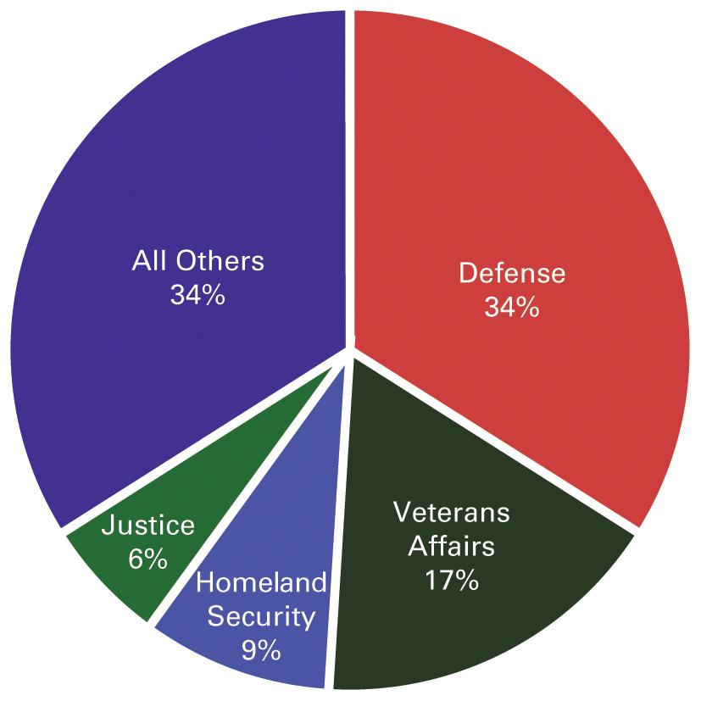
Figure 14.1 Departmental Service of Federal Nonpostal Civilian Employees
Source: Budget of the United States Government, Fiscal Year 2017: Analytical Perspectives (Washington, DC: US Government Printing Office, 2016), Tables 8.2 and 8.3.
Notes:
As can be seen in the pie chart below, just a very few agencies employ the bulk of civilians in the federal workforce.

Slide 10
Figure 14.2 Characteristics of Federal Nonpostal Civilian Employees
Source: United States Office of Personnel Management, Common Characteristics of the Government, Fiscal Year 2015 (Washington, DC: 2016).
Notes:
The statistical profile of civilian workers employed by the federal government, excluding postal service workers, is broadly representative of the American people along four key dimensions: age, education, gender, and race and ethnicity.

Slide 11
Civil Servants
Development of civil service system
Patronage v. merit
Pendleton Act (1883)
Hatch Act (1939)
Notes:
Another impetus was that, as the industrial revolution and urbanization increased demands on the bureaucracy, frankly incompetent patronage employees were becoming a practical problem.
In 1883, the passage of the Pendleton Act created the federal civil service. The civil service is nonpartisan, and uses the merit principle, including entrance exams, to hire and promote people with talent and skill rather than political connections. Government workers cannot be fired when a new party comes into power.
The Hatch Act of 1939 prohibits civil servants from engaging in political activities.

Slide 12
Political Appointees
Plum Book
500 top policymaking posts
2,500 lesser posts
Ambassadorships go to contributors
Demographic balance
Transient employees
Last less than two years
Dependent upon senior civil servants
Less power than anticipated
Take one for the team
Notes:
Each newly elected president has the task of filling thousands of executive appointments. The top jobs are listed in the so-called Plum Book, published by Congress. Presidents launch a nationwide search for talented and accomplished individuals to fill these posts.
Most modern presidents try for some geographical and demographic balance in their appointees. And patronage jobs have not disappeared. Although the civil service is insulated, there are still plenty of jobs that presidents can offer to top campaign contributors, such as ambassadorships.
Unlike civil servants, who are nearly impossible to fire and rarely leave a federal job, political appointments are often short-lived. Most last less than two years. Some dislike the visibility and public scrutiny that come with their jobs. Others find that they are unable to influence civil servants, who have been there longer and know more than they do, and will outlast them.
Also, political appointees are chosen for their loyalty, not their competence, and can be asked to step down if they embarrass the administration too much with their incompetence, as happened to Michael Brown, the patronage head of FEMA during Hurricane Katrina. Although Brown's incompetence is now legendary, sometimes political appointees are asked to take the fall for the president in a scandal.

Slide 13
Learning Objective 14.2
Differentiate the four types of agencies into which the federal bureaucracy is organized.

Slide 14
How the Federal Bureaucracy Is Organized
Cabinet Departments
Independent Regulatory Commissions
Government Corporations
The Independent Executive Agencies
Notes:
There are an overwhelming number of federal agencies, but they can be grouped into four basic types, which we will discuss in this section.

Slide 15
Cabinet Departments
Organization
15 cabinet departments
Each headed by secretary
Undersecretaries, deputy undersecretaries, assistant secretaries, etc.
Own policy area, own budget, own staff
Bureaus within departments
Notes:
There are 15 cabinet departments, each with is own mission, policy area, budget, and staff. Each department is headed by a secretary, who is nominated by the president and confirmed by the Senate.
Each department has a hierarchical organization under the secretary, with various undersecretaries, deputy undersecretaries, assistant secretaries, and other leadership staff who run individual bureaus within the department.

Slide 16
Independent Regulatory Commissions
Alphabet soup: FRB, NLRB, FCC, FTC, SEC, etc.
Make and enforce rules
Judge disputes over rules
Governed by 5–10 commissioners with fixed terms
Somewhat insulated from politics
Regulatory capture
Notes:
Independent regulatory commissions are responsible for making and enforcing rules in the public interest. They also arbitrate disputes over these rules.
IRCs are known as the alphabet soup of government agencies because they are usually known by their acronyms, such as the FCC for the Federal Communications Commission, which licenses and regulates TV and radio programming.
Each IRC is governed by 5 to 10 commissioners who are appointed by the president and confirmed by the Senate. These commissioners serve fixed terms and are not easily fired by the president, which serves to insulate them from politics and ensure that they act in the public interest.

Slide 17
Government Corporations
Different from other government agencies
Provide services that could be handled by private sector
Charge consumers for these services, albeit at cheaper rates
Tennessee Valley Authority (TVA)
U.S. Postal Service
Amtrak
Notes:
Government corporations are not quite like private corporations, in which you can buy stock and collect dividends, but they are not like other government departments either. They provide services that the private sector could provide, but they do it at a lower charge to consumers.
The TVA is an example of a government corporation. It was established in 1933 as part of the New Deal to provide electricity to rural regions. The private sector had not found it profitable to extend this service to poor, rural areas.
The U.S. Postal Service is another example of a government corporation. It has difficulty competing with private companies, such as FedEx and UPS. But the private sector has not found it profitable to provide postal service to poorer, rural areas, and such services would become prohibitively expensive if the USPS were closed.
Amtrak began as a private sector enterprise but was taken over by government when it about to go bankrupt and close.

Slide 18
The Independent Executive Agencies
Everything else
45 to 50 agencies
Administrators appointed by president
GSA, NSF, NASA
Notes:
Agencies that are not cabinet departments, regulatory commissions, or government corporations are called independent executive agencies.
There are approximately 45 to 50 such agencies currently. They are headed by administrators who are appointed by the president. These political appointees are expected to step up or slack off on enforcement of policies according to the priorities of the administration.

Slide 19
Fishermen on Lake Eerie
Notes:
We depend on bureaucrats, such as those in the Environmental Protection Agency, to clean up our environment. They have had many successes, such as restoring Lake Erie to a state in which fish, and these fishermen, can thrive.

Slide 20
Learning Objective 14.3
Identify the factors that influence the effectiveness of bureaucratic implementation of public policy.

Slide 21
Bureaucrats as Implementors
What Implementation Means
Why the Best-Laid Plans Sometimes Flunk the Implementation Test
A Case Study of Successful Implementation: The Voting Rights Act of 1965
Privatization
Notes:
The president is charged by the Constitution to see that the laws are faithfully executed. There are a lot of laws, and he is only one person, so he relies on the vast bureaucracy to implement the policies.
Bureaucracies handle the routines of government, such as collecting taxes and delivering mail, and they devise rules and procedures for implementing policy goals. Because laws are vague, bureaucracies must interpret them when they develop specific guidelines for implementation. This makes bureaucrats policymakers, even though they are not elected. This is unavoidable, but it does raise questions about democracy.

Slide 22
What Implementation Means
Policies are not self-executing
Laws are usually vague
Bureaucracies work out the details
Implementation is critical
Create new agency or assign new responsibility to existing agency
Translate policy goals into rules and guidelines
Coordinate resources
Notes:
When Congress passes a law, it doesn't implement itself. It takes a lot of work, by a lot of people, and usually a lot of money, for a new policy to have noticeable results for individuals. The policies passed by Congress are usually broad and vague, and it is up to bureaucracies to work out the details.
The first step in policy implementation is to create a new agency or assign the new responsibility to an existing agency. This agency must then translate the policy's goals into rules and guidelines, and then coordinate resources to implement those rules and guidelines to achieve the policy's goals.

Slide 23
Why the Best-Laid Plans Sometimes Flunk the Implementation Test (1 of 2)
High expectations lead to dashed hopes
Program design
Lack of clarity
Lack of resources
Lack of funding (Head Start)
Lack of personnel
Notes:
With many public policies, dashed hopes follow high expectations. Why do some policies fail at the implementation stage? We often think the biggest battle is getting a law passed by both houses of Congress and signed by the president. Why is implementation such a major hurdle?
One reason implementation can break down is faulty program design.
Lack of clarity can also stymie implementation. Congress passes vague laws in part because it does not have time to be more specific, and in part for obvious political reasons. Some laws have contradictory objectives. For example, the Forest Service is supposed to protect the national forests and bring in revenue from timber sales.
Many policy failures occur because of a lack of staff, equipment, or funding. About half of children eligible for Head Start are not able to participate for lack of funding. Due to lack of personnel, it takes a year for the SSA to process a disability claim. ICE does not have the staff to find and deport even a small fraction of the millions of illegal aliens in the country. There is never enough money to implement every law, so Congress provides each agency with only part of what it needs to do its job properly. And regulated industries lobby hard against regulators being provided with the funding to inspect them.

Slide 24
Title IX
Notes:
Bureaucracies are often asked to implement unclear laws. When Congress prohibited gender discrimination in college athletics, for example, it left it to bureaucrats to create guidelines that would end discrimination while addressing the unique needs of different sports. It took years—and and several lawsuits—to establish the law’s meaning.

Slide 25
Why the Best-Laid Plans Sometimes Flunk the Implementation Test (2 of 2)
Lack of authority
Administrative routine (SOPs)
Administrators’ dispositions
Fragmentation
Notes:
Industry pressure has also been largely responsible for agencies lacking the authority to do their jobs. The FDA, for example, relies on test results submitted by manufacturers but lacks the power to subpoena company documents if it suspects test results are falsified.
Bureaucracies follow standard operating procedures, or SOPs. These rules ensure the same service is provided to everyone, and they make personnel interchangeable. But they also create inflexibility that can lead to inefficiencies (the infamous red tape) and they must be updated regularly to account for new circumstances, such as the threat of terrorism.
Bureaucrats operate not only within the confines of routines, but often with considerable discretion to behave independently. This allows for a great deal of discretion for bureaucrats in terms of policy implementation.
Fragmentation occurs because policy is often spread across bureaucratic agencies.

Slide 26
Journal Prompt 14.3: Why the Best-Laid Plans Sometimes Flunk the Implementation Test
Should bureaucrats have administrative discretion? Is there any way to limit discretion for those who exercise it?

Slide 27
Illegal Aliens and Border Patrol
Notes:
Bureaucrats typically apply thousands of pages of rules in the performance of routine tasks, but many bureaucrats—especially street-level bureaucrats—must use administrative discretion as well. These border patrol officers, shown arresting undocumented immigrants on the U.S.–Mexican border, must decide who they will search carefully and whom they will let passed with a quick check.

Slide 28
A Case Study of Successful Implementation: The Voting Rights Act of 1965
Clear goals
Register African American voters
Adequate means to achieve them
Federal registrars sent to counties
Protected by U.S. marshals
Federal penalties for obstruction
Notes:
The Voting Rights Act of 1965 provides a case study in successful implementation. The law had a clear goal: register African American voters in southern states. This goal was vigorously pursued by the Justice Department, which dispatched hundreds of federal registrars, protected by U.S. marshals, to register African American voters in southern states. Obstruction by local officials was punished with stiff federal penalties, despite the outrage of southern legislative and executive branch officials.

Slide 29
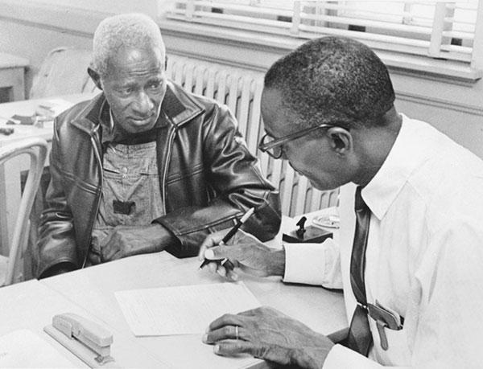
Voter Registration
Notes:
Implementation of the 1965 Voting Rights Act was successful because its goal was clear: to register African Americans to vote in counties that had denied them their voting rights for years. In addition, implementors, such as this federal registrar, had the authority to do their jobs.

Slide 30
Privatization
Reinventing government
Decentralize authority
Room for innovation
Performance incentives
Make government look more like private sector
Contractors
Private sector competition
Theoretical cost savings
Creates appearance of reducing size of government
Less public scrutiny
Notes:
The trend for reinventing government began in the 1980s with the goal of making the public sector look more like the private by decentralizing authority, providing room for innovation, and providing performance incentives for government bureaucrats.
This trend including transferring more work previously done by public employees to the private sector. The government could claim to be trimming the bureaucracy when it was actually increasing the number of people working for the government, a neat political trick. But the idea of using contractors is that it saves money because they must compete with one another to offer better service at lower cost.
The reality is quite different, as most contracts are no-bid, awarded to cronies, and the inner workings of private companies are shielded from public scrutiny, which reduces accountability. Corruption is rampant, as are cost overruns.

Slide 31
Learning Objective 14.4
Describe how bureaucracies regulate, and assess deregulation and alternative approaches to regulation.

Slide 32
Bureaucracies as Regulators
Regulation in the Economy and in Everyday Life
Two Types of Regulatory Activity
Deregulation
Notes:
Regulation is probably the most controversial task of bureaucracies. Regulations are necessary, but they are rarely popular with the regulated industries or individuals. The number of federal regulations in existence today is truly staggering, and they pervade every aspect of our lives.

Slide 33
Regulation in the Economy and in Everyday Life
Free enterprise is highly regulated
Many agencies regulate each company
History of regulation
Virtually none
State and local
Federal after 1887
Interstate Commerce Commission
Guidelines developed with industry
Enforcement varies
Notes:
Our so-called free enterprise economic system is highly regulated. Each aspect of a firm's operations comes under the purview of a different regulatory agency. This was not always the case. Government produced almost no regulation and what little existed came from state and local governments until 1887, when the first regulatory agency, the Interstate Commerce Commission, was created to regulate railroad services and pricing at the behest of farmers incensed by price gouging.
Today, hundreds of agencies promulgate regulations for every aspect of business. Most of these guidelines are developed with the assistance of regulated industries. Enforcement depends upon agency and bureaucrat discretion.
All regulations contain a grant of power from Congress, a set of rules and guidelines, and a means of enforcing compliance.

Slide 34
Two Types of Regulatory Activity
Command-and-control policy
Incentive system
Notes:
Command-and-control policy is the typical system of regulation whereby government tells business how to reach certain goals, checks that these commands are followed, and punishes offenders. By contrast, an incentive system is an alternative to command-and-control, with market-like strategies such as rewards used to manage public policy.

Slide 35
Deregulation
Perceived problems with regulation:
Raising prices
Hurting America's competitive position abroad
Failing to work well
Hazards of deregulation
Notes:
Regulation has its critics, who argue that regulations are expensive, burdensome, complicated, and distort market forces. They complain that the cost of regulatory compliance is passed onto the consumer in the form of higher prices. This is true but the alternative is unsafe products.
They also argue that regulations hurt America's competitive position abroad because American products cost more than products produced in countries with weaker regulations. This is true; however, other countries have been increasing their regulations so this problem is disappearing. Consumers are also becoming more aware that lower prices are often the result of poor pay and unsafe working conditions for workers, shoddy workmanship, and weak environmental and product safety standards.
Critics of regulation also recite tales of failed regulatory policies but this is an argument for better policies and sufficient resources for effective implementation rather than for an absence of regulation altogether.
Deregulation and lax enforcement of regulations have resulted in environmental pollution, the collapse of the finance and housing industries, mine disasters, and countless other avoidable catastrophes.

Slide 36
Journal Prompt 14.4: Deregulation
Regulation is often controversial, especially among those being regulated. Should we deregulate more—or should regulation be even stronger?

Slide 37
Learning Objective 14.5
Identify the means of controlling the bureaucracy and assess the role of iron triangles.

Slide 38
Controlling the Bureaucracy
Presidents Try to Control the Bureaucracy
Congress Tries to Control the Bureaucracy
Iron Triangles and Issue Networks
Notes:
We have noted that the bureaucracy has a very important and responsible job, and we have learned both that the bureaucracy is unelected and that it has a tremendous amount of discretion in implementing laws. The power that the bureaucracy has makes it necessary for it to be controlled. But how to do that? It isn't easy, as we will see in this section.

Slide 39
Presidents Try to Control the Bureaucracy
Appoint agency heads
Issue orders
Executive orders carry force of law
Alter agency budgets
Reorganize agencies
Notes:
Presidents have a range of tactics at their disposal to try and control the sprawling federal bureaucracy under their control.

Slide 40
Congress Tries to Control the Bureaucracy
Paradoxical relationship
Provide services to constituents
Problem-solve
Methods of congressional control
Influence the appointment of agency heads
Alter agency budgets
Hold oversight hearings
Rewrite the legislation or make it more detailed
Notes:
Congress relies on the bureaucracy to provide services to constituents. If a vital service agency is underfunded or understaffed, complaints from disgruntled constituents appear in the congressional member’s office and may result in electoral defeat. Yet Congress is also under pressure to cut taxes and spending, and ease regulations for industry.
Congress also relies on bureaucracies to solve policy problems in controversial areas so it can pass the buck.
Some specific tactics that Congress uses to control the bureaucracy include influencing the appointment of agency heads; altering an agency's budget, its biggest weapon; holding oversight hearings, one of its constitutional responsibilities; and rewriting legislation or making it more detailed to limit agency discretion.

Slide 41
Iron Triangles and Issue Networks
Iron triangle or subgovernments
Amorphous system of issue networks
The death of an iron triangle
Nuclear power
Notes:
An iron triangle is the name given to the cozy relationship that can develop between a regulated industry's interest groups, the regulating agency, and the committees and subcommittees in Congress that make policy in this area. For example, the congressional subcommittee on aging, the Social Security Administration, and senior citizens' interest groups are all likely to be in favor of increasing Social Security benefits.
Recently the systems of governments have become overlaid with an amorphous system of issue networks. This has led to more widespread participation in bureaucratic policymaking. This opening of the policymaking process complicates the calculations and decreases the predictability of those involved in the stable and relatively narrow relationships of subgovernments.
Although iron triangles have dominated policymaking for decades, they are slowly breaking up as competing interests seek to influence policy. One example of a dissolving iron triangle is in the area of nuclear power. At its height of power in the 1960s, the United States was building nuclear power plants and exporting nuclear technology. But a wave of environmental concern that swept the nation in the late 1960s resulted in Congress disbanding several agencies that formed one leg of the iron triangle. The onslaught of nuclear power was stopped; no new nuclear power plants have been built since 1978, and ones in construction at the time were abandoned at huge financial loss.

Slide 42
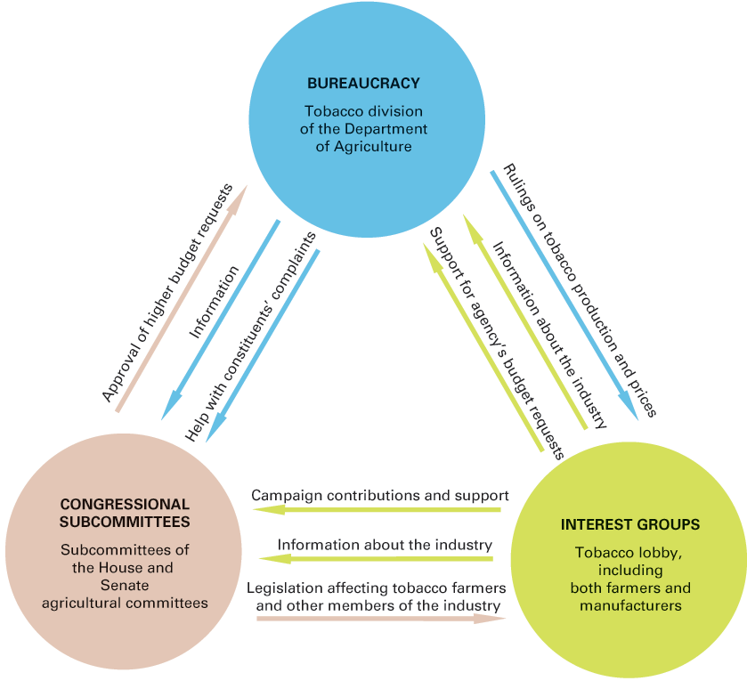
Figure 14.4 Iron Triangles: One Example
Notes:
Iron triangles—composed of bureaucratic agencies, interest groups, and congressional committees or subcommittees—have dominated some areas of domestic policymaking by combining internal consensus with a virtual monopoly on information in their area. The tobacco triangle is one example; there are dozens more. Iron triangles are characterized by mutual dependency in which each element provides key services, information, or policy for the others. The arrows indicate some of these mutually helpful relationships. In recent years, a number of well-established iron triangles, including the tobacco triangle, have been broken up.

Slide 43
Learning Objective 14.6
Assess the role of unelected bureaucrats in American democracy and the impact of the bureaucracy on the scope of government.

Slide 44
Understanding Bureaucracies
Bureaucracy and Democracy
Bureaucracy and the Scope of Government
Notes:
Bureaucracies make policy. You must understand that fact. It is a mistake to think that the federal bureaucracy is merely carrying out the wishes of Congress, the president, and the courts.

Slide 45
Bureaucracy and Democracy
Unelected policymaking institutions
Bureaucracy
Courts
Impossible to elect millions of bureaucrats
Representative of citizens
Responsive to public interest
Notes:
Bureaucracies are one of two unelected policymaking institutions, the other being the courts. It would theoretically be possible to elect all judges but it would be impossible to elect millions of bureaucrats. But we have seen that the employees of the federal bureaucracy are actually fairly representative of the population, much more so than elected officials. It is possible for bureaucrats to act in the public interest even if they are not elected.

Slide 46
Bureaucracy and the Scope of Government
Government out of control?
Bureaucracy is acquisitive
Shrunk over past 40 years
Too small?
Job is to deal with social and economic problems
Bureaucracy cannot stop deregulation
Notes:
Is the huge federal bureaucracy a sign that the government is growing out of control? The bureaucratic agencies are acquisitive—they naturally seeks to expand their size, budget, and authority. But they have not succeeded: The federal bureaucracy has shrunk over the past 40 years.

Slide 47
Shared Writing 14
Is the bureaucracy too big (in personnel and other resources)—or is it too small—to do the job we ask of it?

Slide 48
Photo Credits
Chapter 14
419: Ty Wright/Bloomberg/Getty Images; 421: John Green/Cal Sport Media/Alamy Stock Photo; 424: Jim West/Alamy Stock Photo; 425: Frank Cotham/The Cartoon Bank; 428: Bettmann/Getty Images

