Slide 1
Government in America: People, Politics and Policy
Seventeenth Edition
Chapter 12
The Presidency

Slide 2
Learning Objectives (1 of 2)
12.1 Characterize the expectations for and the backgrounds of presidents and identify paths to the White House and how presidents may be removed.
12.2 Evaluate the president’s constitutional powers and the expansion of presidential power.
12.3 Describe the roles of the vice president, cabinet, Executive Office of the President, White House Staff, and First Lady.
12.4 Assess the impact of various sources of presidential influence on the president’s ability to win Congressional support.

Slide 3
Learning Objectives (2 of 2)
12.5 Analyze the president’s powers in making national security policy and the relationship between the president and Congress in this arena.
12.6 Identify the factors that affect the president’s ability to obtain public support.
12.7 Characterize the president’s relations with the press and news coverage of the presidency.
12.8 Assess the role of presidential power in the American democracy and the president’s impact on the scope of government.

Slide 4
Learning Objective 12.1
Characterize the expectations for and the backgrounds of presidents and identify paths to the White House and how presidents may be removed.

Slide 5
The Presidents
Great Expectations
Who They Are
How They Got There
Notes:
Americans have high expectations for their presidents, who have come from a relatively narrow range of backgrounds. Most presidents are elected directly to that office, but about one in five succeeded to the presidency when the president died or resigned.
No president has been removed for disability, as provided by the Twenty-fifth Amendment, which also provides the means for filling vacancies in the office of vice president. Nor has a president been removed by impeachment, although two presidents were impeached unsuccessfully.

Slide 6
Great Expectations
Are expectations realistic?
Ensure peace, prosperity, and security
Power does not match responsibilities
Cognitive dissonance
Americans want strong leader but fear concentration of power
We want government to be small and limited, yet solve all societal and economic problems
Notes:
Modern presidents face a daunting array of expectations from the American public. We expect our presidents to ensure economic growth and prosperity, and we also expect protection from internal and internal security threats.
As we will see in this chapter, presidential responsibilities have increased dramatically in the twentieth century but presidential power has not necessarily kept pace. Although we expect much from our presidents, Americans dislike a concentration of power. As a society, we tend to be anti-government and at the same time look to government to solve economic and social problems.

Slide 7
Who Are They
Basic requirements
Natural-born citizen
35 years of age or older
Resident of United States for previous 14 years
White, male, Protestant
First female president?
Notes:
The Constitutional requirements to serve as president are pretty basic: You must be a natural-born, as opposed to naturalized, citizen, you must be at least 35, and you must have resided in the United States for at least 14 years.
Until John Kennedy, all presidents had been Protestant. Until Barack Obama, all presidents were white. No woman has yet served as president or vice president. Why do you think that is? Do you think a woman will serve in either of these offices within your lifetime?

Slide 8
Table 12.1 Recent Presidents (1 of 5)
President | Term | Party | Background | Presidency
John F. Kennedy | 1961–1963 | Democrat | U.S. senator from Massachusetts From a very wealthy family War Hero | Known for personal style Presided over Cuban missile crisis Ushered in era of liberal domestic policies Assassinated in 1963
Lyndon B. Johnson | 1963–1969 | Democrat | Senate majority leader Chosen as Kennedy’s running mate; succeeded him after the assassination | Skilled legislative leader with a coarse public image Launched the Great Society Won passage of major civil rights laws Escalated the Vietnam War War policies proved unpopular; did not seek reelection
Notes:
This table features presidents of the last 60 years, giving the dates of their term or terms of office, their party affiliation, background, and major accomplishments and traits. How many recent presidents have served one term or less? How many have served as governor of a state? How many have served in the legislature?

Slide 9
Table 12.1 Recent Presidents (2 of 5)
President | Term | Party | Background | Presidency
Richard M. Nixon | 1969–1974 | Republican | U.S. senator from California Served two terms as Eisenhower’s vice president Lost presidential election of 1960 to John F. Kennedy | Presided over a period of domestic innovation Reopened relations with China Ended Vietnam War Resigned as a result of Watergate scandal
Gerald R. Ford | 1974–1977 | Republican | House minority leader First person ever nominated as vice president under the Twenty-fifth Amendment | Pardoned Richard Nixon Helped heal the nation’s wounds after Watergate Lost election in 1976 to Jimmy Carter
Notes:
This table features presidents of the last 60 years, giving the dates of their term or terms of office, their party affiliation, background, and major accomplishments and traits. How many recent presidents have served one term or less? How many have served as governor of a state? How many have served in the legislature?

Slide 10
Table 12.1 Recent Presidents (3 of 5)
President | Term | Party | Background | Presidency
Jimmy Carter | 1977–1981 | Democrat | Governor of Georgia Peanut farmer | Viewed as honest but politically unskilled Managed Iranian hostage crisis Lost bid for reelection in 1980 Brokered peace between Israel and Egypt
Ronald W. Reagan | 1981–1989 | Republican | Governor of California Well-known actor | Won a substantial tax cut Led fight for a large increase in defense spending Hurt by Iran-Contra scandal Known as the Great Communicator
Notes:
This table features presidents of the last 60 years, giving the dates of their term or terms of office, their party affiliation, background, and major accomplishments and traits. How many recent presidents have served one term or less? How many have served as governor of a state? How many have served in the legislature?

Slide 11
Table 12.1 Recent Presidents (4 of 5)
President | Term | Party | Background | Presidency
George H. W. Bush | 1989–1993 | Republican | U.S. Representative from Texas Director of CIA Ambassador to UN Served two terms as Reagan’s vice president | Led international coalition to victory in Gulf War Presided over end of the Cold War Popular until economy stagnated Lost reelection bid in 1992
William J. Clinton | 1993–2001 | Democrat | Governor of Arkansas Rhodes Scholar | Moved Democrats to center Presided over balanced budget Benefitted from strong economy Tenure marred by Monica Lewinsky scandal Impeached but not convicted
Notes:
This table features presidents of the last 60 years, giving the dates of their term or terms of office, their party affiliation, background, and major accomplishments and traits. How many recent presidents have served one term or less? How many have served as governor of a state? How many have served in the legislature?

Slide 12
Table 12.1 Recent Presidents (5 of 5)
President | Term | Party | Background | Presidency
George W. Bush | 2001–2009 | Republican | Governor of Texas Son of President George Bush Elected without plurality of the vote | Launched war on terrorism Won large tax cut Established Department of Homeland Security Began war with Iraq
Barack Obama | 2009–2017 | Democrat | Senator from Illinois First African American elected as president | Dealt with financial crisis Continued war on terrorism Won health care reform
Donald Trump | 2017– | Republican | Billionaire real estate developer No previous government experience
Notes:
This table features presidents of the last 60 years, giving the dates of their term or terms of office, their party affiliation, background, and major accomplishments and traits. How many recent presidents have served one term or less? How many have served as governor of a state? How many have served in the legislature?

Slide 13
Journal Prompt 12.1: Who They Are
All manner of people have become president. Is there a set of qualifications that makes a better president?

Slide 14
How They Got There
Elections: The typical road to the White House
Twenty-second Amendment (1951)
Succession
Twenty-fifth Amendment (1967)
Impeachment
Watergate
Clinton's sex scandal
Notes:
Presidents serve a four-year term. The Twenty-second Amendment limits them to two terms. Six presidents have chosen not to run again after their first term but most try for a second electoral victory and 13 have succeeded.
When a vice president becomes president, a new vice president must be chosen. The Twenty-fifth Amendment stipulates that the president nominates someone who must be approved by a simple majority vote in both houses of Congress. This Amendment also allows the vice president to become acting president if the president is temporarily disabled.
Impeachment is the process whereby a president is removed from office by Congress. The House of Representatives must vote to impeach and then the Senate conducts a trial on the charges. It takes a two-thirds majority vote in the Senate to oust the president. Presidents can be impeached for "treason, bribery, or other high crimes and misdemeanors." Two presidents have been impeached, Andrew Johnson in 1868 and Bill Clinton in 1998. Neither impeachment was successful. Richard Nixon would have been impeached had he not resigned after incriminating evidence was found on tape about the break-in to Democratic party headquarters at the Watergate Hotel. Clinton's impeachment over his conduct with an intern raised questions over what constitutes an impeachment offense, which is still hotly debated.

Slide 15
Table 12.2 Incomplete Presidential Terms
President | Term | Succeeded By
William Henry Harrison | March 4, 1841–April 4, 1941 | John Tyler
Zachary Taylor | March 4, 1849–July 9, 1850 | Millard Fillmore
Abraham Lincoln | March 4, 1865–April 15, 1865ª | Andrew Johnson
James Garfield | March 4, 1881–September 19, 1881 | Chester A. Arthur
William McKinley | March 4, 1901–September 14, 1901ª | Theodore Roosevelt
Warren G. Harding | March 4, 1921–August 2, 1923 | Calvin Coolidge
Franklin D. Roosevelt | January 20, 1945–April 12, 1945 | Harry S. Truman
John F. Kennedy | January 20, 1961–November 22, 1963 | Lyndon B. Johnson
Richard M. Nixon | January 20, 1973–August 9, 1974ª | Gerald R. Ford
ªSecond term. ^{b}Fourth term.
Notes:
About one in five presidents were not elected to that office but took over the job for presidents who were assassinated or died in office.
Not every president has been able to serve out his full term of office. Who served the shortest time? Who served the longest?

Slide 16
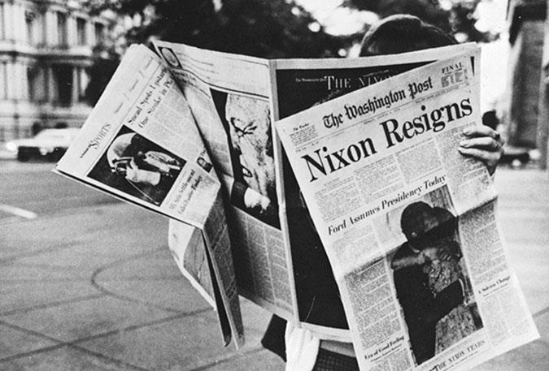
Nixon Resigns
Notes:
Richard Nixon was the only American president ever to resign his office. Nixon decided to resign rather than face impeachment for his role in the Watergate scandal, a series of illegal wiretaps, break-ins, and cover-ups.
.

Slide 17
Learning Objective 12.2
Evaluate the president’s constitutional powers and the expansion of presidential power.

Slide 18
Presidential Powers
Constitutional Powers
The Expansion of Power
Perspectives on Presidential Power
President or Prime Minister?
Notes:
The Constitution gives the president a few national security, legislative, administrative, and judicial powers, some of which are quite general. Presidential power has increased over time, through the actions of presidents. Power has also increased because of factors including technology and the increased prominence of the United States.
The assertion of presidential power has at times created controversy regarding the constitutional balance of powers.

Slide 19
Constitutional Powers
Constitution says little
"The executive Power shall be vested in a president of the United States of America."
Fear of abuse of power
Madisonian system
Shared powers
Checks and balances
Short term of office
Notes:
The Framers of the Constitution spelled out in detail in Article I the powers of the legislature but they kept Article II on the executive powers vague and short. Their fear of a tyrant like the British monarch from whom they had recently escaped made them reluctant to give too much power to the executive.
James Madison believed that having three branches of government which all shared powers and served to check and balance one another was a way to avoid tyranny. Another safeguard against abuse of power was a short term of office for the president, four years as opposed to the six served by a Senator or the life tenure of a federal judge.

Slide 20
Table 12.3 Constitutional Powers of the President (1 of 2)
National Security Powers
Serve as commander in chief of the armed forces
Make treaties with other nations, subject to the agreement of two-thirds of the Senate
Nominate ambassadors, with the agreement of a majority of the Senate
Receive ambassadors of other nations, thereby conferring diplomatic recognition on other governments.
Legislative Powers
Present information on the state of the union to Congress
Recommend legislation to Congress
Convene both houses of Congress on extraordinary occasions
Adjourn Congress if the House and Senate cannot agree on adjournment
Veto legislation (Congress may overrule with two-thirds vote of each house)
Notes:
Article II of the U.S. Constitution contains the enumerated powers of the president. Modern presidents infer that they have other powers in addition to those listed here, known as inherent powers.

Slide 21
Table 12.3 Constitutional Powers of the President (2 of 2)
Administrative Powers
Execute federal laws
Nominate officials as provided for by Congress with the agreement of a majority of the Senate
Request written opinions of administrative officials
Fill administrative vacancies during congressional recesses
Judicial Powers
Grant reprieves and pardons for federal offenses (except impeachment)
Nominate federal judges, who are confirmed by a majority of the Senate
Notes:
Article II of the U.S. Constitution contains the enumerated powers of the president. Modern presidents infer that they have other powers in addition to those listed here, known as inherent powers.

Slide 22
The Expansion of Power
Changes leading to expansion of presidential power
Military
Technological
Economic
Presidents take initiative to expand role
Lincoln
FDR
Notes:
The modern president has power and responsibilities that George Washington could hardly have imagined. He oversees the world's largest and strongest military, the world's largest economy, and a world that is rapidly changing due to technological advancements.
Modern presidents have responded to changing needs by taking the initiative to stretch their powers beyond the original parameters envisioned by the founders. Although Lincoln expanded the powers of the president during the Civil War, FDR is considered to be the first modern president due to the unprecedented scale of his New Deal legislative program initiatives and the presidential leadership they required to be enacted by Congress and ruled constitutional by the Court.

Slide 23
Perspectives on Presidential Power
1950s–1960s
Strong is good; weak is bad
1970s
Vietnam War
Watergate
1980s and beyond
Mixed feeling about presidential power
Notes:
In the post-war prosperity of the 1950s and 1960s, after World War II and FDR's New Deal, presidential power was viewed positively and a weak president was seen as a failure. But the Vietnam War and the Watergate scandal tarnished Americans' view of presidential power. Public trust in government has never returned since this era.
Although presidential power was feared, Americans simultaneously despised the perceived weaknesses of Presidents Ford and Carter and many hoped that Reagan would be a strong leader. He found himself thwarted in his policymaking goals by divided government, as did his successors. George W. Bush asserted a strong view of presidential powers that was embraced by his followers as necessary to meet presidential responsibilities. Obama continued many of his predecessor's practices. He also actively used drones to kill terrorists, even American citizens, without trial and presided over a massive electronic surveillance effort. Once again, critics charged that presidential power threatened the constitutional balance of powers.

Slide 24
President or Prime Minister?
Framers chose a presidential system
Other countries have chosen a parliamentary system
Prime minister comes from the legislature
Presidents and prime ministers differ
Prime ministers never face divided government
Parliamentary systems have better party discipline
Backgrounds are different
More concerned with abuse of power
Notes:
The Framers chose a presidential system which separates the executive from the legislative branch of government. Many countries have a parliamentary system where the prime minister is the leader of the party with the largest majority in parliament. Presidents and prime ministers differ in a variety of ways. The Framers chose a presidential system because they were more concerned with the abuse of power over its effective use.

Slide 25
Learning Objective 12.3
Describe the rules of the vice president, cabinet, Executive Office of the President, White House staff, and First Lady.

Slide 26
Running the Government: The Chief Executive
The Vice President
The Cabinet
The Executive Office of the President
The White House Staff
The First Lady
Notes:
One of the president's principal responsibilities is to manage the executive branch. The vice president has played a central role in recent administrations. Cabinet members focus on running executive departments but play only a modest role as a unit.
The Executive Office includes the Council of Economic Advisers, the National Security Council, which helps organize the president's national security decision-making process, and the Office of Management and Budget, which prepares the budget and evaluates regulations and legislative proposals.
Presidents rely heavily on the White House staff for information, policy options, and analysis.
The First Lady has no official position but may play an important role in advocating on particular issues.

Slide 27
The Vice President
Mainly ceremonial in previous years
Increasing role in modern presidency
Cheney
Biden
Notes:
Vice presidents were often chosen as an afterthought or to placate constituencies and balance the ticket. Vice presidents have performed mainly ceremonial duties until modern times, when presidents have begun to give them policy advisory and advocacy roles. Bush's vice president, Dick Cheney, was considered to have considerable influence over the president's foreign policy especially. President Obama chose Joseph Biden for his substantial experience in government, relying on Biden for advice, especially on foreign policy.

Slide 28
The Cabinet
Traditional, not mandated
Heads of federal agencies and executive departments
Notes:
The president is not required by the Constitution to have a cabinet, but all presidents since Washington have chosen a select group of advisers in major policy areas. The modern cabinet consists of the heads of about 15 federal agencies and major executive departments, such as Agriculture, Commerce, Labor, and Education.
Not all department heads are cabinet level; it is up to the president to grant them that status if he deems their constituency important enough. Modern presidents are no longer likely to convene full cabinet meetings, as this is impractical now that the cabinet is so large and specialized. Instead, they meet individually with their cabinet officials as needed.

Slide 29
Table 12.4 The Cabinet Departments (1 of 2)
Department | Year Created | Function
State | 1789 | Makes foreign policy, including treaty negotiations
Treasury | 1789 | Serves as the government’s banker
Defense | 1947 | Formed by the consolidation of the former Departments of War and the Navy
Justice | 1870 | Serves as the government’s attorney; headed by the attorney general
Interior | 1849 | Manages the nations’ natural resources, including wildlife and public lands
Agriculture | 1862 | Administers farm and food stamp programs and aids farmers
Commerce | 1903 | Aids businesses and conducts the U.S. Census
Labor | 1913 | Formed through separation from the Department of Commerce; runs programs and aids in labor in various ways
Notes:
Washington had four members of his cabinet. Today, there are at least fifteen offices that are included in the modern cabinet. Why has the number of cabinet members increased?

Slide 30
Table 12.4 The Cabinet Departments (2 of 2)
Department | Year Created | Function
Health and Human Services | 1953 | Originally created as the Department of Health, Education, and Welfare, it lost its education function in 1979 and Social Security in 1995
Housing and Urban Development | 1966 | Responsible for housing and urban programs
Transportation | 1966 | Responsible for mass transportation and highway programs
Energy | 1977 | Responsible for energy policy and research, including atomic energy
Education | 1979 | Responsible for the federal government education programs
Veterans Affairs | 1988 | Responsible for programs aiding veterans
Homeland Security | 2002 | Responsible for protecting against terrorism and responding to natural disasters
Notes:
Washington had four members of his cabinet. Today, there are at least fifteen offices that are included in the modern cabinet. Why has the number of cabinet members increased?

Slide 31
The Executive Office of the President
National Security Council (NSC)
Council of Economic Advisers (CEA)
Office of Management and Budget (OMB)
Notes:
We mentioned that the size of the federal bureaucracy greatly expanded under the New Deal programs created by FDR. In 1939, he established the EOP to provide him with staff to help oversee these new programs.
The units of the EOP change depending upon the president's needs, and they have grown to include the NSC, which advises the president on matters of national security, the CEA, which performs the same role on matter of economic policy, and the powerful OMB, which prepares the president's annual budget and advises him on the budgetary implications of policy.

Slide 32
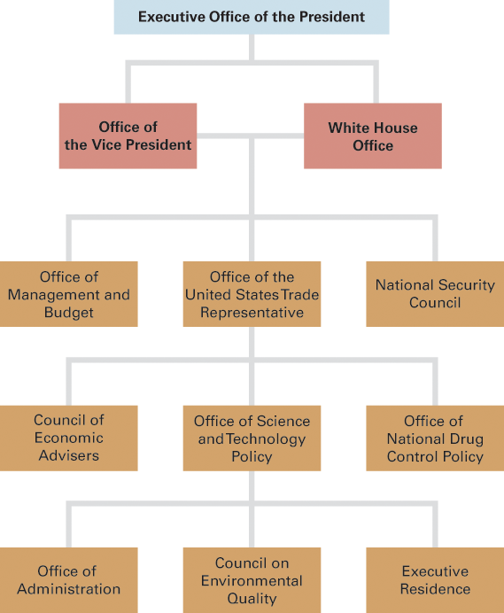
Figure 12.1 Executive Office of the President
Source: White House, Executive Office of the President, 2016.
Notes:
The Executive Office of the President, or the EOP, is home to many of the president's closest advisers.

Slide 33
The White House Staff
President's personal support team
Chief of staff
Press secretary
Anonymous and loyal
President sets style and tone
Notes:
President Jefferson had one secretary and President Wilson typed his own letters. Today's White House Staff numbers at least 600, including the president's chief of staff, who acts as gatekeeper, controlling who the president sees and what information he reads, and his press secretary, who controls his message to the media. Most members of the White House staff are chosen for their loyalty to the president and work anonymously, not receiving any public acknowledgement of their work behind the scenes.
The president's closest and most loyal advisers occupy the West Wing of the White House, near the Oval Office. How much access and influence they have varies by administration. Some presidents use a hierarchical approach, with the chief of staff at the top, who makes sure that everyone is doing their job.
Kennedy and Clinton encouraged their staff to work together, using a wheel-and-spokes approach to encourage aides to participate in the decision making. Whatever the approach, it is the president who sets the tone and must demand that the staff analyze decisions and their consequences before offering advice.

Slide 34
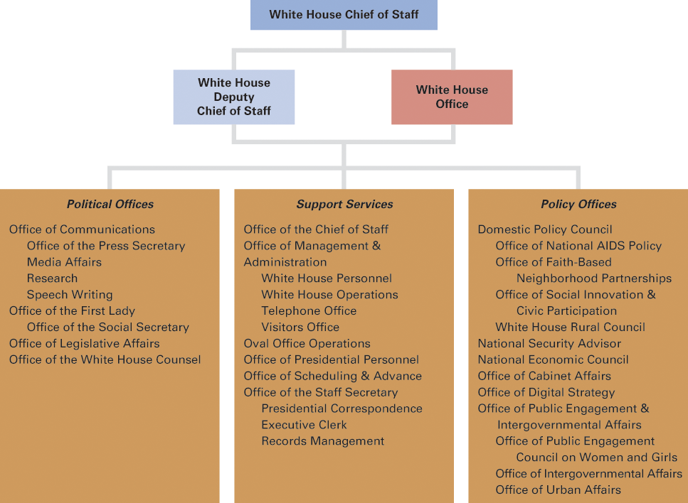
Figure 12.2 Principal Offices in the White House
Source: White House, Executive Office of the President, 2016.
Notes:
The principal offices serve political, support, and policy functions.

Slide 35
The First Lady
No longer just a well-dressed homemaker
Abigail Adams
Edith Wilson
Eleanor Roosevelt
Hillary Rodham Clinton
Michelle Obama
Notes:
The first lady has no formal Constitutional role but many first ladies have exerted influence on their husbands and performed duties well beyond that of hostess at the White House.
Abigail Adams exhorted her husband to consider women in making the nation's laws. Edith Wilson was the most powerful first lady thus far as she took over running the country when her husband was incapacitated by a stroke. Eleanor Roosevelt advocated publicly for policies and charitable causes that she supported. Hillary Clinton headed the planning committee for health care reform during her husband's administration, as well as serving as an influential adviser to him in other policy areas.
More recently, Michelle Obama has taken up the causes of healthy eating and exercise to combat childhood obesity.

Slide 36
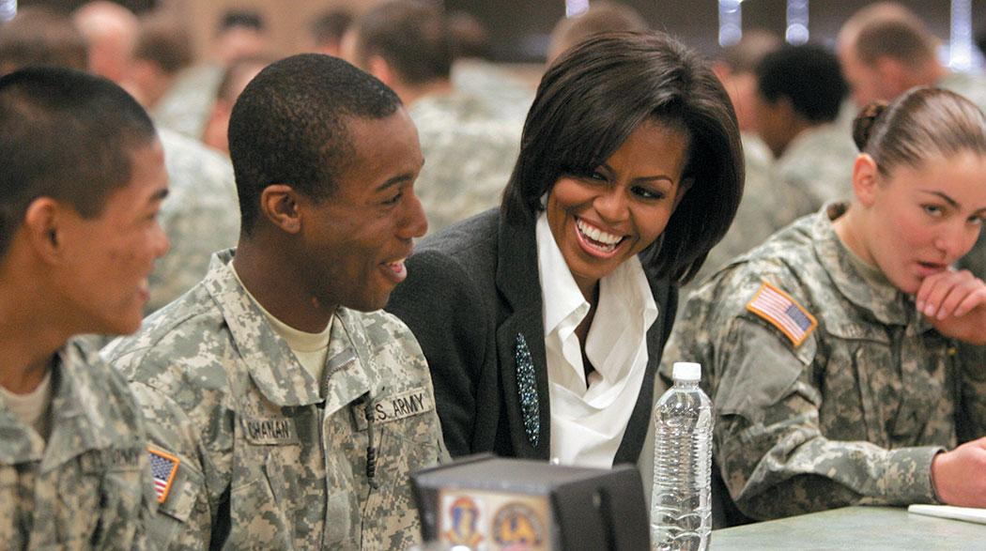
Michelle Obama with Military Families
Notes:
Although the First Lady has no official government position, she is often at the center of national attention. In recent years, First Ladies have taken active roles in promoting policies ranging from highway beautification and mental health to literacy and health care. First Lady Michelle Obama gave high priority to supporting military families and veterans.

Slide 37
Learning Objective 12.4
Assess the impact of various sources of presidential influence on the president’s ability to win congressional support.

Slide 38
Presidential Leadership of Congress: The Politics of Shared Powers
Chief Legislator
Party Leadership
Public Support
Legislative Skills
Notes:
The veto is a powerful tool for stopping legislation the president opposes. The president's role as party leader is at the core of presidents' efforts to assemble a winning legislative coalition behind their proposals, but party members sometimes oppose the president, and presidents cannot do much to increase the number of fellow party members in the legislature, in presidential or midterm election years.
Moreover, the president frequently faces an opposition majority in Congress. Presidents rarely enjoy electoral mandates for their policies, but they can benefit from high levels of public approval. A variety of presidential legislative skills, ranging from bargaining to setting priorities, contribute only marginally to the president's success with Congress.

Slide 39
Chief Legislator
State of the Union
Veto
Pocket veto
Line-item veto
Notes:
The president is constitutionally required to inform Congress annually of the state of the union, a duty he performs in the form of a speech called the State of the Union Address. Since this address is now televised, the modern president is speaking as much to the public as to Congress about his legislative agenda.
Veto power gives the president authority to reject legislation passed by Congress. Often the threat of a veto will persuade Congress to alter legislation before it crosses the president's desk. The president's veto is only a qualified negative because it can be overruled by a two-thirds vote in both houses of Congress. If a president neither signs nor vetoes a bill in 10 days, it becomes law. A pocket veto occurs when a president does not sign a bill for 10 days but Congress adjourns during that time.
Presidents have long sought a line-item veto, which would allow them to strike out individual provisions of a bill without vetoing the whole thing. In 1996, Congress gave President Clinton this power but the Supreme Court ruled it unconstitutional.

Slide 40
Table 12.5 Presidential Vetoes
President | Regular Vetoes | Vetoes Overridden | Percentage of Vetoes Overridden | Pocket Vetoes | Total Vetoes
Eisenhower | 73 | 2 | 3% | 108 | 181
Kennedy | 12 | 0 | 0% | 9 | 21
Johnson | 16 | 0 | 0% | 14 | 30
Nixon | 26 | 7 | 27% | 17 | 43
Ford | 48 | 12 | 25% | 18 | 66
Carter | 13 | 2 | 15% | 18 | 31
G. H. W. Bush | 29 | 1 | 3% | 15 | 44
Clinton | 37 | 2 | 5% | 1 | 38
G. W. Bush | 12 | 4 | 33% | 0 | 12
Obama | 12 | 1 | 8% | 0 | 12
Notes:
Presidents vary in how often they choose to exercise their veto power. In some cases, the threat of a veto is enough to get pending legislation altered before it reaches the president's desk. Are presidential vetoes overridden very often?

Slide 41
Party Leadership
The bonds of party
Slippage in party support
Leading the party
Notes:
Presidents depend upon support from members of their own party in Congress to get their legislative agenda passed. It is natural for party members to have similar policy views and for members of the president's party in Congress to want their party to retain control of the White House and to succeed in implementing the party's policy agenda. It is also natural for members of the other party to resist the president and to vote against bills that he supports, based upon ideological differences as well as a desire to make him look bad.
But presidents cannot always count on votes from Congressional members of their party. Party loyalty is not absolute and parties are decentralized; members of Congress are first and foremost concerned with reelection and that means pleasing their constituents, not the president, especially if he is unpopular.
The president relies on party leaders in Congress to help him gather votes and wheel and deal, offering concessions on some bills to gain votes on others.

Slide 42
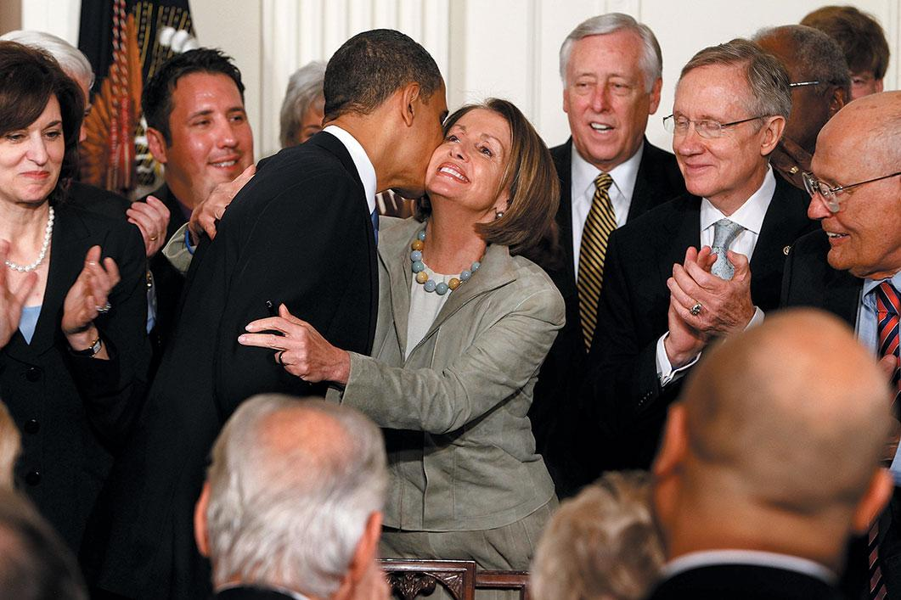
Barack Obama and Democratic Leaders
Notes:
Presidents depend heavily on their party’s leaders in Congress to pass their initiatives. In 2010, President Obama thanked House Speaker Nancy Pelosi after signing the Affordable Care Act. House Majority Leader Steny Hoyer and Senate Majority Leader Harry Reid are to her left.

Slide 43
Table 12.6 Congressional Gains or Losses for the President’s Party in Presidential Election Years (1 of 2)
Year | President | House | Senate
1952 | Eisenhower (R) | +22 | +1
1956 | Eisenhower (R) | –2 | –1
1960 | Kennedy (D) | –22 | –2
1964 | Johnson (D) | +37 | +1
1968 | Nixon (R) | +5 | +6
1972 | Nixon (R) | +12 | –2
1976 | Carter (D) | +1 | 0
1980 | Reagan (R) | +34 | +12
1984 | Reagan (R) | +14 | –2
1988 | G. Bush (R) | –3 | –1
1992 | B. Clinton (D) | –10 | 0
1996 | B. Clinton (D) | +9 | –2
Notes:
Presidents cannot rely on their coattails to carry their party’s legislators into office to help pass White House legislative programs. The president’s party typically gains few, if any, seats when the president wins election. For instance, the Republicans lost seats in both houses when President George W. Bush was elected in 2000.

Slide 44
Table 12.6 Congressional Gains or Losses for the President’s Party in Presidential Election Years (2 of 2)
Year | President | House | Senate
2000 | G.W. Bush (R) | –2 | –4
2004 | G.W. Bush (R) | +3 | +4
2008 | Obama (D) | +21 | +8
2012 | Obama (D) | +8 | +1
2016 | Trump (R) | –7 | –2
 | Average | +7.9 | +1.0
Notes:
Presidents cannot rely on their coattails to carry their party’s legislators into office to help pass White House legislative programs. The president’s party typically gains few, if any, seats when the president wins election. For instance, the Republicans lost seats in both houses when President George W. Bush was elected in 2000.

Slide 45
Public Support
Influence in Congress depends on popularity
Public approval
Electoral mandates
Notes:
Regardless of whether his party holds a majority of seats in Congress, a president's legislative influence depends primarily on his overall popularity.
Widespread public support gives the president leeway and weakens resistance to presidential policies. It provides a cover for members of Congress to cast votes their constituents might otherwise object to. They can defend their votes as support for the president rather than support for a certain policy alone. But the leverage of popularity has limits. Even an extremely popular president is unlikely to sway members of Congress who have strong ideological objections to his policies.
Members of Congress, even of the president's own party, will distance themselves from an unpopular president, even to the point of requesting that he not campaign for their reelection.
When presidents win office by a relatively wide margin and have high public approval ratings, they often consider that they have a mandate to implement their policy agenda; however, it is easy for a president to overestimate the mandate so care must be taken not to overreach.

Slide 46
Legislative Skills
Bargaining
Moving fast
Exploiting the honeymoon period
Setting priorities
Notes:
Concerning the bargaining that President Reagan had to do with members of Congress to get his 1982 tax cuts bill passed, his budget director said David Stockman said, "The hogs were really feeding, the greed level, the level of opportunities, just got out of control." This level of bargaining is discouraged today but wheeling and dealing is still a key part of a president's legislative skills.
The first 100 days of a president's term are called the "honeymoon period" when presidential approval ratings are at their highest and presidents have the best opportunity to successfully introduce legislation. Savvy presidents move quickly to act on their policy agenda during this period.
Even during the honeymoon period, a president's political capital is limited and he can only lobby effectively for a limited number of policies. This means that he must set clear legislative priorities. He must also decisively and publicly set the legislative agenda otherwise Congress will establish its own priorities and force the president into a defensive stance. Even very skilled and popular presidents have limited success with the legislature; the best they can do is exploit favorable conditions for change.

Slide 47
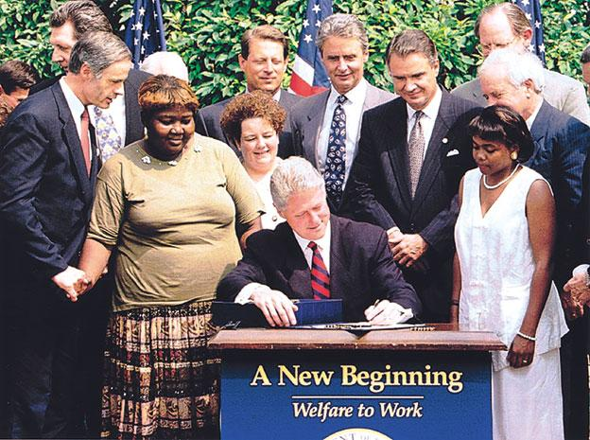
Clinton Signing Welfare Bill
Notes:
Presidents find the role of legislative leader a challenging one. Often they must compromise with opponents in Congress, as President Bill Clinton did in 1996 when he signed the welfare reform bill.

Slide 48
Learning Objective 12.5
Analyze the president’s powers in making national security policy and the relationship between the president and Congress in this arena.

Slide 49
The President and National Security Policy
Chief Diplomat
Commander in Chief
War Powers
Crisis Manager
Working with Congress
Notes:
The president is the chief diplomat, commander in chief, and crisis manager. Presidents have substantial formal and informal powers regarding going to war, and these powers remain a matter of controversy. Congress has a central constitutional role in making national security policy, but leadership in this area is centered in the White House, and presidents usually receive the support they seek from Congress when they choose to deploy the armed forces.

Slide 50
Chief Diplomat
Extending diplomatic recognition
Treaties
Executive agreements
Notes:
The president has the exclusive power to recognize the governments of foreign nations by receiving their ambassadors and appointing his own. He can also terminate relations with countries whose governments he considers illegitimate.
Another portion of the president's role as chief diplomat involves negotiating treaties, which must be approved by a two-thirds vote of the Senate. Recent presidents have begun to favor executive agreements, which are fulfill the same function as treaties but do not require Congressional ratification.
As the leader of the world's largest economic and military power, the president has distinct advantages in foreign relations but also a host of competing expectations and obligations that make this a delicate and complicated role.

Slide 51
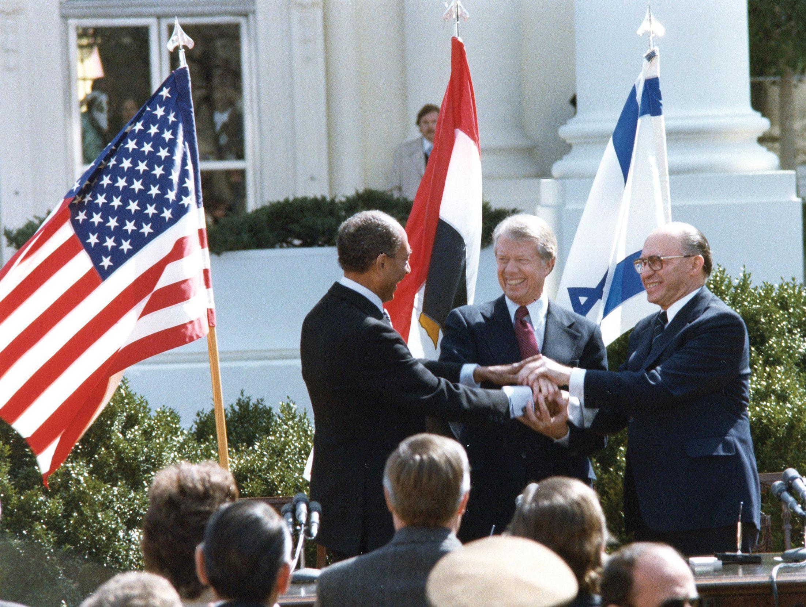
Carter with Begin and Sadat
Notes:
Presidents usually conduct diplomatic relations through envoys, but occasionally they engage in personal diplomacy. Here, President Carter celebrates a peace agreement he brokered between Israeli Prime Minister Menachem Begin and Egyptian president Anwar Sadat.

Slide 52
Commander in Chief
President can deploy troops
Congress must declare war, appropriate funds
Framers did not envision standing army
Or nuclear arsenal
Notes:
Under his power as commander in chief of the armed forces, the president can deploy troops into armed conflict abroad, even though Congress retains the power to officially declare war. Congress must also appropriate funds for military actions, which theoretically provides some constraint on the president's ability to wage undeclared wars.
When President Washington was commander in chief, he personally led troops to put down the Whiskey Rebellion. Modern presidents often have no military experience and do not take their leadership role quite so literally. On the other hand, Washington did not have a standing army of 1.4 million troops at his command, nor the world's largest nuclear arsenal.

Slide 53
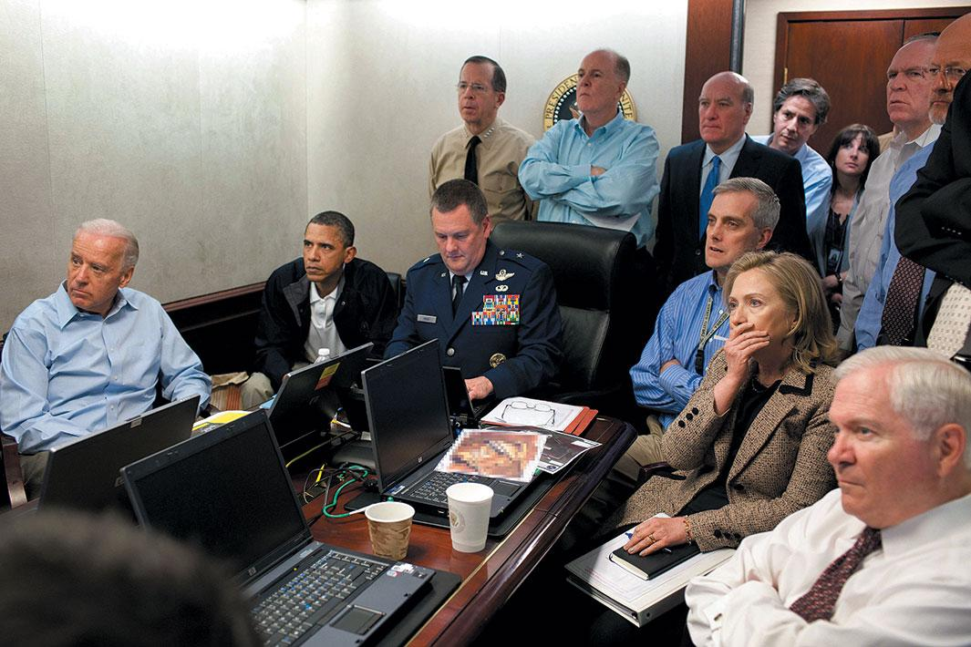
Capture of Osama Bin Laden
Notes:
The president commands vast military resources, ranging from nuclear weapons and aircraft carriers to armies and special forces. Here, President Obama and his national security team watch Navy Seals raid the compound of Osama bin Laden in 2011.

Slide 54
War Powers
War Powers Resolution (1973)
Presidents must seek Congressional approval before deploying armed forces
Legislative veto
Has the president become too powerful?
Notes:
We just noted that the president can deploy troops even without a formal declaration of war from Congress. In fact, the last time Congress declared war was after Pearl Harbor was attacked in 1941. Since presidents have deployed troops without obtaining a formal declaration of war from Congress, war powers seem to have shifted to the executive.
But after the Vietnam War, Congress passed the War Powers Resolution, over Nixon's veto. This law requires the president to seek Congressional approval before deploying troops, except in an emergency. In that case the president must report on his action to Congress within 48 hours, and in all cases end engagement within 60 days unless Congress formally declares war.
Presidents generally ignore this law and consider it unconstitutional but none has yet dared to test it in court.
Some worry that the rapid response capabilities of modern technology allow the president to bypass congressional opposition, thus undermining the separation of powers. Others say the commander in chief needs the flexibility to meet America's global responsibilities and combat international terrorism without the hindrance of congressional checks and balances. What do you think? Should the president show more deference to Congress or should Congress accept the shifting of their war powers to the executive?

Slide 55
Journal Prompt 12.5: War Powers
There is debate about whether the president should take the United States to war without the consent of Congress. Do you think the president should have this power?

Slide 56
Crisis Manager
What constitutes a crisis?
Cuban Missile Crisis
9/11
Modern communications technology
Notes:
A crisis is a sudden, unpredictable, and potentially dangerous event, such as a military attack or an earthquake. How a president handles a crisis makes or breaks his electoral fortunes and his place in history. The discovery of Soviet missiles in Cuba required quick and delicate negotiations on the part of President Kennedy to avoid nuclear war. The terrorist attack on 9/11 necessitated an immediate response from President Bush to deal with the effects of the attack.
Early presidents had fewer crises to deal with because word traveled slowly by foot or horse. Today's presidents have immediate knowledge of what is happening around the globe and must react decisively to a wide range of domestic and international crises.

Slide 57
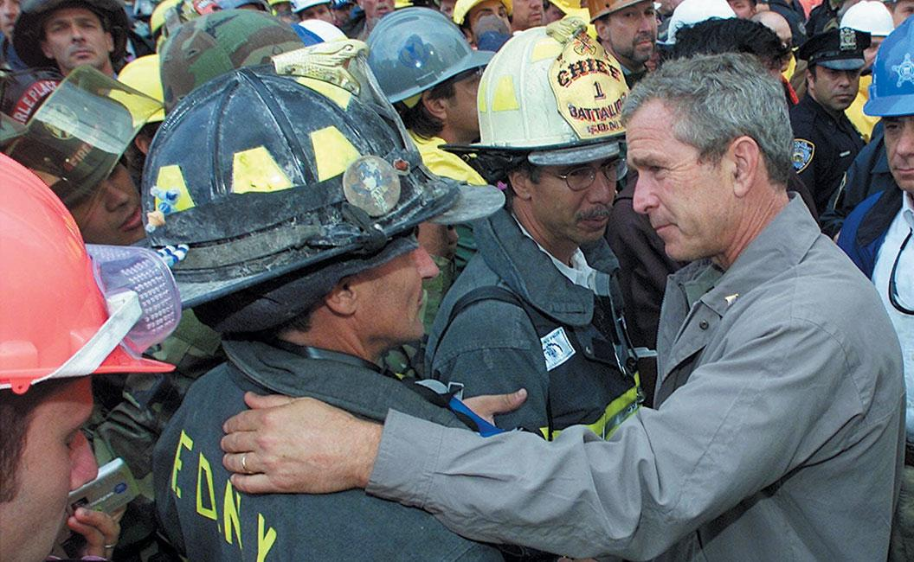
Responding to 9/11
Notes:
Crisis management may be the most difficult of the president’s many roles. By definition, crises are sudden, unpredictable, and dangerous. When President George W. Bush met with firefighters and rescue workers at the World Trade Center site three days after the terrorist attacks of September 11, 2001, the country stood united behind him.

Slide 58
Working with Congress
Two presidencies
Domestic policy
Foreign policy
Notes:
Modern presidents are expected to set foreign policy priorities and the domestic legislative agenda. Since the New Deal, presidents are expected to solve economic problems, keep the economy growing, keep unemployment and inflation and taxes down, and essentially ensure prosperity. They, and their party, will suffer at the ballot box in a weak economy, although their control over these factors is much more limited than the public believes because they must obtain Congressional support to get any bill passed.
The president takes the lead in national security policy in part because the country needs to present a unified image abroad. It would be impractical for all 535 members of Congress to conduct foreign policy. Since Congress plays a larger role, and defers to the president less, on domestic than on foreign policy, it is sometimes considered that there are two presidencies.

Slide 59
Learning Objective 12.6
Identify the factors that affect the president’s ability to obtain public support.

Slide 60
Power from the People: The Public Presidency
Going Public
Presidential Approval
Policy Support
Mobilizing the Public
Notes:
Presidents invest heavily in efforts to win the public's support, but they often have low approval levels. Approval levels are affected by party identification, by evaluations of the president's performance on the economy, foreign affairs, and other policy areas, and by evaluations of the president's character and job-related skills. Presidents typically fail to obtain the public's support for their policy initiatives and rarely are able to mobilize the public to act on behalf of these initiatives.

Slide 61
Going Public
"Public sentiment is everything. With public sentiment nothing can fail; without it nothing can succeed."
Ceremonial duties build public support
Notes:
This quote from Abraham Lincoln makes it clear that even as early as the mid-nineteenth century, public support was key to presidential success.
President Kennedy was the first president to use the power of television to speak directly to citizens. Instead of holding traditional press conferences, presidents can appear on television talk shows and address the voters in prime time. These direct public appeals are known as "going public." Their purpose is clear: use persuasion to raise public support and shape public opinion in favor of policies.
As chief of state, the president must project a sense of national unity and authority as the country's ceremonial leader. The framers of the Constitution only partially understood the symbolic and morale-building functions a president must perform. But over time, presidents have become national celebrities and command media attention merely by jogging, fishing, golfing, or going to church. By their actions, presidents can arouse a sense of hope or despair, honor or dishonor, for the American people, and they are judged by how well they perform this function as much as by the success of their policy initiatives.

Slide 62
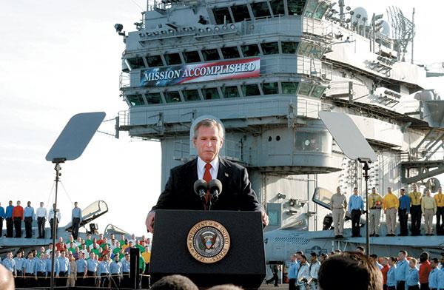
President Bush Announces End of Iraq War
Notes:
Presidents often use commercial public relations techniques to win support for their policy initiatives. President George W. Bush, for example, used the backdrop of an aircraft carrier to announce the end of the war in Iraq and obtain support for his stewardship.

Slide 63
Presidential Approval
Product of many factors
Party affiliation
Honeymoon period
Policy success
Integrity and leadership skills
Rally events
Notes:
Presidential approval ratings are a product of many factors. Generally, people who belong to one party disapprove of leaders of the other party.
Presidential approval ratings tend to fall over the course of their terms, which is why presidents have the most political capital to spend at the start of their term, when approval ratings are highest.
Issues in the news, such as the economy or terrorism, gain the public's attention and affect approval ratings.
Rally events lead to brief spikes in public approval following a significant national event, such as the 9/11 terrorist attack.

Slide 64
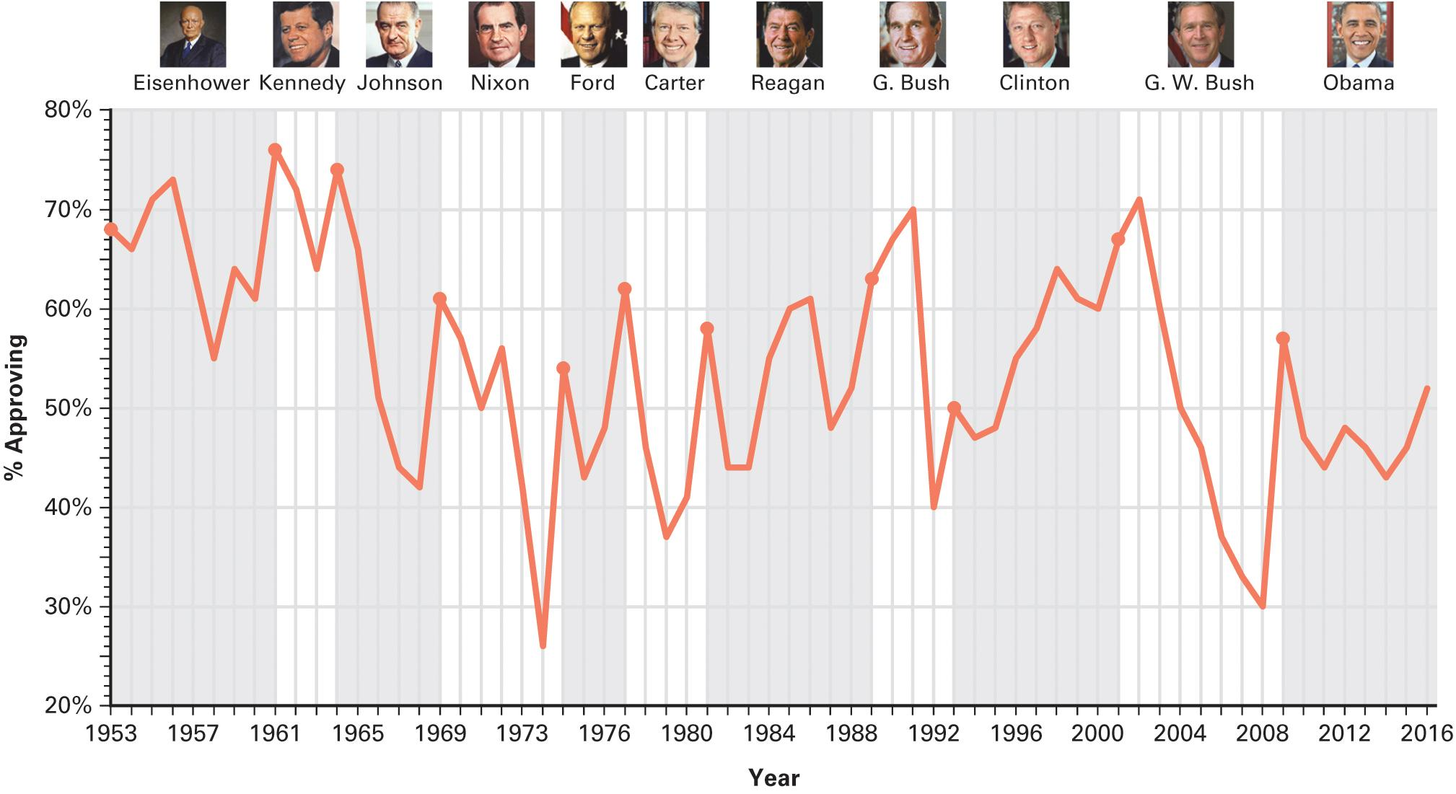
Figure 12.3 Presidential Approval
Source: George C. Edwards III, Presidential Approval (Baltimore, MD: Johns Hopkins University Press, 1990); updated by the authors.
Notes:
Most presidents seem to be most popular when they first enter office; later on, their popularity often erodes. Bill Clinton was an exception, enjoying higher approval in his second term then in his first. George W. Bush had high approval following 9/11, but public support diminished steadily after that.

Slide 65
Policy Support
Using the bully pulpit effectively
Media skills
Public not receptive
Not interested in politics and government
Biased reasoners and partisans
Weak on facts
Notes:
All presidents strive to mobilize public support for their policies by using the "bully pulpit" of the presidency to communicate directly with citizens. They seek media advice from experts on lighting, makeup, stage settings, camera angles, clothing, pacing of delivery, and other facets of making speeches.

Slide 66
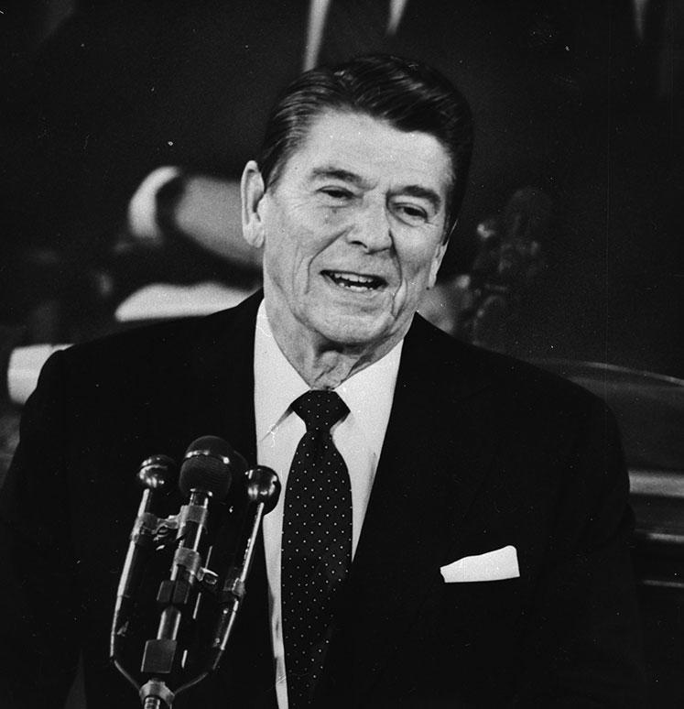
Reagan
Notes:
Ronald Reagan actively sought public support for his policies. Despite his skills as a communicator, he typically failed to move the public in his direction.

Slide 67
Mobilizing the Public
When the people speak, Congress listens
This is a rare event
Inattentive public
Apathetic public
Congress responds to this, too
Notes:
We have just noted how difficult it is for presidents to influence public opinion. Yet, when public opinion is marshaled behind a president's policy initiative, Congress tends to take it seriously.
Unfortunately for most presidents, such mobilization is rare. More often, an inattentive and apathetic public is unmoved and Congress interprets this as a mandate to ignore the president and maintain the status quo.

Slide 68
Learning Objective 12.7
Characterize the president’s relations with the press and news coverage of the presidency.

Slide 69
The President and the Press
Nature of News Coverage
Bias
Superficial, oversimplified, and overblown
Emphasize the negative
Presidential advantages
Notes:
The press is the principal intermediary between the president and the public. Presidents and the press are frequently in conflict over the amount, nature, and tone of the coverage of the presidency. Much of the coverage is superficial and without partisan or ideological bias, but there has been an increase in the negativity of coverage and there are an increasing number of ideologically biased sources of news, such as FOX News.

Slide 70
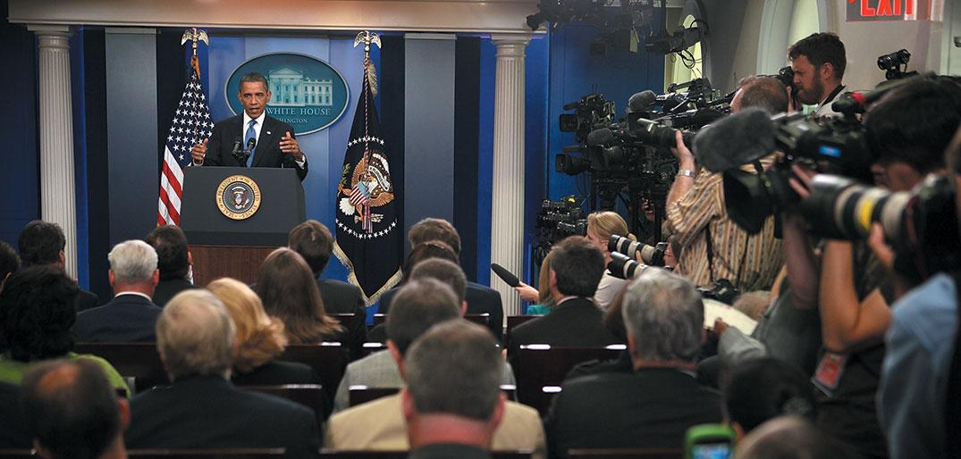
Obama Press Conference
Notes:
Press coverage of the president is pervasive because of the importance of the presidency. At the same time, the press is the primary means by which the president communicates with the public. Here President Obama answers questions from the press in the White House briefing room.

Slide 71
Learning Objective 12.8
Assess the role of presidential power in the American democracy and the president’s impact on the scope of government.

Slide 72
Understanding the American Presidency
The Presidency and Democracy
The Presidency and the Scope of Government
Notes:
The fear of a presidential power harmful to democracy is always present, but there are many checks on presidential power. Support of increasing the scope of government is not inherent in the presidency, and presidents have frequently been advocates of limiting government growth, albeit not necessarily limiting their own powers.

Slide 73
The Presidency and Democracy
Wanting and fearing a strong president
Safety in checks and balances
What happens when government is divided?
Notes:
Given our country's origins, it is not surprising that we fear monarchy and dictatorship, and that we have (very effectively) constitutionally limited the powers of the president and provided checks and balances against his power in the other two branches of government.
Yet Americans are likely to favor a strong president during a crisis and when the occupant of the White House shares their ideological perspective and pushes policies that they support. When the occupant changes, these same people are suddenly convinced the president has too much power. But does he?
Take the example of divided government. It takes the Madisonian checks and balances to an extreme that can result in gridlock. Is this a good thing or not? Is change possible under a divided government?

Slide 74
The Presidency and the Scope of Government
What made Theodore Roosevelt, Woodrow Wilson, and Franklin Roosevelt noteworthy presidents?
Government growth not inherent in presidency
Ideologically conservative and operationally liberal
Notes:
All three of those presidents you see on this slide substantially increased the scope and role of the federal government. Yet some modern presidents have advocated constraints on government and limits on spending, especially on domestic policy.
When we say that Americans are ideologically conservative and operationally liberal we mean that Americans oppose big government, extensive regulations, and high taxes in principle yet we expect government in general, and presidents in particular, to ensure peace, prosperity, and security, all of which cost money and require governmental policies and action.

Slide 75
Shared Writing 12
Presidents have limited power to effect changes in domestic policy. The United States often experiences gridlock in policymaking. Would we be better off if the president were more powerful?

Slide 76
Photo Credits
Chapter 12
344: Jose Nemo-Neves/CartoonStock; 345 (top to bottom): John F. Kennedy Presidential Library and Museum for John F. Kennedy, Lyndon Baines Johnson Library and Museum, National Archives, Gerald R. Ford Presidential Library and Museum, Jimmy Carter Library and Museum, Ronald Reagan Presidential Foundation & Institute, National Archives, National Archives, George W. Bush Presidential Library and Museum, Library of Congress Prints and Photographs Division [LC-DIG-ppbd- 00358], Photo by Scott Olson/Getty Images;347: Alex Webb/Magnum; 356: Mary Ann Chastain/Reuters;359: Chip Somodevilla/Getty Images News/Getty Images; 363: Stephen Jaffe/ Reuters; 366: Carter Archives/ZUMA Press, Inc/Alamy Stock Photo; 368: Pete Souza/dapd/AP Images;369: Doug Mills/AP Images; 371: Scott J. Applewhite/AP Images; 372 (left to right): Dwight D. Eisenhower, White House Historical Assn. 1960-Thomas Edgar Stephens, John F. Kennedy Presidential Library and Museum for John F. Kennedy, Lyndon Baines Johnson Library and Museum, Richard Nixon Presidential Library and Museum, Gerald R. Ford Presidential Library and Museum, Jimmy Carter Presidential Library &Museum, Ronald Reagan Presidential Foundation & Institute, Courtesy of Whitehouse.gov, National Archives, George W. Bush Presidential Library and Museum, Courtesy of White-house.gov; 374: AP Images; 375: Alex Wong/Getty Images News/Getty Images

