Slide 1
Government in America: People, Politics and Policy
Seventeenth Edition
Chapter 11
Congress

Slide 2
Learning Objectives
11.1 Characterize the backgrounds of members of Congress and assess their impact on the ability of members of Congress to represent average Americans.
11.2 Identify the principal factors influencing the outcomes of congressional elections.
11.3 Assess the roles of leaders, political parties, and committees in Congress.
11.4 Describe the process of lawmaking in Congress.
11.5 Describe the factors that influence how members of Congress make decisions.
11.6 Assess Congress’s role as a representative body and the impact of representation on the scope of government.

Slide 3
Learning Objective 11.1
Characterize the backgrounds of members of Congress and assess their impact on the ability of members of Congress to represent average Americans.

Slide 4
Representatives and Senators
The Members
Why Aren’t There More Women in Congress?
Notes:
Being a member of Congress isn’t an easy job. It takes a considerable amount of time, trouble, and money to get elected, and reelected—and the reward for all that effort is a hectic job shuttling between your constituency and Capitol Hill, being expected to solve everyone’s problems but lacking the individual power to change much of anything.

Slide 5
The Members
Not a glamorous job, but there are perks
Power
$174,000 annual salary
Generous retirement and health benefits
Constitutional requirements
House: 25, citizen for 7 years
Senate: 30, citizen for 9 years
Reside in state
435 Representatives; 100 senators
Notes:
Being a member of Congress isn’t a glamorous job, but it has its perks. Members of Congress receive an annual salary of $174,000, along with generous retirement and health benefits—but most attractive of all, they have the power to make important public policy decisions.
The Constitution specifies that members of the House must be at least 25 years old and American citizens for 7 years, that senators must be at least 30 and American citizens for 9 years, and that all members of Congress must reside in the state from which they’re elected. There are 100 senators, two from each state, and 435 representatives in the House.
Members of Congress tend to be lawyers, and to come from relatively wealthy backgrounds. Minorities and women are underrepresented.

Slide 6
Table 11.1 A Portrait of the 115th Congress (1 of 3)
Characteristic | House (435 Total) | Senate (100 Total)
Party
Democrat | 195 | 48
Republican | 240 | 52
Gender
Men | 352 | 79
Women | 83 | 21
Race/Ethnicity
Asian | 10 | 2
African American | 45 | 3
Hispanic | 31 | 4
Native American | 2 | 0
White and other | 347 | 91
Notes:
Which party controlled each chamber of the 115th Congress? What religious affiliation is most represented? What occupations dominate the membership?

Slide 7
Table 11.1 A Portrait of the 115th Congress (2 of 3)
Characteristic | House (435 Total) | Senate (100 Total)
Average Age of Members
Average age† | 57 years | 61 years
Religion†
Protestant | 56% | 53%
Roman Catholic | 31% | 25%
Jewish | 4% | 9%
Other and unspecified | 7% | 10%
Notes:
Which party controlled each chamber of the 115th Congress? What religious affiliation is most represented? What occupations dominate the membership?

Slide 8
Table 11.1 A Portrait of the 115th Congress (3 of 3)
Most Common Prior Occupation*†
Public service/politics | 62% | 60%
Law | 40% | 60%
Business | 53% | 42%
Education | 18% | 25%
† Data for 114th Congress.
* Some members specify more than one occupation.
Source: 115th Congress data based on press reports available a week after the November 8, 2016 elections. 114th Congress data complied from ”Demographics,” CQ Weekly, November 6 2014, 58.
Notes:
Which party controlled each chamber of the 115th Congress? What religious affiliation is most represented? What occupations dominate the membership?

Slide 9
Senator Shelley Moore Capito
Notes:
Representation is at the heart of democracy, but members of Congress, such as Senator Shelly Moore Capito of West Virginia, may have different backgrounds—religious, ethnic, or otherwise—than many of their constituents.

Slide 10
Why Aren’t There More Women in Congress?
Fewer women running
Childcare
Risk averse
Bias
Must be more qualified
Notes:
Women constitute more than half the U.S. population but hold less than a fifth of congressional seats. How can this be?
When women run for office, they win about half of the time, but they’re considerably less likely than men to run. This is partially explained by childcare responsibilities. Women without children are more politically ambitious. Women also seem less likely than men to run for office when they perceive that the odds of winning are low. However, they seem more likely than men to run when they view the odds as being in their favor.
Bias is another factor that accounts for the small numbers of women in Congress. When candidates are equally qualified, there’s a bias in voters toward the male candidate. So female candidates must be more qualified than their male opponents.

Slide 11
Learning Objective 11.2
Identify the principal factors influencing the outcomes of congressional elections.

Slide 12
Congressional Elections
Who Wins Elections?
The Advantages of Incumbency
Defeating Incumbents
Open Seats
Stability and Change
Notes:
One of the most frequent complaints about Congress is that its members spend so much time fundraising and campaigning for reelection that they have no time to actually represent their constituents in policymaking.
But most congressional elections aren’t competitive; incumbents usually win. Most members of Congress choose a career in politics because they enjoy it, and once in office they stay there until retirement.

Slide 13
Who Wins Elections?
Incumbents
Over 90% win reelection in House
Senators do not have it as easy
Incumbents perceive themselves as vulnerable
Hence fundraising and campaigning
Notes:
The most predictable aspect of American elections is that incumbents usually win. More than 90% of House incumbents win reelection, even when the policy positions of the challenger are closer to those of the voters. Senators don’t have it quite as easy. They represent larger, and thus more diverse, constituencies, and they get more media attention than representatives. They tend to be held accountable because they are more visible.
All incumbents tend to perceive themselves as vulnerable, which is one reason they spend so much time fundraising and campaigning.

Slide 14
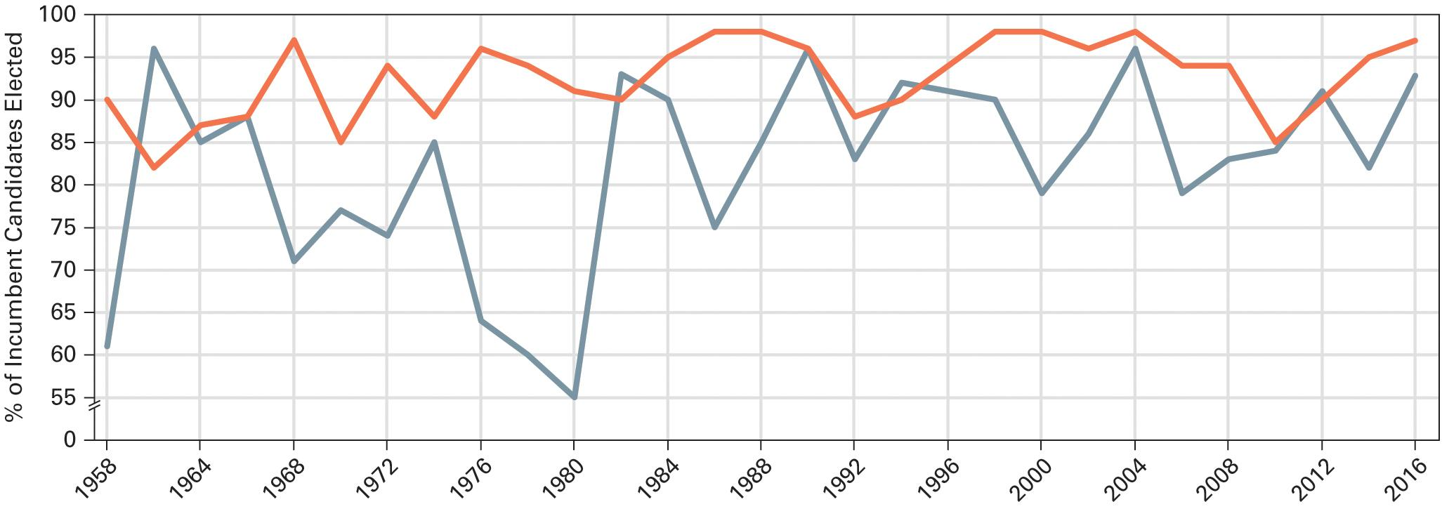
Figure 11.1 The Incumbency Factor in Congressional Elections
Source: Data compiled by the authors. Figure reflect incumbents running in both primary and general elections.
Notes:
It is not unusual for the public to disapprove of the performance of Congress as a whole, but it is unusual for incumbents to lose their bid for reelection. The many advantages of incumbency make it difficult to make substantial changes in the make of Congress in one election.

Slide 15
The Advantages of Incumbency
Advertising
Constituent contact
Credit claiming
Casework
Pork barrel projects
Weak opponents
Campaign spending
Party identification
Notes:
Do Americans reelect their representatives because they agree with their voting record? Hardly. Only 11% of Americans have any idea of how their representatives voted on a given issue. If not policy, what gives incumbents their electoral advantage?
Incumbents have an advantage in visibility. They can use the congressional franking privilege to send mailings to constituents, and they take advantage of telephone and email technology to maintain contact with constituents.
Incumbents can also claim credit for services to individual constituents, called casework, as well as for pork barrel projects in their constituencies. This is safer than taking credit for policy changes because those win enemies as well as supporters.
But even though position taking is risky, sometimes members of Congress do take strong and public positions on certain issues when they believe they are certain how the majority of their constituents feel about the issue.
Another advantage for incumbents is the weakness of opponents, who lack the visibility and experience of incumbents. Incumbents have to raise a substantial sum to mount a realistic challenge. House campaigns typically cost more than a million dollars and the average Senate campaign costs ten times that. The candidate who spends the most money usually (but not always) wins, and incumbents outspend challengers two to one.

Slide 16
The Big Dig
Notes:
Because claiming credit may be important for reelection, members of Congress rarely pass up the opportunity to increase federal spending in their state or district. The early 2000s witnessed a surge in earmarks of expenditures for specific projects. The most expensive was the “Big Dig” in Boston, shown in progress in an aerial view here, which rerouted a principal highway so that it went through a 3.5-mile tunnel, rather than through the heart of the city.

Slide 17
Journal Prompt 11.2: The Advantages of Incumbency
Should we have public funding of congressional campaigns so candidates would spend less time raising money and be less beholden to donors?

Slide 18
Defeating Incumbents
Why does anyone challenge incumbents
Challengers can be naïve
Challengers can receive unexpected help
Incumbent scandal
Redistricting
Wave elections
Notes:
Because incumbents rarely lose elections it is reasonable to ask why anyone would bother to challenge them. Often the answer is because challengers are naïve and overestimate their chances of success. However, challengers can receive unexpected help from scandals, redistricting, and wave elections that can drown an incumbent.
Every 10 years, House districts are redrawn to reflect population shifts indicated by the census. Redistricting is done by the party in power in the state legislature, and new districts can put incumbents in districts dominated by incumbents who belong to the other party.
Sometimes the public can express its dissatisfaction with the economy or political scandals by defeating incumbents and changing the party in power in one or both chambers of Congress. This happens most often in midterm elections, and the party that holds the presidency almost always loses seats in both houses.

Slide 19
Open Seats
Vacant seat means no incumbent running
Most turnover occurs here
Notes:
Sometimes an incumbent will retire or not run for reelection for some other reason. It’s in elections with an open seat when the most turnover in congressional membership occurs.

Slide 20
Stability and Change
Stability from incumbency
Development of expertise
Term limits?
Notes:
It takes practice to get good at anything, and politics is no exception. Because incumbents usually win reelection, Congress is fairly stable. That has some disadvantages, but it does mean that members gain experience, which helps them to develop expertise.
Does this expertise outweigh the lack of responsiveness that results from career politicians in safe seats? Some people have proposed term limits for members of Congress. Do you think that’s a good idea?

Slide 21
Learning Objective 11.3
Assess the roles of leaders, political parties, and committees in Congress.

Slide 22
How Congress Is Organized to Make Policy
American Bicameralism
Congressional Leadership
The Committees and Subcommittees
Caucuses: The Informal Organization of Congress
Congressional Staff
Notes:
Making policy is Congress’s most difficult role. Congress is a collection of generalists trying to make policy on specialized topics. Experts stand ready to advise Congress on each policy issue, but these experts are usually biased. It’s up to Congress to organize itself in such a way that it can build specialized expertise and make wise use of outside experts.
The Senate protects elite interests and the House protects the interests of the masses, according to the Framers’ original plan.

Slide 23
American Bicameralism
Bicameral legislature
Bills must pass both houses
Checks and balances
Result of Connecticut Compromise
The House
More institutionalized Rules Committee
The Senate
Less centralized and less disciplined
Notes:
Bicameral simply means that the legislature is divided into two houses, such as our House of Representatives and Senate. All state legislatures except Nebraska are also bicameral. If you recall from earlier chapters, the legislature is bicameral as a result of the Connecticut Compromise. A bill must pass both houses in identical form to become law, providing a check and balance in the system.
The House is more institutionalized than the Senate and party loyalty is more common in voting. The House has a Rules Committee that functions as a traffic cop for bills coming out of committee. It gives each bill a “rule,” which schedules the bill on the calendar, allots time for debate, and specifies what kind of amendments may be offered.
The Senate is less centralized and less disciplined than the House of Representatives. Even junior senators can get plum committee assignments since the chamber is smaller.

Slide 24
Table 11.2 House Versus Senate: Some Key Differences
Characteristics | House of Representatives | Senate
Constitutional powers | Initiates all revenue bills | Confirms many presidential nominations
 | Passes all articles of impeachment | Tries impeached officials Approves treaties
Membership | 435 members | 100 members
Term of office | 2 years | 6 years
Constituencies | Usually smaller | Usually larger
Centralization of power | More centralized; stronger leadership | Less centralized; weaker leadership
Political prestige | Less prestige | More prestige
Role in policymaking | More influential on budget; more specialized | More influential on foreign affairs; less specialized
Turnover | Small | Moderate
Role of seniority | More important in determining power | Less important in determining power
Procedures | Limited debate; limits on floor amendments allowed | Unlimited debate
Notes:
This table represents some key differences between the House of Representatives and the U.S. Senate. What are the main differences between the two chambers?

Slide 25
Congressional Leadership (1 of 2)
Chosen by party
The House
Speaker of the House
Majority and minority leaders
Whips
The Senate
Vice president
Majority leader
Congressional leadership in perspective
Notes:
Leadership assignments in Congress are chosen by parties. The Speaker of the House, chosen by the majority party, has the key leadership role in the House of Representatives. The Speaker is third in line for the presidency, and presides over the House when it’s in session. He or she makes committee assignments and assigns bills to committee. Below the Speaker is the majority leader, who works with the party whips to persuade members to vote with their party on important bills. There is also a minority leader who fulfills the same function within the minority party.
The vice president is head of the Senate but only appears there to break tie votes. The de facto head is the majority leader, who works with majority whips to encourage party line voting.
Congressional leaders cannot force their fellow party members to vote with the party; their real power is limited. They can only offer them pork or other inducements to do so. Senator Robert Dole nicely summed up any congressional leader’s situation when he dubbed himself the “Majority Pleader.”

Slide 26
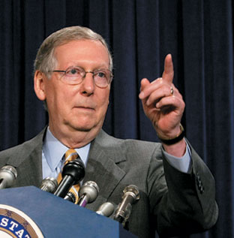
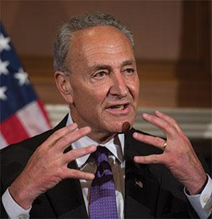
Congressional Leadership (2 of 2)
Notes:
Paul Ryan of Wisconsin (left) was elected speaker in 2015. He is the most powerful member of the House of Representatives. Majority leader Mitch McConnell of Kentucky (center) leads the Republicans in the Senate, which makes him the most powerful member of that body. Nevertheless, in the decentralized power structure of the upper chamber, even he must work and negotiate with minority leader Chuck Schumer of New York (right).

Slide 27
The Committees and Subcommittees
Four types of committees
Standing committees
Joint committees
Conference committees
Select committees
Getting on a committee
Constituent needs
Appealing to leadership
Committee chairs and the seniority system
Notes:
Committees control the congressional agenda and guide legislation. There are four types of committees.
Since more than 11,000 bills are submitted in each two-year period, Congress must divide and conquer to get through even a fraction of them. New bills are assigned to a subcommittee, where they usually die. If they are debated and passed, they move on to the full committee, where they have another good chance of never again seeing the light of day. If the bills pass out of committee, they move to the full floor of the chamber for debate and voting. They can also die there, if they’re never brought up.
Once a bill becomes law, committees remain involved in assigning budgets and monitoring the work of the executive branch agency responsible for implementing the law. This is known as legislative oversight.
Standing committees handle bills in different policy areas. Members of Congress each serve on several standing committees and subcommittees.
Joint committees between the two chambers exist in a few key policy areas, such as the economy and taxation.
Conference committees are created when the House and Senate need to reconcile different versions of the same bill.
Select committees are created to deal with a policy issue, such as deficit reduction, and may be temporary or permanent.
New members of Congress want to get on committees that will help them achieve three goals: reelection, influence in Congress, and the opportunity to make policy in areas they think are important or that are important to their constituents.
A member from a farming state will try to get an Agriculture Committee assignment, whereas a member from an urban jurisdiction will prefer the Urban Affairs Committee. New members must appeal to party leaders for their preferred committee assignments.
Committee chairs are the most important influencers of their committees’ agendas. In the 1970s younger members of Congress rebelled, and as a result both parties in both branches permitted members in both houses to vote on committee chairs. Today seniority remains the general rule for selecting chairs, especially in the Senate, but there are plenty of exceptions.

Slide 28
Caucuses: The Informal Organization of Congress
As important as formal structure
Dominated by caucuses
Nearly 500 caucuses today
Made representation more direct in Congress
Goal is to promote a variety of interests
Examples: Black Caucus, Hispanic Caucus, and Sunbelt Caucus
Notes:
The informal organization of Congress is as important as the leadership and committee structures we have been discussing. These networks spring mainly from friendship, ideology, and geography. They tend to operate through caucuses, which are essentially congressional interest groups.
Caucuses are formed by members who share a policy interest and work together to advance legislation they favor and oppose legislation that they don’t support. There are currently more than 500 congressional caucuses, including the Black Caucus, the Hispanic Caucus, and the Caucus for Women’s Issues.

Slide 29
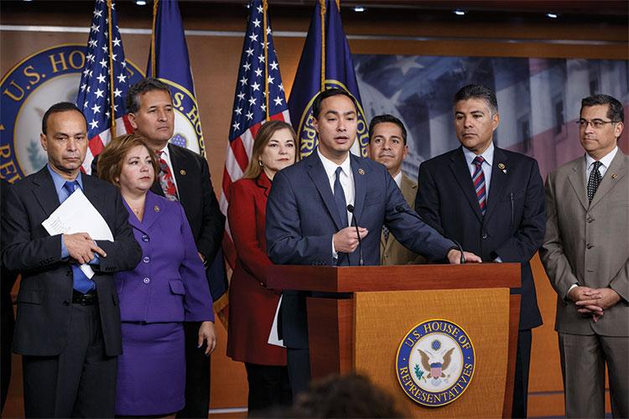
The Hispanic Caucus
Notes:
The proliferation of congressional caucuses gives members of Congress an informal yet powerful means of shaping policy. Composed of legislative insiders, caucuses—for example the Hispanic Caucus—exert a much greater influence on policymaking than most citizen-based, outside interest groups can.

Slide 30
Congressional Staff
Personal staff
Casework
Legislative functions
Committee staff
2,000 staff members
Legislative oversight
Staff agencies
Congressional Research Service (CRS)
Government Accountability Office (GAO)
Congressional Budget Office (CBO)
Notes:
Congress has a lot of work to do, but it has plenty of assistance. More than 11,000 staff members serve Congress, and another 4,000 interns show up in the summer. Many staff members are assigned to casework and work in the member’s constituency, not in Washington. Other personal staff help with legislative functions, including drafting legislation, meeting with lobbyists and administrators, negotiating agreements on behalf of their bosses, writing questions to ask witnesses at committee hearings, summarizing bills, and briefing legislators.
The congressional committees have about 2,200 staff members who organize hearings, research legislative options, draft committee reports on bills, write legislation, and engage in legislative oversight.
Three staff agencies aid Congress in its work. The Congressional Research Service, administered by the Library of Congress, responds each year to more than 250,000 information requests from members of Congress. The Government Accountability Office handles legislative oversight, and the Congressional Budget Office analyses the president’s budget and makes economic projections.

Slide 31
Learning Objective 11.4
Describe the process of lawmaking in Congress.

Slide 32
The Lawmaking Process
Agenda Setting
The Committees at Work: Legislation
The Committees at Work: Oversight
Floor Debate and the Filibuster
Unorthodox Lawmaking
Notes:
Only members of Congress can introduce a bill for consideration; not even the president can do so. Most bills are quietly killed off early in the lawmaking process, and the ones that become law must negotiate a labyrinthine process of rules, which we demystify in this section.

Slide 33
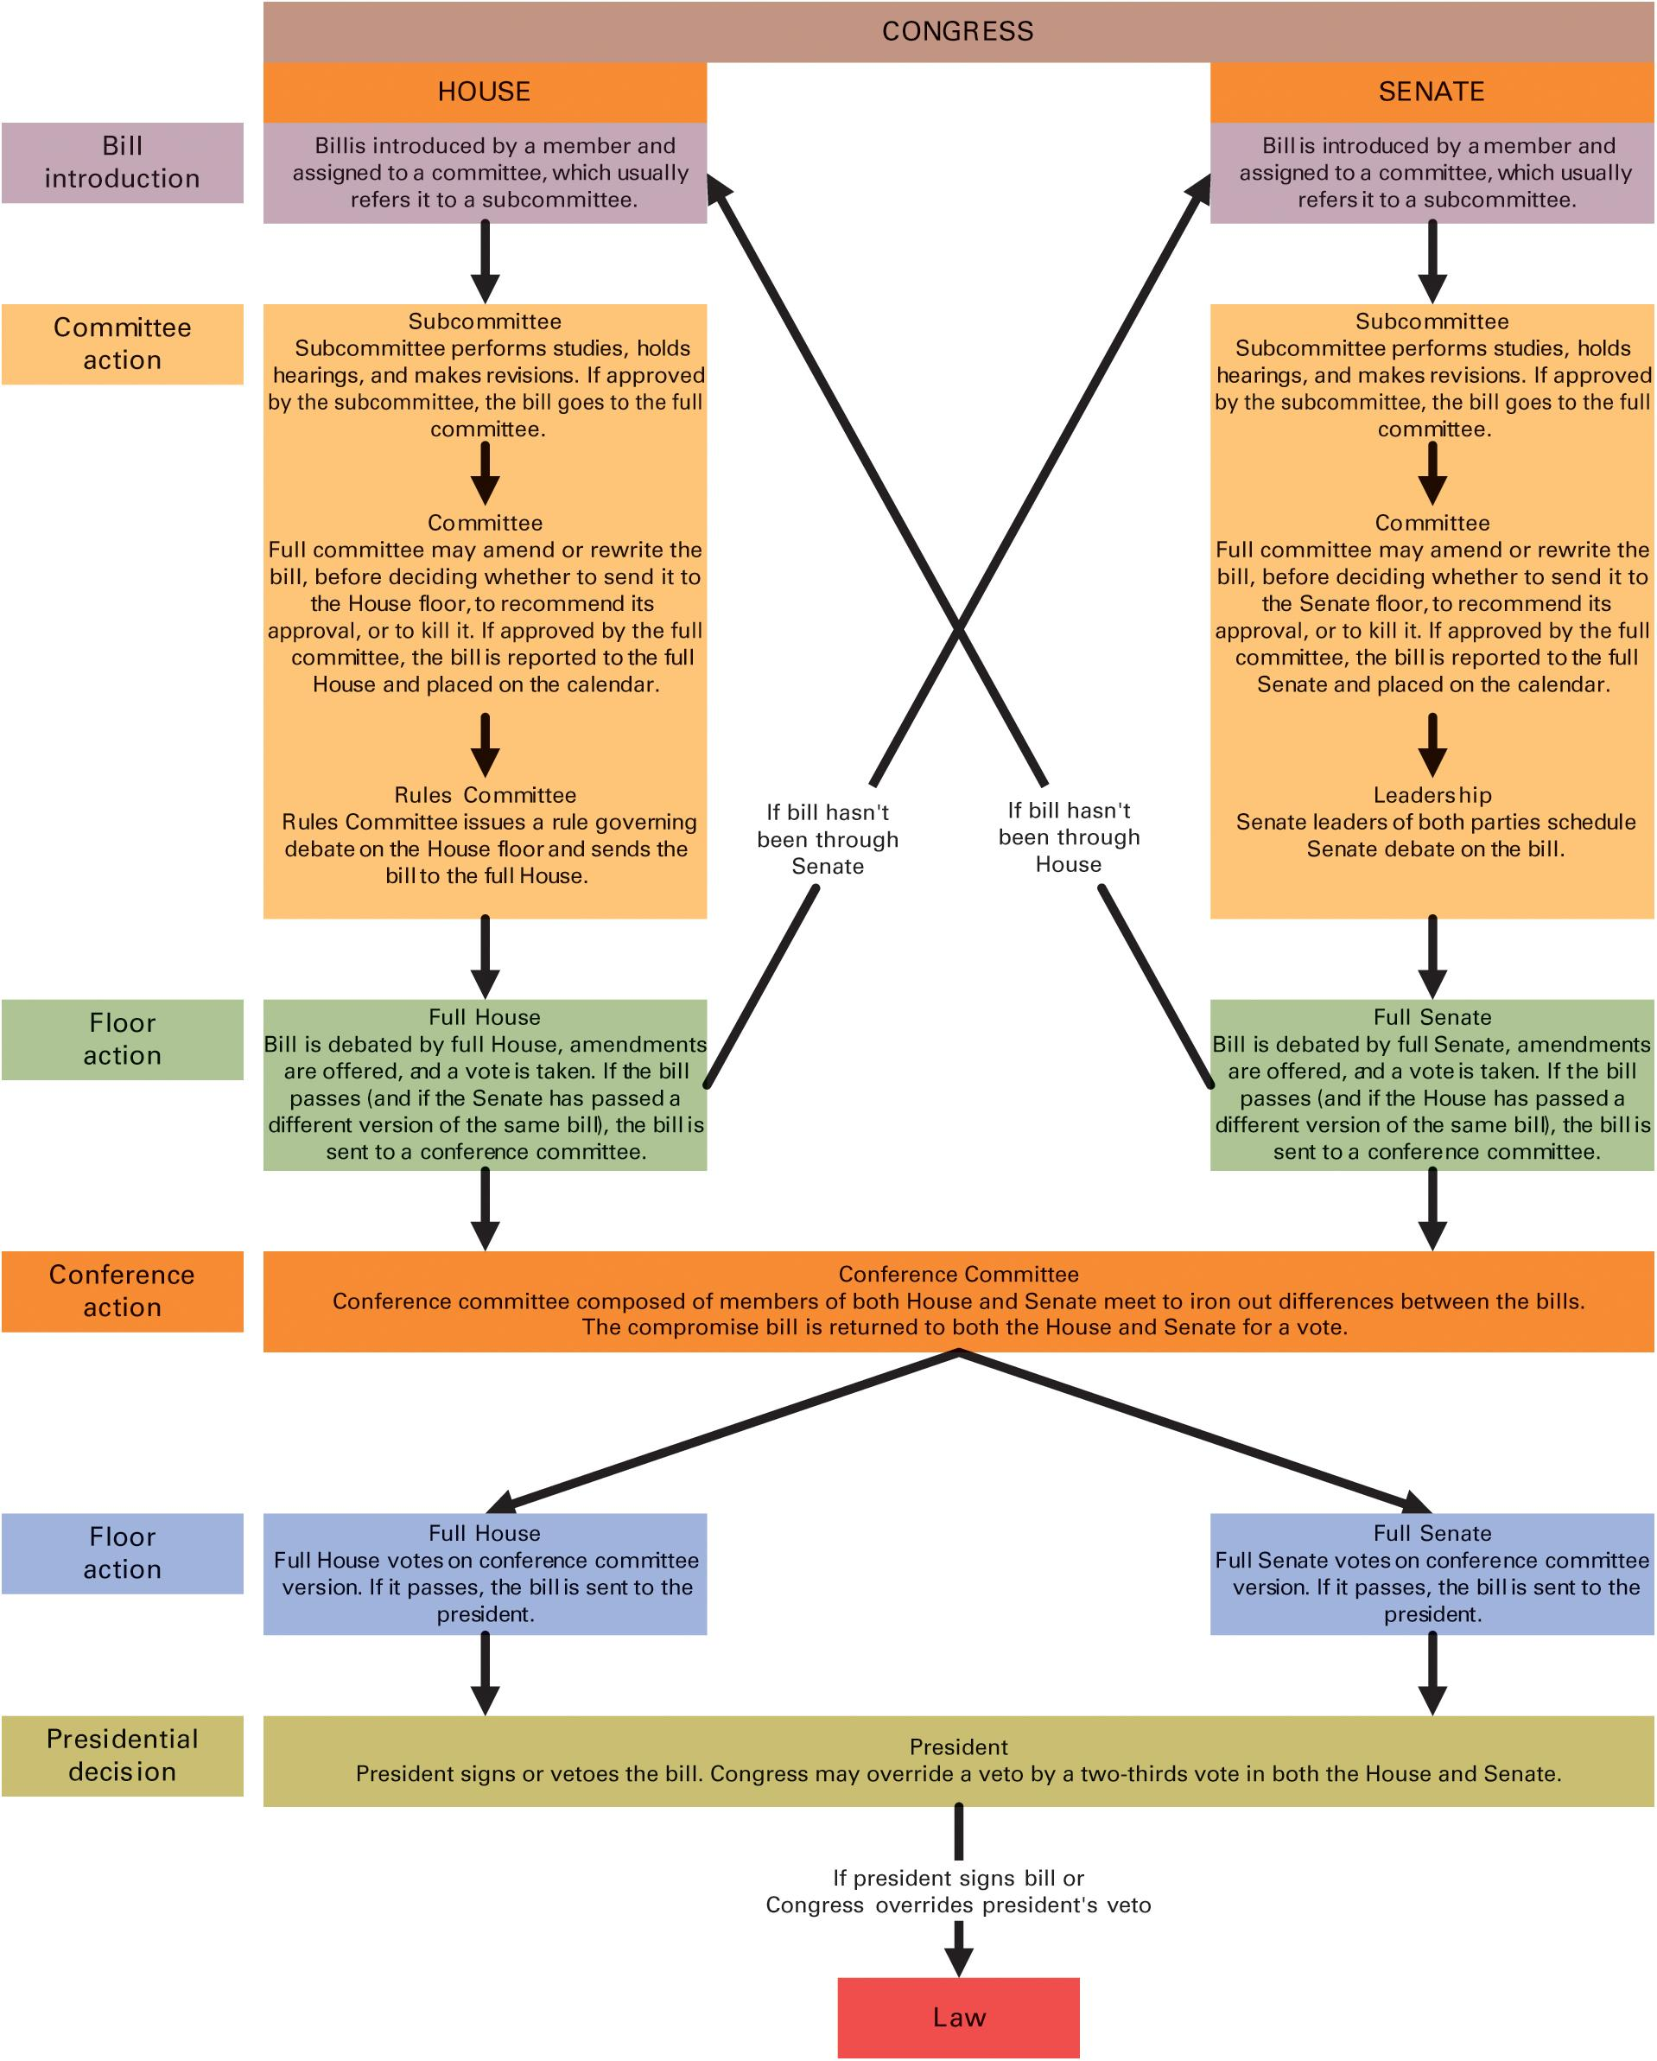
Figure 11.2 How a Bill Becomes a Law
Notes:
Bills can come to Congress in two different ways:
A bill can be introduced in either the house or the Senate by a member of that chamber. If the bill passes the chamber in which it originates, it is then sent to be introduced in the other chamber.
A bill (in similar or identical versions) can be introduced in both chambers at the same time. (This type of bill is termed a companion bill.)
In either case, the bill follows parallel processes in the House and Senate, starting with committee action. If a committee gives a bill a favorable report, the whole chamber considers it. Many bills travel full circle, coming first from the White House as part of the presidential agenda and then, if the bill is passed by both chambers, returning to the president.

Slide 34
Agenda Setting
House and Senate set their own agendas
House Rules Committee
Hastert Rule
Notes:
Both the House and the Senate get to set their legislative agenda. The House Rules Committee is a unique institution in the House of Representatives that sets the terms for floor debate. The Rules Committee is responsive to the House Leadership. In recent years, House Republicans have used the informal Hastert rule, which holds that Republicans will not vote on a bill unless it has the support of a majority of the Republican caucus.

Slide 35
The Committees at Work: Legislation
The committees at work: legislation
Bills go first to standing committee
Bills referred to subcommittee
Only bills with favorable reports get full consideration
Floor managers
Notes:
Most bills go first to a standing committee and then are assigned to a subcommittee , which is where most bills die.
Committee and subcommittee staff conduct research, line up witnesses for hearings, and write and rewrite bills. Committees and their subcommittees produce reports on proposed legislation.
Members of the committee usually serve as “floor managers” of the bill, helping party leaders hustle votes for it.

Slide 36
The Committees at Work: Oversight
Legislative oversight
Grown in size and complexity
Keeping tabs on the executive branch
Tracking the implementation of public policy
Little incentive for members of Congress
Majority party determines oversight agenda
Notes:
Committees are tasked with the process of monitoring the executive branch bureaucracy and its administration of policies, most of which Congress establishes by passing bills.
Congressional oversight grew as the size and complexity of the national government grew in the 1960s and in response to numerous charges that the executive branch had become too powerful.
Members of Congress have many competing responsibilities, and there are few political payoffs for carefully watching a government agency to see whether it is implementing policy properly.

Slide 37
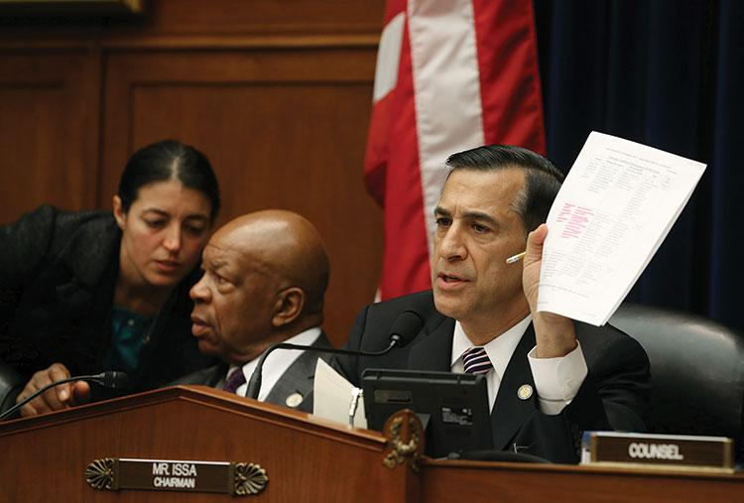
House Oversight and Government Reform Committee
Notes:
Most of the work in Congress occurs in committees. In 2013 the House Oversight and Government Reform committee held a hearing on the flawed rollout of the Affordable Care Act.

Slide 38
Floor Debate and the Filibuster
The filibuster
Allows for unlimited debate
Talking a bill to death
Cloture
Takes 60 votes to end debate
Questions about democracy
Tool of the minority
Recent rule changes
Notes:
Unlike the House where debate is tightly controlled, in the Senate debate is unlimited. This has allowed the minority to ”talk a bill to death.” A filibuster can be overcome through a motion of cloture, which requires a 60 votes to pass; many senators are reluctant to vote for ending debates because they don’t want to set a precedent.
The filibuster raises serious questions about American democracy because it is a tool that the minority uses to defeat the majority.

Slide 39
Rand Paul Drone Filibuster
Notes:
The goal of a filibuster is to prevent the Senate from voting on a bill favored by majority of senators. Senators may also use filibusters to call attention to a policy. Senator Rand Paul of Kentucky protested U.S. drone policy by trying to block a vote to confirm John Brennan as director of the CIA. He finally walked off the Senate floor after speaking for nearly 13 hours.

Slide 40
Unorthodox Legislating
Legislating has become more difficult
Methods of coping
Party leaders get involved earlier and more deeply
Multiple legislative referrals
Special rules from the House Rules Committee
Omnibus legislation
House party leaders have more leverage
Notes:
The polarized political climate in Congress has made legislating more difficult. As a result party leaders have developed a range of unorthodox legislative methods for coping with this difficult climate. Party leaders in the House have far more leverage to engage in unorthodox legislative activity than party leaders in the Senate.

Slide 41
Learning Objective 11.5
Describe the factors that influence how members of Congress make decisions.

Slide 42
Influences on Congressional Decision Making
Presidents and Congress: Partners and Protagonists
Party, Ideology, and Constituency
Lobbyists and Interest Groups
Notes:
There are multiple sources of influence on the decisions made by members of Congress with respect to legislation.

Slide 43
Presidents and Congress: Partners and Protagonists
President’s legislative agenda
Persuade Congress
Work at the margins but usually win
Yet Congress is quite independent
Notes:
The modern president usually has his own legislative agenda and is sometimes referred to as the chief legislator, a moniker that would have appalled the Framers. Presidents have to persuade Congress that their legislative agenda should be Congress’s priority.
Presidents don’t have time to serve as whips for their preferred policies and telephone members of Congress individually to urge them to vote for them; they leave this to staff, but they can speak to members of Congress at key moments on critical pieces of legislation to exert their influence.
Popular presidents usually win their legislative battles with Congress, but they lose or compromise often enough that we can safely say that Congress is truly independent, as the Framers intended.

Slide 44
Party, Ideology, and Constituency
Party influence
Economic and social welfare policies
Ideology and polarized politics
Parties more internally homogeneous
Less likelihood of compromise
Constituency opinion versus member ideology
Trustees versus instructed delegates
Notes:
Presidents come and go during a legislator’s career. It’s the constituents, not the president, who give congressional members their job and can fire them from it.
Party exerts a greater influence on members of Congress than it used to. Although not all votes are split strictly along party lines, this is increasingly the case as the parties become more polarized, especially on economic and social welfare policies. Republican legislators have become more conservative, and Democratic legislators more liberal. Redistricting has meant that representatives have fewer constituents of the opposite party in their districts.
What if a member of Congress has a different preference on a policy than his constituents? The trustee model of representation says that legislators are elected to use their best judgment. They have access to information that their constituents don’t have and they should act in their best interests. The instructed delegate model of representation states that representatives must mirror the preferences of their constituents.

Slide 45
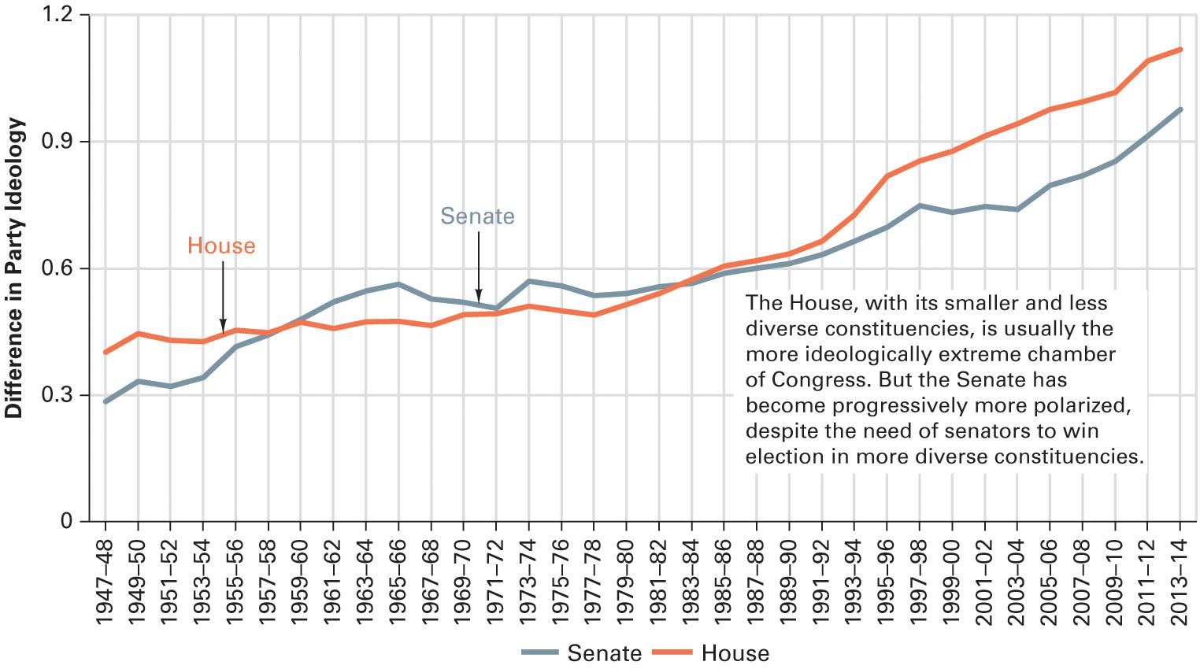
Figure 11.3 Increasing Polarization in Congress
Source: Authors’ calculation of data from Keith Poole, “The Polarization of Congressional Parties,” Voteview, January 30, 2016.
Notes:
Differences between Democrats and Republicans in Congress have grown considerably since 1980. Polarized parties make for clear choices for the voters but also make compromise more difficult.
Is America best served by clear but sizeable differences between the parties in Congress? Why or why not?

Slide 46
Lobbyists and Interest Groups
D.C. is crawling with lobbyists
12,000 of them
Spent $3 billion in 2015
Former members of Congress
How lobbyists persuade
Provide policy information
Provide promises of money
Ghostwrite legislation
Status quo usually wins
Disclosure requirements
Notes:
As we learned in an earlier chapter, there are more than 12,000 lobbyists, representing as many organizations, in Washington, all trying to influence Congress. Lobbyists spent $3 billion in 2011 on lobbying federal officials. Many lobbyists are former members of Congress who have the connections and knowledge of how the system works.
Lobbyists provide members of Congress with policy information and promises of money for their reelection campaigns. Lobbyists ghostwrite most legislation so it conforms to the preferences of the industry or interest affected by it. Lobbyists are more successful lobbying against change than for it.
Lobbyists are subject to disclosure requirements so that their influence is made public, but these requirements haven’t slowed them down.

Slide 47
Learning Objective 11.6
Assess Congress’s role as a representative body and the impact of representation on the scope of government.

Slide 48
Understanding Congress
Congress and Democracy
Congress and the Scope of Government
Notes:
Members of Congress have conflicting incentives. They want to make sound national policy but they also want to be reelected. How does this problem affect democracy and the scope of government?

Slide 49
Congress and Democracy
Democracy depends upon successful representation
Congress unrepresentative
Members are elites
Leadership chosen, not elected
Senate based on states, not population
Obstacles to good representation
Constituent service
Reelection campaigns
Representativeness versus effectiveness
Notes:
Direct democracy is impractical in a place as large as the United States so democratic government depends upon successful representation. But as we have seen in this chapter, Congress isn’t demographically representative of the American people. Its members are elites and, what’s more, its leadership is chosen by its members, not voters. The Senate represents each state equally, regardless of population, which undermines democratic representation.
There are other obstacles to good representation. Constituent service takes up a proportion of time that members of Congress could otherwise use for policymaking. They also devote considerable time to their reelection campaigns.
But could Congress actually be too representative in some ways? Policies in the national interest often have short-term negative effects on certain constituencies. With each member of Congress fighting for his or her own constituency, no one in Congress is looking out for the national interest. Each member of Congress wants to please his or her own constituents, whose particular interests he or she has been elected to represent.

Slide 50
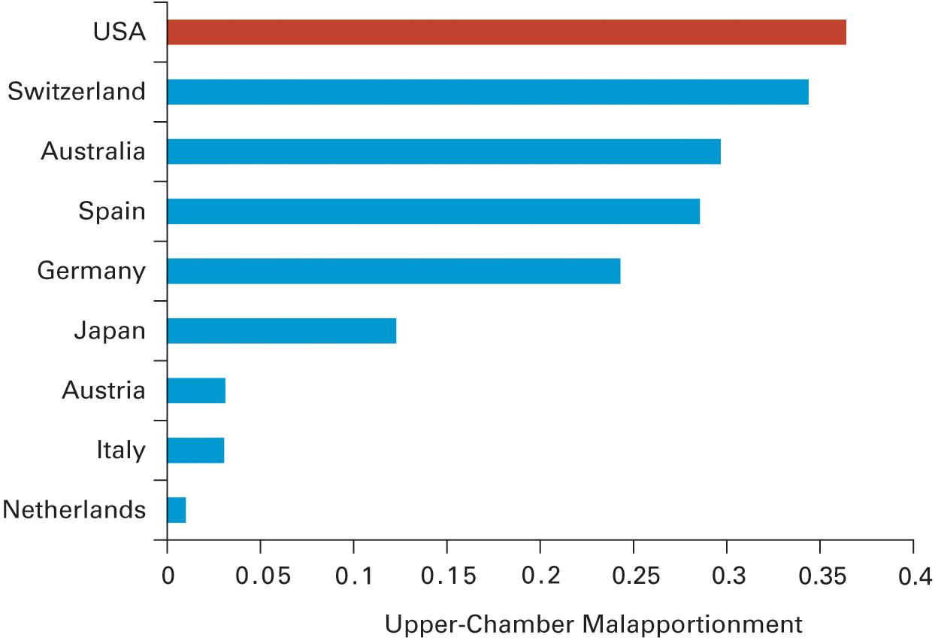
Figure 11.4 Malapportionment in the Upper House
Source: David Samuels and Richard Snyder, “The Value of a Vote: Malapportionment in Comparative Perspective,” British Journal of Political Science 31 (October 2001), 662.
Notes:
In a perfectly apportioned system, such as the Dutch Senate, no citizen’s vote weighs more than another's. In a malapportioned system, by contrast, the votes of some citizens weigh more than the votes of others. A number of democracies in developed countries have upper houses with significant powers. The U.S. Senate is the most malapportioned among them.
In your opinion, is the high degree of malapportionment in the Senate a problem for American democracy? Why or why not?

Slide 51
Congress and the Scope of Government
Does size of government increase to please public?
Pork barrel spending
Contradictory preferences
Against large government, for individual programs
Notes:
The desire to bring home the pork to their constituents tends to increase the size and scope of government. No member of Congress wants to cut a program that benefits his or her constituents, even if that member—and his or her constituents—advocates for smaller government. Americans have contradictory preferences in that they favor smaller government in general but oppose cutting individual programs. This puts Congress in an awkward position.

Slide 52
Journal Prompt 11.6: Congress and Democracy
In your opinion, is the high degree of malapportionment in the Senate a problem for American democracy? Why or why not?

Slide 53
Shared Writing 11
Gridlock results when the parties in Congress are highly polarized. How can Americans break that logjam so that Congress can deal with pressing problems in the country?

Slide 54
Photo Credits
Chapter 11
312: Tom Williams/CQ Roll Call Role/Getty Images; 315, left and right: David L Ryan/The Boston Globe/Getty Images; 321, left: Al Drago/CQ Roll Call/Newscom; 321, center: Alex Wong/Getty Images News/Getty Images; 321, right: Planetpix/US Senate/Alamy Stock Photo; 324: Scott J. Applewhite/AP Images; 328: Mark Wilson/Getty Images News/Getty Images; 330: Pete Marovich/EPA/Newscom; 335: J.B. Handelsman/The Cartoon Bank

