Slide 1
Government in America: People, Politics and Policy
Seventeenth Edition
Chapter 10
Interest Groups

Slide 2
Learning Objectives
10.1 Explain the origins of interest groups in America and the theories of their role in our democracy.
10.2 Analyze the factors that make some interest groups more successful than others in the political arena.
10.3 Analyze the methods and activities that interest groups use to influence political outcomes.
10.4 Identify the various types of interest groups and their policy concerns.
10.5 Evaluate how well James Madison’s ideas for controlling the influence of interest groups has worked in practice.

Slide 3
Learning Objective 10.1
Explain the origins of interest groups in America and the theories of their role in our democracy.

Slide 4
Theories of Interest Group Politics
The Role of Interest Groups in Politics
Pluralism
Elitism
Hyperpluralism

Slide 5
The Role of Interest Groups in Politics
Interest groups pursue policy goals
Different from political parties
Do not run candidates
Policy specialists, not generalists
23,000 interest groups
Technology aids lobbying
Notes:
Interest groups are organized to pursue policy goals. For example, the goal of some interest groups is to outlaw abortion and the goal of others is to assure access to it.
Political parties may also have policy goals that they pursue, but parties exist to run candidates for political office. Interest groups may support candidates, but they don't run their own slate of candidates for elective offices. Also, interest groups tend to specialize in one policy area, whereas major political parties must be policy generalists.
There are more than 23,000 interest groups in the United States, representing every conceivable interest. Developments in electronic communications have made it easier for interest groups to reach both policymakers and the public.

Slide 6
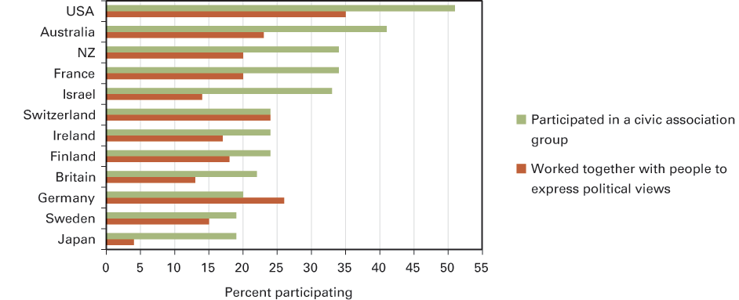
Figure 10.1 Interest Group Participation
Sources: Authors’ analysis of the 2007 International Social Survey Program survey for civic associations and the Comparative Study of Electoral Systems, module 2 (2001–2006) for working with others to express political views.
Notes:
Americans are very associational compared to people in other democracies, as you can see in the following graphic.
Question Wording: For civic associations – “In the last 12 months, have you participated in the activities of one of the following associations or groups: a community service or civic organization group?” For working with others to express political views –"Over the past 5 years or so, have you done any of the following things to express your views about something the government should or should not be doing: worked together with people who share the same concern?”

Slide 7
Pluralism (1 of 2)
Group theory of politics
Groups provide a key link between people and government
Groups compete
No one group is likely to become too dominant
Groups usually play by the rules of the game
Groups weak in one resource can use another
Notes:
Pluralists have a positive view of interest groups. Since lobbying is open to all, groups compete with one another. No group wins or loses all the time.
According to the pluralist perspective, interest groups are useful for democracy because they link people and government. If you can get your interest organized, it'll receive a hearing by government. Groups make competing claims on government, balancing each other and preventing any one interest from dominating. Most groups play by the rules to keep the competition fair, and groups can each use their own advantages. Big business, for example, may have more money, but labor has more people.

Slide 8
Pluralism (2 of 2)
Concessions
Some groups stronger than others
All interests do not get equal hearing
Notes:
This isn't to say that some groups aren't stronger than others, nor to claim that all interests get an equal hearing, but lobbying is ultimately open to all, which prevents interest groups from being a problem in our system.

Slide 9
Elitism
Real power held by a few
75% of Americans share this view
Interlocking directorates
Multinational corporations
Lobbying benefits the few at the expense of the many
Notes:
In contrast to the pluralists who see many groups competing on a relatively equal footing, elitists observe that these groups are vastly unequal in their power and influence. Elitism is the dominant view of interest group politics today.
Elitists have observed that certain people tend to hold more than one institutional leadership position, creating interlocking directorates, and the interests of multinational corporations prevail over consumer interests. Interest groups are detrimental in this view because the interests of the wealthy few benefit at the expense of everyone else.

Slide 10
Hyperpluralism
Interest group liberalism
Groups out of control
Government tries to appease all of them
Budgets, programs, regulations expand
Iron triangles
Contradictory and confusing policy results
Notes:
Like pluralists, hyperpluralists see many groups competing on a relatively equal footing for government attention. But unlike pluralists, hyperpluralists don't see good governance as the result. Because government seeks to appease all interests, policies proliferate. Budgets increase, and more programs and regulations are created.
In some cases, interest groups will develop a tight, ongoing relationship with the federal agency that oversees policy related to their interest—and the congressional committee in charge of handling relevant policy. These networks are known as iron triangles and they lead to control of the regulators by the regulated.
Basically, hyperpluralists see the selfish competition of groups for promulgation of policies that narrowly benefit their interests as leading to contradictory and confusing policy results.

Slide 11
Journal Prompt 10.1: Hyperpluralism
What are the key differences between the three main theories of interest groups—pluralism, elitism, and hyperpluralism? Which theory do you think is most applicable to American government today?

Slide 12
Learning Objective 10.2
Analyze the factors that make some interest groups more successful than others in the political arena.

Slide 13
What Makes an Interest Group Successful?
The Surprising Effectiveness of Small Groups
Intensity
Financial Resources
Notes:
Why are some interest groups more successful than others? The size, intensity, and financial resources of an interest group all contribute to the likelihood of its achieving its goals.

Slide 14
The Surprising Effectiveness of Small Groups
Smaller groups have advantage
Potential group
Actual group
Collective good
Free-rider problem
Selective benefits
Notes:
Small groups have an advantage in interest group politics because it's easier for them to organize—that is, to turn potential members into actual members. A potential group is composed of all people who might be group members because they share some common interest, whereas an actual group is composed of those in the potential group who choose to join. Groups vary enormously in the degree to which they enroll their potential membership. A small number of producer companies can organize more effectively than large numbers of consumers.
When a group secures benefits for its members, those in the potential member category also reap those benefits. For example, if a labor group fights for a higher minimum wage, nonmembers will receive that higher wage, too. Benefits like clean air, which cannot be withheld from nonmembers, are known as collective goods. It's perfectly rational for people to sit back and let others do the work when the benefits are in the form of collective goods. This is called the free-rider problem, and it's much more of a problem for larger groups than smaller ones.
One way that large groups can overcome the free-rider problem is to offer selective benefits, that is, some sort of reward for joining the group that's unavailable to nonmembers.

Slide 15
Intensity
Psychological advantage
Single-issue groups
On the rise
Dislike compromise
Examples: nuclear power plant, gun control, abortion
Notes:
The intensity of support for or opposition to a policy has an impact on its likelihood of passage. Single-issue groups, which lobby passionately for a narrow interest, are on the rise. These groups dislike compromise and develop sophisticated strategies for enacting policies that lead to their goals. Abortion is an example of a policy issue that's spawned many single-issue groups on both sides of the policy debate.

Slide 16
Financial Resources
System is biased toward wealthy
Donations lead to access
But $$$ does not always lead to lobbying success
Other side contributes, too
Notes:
The interest group system is biased toward the wealthy mainly because of the cost of political campaigns. Campaign contributions by interest groups buy access to politicians that the groups expect to lead to favorable policy outcomes.
But campaign contributions don't always lead to lobbying success. Remember that lobbying is competitive, and the other side is also making contributions.

Slide 17
Journal Prompt 10.2: Financial Resources
Focusing on an interest group that you are particularly supportive of, evaluate how successful it is likely to be based on the general factors predicting interest group success that you have learned about.

Slide 18
Learning Objective 10.3
Analyze the methods and activities that interest groups use to influence political outcomes.

Slide 19
How Groups Try to Shape Policy
Lobbying
Electioneering
Litigation
Going Public
Notes:
Interest groups use four main strategies to achieve their policy goals: lobbying, electioneering, litigation, and going public. Groups vary in which strategies dominate, but most use multiple tactics in pursuit of their policy goals.

Slide 20
Lobbying
Two types of lobbyists
Full-time employee
Temporary employee
Often former legislators
Why do Congressmen listen to lobbyists?
Lobbyists provide specialized expertise
Lobbyists help with political & campaign strategy
Lobbyists provide ideas
Notes:
Interest groups employ lobbyists to haunt the halls of the Capitol and buttonhole legislators and officials. Well-funded interest groups can afford to have full-time lobbyists on staff. Groups that are too small to afford a full-time lobbyist hire temporary ones when critical policies are being debated. Lobbyists are often former legislators. Can you guess why?
Why do members of Congress give lobbyists their time and attention? Well, lobbyists are important sources of information. Congress members must be policy generalists, but lobbyists can be experts in a specific policy area and provide information on the effects of various policy options.
Lobbyists are also politically savvy and can serve as consultants, offering advice on how to shepherd policy through or how to win the votes of a certain constituency. Members of Congress are always eager to claim credit, and lobbyists can give them ideas for bills to introduce.

Slide 21
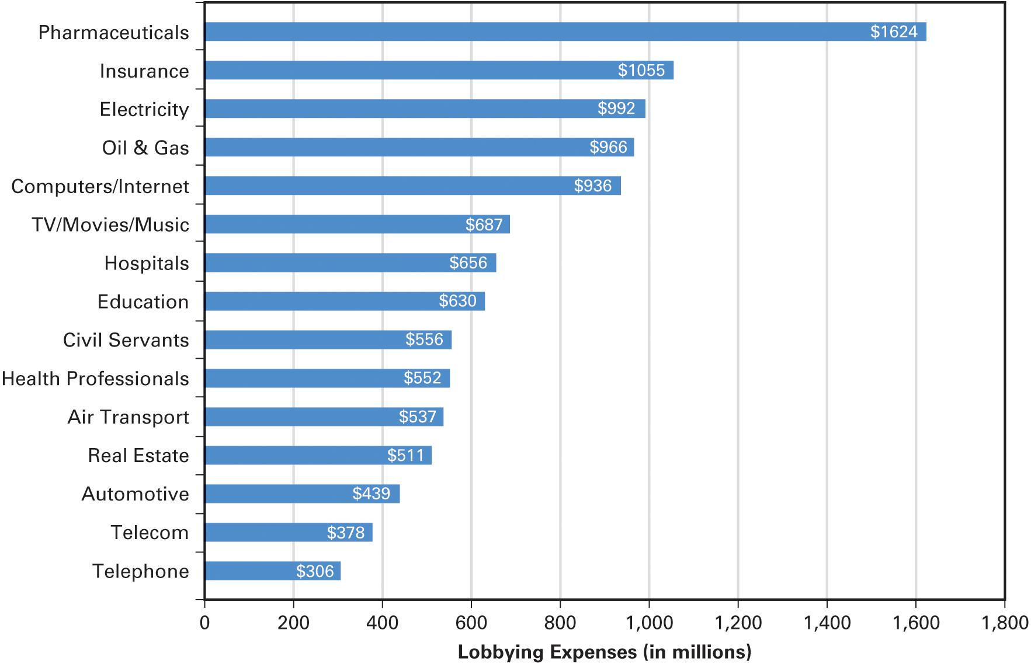
Figure 10.2 Big Spenders on Lobbying, 2009–2015
Source: Compiled by the authors from the 2009–2015 data from the Center for Responsive Politics.
Notes:
This graph presents a total amount spent on lobbying during the first seven years of the Obama presidency buy the biggest-spending professional sectors. Keep in mind that the data are presented in terms of millions spent. Thus, the pharmaceutical industry spent $1,624,243,595 on lobbying. All told, just these 15 industries spent about $10.8 billion on lobbying during these seven years.

Slide 22
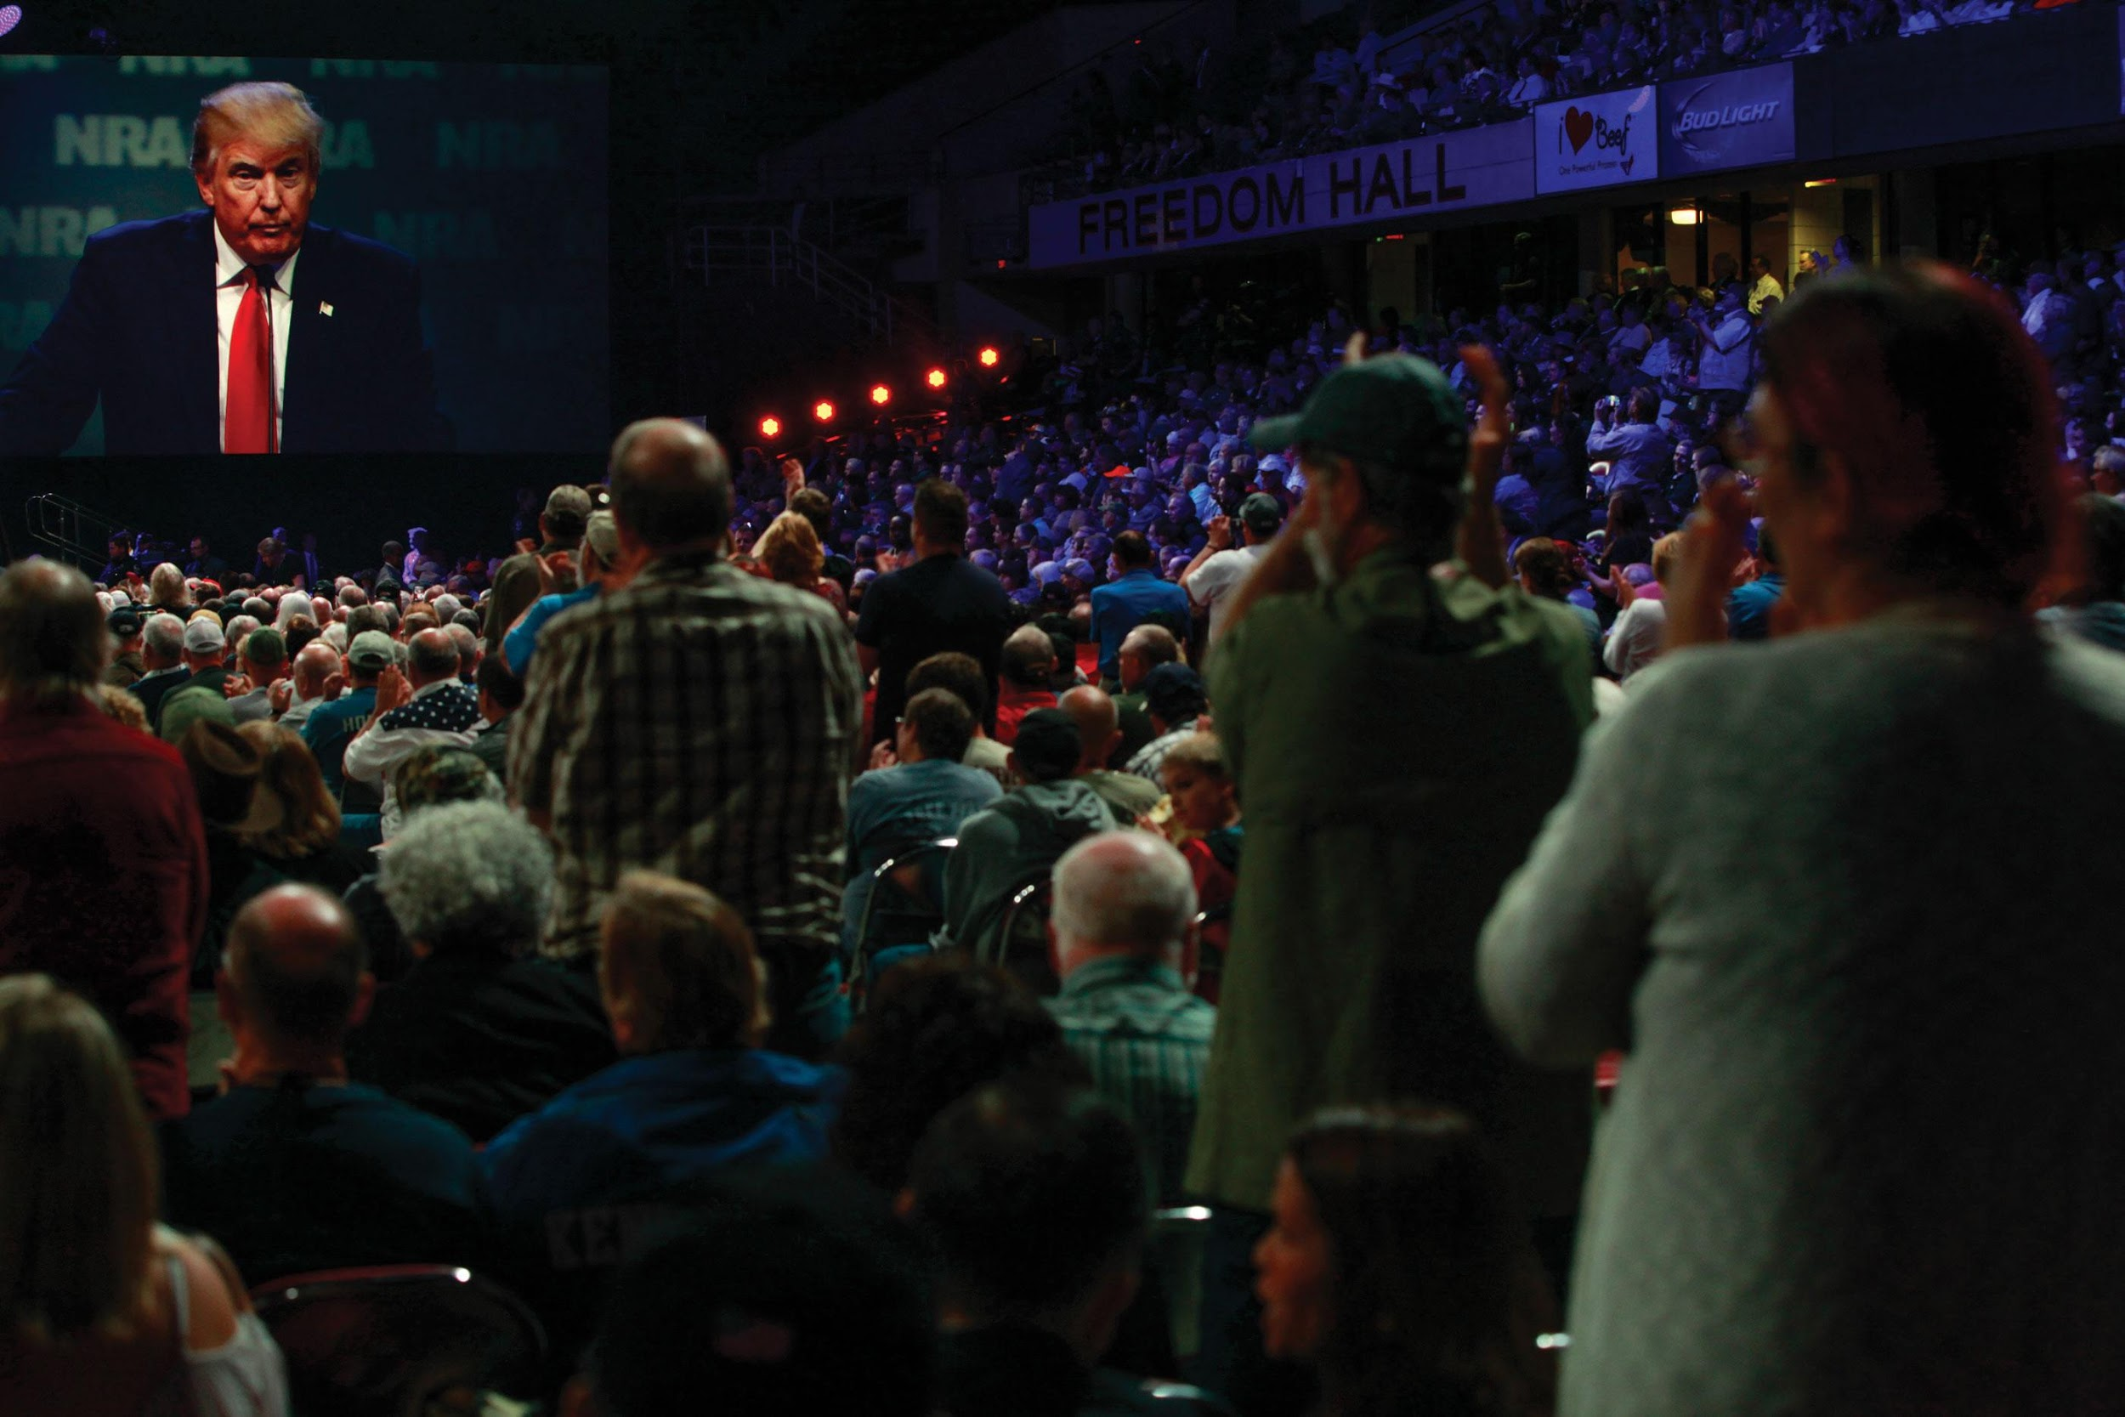
NRA
Notes:
For years, the National Rifle Association has successfully lobbied against gun control measures, arguing that the Second Amendment to the Constitution guarantees all citizens the right to bear arms. During his address to the 2016 annual meeting of the NRA, shown here, Donald Trump told the gun advocacy group that bearing arms “is the most basic human right of all.”

Slide 23
Electioneering
Aiding candidates financially
Getting out the vote
PACs
5,819 PACS as of January 2016
$5,000 limit in primary and general election
Mainly support incumbents
Candidates need PACs
Majority of money goes to incumbents
Should PACs be eliminated?
Notes:
Interest groups don't want to waste their time lobbying officials known to be opposed to their positions, so they try to get sympathetic candidates elected. Electioneering is the strategy of aiding candidates financially and getting group members to support them.
In order to legally funnel donations to candidates, interest groups form political action committees, or PACs. PACs can give $5,000 per candidate in the primary and general election campaigns. PACs overwhelmingly support incumbents. Can you figure out why?
Some people think that PAC money makes candidates beholden to wealthy interest groups. Today, many candidates receive the majority of their campaign money from PACs. Do you think PACs should be eliminated? Why or why not?

Slide 24
Litigating
Suing for enforcement
Environmental regulations
Civil rights groups – 1950s
Amicus curiae briefs
Class action lawsuits
Notes:
Lawsuits are another strategy employed by interest groups. If they fail in Congress or the White House, they can appeal to the courts to rule in their favor. Environmental groups have had some success suing for enforcement of environmental legislation. In the 1950s, when civil rights groups had failed to make headway with Congress, they sued to invalidate discriminatory laws on constitutional grounds.
Even when a group is not directly involved in litigation, they can weigh in with their opinion on how the court should rule, and why, by filing an amicus curiae brief. Hundreds of these friend-of-the-court briefs are filed in cases, with many interest groups on both sides of the issue.
Because interest groups frequently represent the interests of large numbers of people affected by a policy, they can file class action lawsuits to combine common grievances into a single suit.

Slide 25
Fisher v. University of Texas
Notes:
Abigail Fisher, shown in the photo on the left with her lawyer, was a plaintiff in the 2016 Supreme Court case Fisher v. University of Texas, which challenged the university’s affirmative action policy. In response to this challenge, many amicus briefs were filed by groups that supported the policy. One such brief was presented by a group of African American graduates of UT, including the internationally acclaimed mezzo soprano Barbara Smith Conrad, shown in the photo on the right.

Slide 26
Going Public
Public opinion influences policymakers
Mobilize public opinion
Public relations
Notes:
Interest groups appeal to politicians to support their policy stands, but they also appeal to the public because officials respond to public opinion to some extent.
Interest groups can mobilize public opinion by urging supporters to send postcards or emails to legislators or sign petitions that demonstrate the extent of support or opposition to a policy.
Business interest groups engage in public relations efforts to defend their reputations and promote their stands on issues. The fossil fuel industry spends a tremendous amount of money trying to remold its reputation in the public eye with vigorous PR campaigns in national media. This PR advertising seems to pay off for big business.

Slide 27
Interest Group Rally
Notes:
Interest groups spent tremendous sums lobbying during the debate over Obamacare. Here, a liberal group is shown supporting the proposal of the public option, which would have given everyone the chance to opt into the Medicare system.

Slide 28
Learning Objective 10.4
Identify the various types of interest groups and their policy concerns.

Slide 29
Types of Interest Groups
Economic Interests
Environmental Interests
Equality Interests
Consumer and Other Public Interest Lobbies
Notes:
Interest groups can be divided into four distinct types: economic, environmental, equality, and consumer or public interest groups.

Slide 30
Economic Interests
Labor
Unions
Union shop versus "right-to-work"
Business
Dominate lobbying and PACs
Business interests not monolithic
Policy differences among industries
Notes:
Economic policies cause consternation for business, labor, and farm interests. They fret over taxes, subsidies, and regulations.
The interests of workers are represented by labor unions. About 11% of the workforce belong to labor unions, down from 33% in 1956. In order to avoid the free-rider problem, labor unions would like membership to be obligatory. This is called a union shop.
Some states forbid unions to require membership; these are known euphemistically as right-to-work states. As blue-collar manufacturing jobs have declined in the United States, union power and membership have fallen, but some white-collar and public sector jobs have become unionized.
Business interests have the wealthiest and most powerful lobbying groups. They have the largest number of PACs and make the most contributions. Although we tend to assume that business interests will give more to Republicans because that party generally supports lower corporate taxes and fewer regulations, the truth is that PACs tend to give the most money to the party in power because they are paying for access to power. And business interests are not monolithic. Trucking and rail businesses, for example, would favor different policies.

Slide 31
Wisconsin Collective Bargaining Fight
Notes:
Over the vigorous protest of union supporters, shown here, the Wisconsin state legislature passed a law that took away collective bargaining rights from public sector employees. After Governor Walker signed the bill into law, union activists mounted a campaign to recall the governor, which ultimately failed by 53–47 percent margin in 2012.

Slide 32
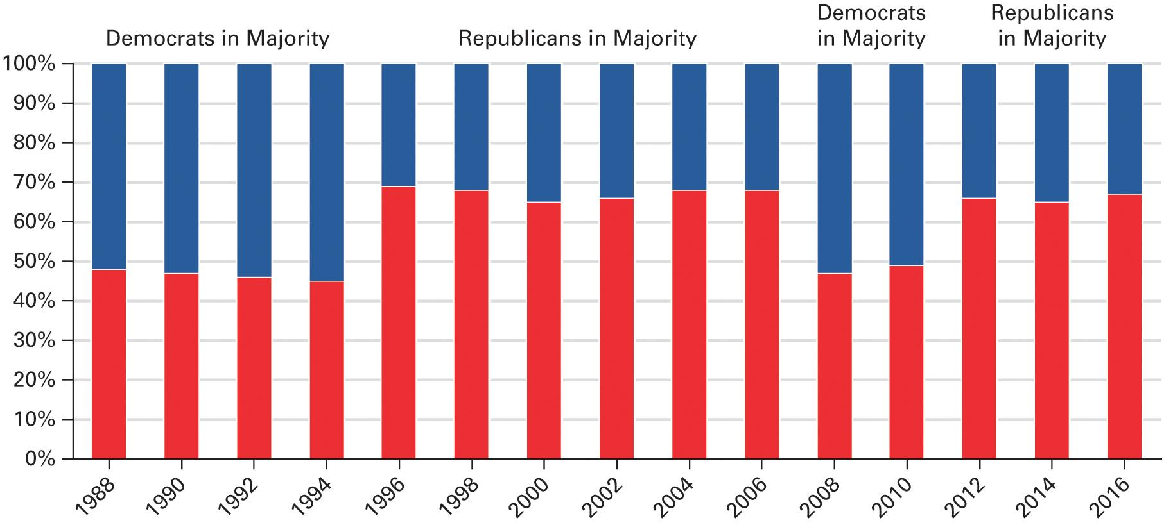
Figure 10.3 How Corporate PACS Have Shifted Toward the Majority Party
Source: Federal Election Commission, PAC Contributions, 2016.
Note: Data for 2016 are through June 30, 2016.
Notes:
This graph shows percentage of corporate PAC spending in each two-year election cycle that went to Republican candidates for the House of Representatives. In years in which the Republicans were in the majority, they received about two-thirds of corporate PAC donations. In contrast, in years in which the Democrats were in the majority, the Democrats got a slight majority of corporate PAC donations.

Slide 33
Environmental Interests
Sprang up since 1970
More than 10,000 groups with $2.9 billion revenue
Profound policy impact
Influential due to numbers, not money
Notes:
Although a few environmental groups, such as the Sierra Club, have existed since the nineteenth century, most have sprung up since 1970. There are now more than 10,000 environmental groups, with a combined revenue of more than $2.9 billion.
Environmental groups do not have the money of economic interests, but they have exerted influence in Congress because of their strong public support.

Slide 34
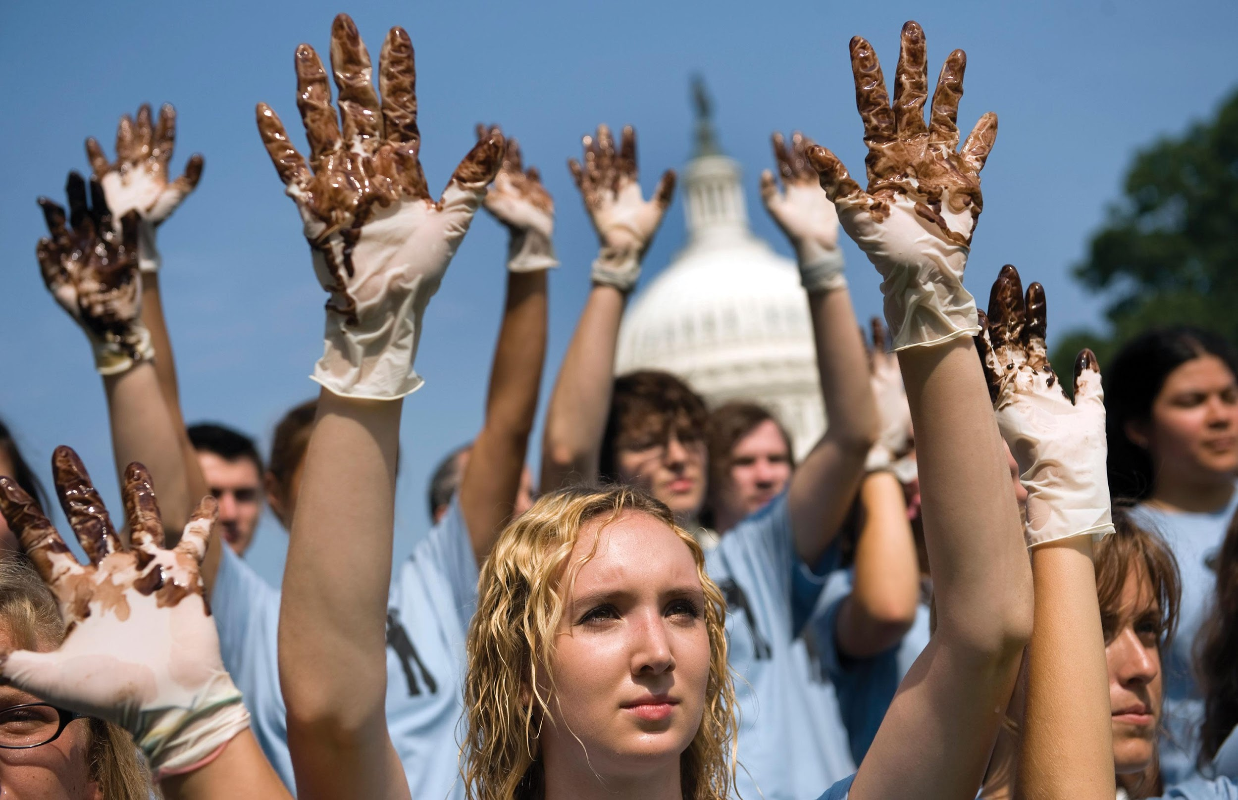
Greenpeace
Notes:
A few interest groups use unconventional methods to get attention for their views and demands. The environmental activist group Greenpeace is well known for coming up with activities the media can hardly ignore. Here, Greenpeace activists attract media attention by displaying hands covered with oil as they asked Congress to stop taking campaign contributions from the oil industry.

Slide 35
Equality Interests
Fourteenth Amendment guarantees
Minorities
NAACP/Brown v. Board of Education (1954)
Social welfare policies
Women
National Organization for Women (NOW)
Equal Rights Amendment (ERA)
Notes:
African Americans have been fighting against segregation and discrimination throughout American history. One of the oldest groups pushing for civil rights is the National Association for the Advancement of Colored People, which argued and won the monumental Brown v. Board of Education school desegregation case in 1954. Recently, civil rights groups have been focusing on social welfare policies to help the poor.
Women's rights groups have fought long and hard for equal rights for women. The National Organization for Women has lobbied to end discrimination on account of gender. One of their top goals has long been the passage of the Equal Rights Amendment, which states that "equality of rights under the law shall not be abridged on account of sex."

Slide 36
Consumer and Other Public Interest Lobbies
Policies in the public interest
Collective goods
What is the public interest?
Notes:
Consumer and public interest groups pursue policies that they believe will benefit everyone, not just the members of the groups. Because they seek collective goods, they have a significant free-rider problem and are not usually well funded. Despite this, they have won some legislative and legal victories in making consumer products safer.
What exactly is the public interest? Each public interest group believes it knows what's in the public interest, but some religious groups believe they're acting in the public interest when they seek to impose their moral views on everyone.

Slide 37
Learning Objective 10.5
Evaluate how well James Madison’s ideas for controlling the influence of interest groups have worked in practice.

Slide 38
Understanding Interest Groups
Interest Groups and Democracy
Interest Groups and the Scope of Government
Notes:
So, we have a bit of a conundrum about interest groups. A free society must allow for the representation of all groups that seek to influence political decision making, yet groups are usually more concerned with their own self-interest than with the needs of society as a whole. For democracy to work well, it's important that groups not be allowed to assume a dominant position. Do interest groups have a dominant position in the United States today?

Slide 39
Interest Groups and Democracy
Does pluralism prevail?
Growth in number of interest groups
Less clout for any one group
Interest group corruption?
Business PACs
Wealthy groups dominate
Gridlock?
Notes:
James Madison believed that opposing interests would counteract each other. The theory of pluralism agrees with Madison. The fact that we have a large number of interest groups that are continually increasing in number and variety, and that their sheer numbers reduce the clout of any one interest, would seem to imply that Madison and the pluralists are right.
But considering numbers alone masks the fact that a few big-spending groups representing business interests dominate interest group politics. Does the money coming from these groups corrupt the democratic process?
Hyperpluralists would argue that the formation of so many interest groups has led to policy gridlock. It's increasingly difficult to initiate major policy change due to the variety of interests that must be appeased.

Slide 40
Interest Groups and the Scope of Government
Individualistic and associational
Difficult to reduce spending
Vicious circle
Groups lead to policy
Policy prompts new groups to form
Notes:
Americans are individualistic, but we also love to join interest groups. That isn't a contradiction because interest groups channel political participation and facilitate representation of individual interests. But all these interests want something from government, making it difficult to cut government spending. Every attempt to cut a program affects some interest group.
There is also a vicious circle created when government attempts to take responsibility for a new policy area due to interest group pressure, which encourages new groups to spring up around the issue. For example, once the government got actively involved in protecting the environment, many groups sprung up to lobby for strong standards and enforcement.

Slide 41
Shared Writing 10
America’s founding fathers designed a constitutional structure that they thought would control the power of interest groups. Considering the current state of interest group politics, how well did they succeed? Do you think interest groups have too much power over policymaking in Washington?

Slide 42
Photo Credits
Chapter 10
288: Adam Zyglis/The Buffalo News/Cagle Cartoons, Inc.; 294: Jeremy Hogan/Polaris/Newscom; 298: Gary Miller/FilmMagic/Getty Images; 298: Scott J. Applewhite/AP Images; 299: Stephen J. Boitano/ LightRocket/Getty Images; 301: Justin Sullivan/Getty Images News/ Getty Images; 303: Tom Williams/Roll Call Photos/Newscom

