Slide 1
Government in America: People, Politics and Policy
Seventeenth Edition
Chapter 9
Campaigns and Voting Behavior

Slide 2
Learning Objectives (1 of 2)
9.1 Evaluate the fairness of the presidential primary and caucus systems.
9.2 Describe campaign methods and strategies.
9.3 Identify how the financing of federal campaigns is regulated and evaluate the influence of money in elections.
9.4 Determine why campaigns have an important yet limited impact on election outcomes.

Slide 3
Learning Objectives (2 of 2)
9.5 Identify the factors that influence whether people vote.
9.6 Analyze why people vote as they do.
9.7 Evaluate the fairness of the Electoral College system for choosing the president.
9.8 Assess the advantages and disadvantages of the U.S. system of campaigns and elections.

Slide 4
Learning Objective 9.1
Evaluate the fairness of the presidential primary and caucus system.

Slide 5
The Nomination Game
Competing for Delegates
The Convention Send-Off
Notes:
Earning a party's nomination for office requires money, media attention, and momentum. Candidates must develop a smart campaign strategy to have a hope of winning their party's nomination.
A campaign is a test of endurance and energy, of living with sleep deprivation, junk food, lack of exercise, and no life outside the campaign for year after year. In contrast, campaigns in other wealthy democracies usually last no more than two months.

Slide 6
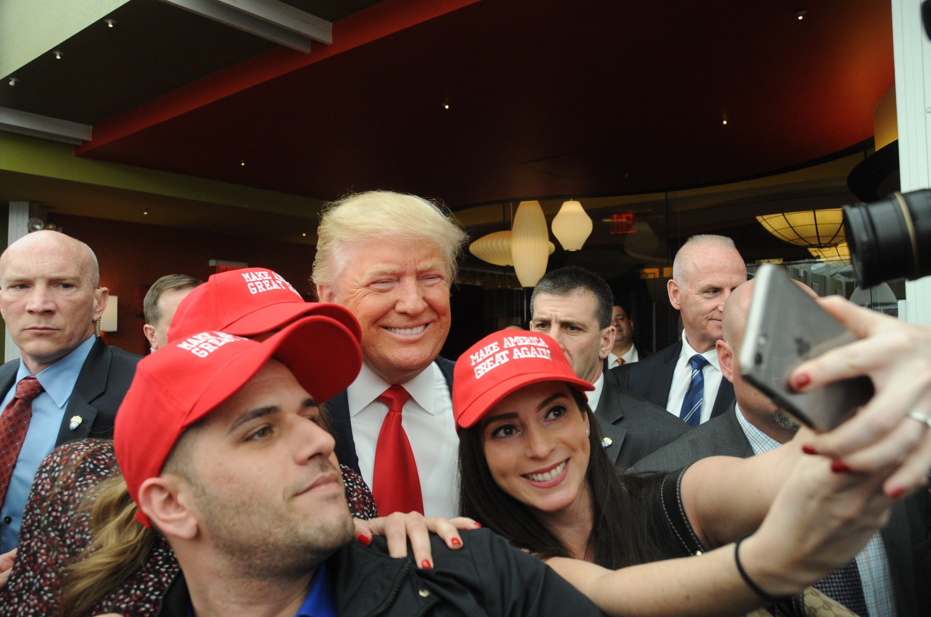
Donald Trump Campaigns
Notes:
All candidates for public office, even for the presidency, have to get out and meet people to win votes and drum up enthusiasm for their electoral campaign. In today's world, posing for a selfie with excited supporters has become commonplace in the world of campaigning.

Slide 7
Competing for Delegates (1 of 2)
National party convention
State delegates meet and vote on nominee
Nomination process more democratic today
McGovern-Fraser Commission
Superdelegates
The invisible primary
Woo support out of the public eye
Craft positive personal image
Distinguish themselves from other candidates
Seek media attention but avoid blunders
Notes:
Before candidates for each party can campaign against each other in a general election, they must compete against other potential nominees in their party's primary elections. These elections are held to determine delegates for each candidate. The delegates assemble at the national party convention and the winner is known before they arrive, based on the primary election results.
It was progressive reformers in the early twentieth century who wrenched the nominating process from the hands of party bosses and gave that power to the party membership as a whole. But the parties were slow to implement democratic reforms in their nominating processes until the riots at the Democratic national convention in 1968, when party leaders could no longer ignore the fact that delegate selection effectively excluded women, minorities, youth, the poor, and other groups who were not represented in party leadership.
The McGovern-Fraser Commission implemented reforms in the Democratic Party's delegate selection process that encouraged the Republican Party and the states to move to primary elections.
One vestige of party leadership control is the superdelegate. Superdelegates are people who are awarded automatic slots as delegates because they are a member of Congress or their party's national committee. Their job is to balance the tendencies of the more partisan party electorate and ensure that an electable candidate is given the nomination.
Long before any primary votes are cast, potential nominees are hard at work wooing support from elected officials (most importantly, governors and members of Congress), top fundraisers, and skilled political aides. Since this garnering of key endorsements takes place out of the public eye, it's known as the invisible primary.
Candidates from the same party try to distinguish themselves from one another by crafting a positive personal image that highlights their qualifications and character. They seek media attention but try to avoid blunders that will deflate their campaign.

Slide 8
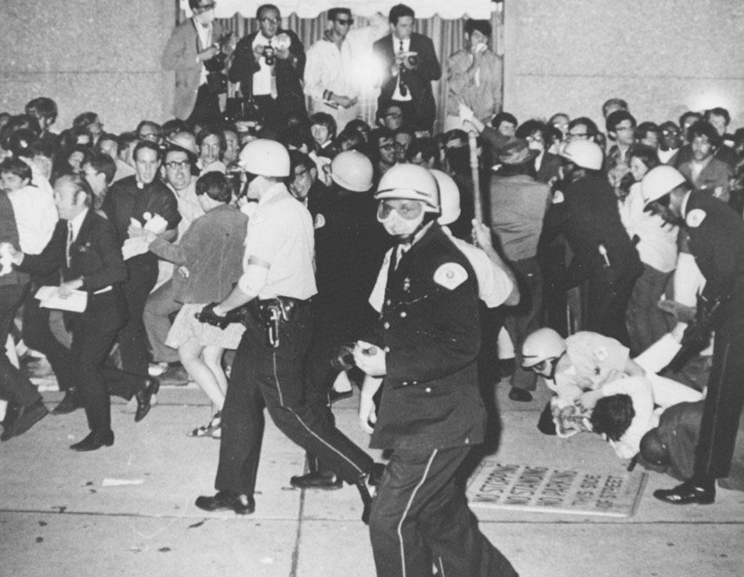
1968 Democratic National Convention Riots
Notes:
Riots at the 1968 Democratic national convention led to the establishment of more open procedures for delegate selection. These reforms have made recent party conventions more representative.

Slide 9
Competing for Delegates (2 of 2)
The caucuses and primaries
Iowa caucus
New Hampshire presidential primary
Frontloading
Evaluating the primary and caucus system
Disproportionate attention on early caucuses and primaries
Politicians find it hard to take time out to run
Money plays too big a role
Participation is low in primaries and caucuses are unrepresentative
Notes:
Most states hold primary elections, but a few hold caucuses, which are meetings where citizens discuss and vote on a nominee. Caucuses require more effort, so voter participation is lower and reflects more intense feelings. Iowa is the first state to hold its caucus, which gives it media attention disproportionate to its size. With so much attention paid to the early contests, more states have tried to frontload, or move their primaries up in the calendar, to capitalize on the media attention.
New Hampshire is the first state to hold a presidential primary election, which, like the Iowa caucuses, attracts intense media attention. Although the winners in Iowa and New Hampshire don't always stay the frontrunners, winning these early primaries gives a campaign visibility and momentum that attracts donors and supporters.
Candidates who do poorly in early primaries are often forced to drop out of the race due to lack of campaign funding. Some states designate all of their delegates for the winning candidate; others apportion them according to the percentage of the vote.
The primary and caucus systems brought welcome democratic reforms to the nominee selection process, but they have developed problems of their own. For starters, the candidates devote a disproportionate amount of attention to early primary and caucus states, even though the number of delegates at stake is small.
Since campaigning is a full-time job, officials running for reelection often neglect their duties. In fact, legislators are often absent for crucial votes because they're out on the campaign trail.
Most Americans think that money plays too large a role in political campaigns. Voters in primaries and caucuses tend to be unrepresentative of party membership, and of the electorate as a whole. Only about 25% of eligible voters cast ballots in primary elections, and about 5% participate in caucuses. Finally, the primary system gives tremendous power to the media. They get to be kingmakers by designating a candidate as the likely winner.

Slide 10
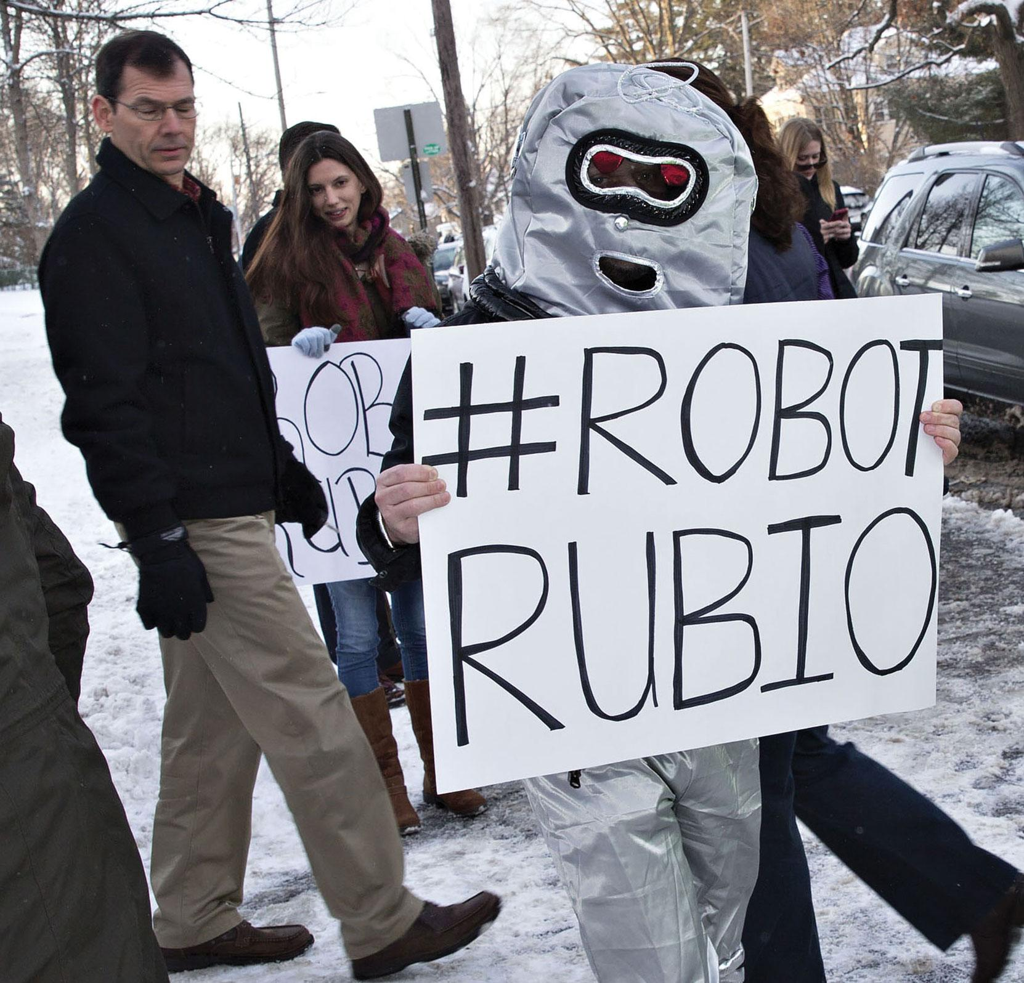
#Robot Rubio
Notes:
The early stages of the nomination process provide a rigorous test for candidates who are relatively new to the national stage. Sometimes, a major slip-up can seriously damage a promising campaign, as occurred to Marco Rubio in New Hampshire in 2016 when his repetition of the same memorized line earned him much negative press attention. Here, a demonstrator in New Hampshire is seen making fun of Senator Rubio as voters went to the polls.

Slide 11
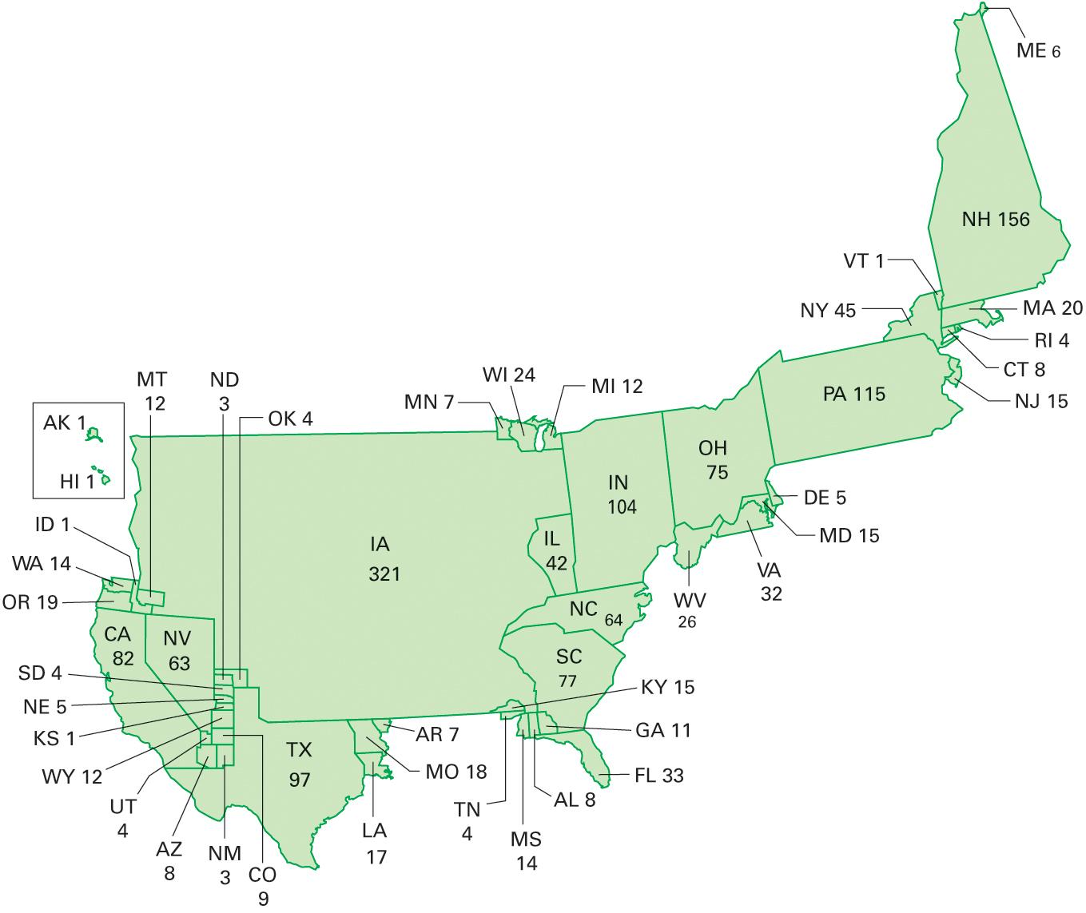
Figure 9.1 A Count of Clinton and Obama Events During the 2008 Nomination Campaign
Source: Washington Post campaign tracker data for January 2007 through May 20, 2008.
Notes:
In 2008, the contest for the Democratic nomination turned into a 50-state contest, with Obama and Clinton battling in a close race for every delegate. Yet, as usual, the first caucus in Iowa and the first primary in New Hampshire received far more attention from the candidates than their number of delegates would warrant, as you can see in this map. each state is drawn to scale in terms of the number of events at the two major Democratic candidates held in them.

Slide 12
The Convention Send Off
Winner foregone conclusion
Reduced TV coverage
Party infomercial
Carefully scripted
Party platform
Policy goals for next four years
Notes:
There is no drama in today's party conventions because the winner is known beforehand. As a result, television news coverage has been reduced and ratings have fallen. Only 30 million people tuned into Romney's acceptance speech at the 2012 Republican National Convention, while 111 million watched the Giants defeat the Patriots earlier that year.
Today's conventions are carefully scripted infomercials for the party, designed to get delegates and viewers energized to help the campaign. The party's platform used to be debated at the convention, but parties are leery of showing any internal dissent. For that reason, the platform is now agreed behind the scenes and simply unveiled at the convention.
The convention ends with the nominee announcing his vice-presidential pick, followed by acceptance speeches from both nominees. The general election campaign is then officially under way.

Slide 13
Learning Objective 9.2
Describe campaign methods and strategies.

Slide 14
The Campaign Game
The High-Tech Media Campaign
Organizing the Campaign
Notes:
The word campaign originated as a military term: generals mounted campaigns, using their limited resources to achieve strategic objectives. Political campaigns are conducted using similar strategies to deploy time, money, and energy in the most effective manner. Campaigns deal almost exclusively in images, with the goal of presenting the candidate as a model of desirable leadership qualities. Technology is crucial to the modern political campaign.

Slide 15
The High-Tech Media Campaign
Main means of reaching voters is TV
Internet increasingly important
Direct mail now digital
Digital campaigning via Twitter, Facebook
Obligatory for the modern campaign
Two ways to get attention
Television advertising
News coverage
Notes:
Television is still the main media outlet that connects candidates to voters, but the Internet is rapidly catching up, especially with younger voters. The Internet has revolutionized campaign fundraising by making it easier to donate and cheaper to solicit funds. Campaigns have long used mailing lists for targeted fund-raising, but it's much cheaper to send an email than a letter through the mail.
In addition to maintaining websites, candidates must have Twitter feeds and Facebook pages. A strong presence on major Internet applications is necessary to be competitive in modern political campaigns.
Candidates get media attention in two main ways, advertising and news coverage. The bulk of today's campaign budget is spent on TV advertising because it reaches the largest audience and candidates have control of how their image is presented. They do not have as much control of how—or even if—the news media cover them. Candidates issue press releases and stage events to attract media coverage, but it's up to the news media to decide which candidates they cover and how to portray them

Slide 16
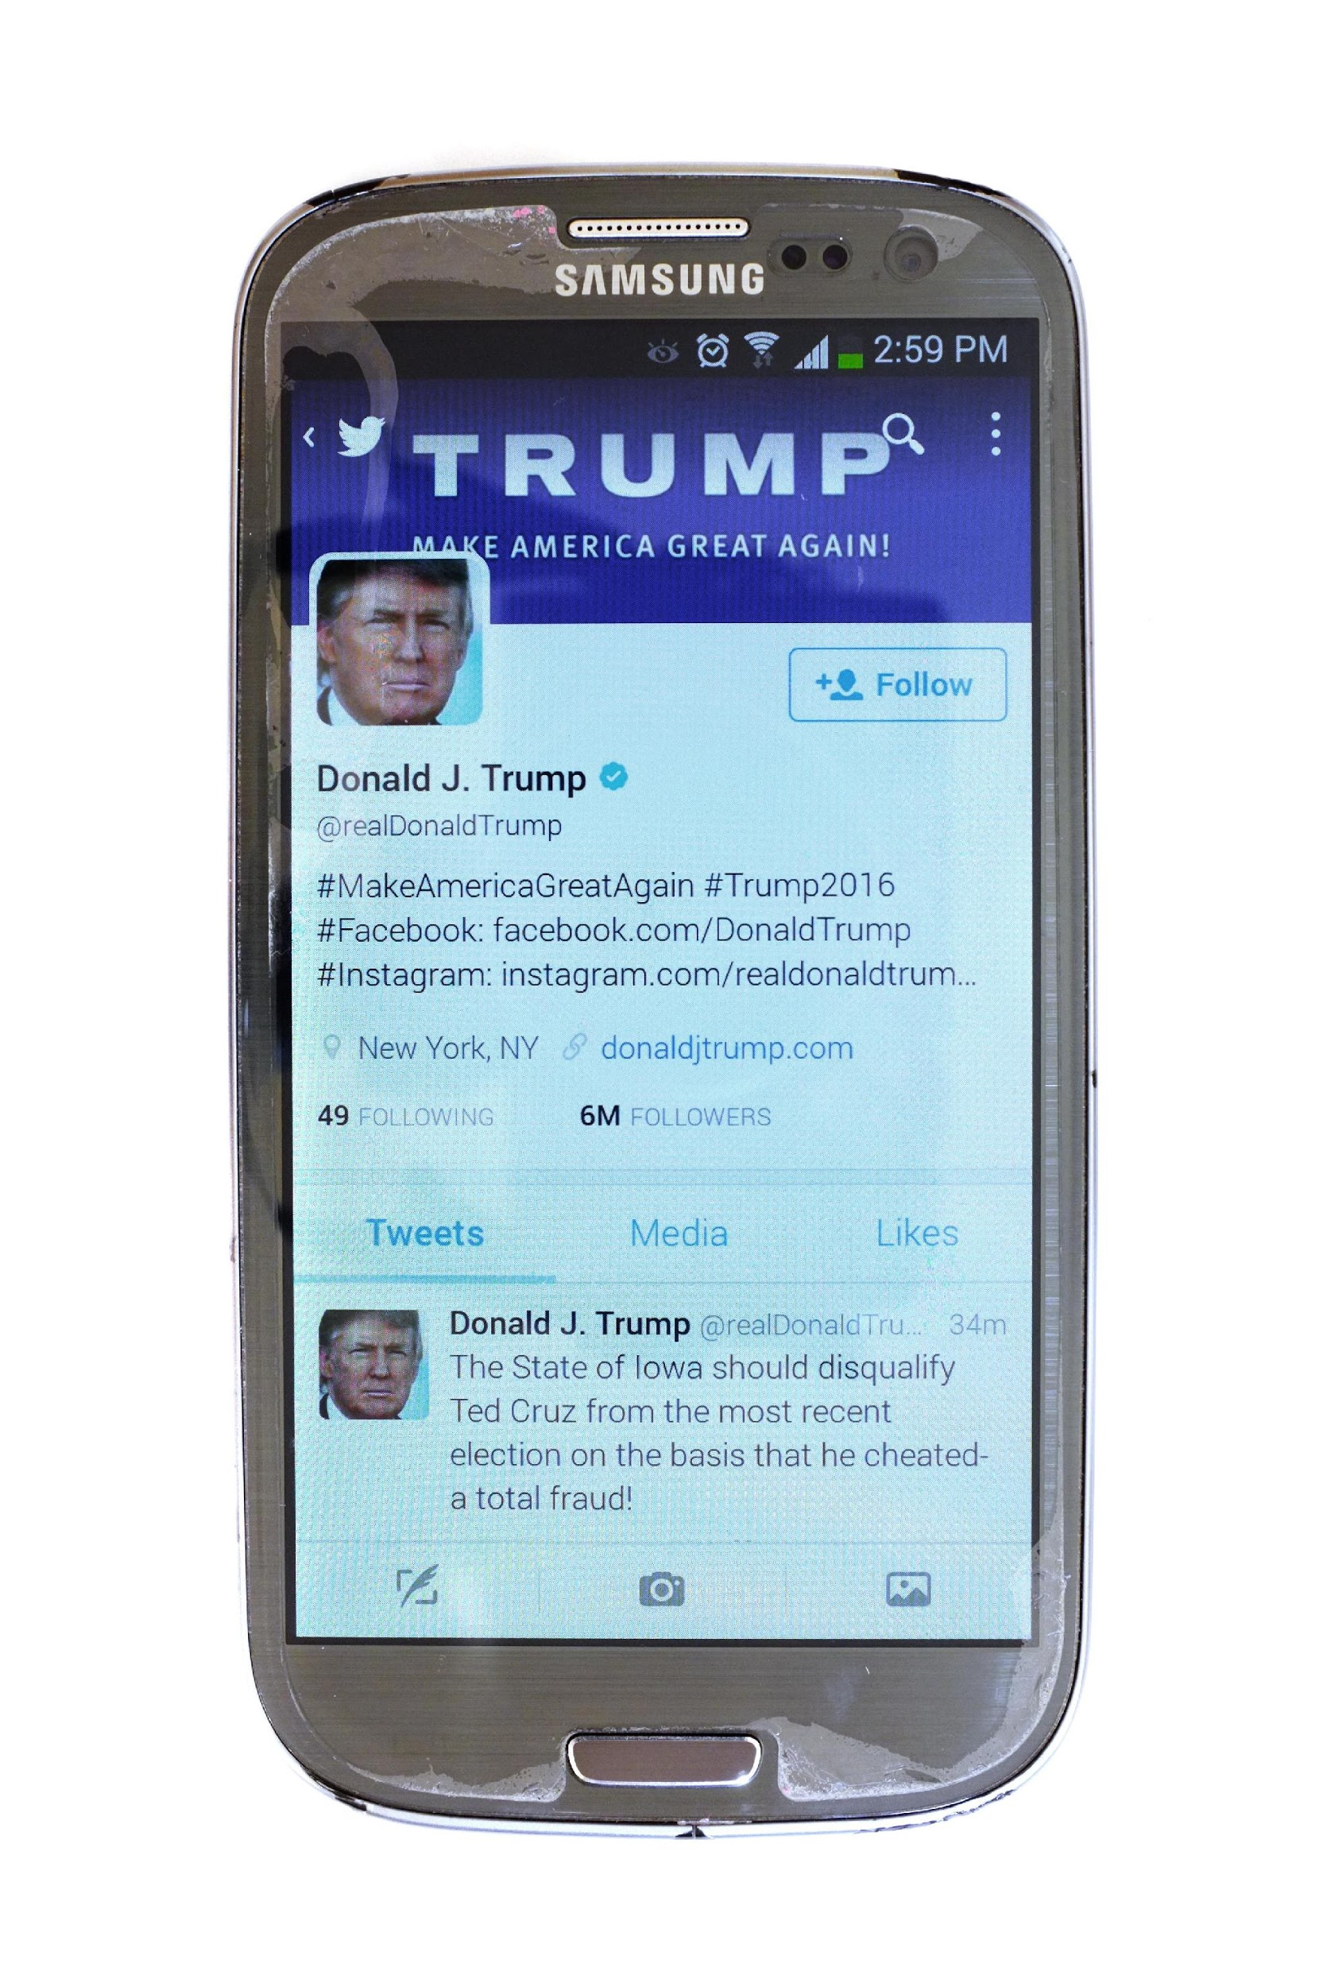
Trump Tweets
Notes:
A campaign’s smartphone apps and social media accounts provide powerful tools for outlining a candidate’s positions, advertising events, and raising money. By the end of the campaign, Donald Trump had 15 million followers on Twitter.

Slide 17
Organizing the Campaign (1 of 2)
Get a campaign manager
Get a fund-raiser
Get a campaign counsel
Hire media and campaign consultants
Assemble a campaign staff
Notes:
Organizing the modern political campaign is time-consuming and expensive. Candidates usually begin by hiring a professional campaign manager who's responsible for keeping everyone on message and setting the tone for the campaign. Fund-raising is essential, as money is key to victory. A campaign counsel is also necessary, to ensure compliance with campaign finance laws.

Slide 18
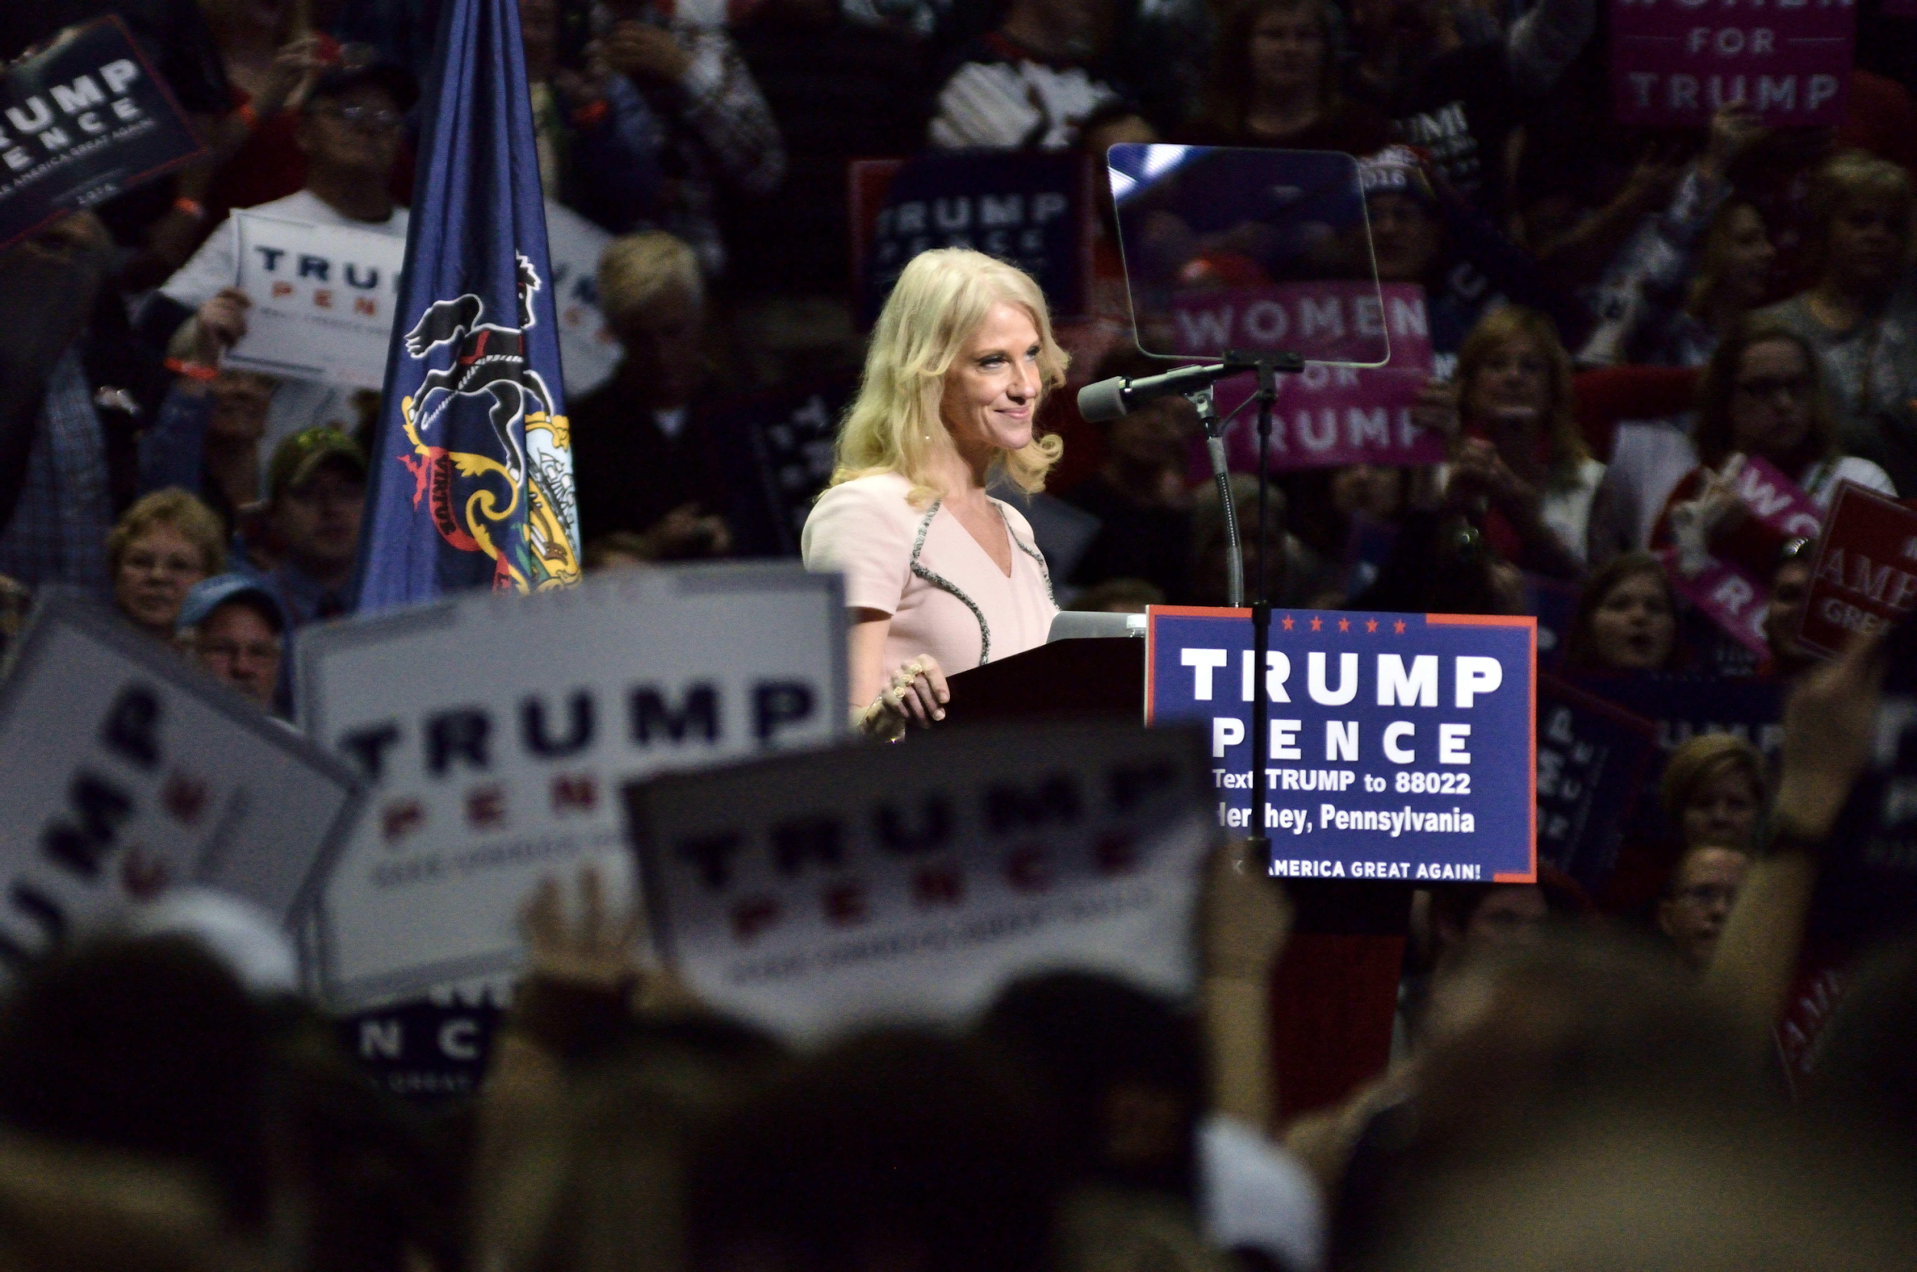
Kellyanne Conway
Notes:
A campaign manager is the focal point for a candidate’s organization, ensuring the smooth running of the organization and often serving as the candidate’s chief spokesperson to the media. Kellyanne Conway, shown here talking to reporters after a campaign stop in Berwyn, Pennsylvania, was a veteran Republican pollster—with a particular emphasis on women—before she became Donald Trump’s third campaign manager in August 2016.

Slide 19
Organizing the Campaign (2 of 2)
Plan the logistics
Get a research staff and policy advisers
Hire a pollster
Get a good press secretary
Establish a Web site
Notes:
Media and campaign consultants are critical to marketing the candidate to the voters. There will always be a need for volunteers and advance workers to handle the logistics of candidate scheduling and to coordinate events for maximum attendance and media exposure.
Although campaigns are mainly about image, candidates must have research and policy staff to brief them on policy-related questions. Their answers will change depending on what the polls say about voters. Candidates must be prepared to change their policy stances the second they don't poll well with potential supporters.
A good press secretary keeps the candidate in the media spotlight. Finally, a candidate must have a Web site. This requires staff to design it and post information regularly. Most candidates collect donations via their Web sites.

Slide 20
Learning Objective 9.3
Identify how the financing of federal campaigns is regulated and evaluate the influence of money in elections.

Slide 21
Money and Campaigning
Regulations on Campaign Contributions
Regulations on Independent Political Expenditures
Are Campaigns Too Expensive?
Does Money Buy Victory?
Notes:
Many people of moderate means make small donations to political candidates, but the cost of campaigns is so high that wealthy contributors can buy special influence over elected officials, to the detriment of middle-class and poorer Americans.
There are two basic ways of contributing money to campaigns. Donors can make a direct contribution to the campaign or they can spend money independently to support a candidate, without coordinating this expenditure with the campaign.

Slide 22
Regulations on Campaign Contributions
Federal Election Campaign Act (1974)
Who contributed
How money spent
Limits on individual and interest group contributions
Federal Election Commission (FEC)
Public financing
PACs
Loopholes
No limits on spending own money
Soft money
Notes:
As corruption and distrust of government grew in the early 1970s, momentum built for campaign finance reform. In 1974 Congress passed the Federal Election Campaign Act, which required candidates to publicly disclose who contributed to their campaigns and how the money was spent. This law also limited the amount that individuals and interest groups could contribute. PACs are groups that raise money from individuals and then distribute it in the form of contributions to candidates that the group supports. PACs must register with the FEC and report their donations and contributions to it. Individual contributions to a PAC are limited to $5,000 per year, and a PAC may give up to $5,000 to a candidate for each election.
Another result of this legislation was the creation of the Federal Election Commission to serve as a repository of campaign funding information. There are also two Web sites, opensecrets.org and fundrace.org, where you can look up campaign finance information, including looking up your friends and neighbors to see how much they've donated.
The Federal Election Campaign Act also created a fund for public financing of elections. People can check a box on their tax returns to designate $3 of their taxes to this fund. Because candidates have to agree to overall spending limits if they accept this money, no candidate does so.
The Act originally limited the amount of their own money that candidates could spend, but that provision was overturned by the Supreme Court in 1976. Ross Perot spent $60 million of his own money on his 1992 independent bid for president.
For a time, another great loophole existed in the form of soft-money contributions. Soft money was given to parties rather than candidates, so it was not subject to contribution limits until the McCain-Feingold Campaign Finance Reform Act of 2002 was passed. This Act banned soft-money contributions, although corporations and wealthy donors continue to find new loopholes to gain influence over elected officials.

Slide 23
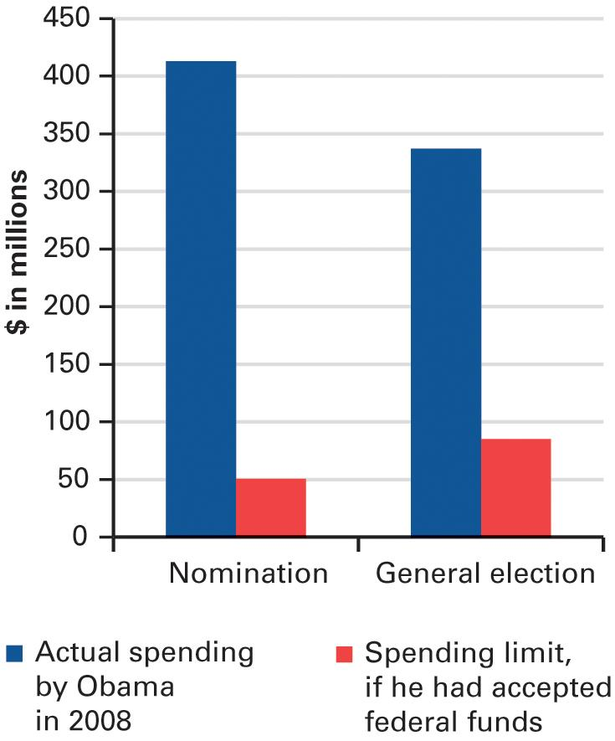
Figure 9.2 How Obama Raised More Campaign Money by Declining Federal Funds
Source: Federal Election Commission reports.
Notes:
In 2008, Barack Obama became the first presidential candidate to turn down federal funds for the nomination and general election campaigns since the option of public financing was instituted for presidential campaigns in the mid-1970s. The public financing system entitled him to receive matching funds for contributions of up to $250 during the primaries and to completely finance his general election campaign with a check from the FEC. The catch would have been that he would have had to limit his total spending to the amounts prescribed by Congress in the 1970s, adjusted for inflation. These limits, however are voluntary—a candidate is free to decline the federal funds. As you can see the figure, saying ”no thanks” to federal financing freed Obama to raise far more money.

Slide 24
Regulations on Independent Political Expenditures
527 groups
New route for soft money
Independent expenditures
Endorsements forbidden
Citizens United v. FEC (2010)
501c groups
The rise of Super PACs
Notes:
Since wealthy donors are limited in how much they can contribute directly to candidates, and soft-money contributions have been banned, it was inevitable that a new route for influential spending would be devised. It's come in the form of 527 groups, so-named for the section of the federal tax code that covers them. These groups can spend unlimited amounts provided that they spend the money independently, with no coordination with the campaign, and that they don't endorse a candidate explicitly.
501(c) groups emerged as vehicles for unlimited political donations that could remain anonymous. Such groups are regulated by the IRS rather than the FEC; donations to 501(c) groups do not have to be reported unless a donor gives money specifically for a political ad.
The SpeechNow ruling made it possible for a PAC that just expresses its views to collect and spend unheard of amounts of money. Journalists realized the impact of these independent expenditure-only PACs, labeling them Super PACs.

Slide 25
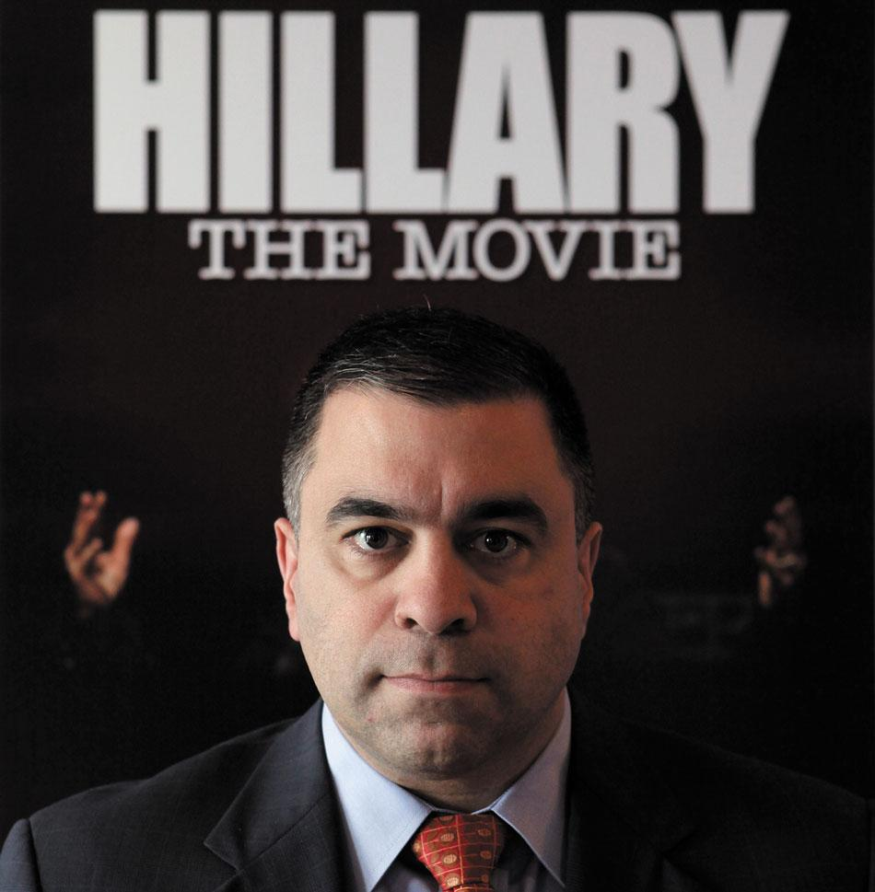
Citizens United
Notes:
David Bossie was president of Citizens United when he produced Hillary: The Movie, a relentlessly unsympathetic portrayal of Hillary Clinton designed to convince viewers that she was unfit for public office. When the Federal Election Commission ruled that this movie was unlawful electioneering, Citizens United successfully sued, establishing the right of any group to engage in independent political expenditures.

Slide 26
Journal Prompt 9.3: Regulations on Independent Political Expenditures
What is the difference between direct campaign contributions and independent political expenditures? Why are campaign contributions limited by federal law whereas independent expenditures are unlimited?

Slide 27
Are Campaigns Too Expensive?
Yes
2012 federal elections cost $6.3 billion
Fundraising distracts from official duties
No
Only .05% of GDP spent on elections
About the cost of one DVD per person
How to reform system?
Notes:
Most people are appalled by the cost of U.S. elections. The Center for Responsive Politics totaled the cost of the 2012 campaigns for presidency and Congress to be $6.3 billion. Incumbents must spend so much of their time fundraising, they're distracted from doing their jobs. But a minority of Americans point out that the cost of elections is actually quite small when you look at it as a portion of GDP or average it out per person.
Public financing of public elections is often looked at as the mechanism by which to reform the system.

Slide 28
Does Money Buy Victory?
Is there a link between money and votes?
Some say no
Spend more only when weak
Doctrine of sufficiency
No need to outspend opponent to win
Notes:
Is there a direct link between the amount a candidate spends and the number of votes he receives? Some political scientists say no. They note that an incumbent has to spend a lot of money only if he has a strong challenger. So less spending can mean a more secure seat, that is, more votes.
In fact, some argue that there's a point of diminishing returns. The doctrine of sufficiency states that you need to spend enough to get your message across but spending more than your opponent isn't always necessary. There are notable examples of candidates who outspent their opponents 5 to 1 and yet lost.

Slide 29
Learning Objective 9.4
Determine why campaigns have an important yet limited impact on election outcomes.

Slide 30
The Impact of Campaigns
How important are campaigns?
Reinforcement
Activation
Conversion
Campaigns mainly reinforce and activate
Why are conversions rare?
Selective perception
Party identification
Incumbent advantage
Wedge issues
Notes:
How important are campaigns in determining electoral outcomes? Not as important as you'd think given the vast amounts of time, energy, and money devoted to them. Campaigns serve three main purposes: reinforcing voters' preferences for candidates, getting them to contribute time or money rather than merely voting, and converting voters, or changing their minds.
Research over the past half century has shown that campaigns mainly reinforce and activate; only rarely do they convert. Why is this? People have a remarkable capacity for selective perception. That is, they pay the most attention to things they already agree with and interpret events according to their own predispositions. People also tend to vote according to their party identification, which can change but rarely does so. The advantage of incumbents in terms of name recognition and record also tends to outweigh the influence of political campaigns.
In order to try to convert voters, candidates will focus on a wedge issue that splits members of the other party and try to lure voters who feel strongly about that one issue. Democrats, for example, will try to appeal to pro-choice Republicans, and Republicans will attempt to win over anti-abortion Democrats.

Slide 31
Learning Objective 9.5
Identify the factors that influence whether people vote.

Slide 32
Whether to Vote: A Citizen’s First Choice
Deciding Whether to Vote
Registering to Vote
Who Votes?
Notes:
American electoral history is defined by the continual expansion of suffrage, the right to vote. Today, most citizens over the age of 18 can vote. Convicted felons are prohibited from voting in some states for a period of time or, in 10 states, for life.
As the franchise has expanded, a smaller percentage of the electorate has bothered to exercise it. Even smaller percentages vote in midterm congressional elections than in presidential elections—only 36% of eligible voters cast their ballots in 2014.

Slide 33
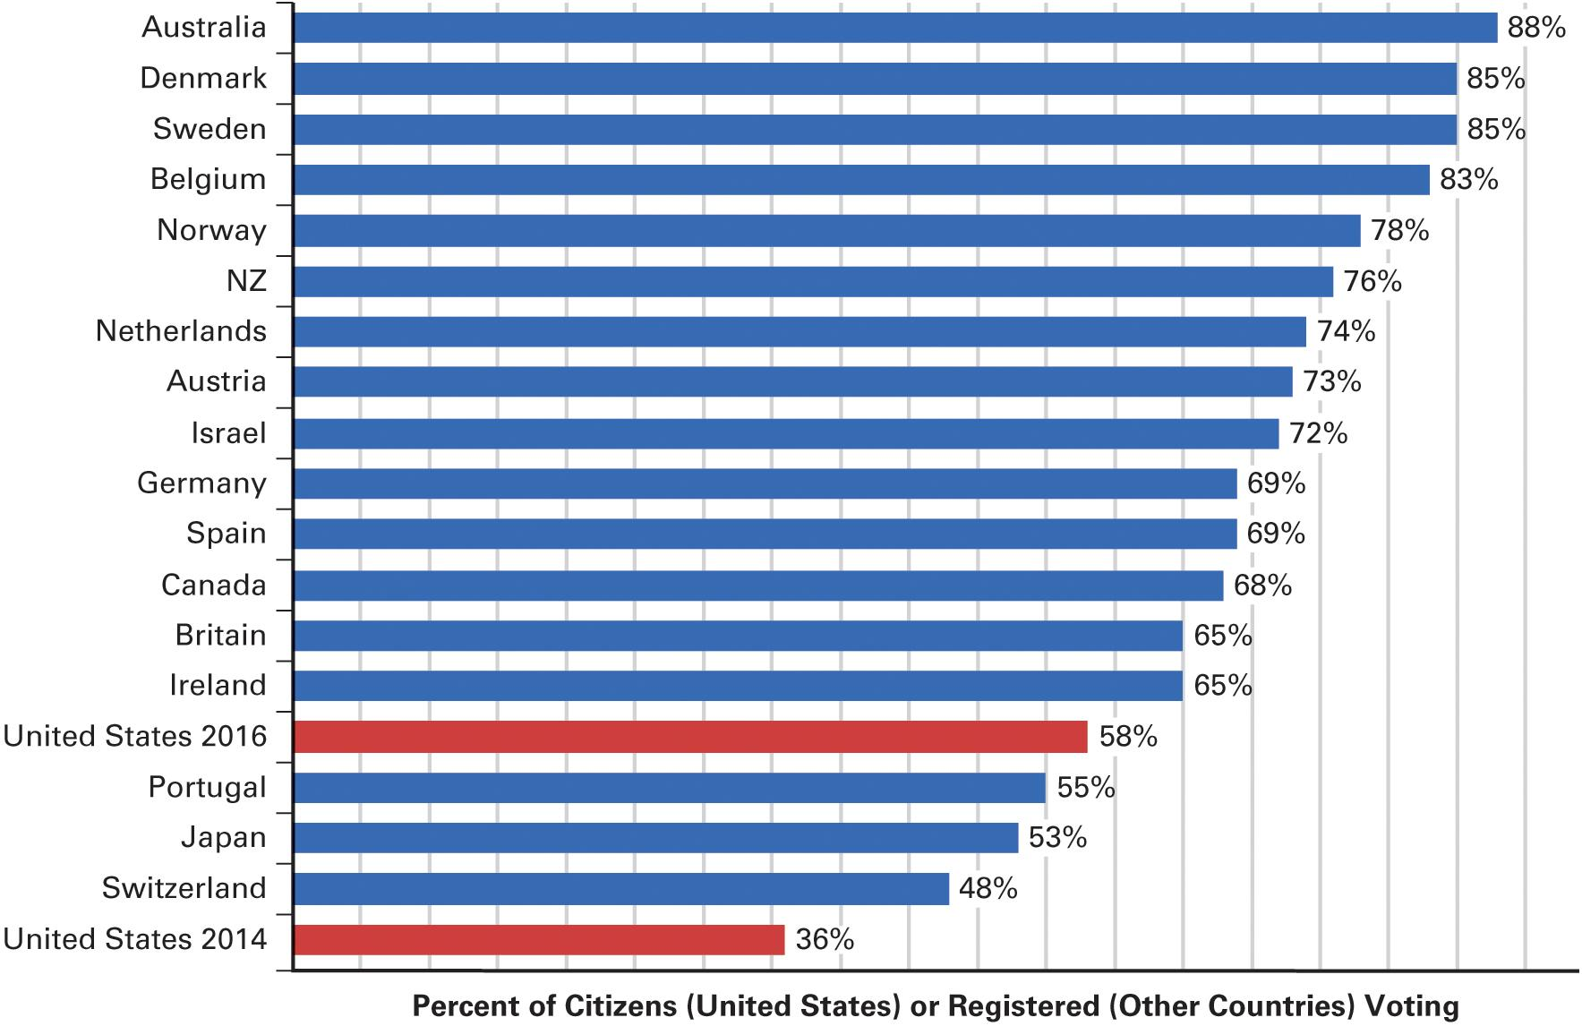
Figure 9.3 American Turnout Rates Compared to Other Established Democracies
Sources: In all countries except the United States, official reports of the percentage of registered voters casting valid votes, as reported at Election Resources on the Internet. For the United States, the percentage of citizens participating was calculated based on Census Bureau reports of the numbers of citizens of voting age and reports from the states regarding how many people voted.
Notes:
American turnout rates are lower than those found in most other established democracies, as you can seen a graph shown below.

Slide 34
Deciding Whether to Vote
Does one vote matter?
Voting is costly
Tuesday is a workday
Is it rational to vote?
Policy differences
Political efficacy
Civic duty
Notes:
It's rare for one vote to determine an election, so voters might decide that their vote doesn't matter and not bother to get to the polls on Election Day. Tuesday is a workday for most people. It may be difficult to take the time to get to the polls, and it's time consuming to learn about the candidates and make up your mind.
So, is it rational to vote? That depends on your perspective. If you see genuine policy differences between the candidates and believe that one or the other would be better for the country, then, yes, it's rational to vote. People who vote tend to have a sense of political efficacy. That is, they believe that ordinary people can influence government. If you lack that belief, you are unlikely to bother to vote unless you have a strong sense of civic duty.
Note that most other democratic countries make Election Day a holiday or hold elections on weekends. Why does the U.S. hold elections on a weekday?

Slide 35
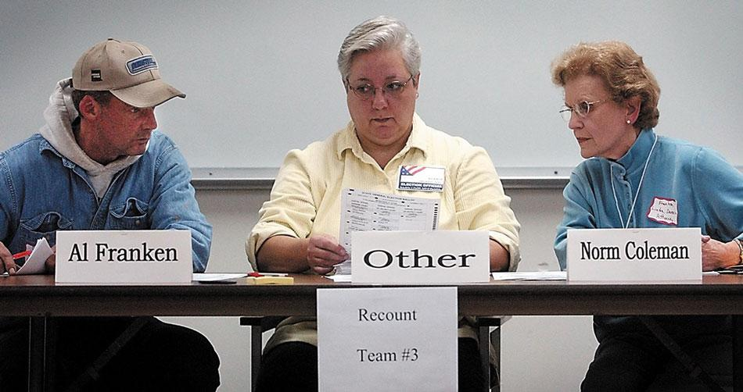
2008 Minnesota Senate Race
Notes:
Occasionally election outcomes are so close that all the individual ballots have to be carefully recounted. Here, an election official examines a ballot in the 2008 Minnesota Senate race, with representatives from the opposing candidates observing on either side. In the original count, Norm Coleman finished 215 votes ahead, but after the recount Al Franken won the election by 225 votes.

Slide 36
Registering to Vote
Voter registration laws differ by state
Motor Voter Act (1993)
Voter ID laws
Show government-issued photo ID to vote
Democratic states have passed laws facilitating voting
Notes:
Another reason that turnout is lower in the United States than in other democratic countries is the burden of voter registration. Registration laws differ by state, with some states allowing registration on Election Day and others requiring registration well beforehand. States with less burdensome registration requirements tend to have higher turnout. In 1993, Congress tried to simplify registration with the passage of the Motor Voter Act, which allowed voters to register by ticking a box on their driver's license application or renewal forms. But this law didn't lead to the expected increase in voter turnout.
In most other democratic countries, the burden falls on government to make sure all eligible citizens are registered. The process is automatic and the citizen doesn't have to do anything besides show up to vote. The United States also holds elections more often than most other democratic countries, and it offers voters fewer meaningful choices among candidates.
Recently, states have begun to pass laws that require voters to show a government-issued photo ID such as a driver's license or passport to prove they are who they say they are. However, some groups are less likely to have photo ID than others, and the laws may discriminate against them.

Slide 37
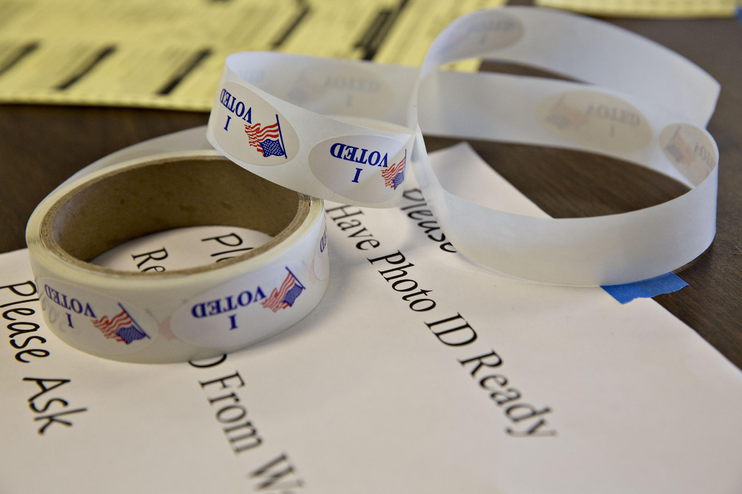
New Voter ID Laws
Notes:
In recent years, a number of states have adopted laws required voters to show a photo ID at the polls. Many lawsuits have been filed against voter ID laws, claiming that such laws unfairly restrict the ability of young people and minorities from voting. Proponents argue that voter ID laws are necessary to prevent people from voting multiple times under different names.

Slide 38
Who Votes? (1 of 2)
Education
Main factor
Increased sense of political efficacy
Ease of clearing bureaucratic hurdles
Age
Older are more likely to vote
Younger citizens less settled
Race and ethnicity
Black and Hispanic turnout lower
Notes:
Who votes and who doesn't is not random. Certain demographic factors are closely related to voter turnout. Most important is education. The more educated someone is, the more likely that person is to vote. This is due in part to an increased sense of political efficacy and to an ability to clear bureaucratic hurdles to voting.
Age is the second greatest predictor of voting. Older citizens are much more likely to vote, with those over 65 the most likely to vote and those under 25 the least. Turnout among younger voters is lower in part because they're less settled, which makes it more of a burden to register to vote. Once you buy a house, have a family, and join a profession, you begin to develop a stronger sense of how political decisions affect your life.
The turnout of minority voters has historically been lower than their percentage in the population, although that changed in the 2008 presidential election.
Women are slightly more likely to vote than men, and married people, who tend to be more tied into their communities, are more likely to vote than single people. Government employees have more at stake in elections, and a greater sense of how the government works, so they're more likely to vote than other citizens.
What are the policy consequences of the demographics of voter participation?

Slide 39
Who Votes? (2 of 2)
Gender
Marital status
Government employment
Notes:
Today women vote at slightly higher rates than men. People who are married are more likely to vote than those who are not. This pattern is true among all age categories and generally reflects the fact that married people are more tied to their communities. Government workers vote in higher proportions due in part to having something at stake (e.g. their programs) and having greater knowledge of government.

Slide 40
Table 9.1 Reported Turnout Rates for Groups of U.S. Citizens in 2012 and 2014 (1 of 4)
 | % Voting in 2012 | % Voting in 2014
Turnout by Age
18–24 | 41 | 17
25–34 | 54 | 28
35–44 | 61 | 38
45–54 | 65 | 45
55–64 | 71 | 54
65 and over | 72 | 59
Notes:
In which election was turnout higher? Who's most and least likely to vote?

Slide 41
Table 9.1 Reported Turnout Rates for Groups of U.S. Citizens in 2012 and 2014 (2 of 4)
 | % Voting in 2012 | % Voting in 2014
Turnout by Education Level
No high school diploma | 38 | 22
High school diploma | 53 | 34
Some college | 64 | 42
College degree | 75 | 53
Advanced degree | 81 | 62
Turnout by Race/Ethnicity
White non-Hispanic | 64 | 46
African American | 66 | 41
Hispanic | 48 | 27
Asian American | 48 | 27
Notes:
In which election was turnout higher? Who's most and least likely to vote?

Slide 42
Table 9.1 Reported Turnout Rates for Groups of U.S. Citizens in 2012 and 2014 (3 of 4)
 | % Voting in 2012 | % Voting in 2014
Turnout by Gender
Men | 64 | 41
Women | 66 | 43
Turnout by Marital Status
Married | 69 | 51
Single | 54 | 32
Notes:
In which election was turnout higher? Who's most and least likely to vote?

Slide 43
Table 9.1 Reported Turnout Rates for Groups of U.S. Citizens in 2012 and 2014 (4 of 4)
Turnout by Employment Status
Government workers | 76 | 57
Self-employed | 67 | 47
Work in private industry | 62 | 39
Unemployed | 52 | 30
Source: Author’s analysis of the 2012 and 2014 U.S. Census Bureau surveys.
Notes:
In which election was turnout higher? Who's most and least likely to vote?

Slide 44
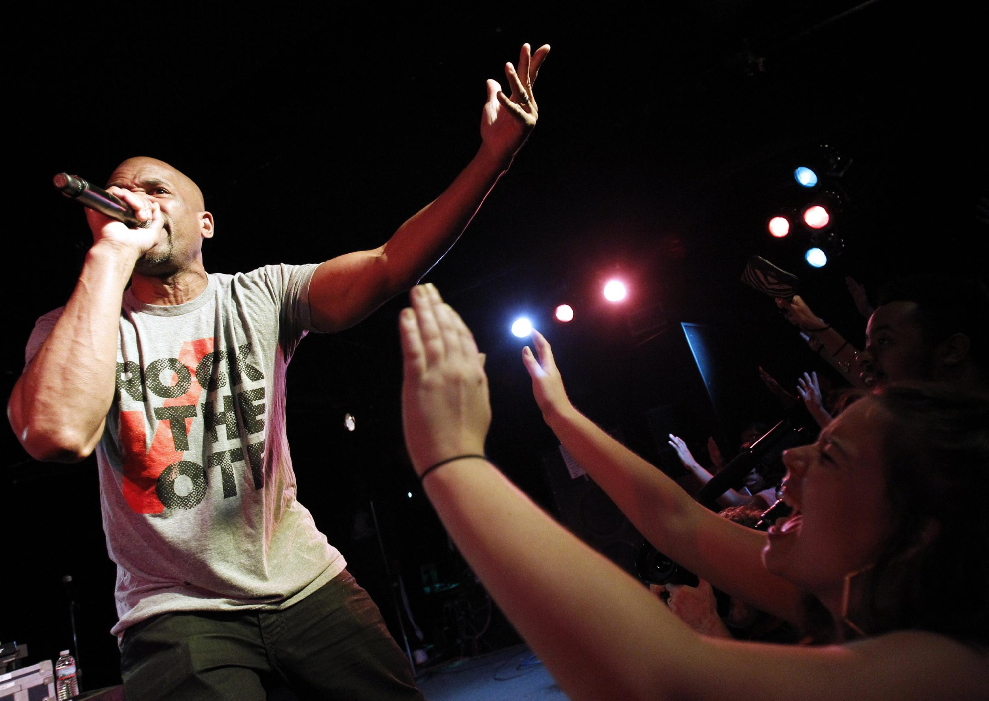
Rock the Vote
Notes:
Since the early 1990s, Rock the Vote has sought to engage and build political power for young people in the United States using pop, hip hop, rap, and rock music stars to urge people to vote. Rock the Vote’s 25th fifth anniversary concert, held in Washington, D.C., in October 2015, headlined 2 Live Crew and Darryl "DMC” McDaniels of Run DMC.

Slide 45
Journal Prompt 9.5: Who Votes?
What are the factors that explain who votes and who does not in America? What groups are particularly likely to have high turnout rates?

Slide 46
Learning Objective 9.6
Analyze why people vote as they do.

Slide 47
How Americans Vote: Explaining Citizens’ Decisions
Party Identification
Candidate Evaluations: How Americans See the Candidates
Policy Voting
2016: An Election Like No Other
Notes:
Do voters select candidates whose policy views they prefer? That would make sense. If it were the case, the winner could assume that he had a mandate from the people to implement his policies. But there's ample evidence that policy views play only a small role in voter selection. Instead, voters base their decisions on their party identification and their personal view of the candidates.

Slide 48
Party Identification
Provide perspective
Similar to sports teams and religion
Cue to who is on one's side
Simplifies candidate selection
"My party—right or wrong" no more
Floating voters
Likely to be younger
Notes:
Party identification is crucial for many voters because it provides a stable perspective through which voters can view the political world. Like sports team loyalty and religious affiliation, voters rarely change their party identification. It gives them a cue as to who is on their side. Voters don’t need to know where every candidate for state and local office stands on every issue. If they usually vote for one party, they can simply choose the candidate for each office from that party.

Slide 49
Candidate Evaluations: How Citizens See the Candidates
Image is key to getting votes
Integrity
Reliability
Competence
Superficial and irrational?
Notes:
To win an election, a candidate must craft a personal image that appeals to voters. Researchers have found that candidates do best when they project an image of integrity, reliability, and competence.
Is it superficial and irrational for voters to pick candidates based on perceived personal qualities rather than policy positions? Yes and no. It's irrational to the extent that most images are crafted by consultants rather than reflective of a candidate's true qualities. On the other hand, it isn't superficial, because you can't know or agree with the candidate on every policy issue, but you want someone competent and reliable to be commander-in-chief of the armed forces, and you want someone with integrity to be making policy decisions.

Slide 50
Policy Voting
Voting based on issue preferences
Clear sense of policy preferences
Know where candidates stand on issues
Differences between candidates on issues
Vote for candidate closest to own preferences
Preferences may not line up with one candidate
Candidates deliberately ambiguous
Notes:
It isn't easy for citizens to vote based on policy issues. They have to have a clear sense of their own issue preferences, and know where the candidates stand in relation to them. The candidates also need to differentiate themselves on policy issues so that citizens can vote for the candidate whose policy preferences are closest to their own. Candidates are often deliberately ambiguous about their policy views, and a voter may agree with one candidate on some issues and the other candidate on different ones.
It's challenging for voters to become informed of where candidates stand, but it's a bit easier today now that we have primary elections instead of party bosses selecting the nominee. Candidates must take some policy stances in the primary to distinguish themselves from other potential nominees from their own party.

Slide 51
2016: An Election Like No Other
Trump victory a surprise upset
Primary campaign divides party
Faced numerous disadvantages
Negative personal image
Overcoming disadvantages
Populist/nativist message
Electoral College
Trump wins but does not win popular vote
Notes:
The 2016 election shocked political scientists and citizens alike as Donald Trump rode a wave of populist and nativist rhetoric to an historic upset of former Secretary of State Hillary Clinton. Trump overcame a range of disadvantages, including an incredibly negative public perception of him personally as well deep concerns about his ability to be president. Outspent in advertising and bested at the ground game, Trump won a commanding victory in the Electoral College, flipping three key states that had voted for Obama in 2012: Wisconsin, Michigan, and Pennsylvania. In spite of this, Trump failed to win the popular vote, which meant that for the second time in 16 years and just the fifth time in American history the winner of the presidency was not the winner of the popular vote.

Slide 52
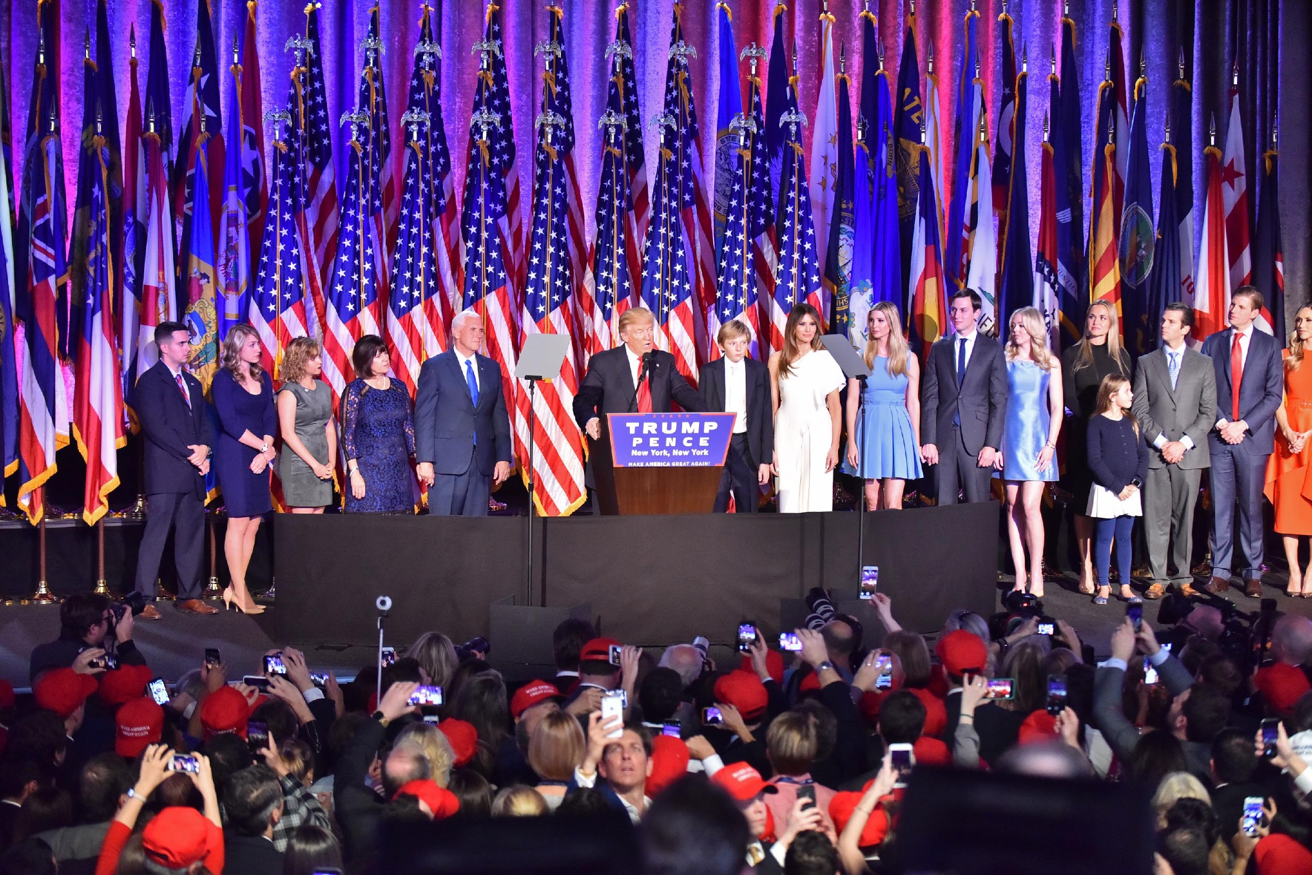
Trump 2016 Victory Party
Notes:
President Trump and Vice President Pence celebrated their election in 2016, with their families and supporters, at the Republicans’ victory party in New York City.

Slide 53
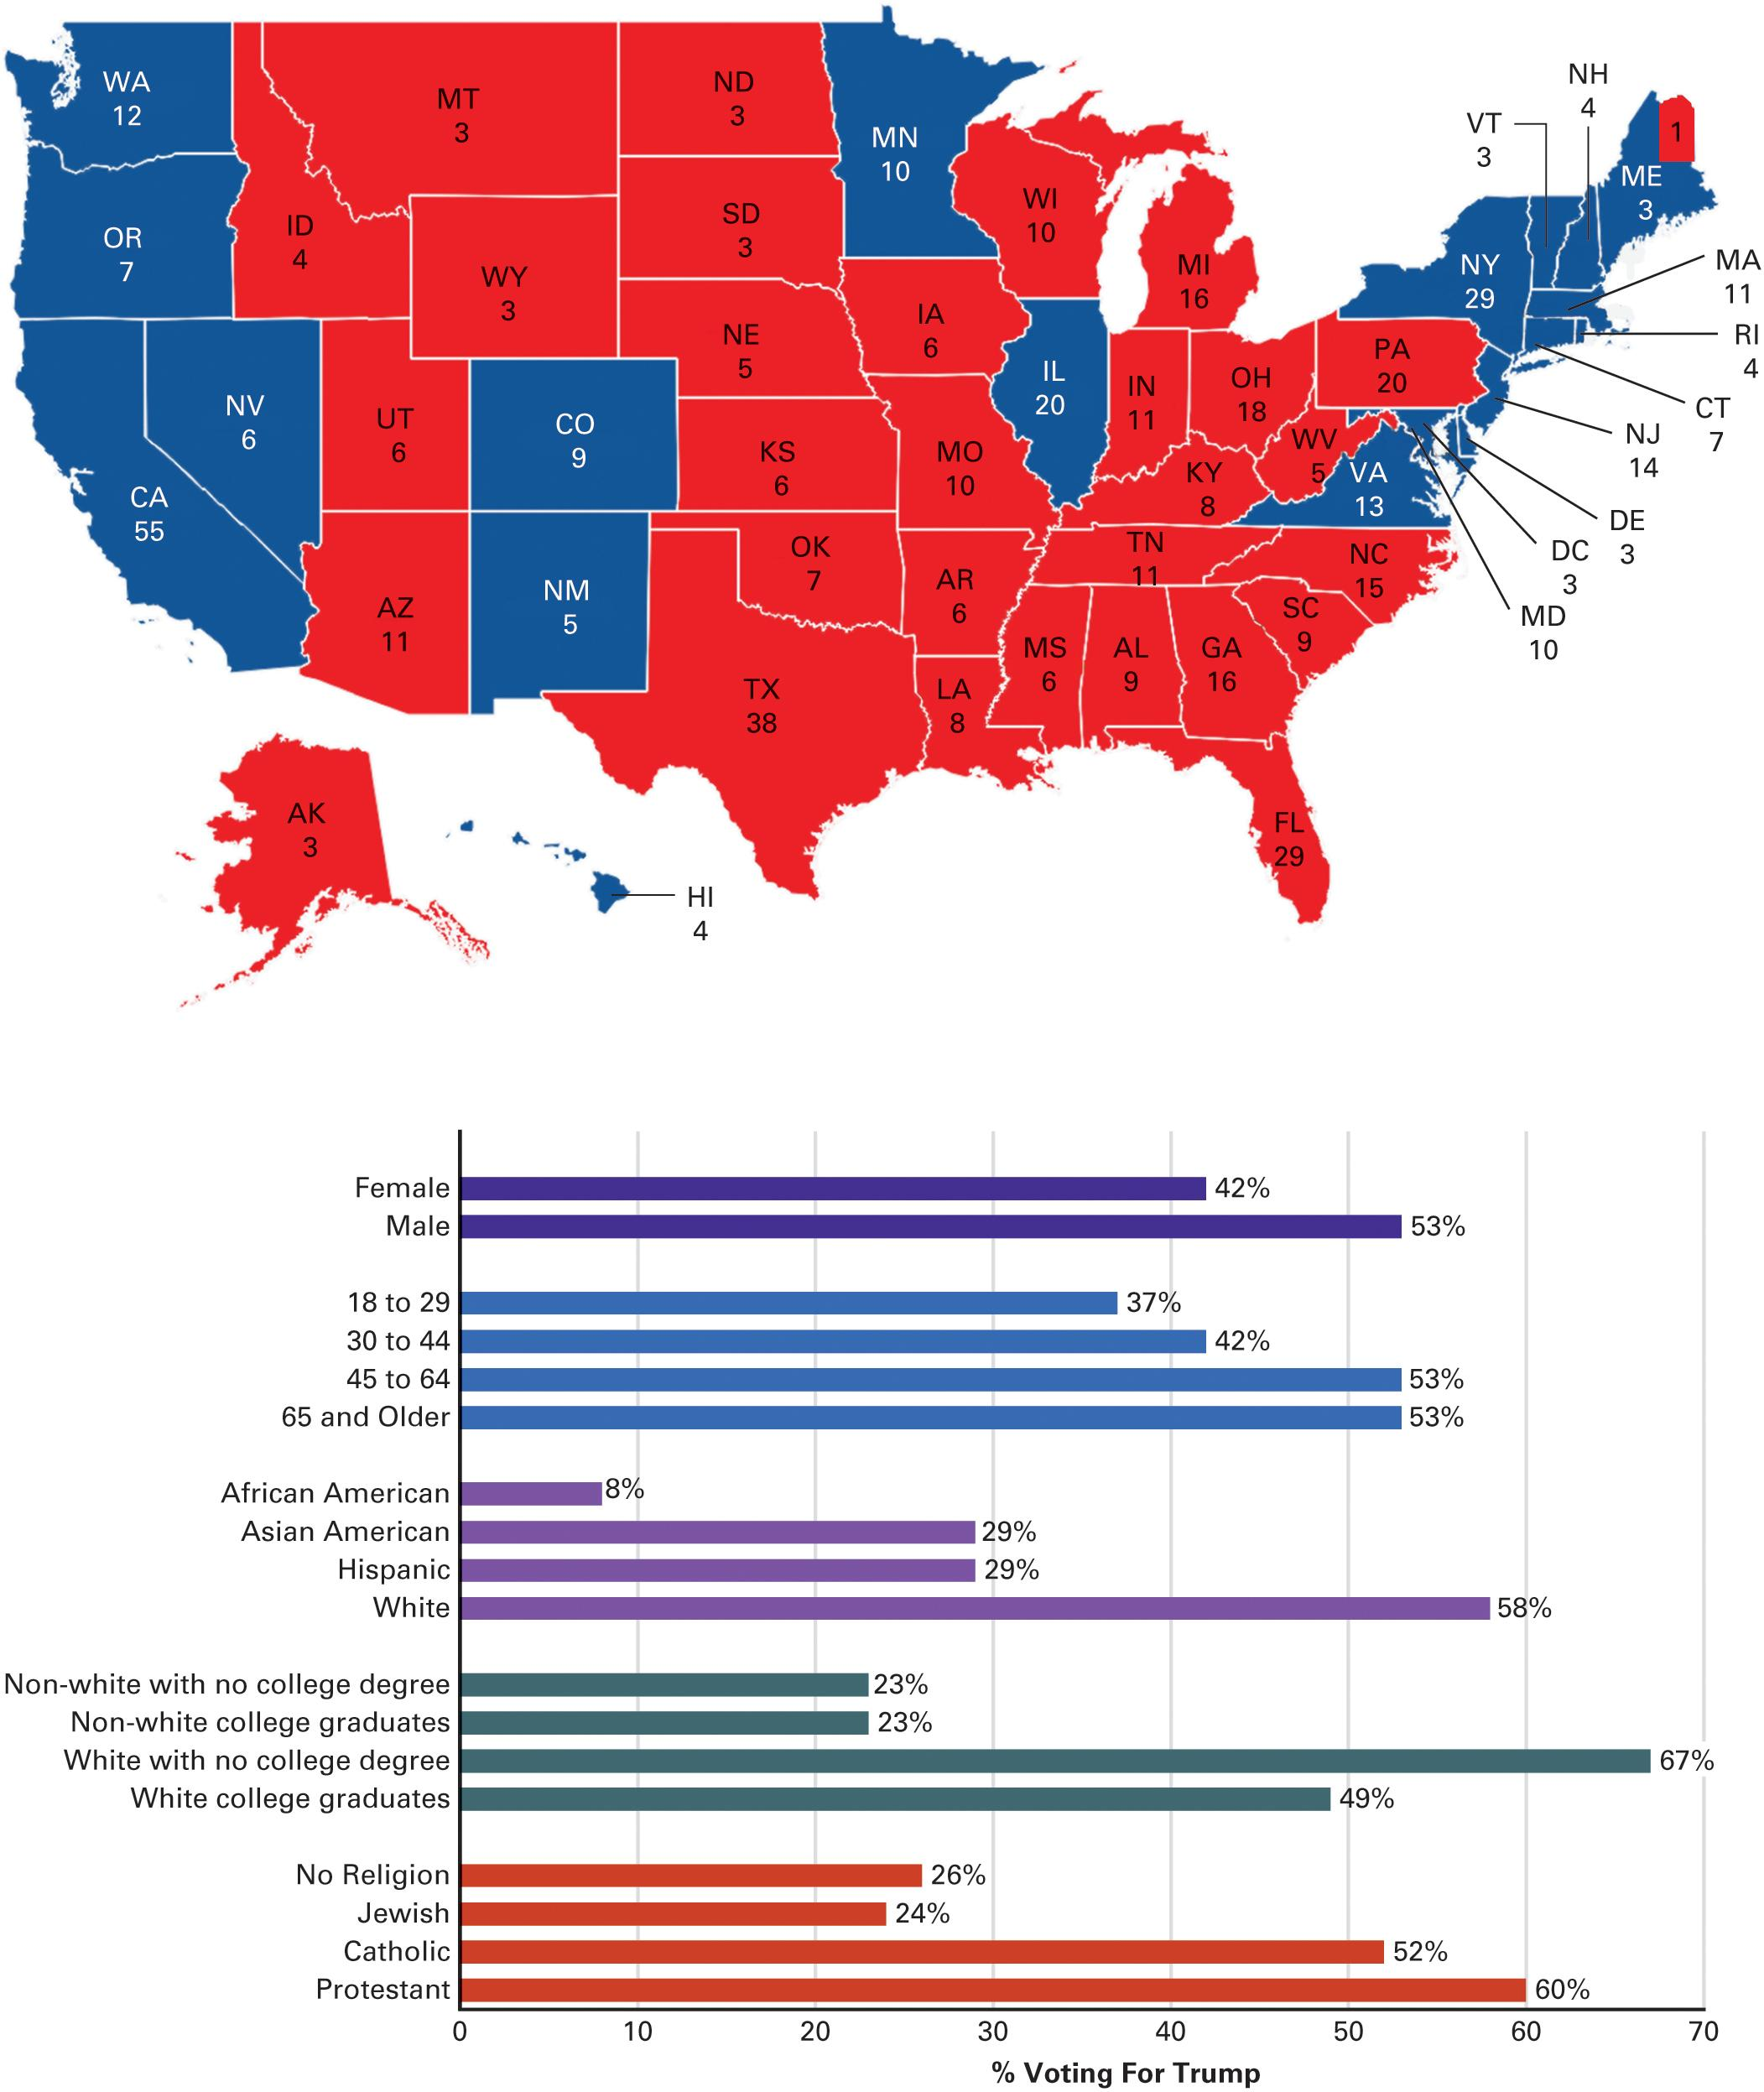
Figure 9.4 Electoral College and Exit Poll Results for 2016
Source: 2016 National Exit Poll
Notes:
The map shows the number of votes each state had in the Electoral College in 2016 and which states were carried by the Democrats (blue) and Republicans (red). After the map you’ll find some selected data from the 2016 national exit poll, which demonstrate some of the individual demographics that were related to voting behavior.

Slide 54
Learning Objective 9.7
Evaluate the fairness of the Electoral College system for choosing the president.

Slide 55
The Last Battle: The Electoral College
Unique American institution
Most people want it abolished
Archaic and undemocratic
Founders' plan and revisions
President elected by elites
Electors is equal to the number of Congressmen
48 states are winner-take-all
Battleground states
Notes:
The winner of the presidential election is chosen by the Electoral College, not the voters. The Electoral College is unique to the United States, and it's no longer a popular institution. Most people want it abolished because of its undemocratic nature and the effect it has on the presidential campaign.
The Founders created the Electoral College precisely because they didn't want the president selected democratically by the masses; they believed that only elites were qualified to make that choice on behalf of everyone.
The number of electors in each state is equal to the number of senators and representatives in that state. In 48 states, the candidate who wins the most votes, no matter by how thin a margin, gets all of that state's electoral votes. Maine and Nebraska divide their electoral votes proportionally.
It's possible for a candidate to receive enough electoral votes to win the election without winning a majority of the popular vote, as happened in the presidential election of 2000 and again in 2016.
Because of the winner-take-all norm in electoral votes, candidates focus their campaigns exclusively on large states that could go red or blue. These battleground states become the center of the campaign storm. How would campaigning change if we eliminated the Electoral College?

Slide 56
Learning Objective 9.8
Assess the advantages and disadvantages of the U.S system of campaigns and elections.

Slide 57
Understanding Campaigns and Voting Behavior
Are Nominations and Campaigns Too Democratic?
Do Elections Affect Public Policy?
Do Campaigns Lead to Increases in the Scope of Government?
Notes:
Elections are key to the peaceful transition of power because leaders can be replaced without being overthrown. They socialize and institutionalize political activity, channeling participation through the electoral process rather than via riots or revolutions.
Because election by the people gives leaders legitimacy, it's often thought that the only thing better than democracy is more democracy. But is that true? Can our system be too democratic?

Slide 58
Are Nominations and Campaigns too Democratic?
Outsiders have a way in
Candidates chosen by voters, not party elites
The permanent campaign
Voters overwhelmed
Lengthy process discourages candidates
Fundraising is worrisome burden
Notes:
Because nominees are chosen by voters, not party elites, party outsiders have a greater opportunity to be selected as candidates than in many other democracies.
But the downside to all this democracy is that elected officials in the United States are required to wage a permanent campaign. Americans are often overwhelmed by the constant campaigning, and tend to tune out. Good candidates are discouraged from running for office by the demands of campaigning and the constant, worrisome burden of fundraising.

Slide 59
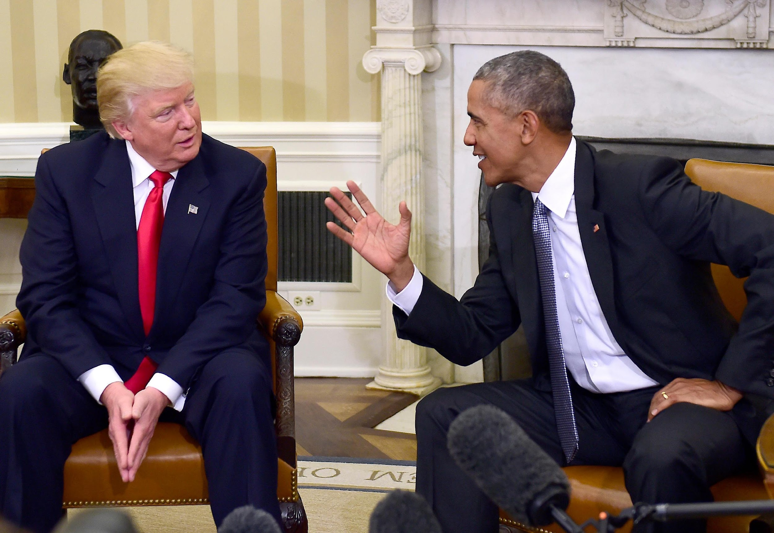
Trump and Obama
Notes:
On November 10, 2016, two days after winning the White House, President-Elect Donald Trump met with Barack Obama in the Oval Office. The meeting marked the beginning of the transition of power from the 44th president of the states of United States to the the 45th.

Slide 60
Do Elections Affect Public Policy?
Two-way street
Elections affect public policy to some degree
Public policy decisions affect electoral outcomes to some degree
Depends on policy differences between candidates
Notes:
Do electoral results affect public policy to any significant degree? The jury is still out on that question. There's no doubt that elections affect public policy slightly, and vice versa, but not to the extent that many voters, especially strong partisans, assume.
The greatest chance of voters steering policy arises in elections when there are clear policy differences between the candidates. But, as you've just learned, candidates take great pains to avoid taking clear policy stances. The more ambiguous they are, the fewer potential supporters they'll alienate.

Slide 61
Do Campaigns Lead to Increases in the Scope of Government?
Local promises add up
Government as servant rather than master
Notes:
Legislative campaigns are conducted locally, in states and districts. To appeal to local voters, candidates promise new government programs, subsidies, and tax breaks that are tailored to local interests. These promises add up, and explain why legislators find it much easier to expand the scope of government than to limit it.
Elections tend to reinforce the idea that the government is the servant of the voters, not its master, and must be responsive to the needs of voters.
Expanding the state's power is sometimes seen as increasing its capacity to serve citizens. Democracy increases the desire of citizens to benefit from the state and reduce their wish to be protected from it.

Slide 62
Shared Writing 9
The selection of Democratic and Republican Party presidential nominees is the most open and participatory process for selecting party leaders anywhere in the democratic world. Yet it is widely criticized by scholars and politicians alike. What are the advantages and disadvantages of this system? How might it be improved in the future?

Slide 63
Photo Credits
Chapter 9
245: John Roca, PacificCoastNews/Newscom; 247: Michael Boyer/AP Images; 248: Daniel Acker/Bloomberg/ Getty Images; 249: John Cole/Cagle Cartoons, Inc.; 254: Jonny White/Alamy Stock Photo; 257: ZUMA Press, Inc./ Alamy Stock Photo; 261: Evan Vucci/AP Images; 266: John Cross/Mankato Free Press/AP Images; 267: Daniel Acker/Bloomberg/Getty Images; 269: Paul Morigi/ WireImage/Getty Images; 273: Louis Lanzano/Polaris/ Newscom; 277: © dpa/Alamy Live News

