Slide 1
Government in America: People, Politics and Policy
Seventeenth Edition
Chapter 8
Political Parties

Slide 2
Learning Objectives (1 of 2)
8.1 Identify the functions of political parties.
8.2 Determine the significance of party identification in America today.
8.3 Describe the structure of political parties at the national, state, and local level.
8.4 Evaluate how well political parties generally do in carrying out their promises.

Slide 3
Learning Objectives (2 of 2)
8.5 Trace the evolution of political parties in America.
8.6 Evaluate the role of minor parties in the U.S. electoral system.
8.7 Evaluate the advantages and disadvantages of responsible party government.

Slide 4
Learning Objective 8.1
Identify the functions of political parties.

Slide 5
The Meaning of Party
Tasks of the Parties
Parties, Voters, and Policy: The Downs Model
Notes:
The purpose of political parties is to win elections. Parties seek to control the government. Period. That is their entire function: win elections, control the government.
Political scientists think about parties in three ways: The party in the electorate is the party’s membership. It’s easy to be a member of a party. There are no dues to pay and you aren’t obliged to officially register as a party member or work on campaigns. You aren’t even obliged to vote for your party’s candidates.
The party as an organization comprises the party’s national, state, and local offices, and their staffs, budgets, and rules.
Finally, the party in government consists of elected officials who call themselves party members. Officials are not obliged to vote with their party, and may sometimes vote with the opposition. But party leaders are the main spokespeople for the parties and sometimes try to enact their party’s policy promises into law.

Slide 6
Tasks of the Parties
Pick candidates
Run campaigns
Give cues to voters
Articulate policies
Coordinate policymaking
Notes:
In a large democracy, citizens rely on linkage institutions to indicate their policy preferences to government. Linkage institutions include parties, elections, interest groups, and the media.
To serve effectively as linkage institutions, parties must pick candidates to run for office under the party banner. Party leadership used to nominate candidates, but now the party membership votes for nominees in primary elections. Parties must help coordinate their nominees’ political campaigns, although personal campaign organizations are replacing the role of parties in this capacity.
Parties are still important, though, because they give cues to voters as to the liberal or conservative policy preferences of the candidate. Parties provide this shortcut in part because they have platforms that articulate a list of the party’s policy goals.
Finally, parties coordinate policymaking between the executive and legislative branches of government. Executives and legislators look for support from fellow party members and expect opposition from opposing party members.

Slide 7
Parties, Voters, and Policy: The Downs Model
Rational-choice theory
Political scientist Anthony Downs’ model
Most voters are moderate
Center of political spectrum
Parties seek voter loyalty
Position themselves to left and right of center
Notes:
In theory, parties compete like businesses for voters’ support. The products for sale are candidates and policies. Some political scientists use a rational-choice model to explain the relationship among citizens, parties, and policy. They assume that actors are rational and make decisions to sensibly pursue goals.
Political scientist Anthony Downs argues that voters want their favored policies to be enacted by government and parties want to get elected. So parties will adopt popular policies to maximize their chances of winning votes. Because most voters are moderate, parties will cluster around the center of the political spectrum.
Yet parties must also distinguish themselves to win over loyal adherents. To do this, they position themselves just to the left and right of center.

Slide 8
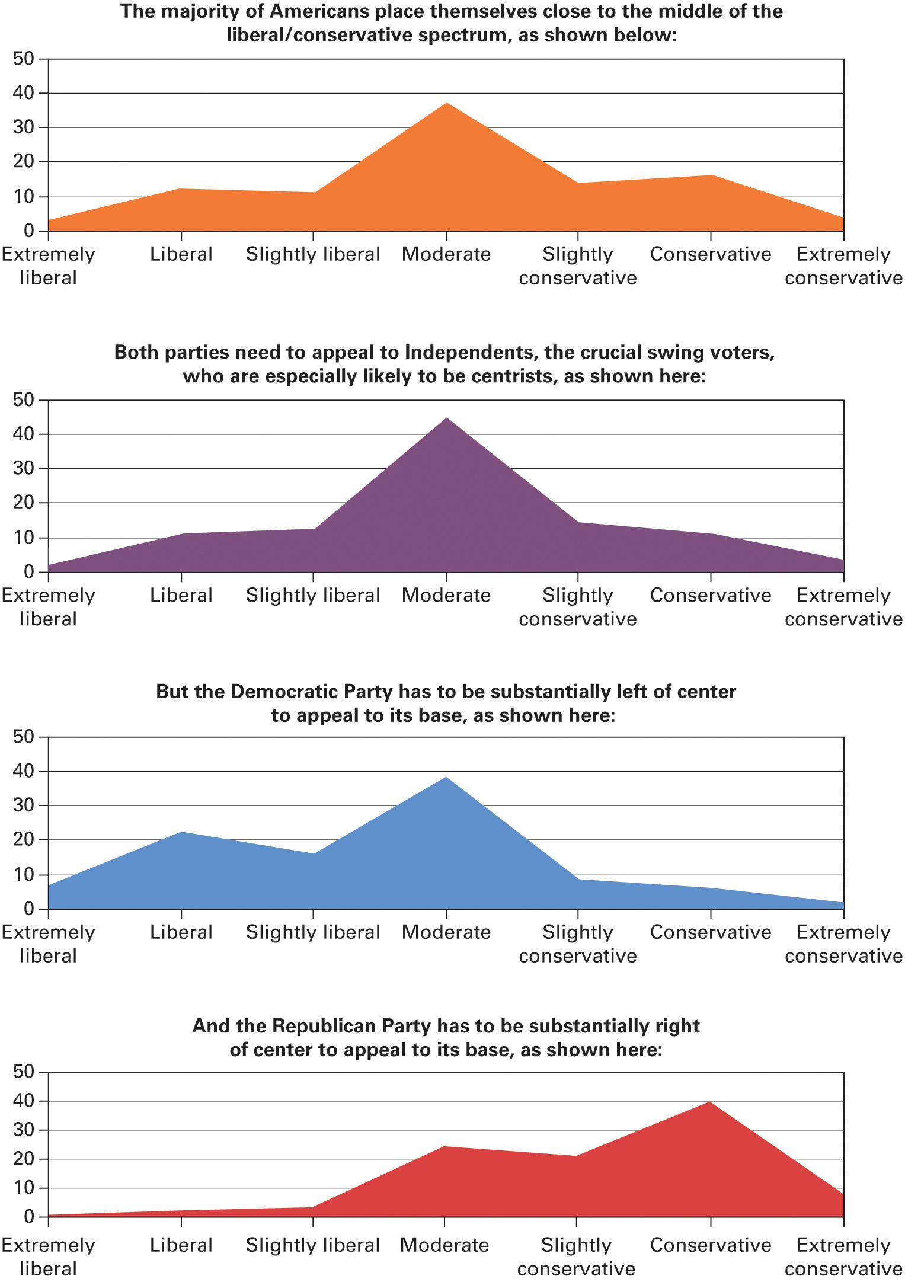
Figure 8.1 The Downs Model: How Rational Parties Position Themselves Near (but not at) the Center of Public Opinion
Source: Author’s analysis of combined 2008 and 2010 General Social Survey data.
Notes:
The General Social Survey regularly asks a sample of the American population to classify themselves on a 7-point scale from extremely liberal extremely conservative. As illustrated in the four graphs below, both political parties regularly face the challenge of positioning themselves relatively close to the median voter, in particular to appeal to Independents, while at the same time being responsive to the position of their own base of supporters.

Slide 9
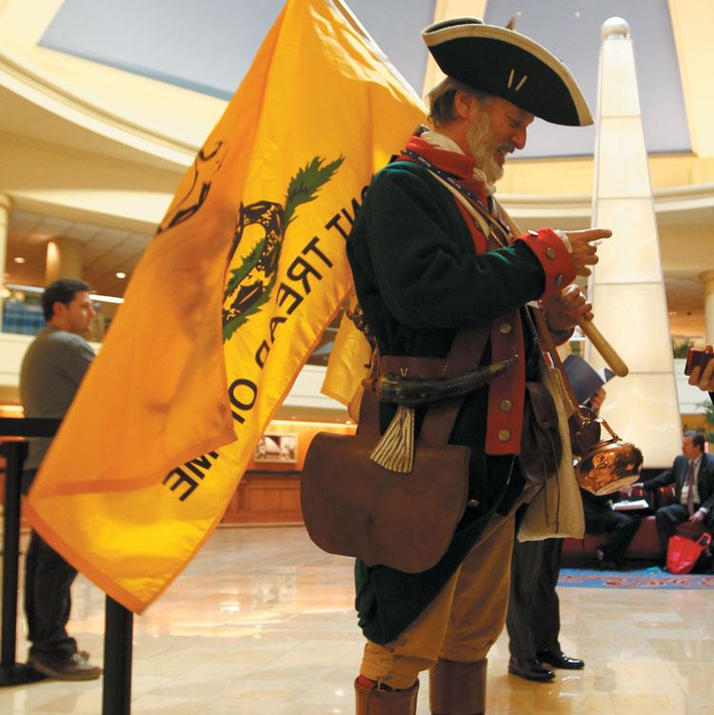
Tea Party
Notes:
Political parties have to cater to their most enthusiastic and active supporters—liberals for the Democrats and conservatives for the Republicans. Tea Party activists, who advocate a strict adherence to the U.S. Constitution, have been quite visible among conservatives in recent years. Here, a member of the Tea Party dresses as a eighteenth-century patriot at the annual Conservative Political Action Conference.

Slide 10
Learning Objective 8.2
Determine the significance of party identification in America today.

Slide 11
The Party in the Electorate
Party membership is psychological
Citizens think they know what parties stand for
Choose parties based on affinity with personal preferences
More Americans identify as Independents
Notes:
Party membership in America is a psychological label. Voters think they know what each party stands for and they choose an affiliation based on which party is closer to their preferences. The self-proclaimed preference for one party or the other is called party identification.
Polls have traced party identification over time. Two patterns have emerged in recent decades from these polls. First, more Americans now identify as Republicans than Democrats, and more Americans (44% in 2012) call themselves Independents, especially younger citizens. Independents claim to vote for the person, not the party, and are more likely than partisans to engage in ticket-splitting.

Slide 12
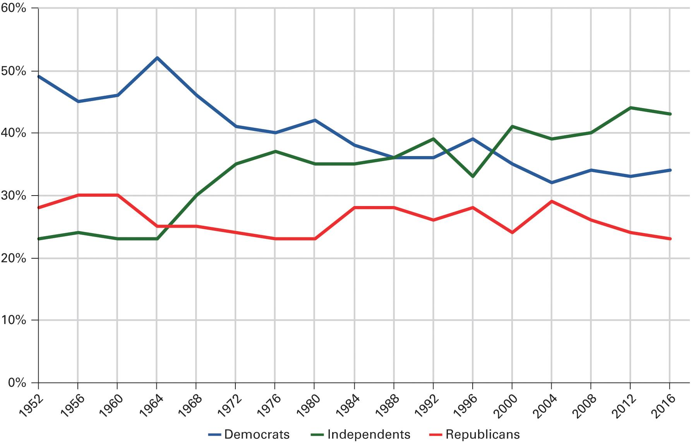
Figure 8.2 Party Identification in the United States
Source: American National Election Studies, 1952–2012; an average of eight ABC News/Washington Post polls conducted between January and October of 2016.
Note: A small percentage of people who identify with a minor party or who cannot answer the question are excluded.
Notes:
Political analysts and scholars carefully monitor changes in the distribution party identification. Below, you can see the percentage of population that has identified itself as Democrats, Independents, and Republicans during each presidential election year from 1952 to 2016.

Slide 13
Table 8.1 Youthful Independence
Age | Democrat | Independent | Republican
18–24 | 23 | 68 | 9
25–34 | 29 | 54 | 17
35–44 | 32 | 48 | 20
45–54 | 29 | 45 | 25
55–64 | 35 | 41 | 24
65+ | 36 | 35 | 29
Source: Authors’ analysis of the 2014 General Social Survey.
Notes:
Using data drawn from the 2014 General Social Survey, this table illustrates the percentage of an age group and their respective partisan identification. As we can see young voters have a pronounced tendency to more independent of the major political parties than older people.

Slide 14
Journal Prompt 8.2: The Party in the Electorate
Do you think that as the current generation of young people ages they will become more likely to identify with the major political parties? Because younger people are so likely to be independent, does this mean that many young voters are particularly open to persuasion during campaigns? If so, why don’t the Democrats and Republicans pay special attention to getting them on their side?

Slide 15
Learning Objective 8.3
Describe the structure of political parties and the national, state, and local level.

Slide 16
The Party Organizations: From the Grass Roots to Washington
Local Parties
The 50 State Party Systems
The National Party Organizations
Notes:
Local, state, and national party organizations would appear to have a hierarchical structure, but that appearance is deceiving, as the parties are highly decentralized and fragmented.

Slide 17
Local Parties
Once main party organization
Party machines
Rewarded voters
New York and Chicago
Patronage
Jobs for voters and contributors
Progressive reforms ended this system
Notes:
The urban political party was the main party organization from the late nineteenth century until at least the New Deal. The party’s effectiveness at getting out the vote came from so-called party machines, which rewarded voters for their support in a variety of ways.
Patronage was the key inducement used by party machines. Jobs were given to contributors, not based on merit or competence. New York and Chicago had the best known and most corrupt political machines. At its height, the Democratic political machine in Chicago dispensed 40,000 patronage jobs, the recipients of which were expected to deliver at least 10 votes each on Election Day and to kick back 5% of their salary in the form of a donation to the local Democratic Party.
Progressive reforms that made jobs merit-based and government contracts subject to bidding largely ended the patronage system.

Slide 18
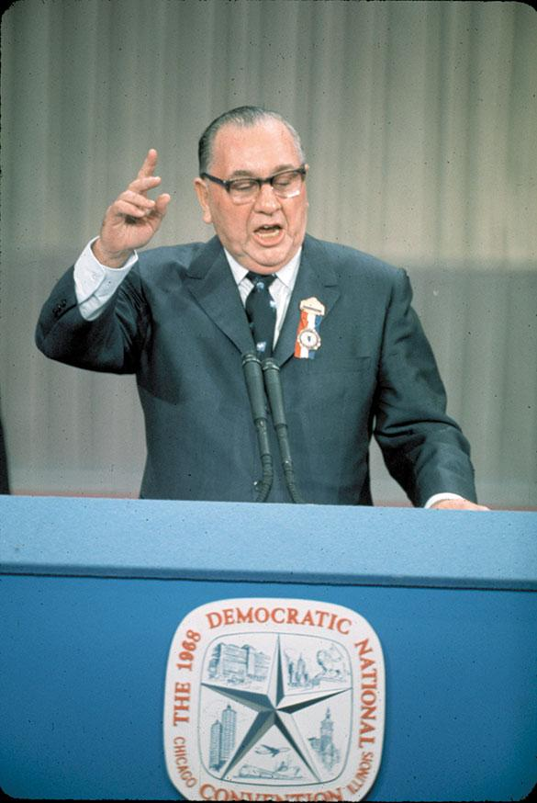
Chicago Mayor Richard Daley
Notes:
Mayor Richard J Daley ruled the city of Chicago from 1955 until his death in 1976. His Cook County Democratic party organization was highly organized at the precinct level. Members of the organization kept people in their neighborhoods happy by providing for their local needs, such as street maintenance, new stoplights, no-parking zones, and so on, and the people reciprocated on Election Day by supporting the organization’s candidates.

Slide 19
The 50 State Party Systems
No two exactly alike
Some well-funded, some weak
Permanent headquarters
Provide technical services
Open or closed primaries
Straight-ticket voting
Single column or random list of candidates
Notes:
The state party organizations vary in their levels of organization and funding. States get to decide certain rules related to voting, such as whether to hold open or closed primaries, whether to allow one-punch straight-ticket voting, and whether to list party candidates in a single column or randomly on ballots. These rules make a big difference in voter behavior.
State parties are increasingly establishing permanent headquarters. Their job is to provide technical assistance with campaigns since candidates usually have their own campaign organizations.

Slide 20
The National Party Organizations
National convention
Meets every four years
Writes party platform
Formal nomination of candidates
National committee
Operates between conventions
National party chairperson
Attends to the daily operations of the party
Notes:
The national convention of each party meets every four years to formally nominate the party’s presidential candidate and revise the party platform. The national committee operates between conventions, led by the national chairperson, who hires staff, raises money, pays bills, and attends to the daily duties of the party. The party chair sometimes uses this position as a means of political advancement.

Slide 21
Learning Objective 8.4
Evaluate how well political parties do in carrying out their promises.

Slide 22
The Party in Government: Promises and Policy
Party in power determines policy
Coalitions support parties
Most presidents fail to implement campaign promises
But they do live up to some of them
Party platforms are blueprints
Notes:
The party that controls the most government offices and branches will have the most influence in public policy. In other words, they get to determine who gets what, where, when, and how.
Individuals and groups form coalitions to support parties based on the party’s performance in office, that is, what it has done and what it’s promised to do. Most presidents fail to live up to their campaign promises, such as by raising taxes when they promised not to or failing to cut them when they promised to do so. But they do accomplish some of their stated goals. Ronald Reagan promised to increase defense spending and cut social welfare expenditures, and he did both of those things. Barack Obama got the troops out of Iraq, as promised.
Party platforms serve as a blueprint for legislative plans and reflect the attitudes of the party’s base.

Slide 23
Table 8.2 Party Platforms, 2016 (1 of 4)
Issue Position | Republicans | Democrats
Foreign Policy | We are the party of peace through strength. We believe that American Exceptionalism… requires the United States to retake its natural position as leasder of the free world... [The Democrats] pander to world opinion and neglect the national interest. | Democrats believe that global institutions and multilateral organizations have a powerful role to play and are an important amplifier of American strength and influence...It would be reckless to follow Donald Trump and turn our back on the international system that America built.
Immigration | We oppose any form of amnesty for those who, by breaking the law, have disadvantaged those who have obeyed it. The executive amnesties of 2012 and 2014 are a direct violation of federal law and usurp the powers of Congress… We support building a wall along our southern border. | We need to urgently fix our broken immigration system—which tears families apart and keeps workers in the shadows—and create a path to citizenship for law-abiding families who are here. We will defend and implement President Obama’s Deferred Action for Childhood Arrivals.
Notes:
Although few people actually read party platforms, they are one of the best-written sources for what the parties believe in. A brief summary of some of the contrasting positions in the Democratic and Republican platforms of 2016 illustrates major differences in beliefs between the two parties.

Slide 24
Table 8.2 Party Platforms, 2016 (2 of 4)
Issue Position | Republicans | Democrats
Abortion | We assert the sanctity of human life and affirm that the child has a fundamental right to life which cannot be infringed. We support a human life amendment to the Constitution. | We believe unequivocally that every woman should have access to quality reproductive health care services, including safe and legal abortion—regardless of where she lives, how much money she makes, or how she is insured.
Same-sex marriage | We do not accept the Supreme Court's redefinition of marriage and we urge its reversal, whether through judicial reconsideration or a constitutional amendment returning control over marriage to the states. | Democrats applaud last year’s decision by the Supreme Court that recognized LGBT people—like every other American— have the right to marry the person they love.
Notes:
Although few people actually read party platforms, they are one of the best-written sources for what the parties believe in. A brief summary of some of the contrasting positions in the Democratic and Republican platforms of 2016 illustrates major differences in beliefs between the two parties.

Slide 25
Table 8.2 Party Platforms, 2016 (3 of 4)
Issue Position | Republicans | Democrats
Health Care | Any honest agenda for improving healthcare must start with repeal of the dishonestly named Affordable Care Act…It must be removed and replaced with an approach based on genuine competition, patient choice, excellent care, wellness, and timely access to treatment. | Democrats will never falter in our generations-long fight to guarantee health coverage as a fundamental right for every American. As part of that guarantee, Americans should be able to access public coverage through Medicare or a public option.
Environment | We firmly believe environmental problems are best solved by giving incentives for human ingenuity and the development of new technologies, not through top-down, command-and-control regulations that stifle economic growth and cost thousands of jobs. | Climate change is an urgent threat and the defining challenge of our time…We will take bold steps to slash carbon pollution and protest clean air at home, and lead the fight against climate change around the world.
Notes:
Although few people actually read party platforms, they are one of the best-written sources for what the parties believe in. A brief summary of some of the contrasting positions in the Democratic and Republican platforms of 2016 illustrates major differences in beliefs between the two parties.

Slide 26
Table 8.2 Party Platforms, 2016 (4 of 4)
Issue Position | Republicans | Democrats
Taxes | Republicans consider the establishment of a pro-growth tax code a moral imperative…We oppose tax policies to deliberately divide Americans or promote class warfare. | At a time of massive income and wealth inequality, we believe the wealthiest Americans and large corporations must pay their fair share in taxes…We will establish a multimillionaire surtax to ensure that millionaires and billionaires pay their fair share
Rising college costs | The federal government should not be in the business of originating student loans. | Democrats will allow those who currently have student debt to refinance their loans at the lowest rates possible
Source: Excerpts from party platforms as posted on the Web sites of each organization.
Notes:
Although few people actually read party platforms, they are one of the best-written sources for what the parties believe in. A brief summary of some of the contrasting positions in the Democratic and Republican platforms of 2016 illustrates major differences in beliefs between the two parties.

Slide 27
Learning Objective 8.5
Trace the evolution of political parties
in America.

Slide 28
Party Eras in American History
1796–1824: The First Party System
1828–1856: Jackson and the Democrats Versus the Whigs
1860–1928: The Two Republican Eras
1932–1964: The New Deal Coalition
1968–Present: Southern Realignment and the Era of Divided Party Government
Notes:
The United States has a two-party system. Most other democratic countries have more than two parties. Throughout American history, one party has been the dominant majority party for long periods of time, followed by the other party.
Political scientists study these party eras. Each one starts with a critical election in which old party coalitions fracture and new ones begin to form. Voters realign their preferences and the other party dominates until a new party realignment occurs. Party realignments don’t occur often, and they are usually sparked in response to some crisis, such as the Great Depression.

Slide 29
1796–1824: The First Party System
Madison warned against factions
Hamilton and the Federalist Party
Capitalist support, Northeast
Short-lived
Ideas of loyal opposition and rotation of power new
Jefferson and the Democratic-Republicans
Agrarian support, South
Torn by factions
Notes:
The framers of the Constitution didn’t anticipate the advent of parties. James Madison had warned against the dangers of “factions,” which we would call political parties, but they formed almost immediately.
The Federalist Party was the first to form, when Secretary of State Alexander Hamilton was seeking support for starting a national bank. The Federalist Party drew support from capitalists and those who favored a stronger national government. An opposition party coalesced around Thomas Jefferson, comprising agrarian interests who favored stronger state government and weaker national control.
After Jefferson defeated Federalist John Adams in the presidential election of 1800, the Federalist Party fizzled. The ideas of loyal opposition and rotation of power were not yet established. The Democratic-Republican Party disintegrated due to the rise of internal factions shortly thereafter, and was replaced with the beginnings of modern political parties.

Slide 30
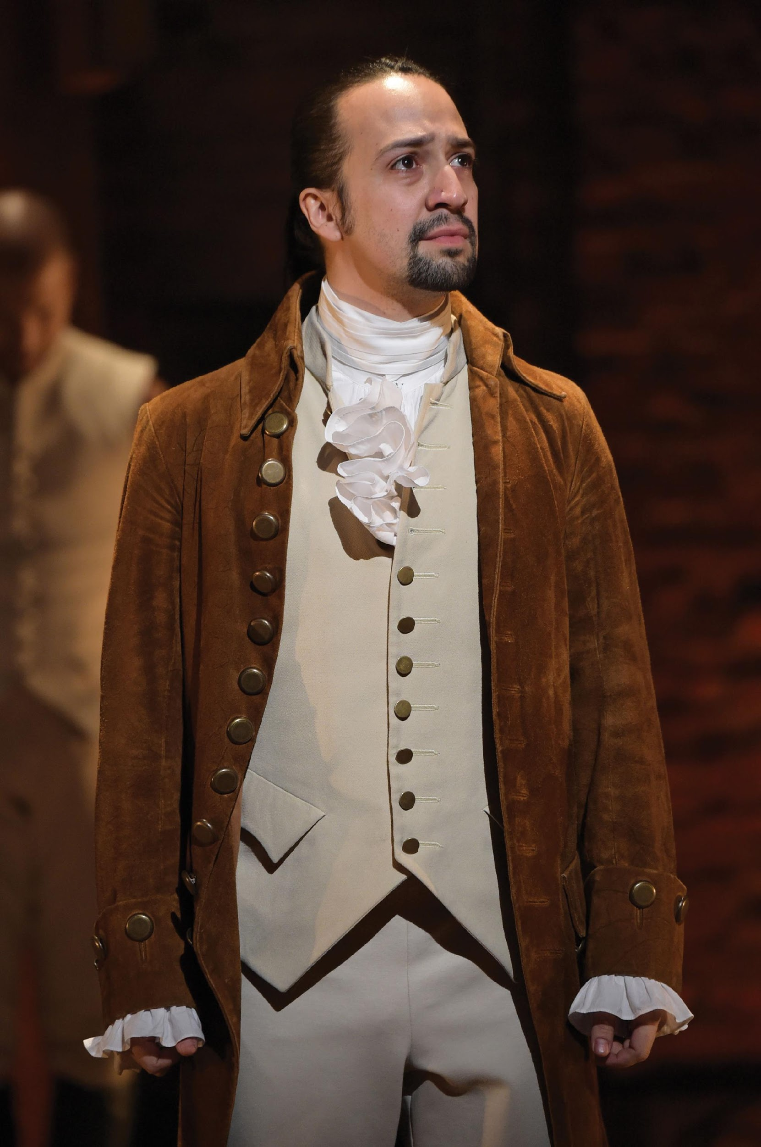
Lin-Manuel Miranda from the Broadway Play Hamilton
Notes:
Alexander Hamilton was one of the most important leaders of the Federalist party. His political and personal life has recently drawn a lot of attention due to the overwhelming success of "Hamilton” on the Broadway stage. Lin-Manuel Miranda wrote the play and performed the role of Hamilton, as shown here.

Slide 31
1825–1856: Jackson and the Democrats Versus the Whigs
General Andrew Jackson as leader
Democratic-Republicans vs. Democratic Party
New coalition in election of 1828
Westerners, Southerners, new immigrants
Broaden participation opportunities
Martin Van Buren
Theory of loyal opposition
Whig Party
Notes:
Andrew Jackson is considered to be the founder of the modern American political party because he created a new coalition of Westerners, Southerners, and new immigrants who emerged from the old Democratic-Republican Party and formed the antecedent to the modern Democratic Party. One of Jackson’s goals broaden political opportunity by eliminating many vestiges of elitism and mobilizing the masses
Martin Van Buren, who succeeded Jackson as president, theorized that one party could not please everyone and needed loyal opposition to represent other segments. This came initially in the form of the short-lived Whig Party.

Slide 32
1860–1928: The Two Republican Eras
1850s: Slavery dominated politics
Split both parties
Republicans rose as antislavery party
Abraham Lincoln and the Civil War
Second party realignment
Lasted 60 years
Democrats controlled the South
1896: Second Republican era
Democrats and “free silver”
Notes:
Slavery dominated political discourse by the 1850s, and split both parties internally. Abraham Lincoln formed an antislavery coalition that emerged as the Republican Party. After the Civil War, the Republican Party enjoyed 60 years of dominance. This was the second party realignment, and it lasted until the Great Depression.

Slide 33
1932–1964: The New Deal Coalition
Hoover loses to FDR
FDR promises New Deal
New coalition formed
Elements of New Deal coalition
Urban dwellers
Labor unions
Catholics and Jews
The poor
Southerners
African Americans
Notes:
President Herbert Hoover’s poor handling of the Great Depression caused him to lose the 1932 presidential election to Franklin D. Roosevelt, who promised Americans a New Deal and forged a new coalition made up of urban dwellers, labor unions, Catholics and Jews, the poor, Southerners, and African Americans. The New Deal coalition kept the Democrats in power until the 1960s, when President Lyndon Johnson’s Vietnam War and civil rights policies fractured it.

Slide 34
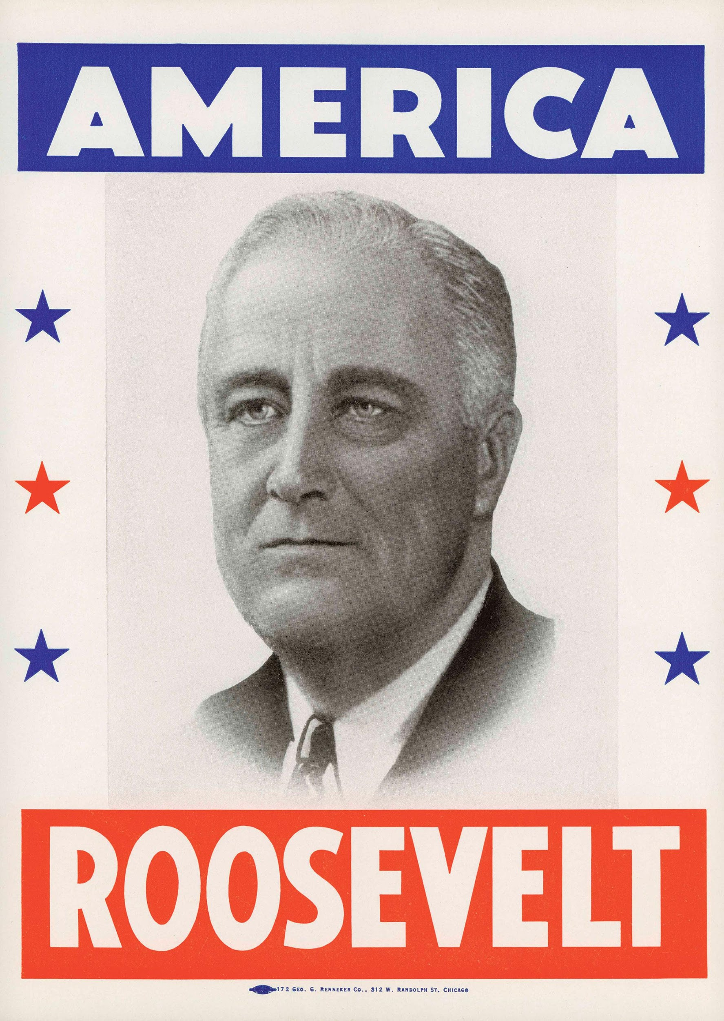
Franklin D. Roosevelt
Notes:
Franklin Roosevelt reshaped the Democratic Party, bringing together a diverse array of groups that had long been marginalized in American political life. Many of the key features of the Democratic Party today, such as support from labor unions, can be traced to the FDR era.

Slide 35
1968–Present: Southern Realignment and the Era of Divided Party Government
Nixon’s Southern strategy
Support for states’ rights, law and order, strong military posture
Win Southern conservatives
Republicans did not have Congress
New pattern
Divided government now normal
Party dealignment
Notes:
When Nixon was running for president in 1968, he formulated a policy platform emphasizing support for states’ rights, law and order, and a strong military posture. This platform was calculated to win over Southern conservatives to the Republican Party. Southern whites had been defecting to the Republicans ever since the Democrats first began to embrace civil rights in 1948, and Nixon’s “states’ rights” was code for opposition to civil rights.
Unlike in previous realignments, Nixon’s party didn’t have both houses of Congress. This wasn’t an exception, but the emergence of a new pattern that held for Presidents Ronald Reagan and George Bush. Divided government and gridlock are now business as usual.
Instead of party realignments, we are now seeing dealignment, in which voters are gradually moving away from both parties. What are the implications of dealignment for the political party system?

Slide 36
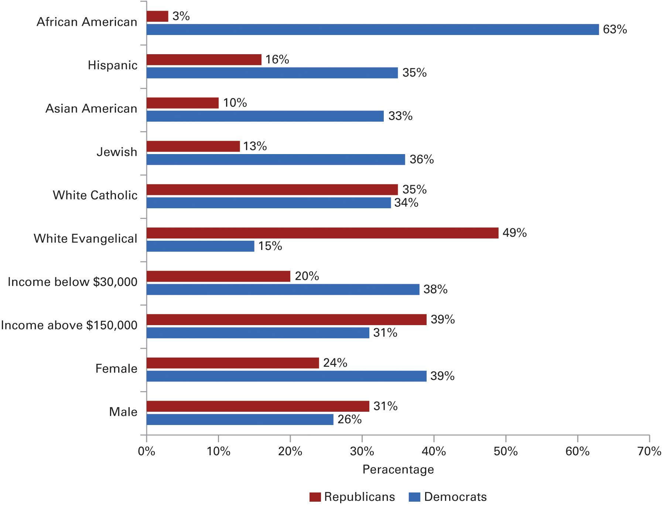
Figure 8.3 Party Coalitions Today
Source: Author’s analysis of the 2014 Pew Research Center post-election survey.
Notes:
The two parties continue to draw support from very different social groups, many of which have existed since the New Deal era. This figure shows the percentage identifying as Democrats and Republicans for various groups shortly after the 2014 midterm elections.

Slide 37
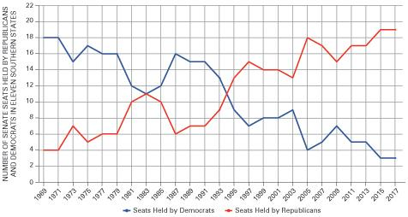
Figure 8.4 Realignment in the South
Notes:
One of the most significant political changes over the past four decades has been the partisan realignment in the Southern states that has transformed this region from a solid Democratic base of support to a solid Republican area.
Without strong Southern support for the Republicans in recent elections, it is doubtful that the GOP would have been able to attain majority party status in the Congress for the majority of the period from 1995 to 2018. The crucial role of the South in Republican politics has lately been reflected in the makeup of the GOP congressional leadership. Mitch McConnell of Kentucky and Trent Lott of Mississippi have served as the Republicans’ leader in the Senate. Georgia’s Newt Gingrich served as a Speaker of the House for three terms, and Louisiana's Stephen Scalise currently holds the position of House Majority Whip.

Slide 38
Learning Objective 8.6
Evaluate the role of minor parties in the U.S. electoral system.

Slide 39
Third Parties: Their Impact on American Politics
Three types of third parties
Cause parties
Offshoots of major parties
Vehicles for individual candidacies
Rarely win office but can affect elections
Why only two parties?
Notes:
Although two parties dominate American politics, third parties do exist and occasionally they even briefly capture the public’s attention. There are three types of third parties.
One type promotes a cause, such as the Prohibition Party that formed over the single issue of outlawing alcoholic beverages. Some “cause parties” take extreme ideological positions.
Another type of third party is a splinter party, or offshoot of a major party. In 1912, for example, Theodore Roosevelt, who had previously been elected president as a Republican, ran under the Progressive Party banner.
Sometimes parties form around a candidate—such as Ross Perot in 1992—who chooses not to affiliate with a party in the hopes of appealing to voters who are dissatisfied with both parties.
Third-party candidates almost never win office but they can split the major party vote and affect the outcome of an election, as in 1912 when the Progressives split the Republican vote and enabled a Democrat to win in a Republican era.
Do you know why there are only two parties in the United States but more in most other democracies? In the United States, we have a winner-take-all system. Many other democracies have proportional representation, in which each party receives seats in proportion to the number of votes they received.

Slide 40
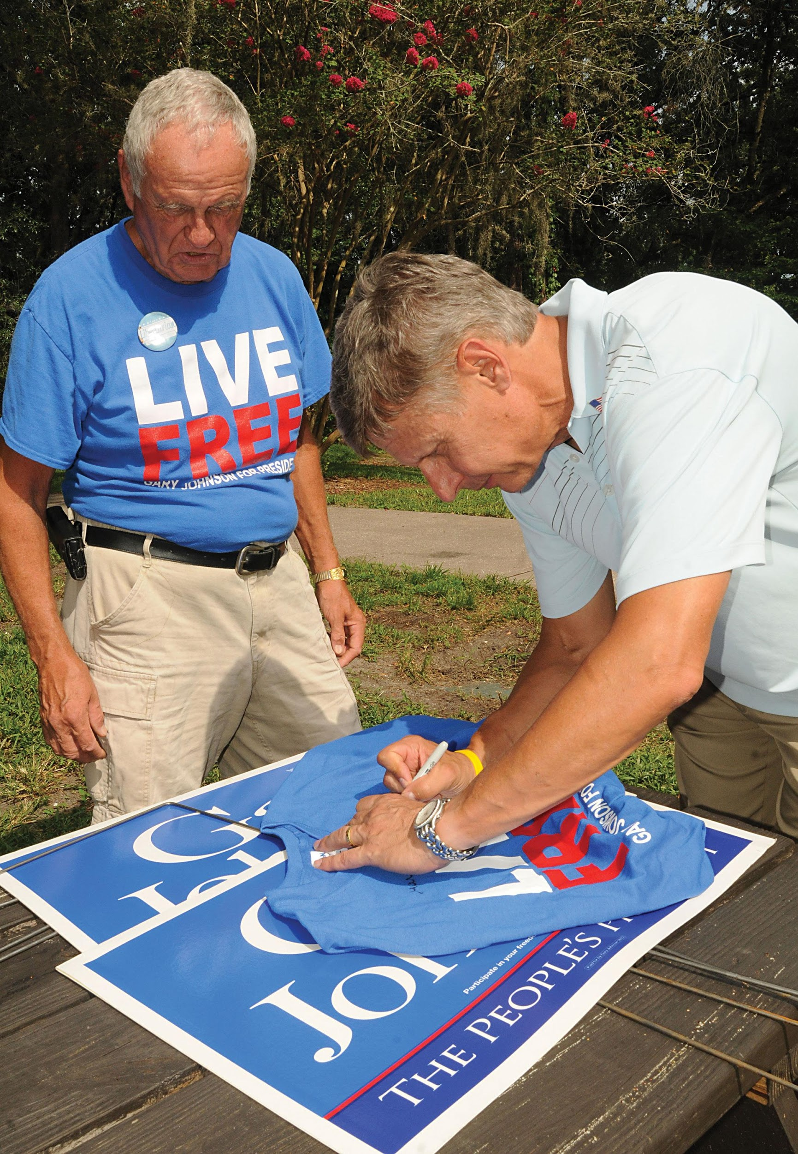
Libertarian Party
Notes:
The Libertarian party is one of America's strongest third parties and usually gets its presidential candidates on the ballot in most states. Gary Johnson, the former governor of New Mexico, was the Libertarian candidate for president in both 2012 and 2016. In this photograph, Johnson is shown autographing a T-shirt for a supporter.

Slide 41
Journal Prompt 8.6: Third Parties: Their Impact on American Politics
If the United States adopted a form of proportional representation, what new parties do you think would be formed and would become important players? Do you think your political views would end up being better represented if we had proportional representation and there were more viable parties to choose from on Election Day? If so, how?

Slide 42
Learning Objective 8.7
Evaluate the advantages and disadvantages of responsible party government.

Slide 43
Understanding Political Parties
Democracy and Responsible Party Government: How Should We Govern?
American Political Parties and the Scope of Government
Notes:
Today, multiparty systems are considered essential to democratic government. The absence of the free competition of parties is a feature of totalitarian regimes. Yet the Founders were leery of parties and sought to limit the role they could play in American democracy. What role should they play? Should parties continue to be so loosely organized?

Slide 44
Democracy and Responsible Party Government: How Should We Govern?
Responsible party model
Distinct governing programs
Internal cohesion and commitment
Majority party must implement program
Majority party must accept responsibility
Party leadership weak in U.S.
Is this good or bad?
Notes:
There’s only a limited connection between what candidates say they’ll do and what they accomplish once in office. Advocates of a responsible party model would like to see each party present a distinct, comprehensive governing program. Each candidate should be committed to the program. The major party must implement its programs and accept responsibility for its performance. According to this model, parties should be more cohesive and accept collective responsibility for their actions so voters would know who to blame.
This model is far from the reality today. Politicians face no sanctions for deviating from the party line, and party leadership has no control over them. Southern Democrats are often more conservative, and serve more conservative constituencies, than Northern ones, and regularly defect from their party on social issues. Such behavior is unusual in most other democracies where party leadership has much more power to enforce party unity and voting.
Are decentralized parties bad or good? It’s a matter of opinion. America’s a big country, so it might be unrealistic to expect Massachusetts Democrats to vote the same way as Arizona Democrats. What do you think?

Slide 45
Table 8.3 Partisan Divisions on Key Roll Call Votes During the Obama Presidency (1 of 2)
 | Dems For | Dems Against | Reps | Reps Against
Party-Line Voting
2009 $787 Billion Stimulus | 244 | 11 | 0 | 177
2010 Affordable Care Act | 220 | 32 | 0 | 175
2010 Student Loan Reform | 220 | 32 | 0 | 176
2010 Don’t Ask, Don’t Tell Repeal | 235 | 15 | 15 | 160
2010 Financial Services Reform | 234 | 19 | 3 | 173
2009 Truth in Lending Act | 248 | 0 | 113 | 63
2010 Extension of the Bush tax cuts | 139 | 112 | 138 | 36
2011 Patient Reform | 136 | 50 | 168 | 67
2015 Every Student Succeeds Act | 181 | 0 | 178 | 64
Notes:
During the presidency of Barack Obama, there was much discussion in the press about heightened partisan tensions between Democrats and Republicans in Congress. A close look at votes in the House of Representatives on major legislation that President Obama signed into law reveals three patterns: Democrats and Republicans sometimes differ greatly, sometimes cooperate, and sometimes oppose their own party’s president more than the other party.

Slide 46
Table 8.3 Partisan Divisions on Key Roll Call Votes During the Obama Presidency (2 of 2)
 | Dems For | Dems Against | Reps | Reps Against
Opposition Party Support
2011 Debt Ceiling Raise | 95 | 95 | 174 | 66
2011 South Korean Trade Agreement | 59 | 130 | 219 | 21
2014 Trillion Dollar-Spending Bill | 57 | 138 | 162 | 67
Notes:
During the presidency of Barack Obama, there was much discussion in the press about heightened partisan tensions between Democrats and Republicans in Congress. A close look at votes in the House of Representatives on major legislation that President Obama signed into law reveals three patterns: Democrats and Republicans sometimes differ greatly, sometimes cooperate, and sometimes oppose their own party’s president more than the other party.

Slide 47
American Political Parties and the Scope of Government
Not as broad as in Europe
Health care example
Parties not disciplined
Hard to cut spending
Not disciplined enough to say “no”
Get more for own constituents
Notes:
America’s lack of strong party discipline limits the scope of government because one party usually cannot gain enough votes to make major legislative changes. Health care provides a good example. Most European countries enacted universal health care laws after World War II. But Democratic president Bill Clinton, with a Congress controlled by Democrats, wasn’t able to get enough votes from his own party to implement universal health care in the United States.
On the other hand, it’s also hard for parties to cut government spending. Politicians are out to get more for their own constituents, and there’s nobody with an incentive to say no.

Slide 48
Shared Writing 8
Many scholars have called upon the parties to follow the responsible party model more closely, with the parties saying precisely what they plan to do and then doing what they said they would do. Why is it that American political parties find it so hard to operate this way? Do you think our democracy would be better or worse if they did so?

Slide 49
Photo Credits
Chapter 8
223: Kevin Lamarque/Reuters; 226: Walter Bennett/The LIFE Picture Collection/Getty Images; 231: Theo Wargo/ WireImage/Getty Images; 233: Stock Montage/Archive Photos/Getty Images; 237: Paul Hennessy/Polaris/ Newscom; 240: Daryl Cagle/Cagle Cartoons, Inc.

