Slide 1
Government in America: People, Politics and Policy
Seventeenth Edition
Chapter 7
The Mass Media and the Political Agenda

Slide 2
Learning Objectives
7.1 Describe how American politicians choreograph their messages through the mass media.
7.2 List the major criteria that determine which news stories receive the most media attention.
7.3 Analyze the impact of the media on public opinion and political behavior.
7.4 Describe how politicians use the media to communicate with the electorate.
7.5 Assess the impact of the mass media on the scope of government and democracy in America.

Slide 3
Learning Objective 7.1
Describe how American politicians choreograph their messages through the mass media.

Slide 4
The Mass Media Today (1 of 2)
The Development of Media Politics
The Print Media
The Emergence of Radio and Television
Government Regulation of Electronic Media
Notes:
Since the latter part of the twentieth century American politics has been increasingly shaped by technology. Political success depends on getting your message to the public, and one of the most effective ways to do that is to have it presented on the daily news. One way to get the media's attention is to stage an event just for them. Of course, you want to control how the various media present you, so media events tend to be carefully staged and tightly scripted.

Slide 5
The Mass Media Today (2 of 2)
From Broadcasting to Narrowcasting: The Rise of Cable and Cable News
The Impact of the Internet
Private Control of the Media

Slide 6
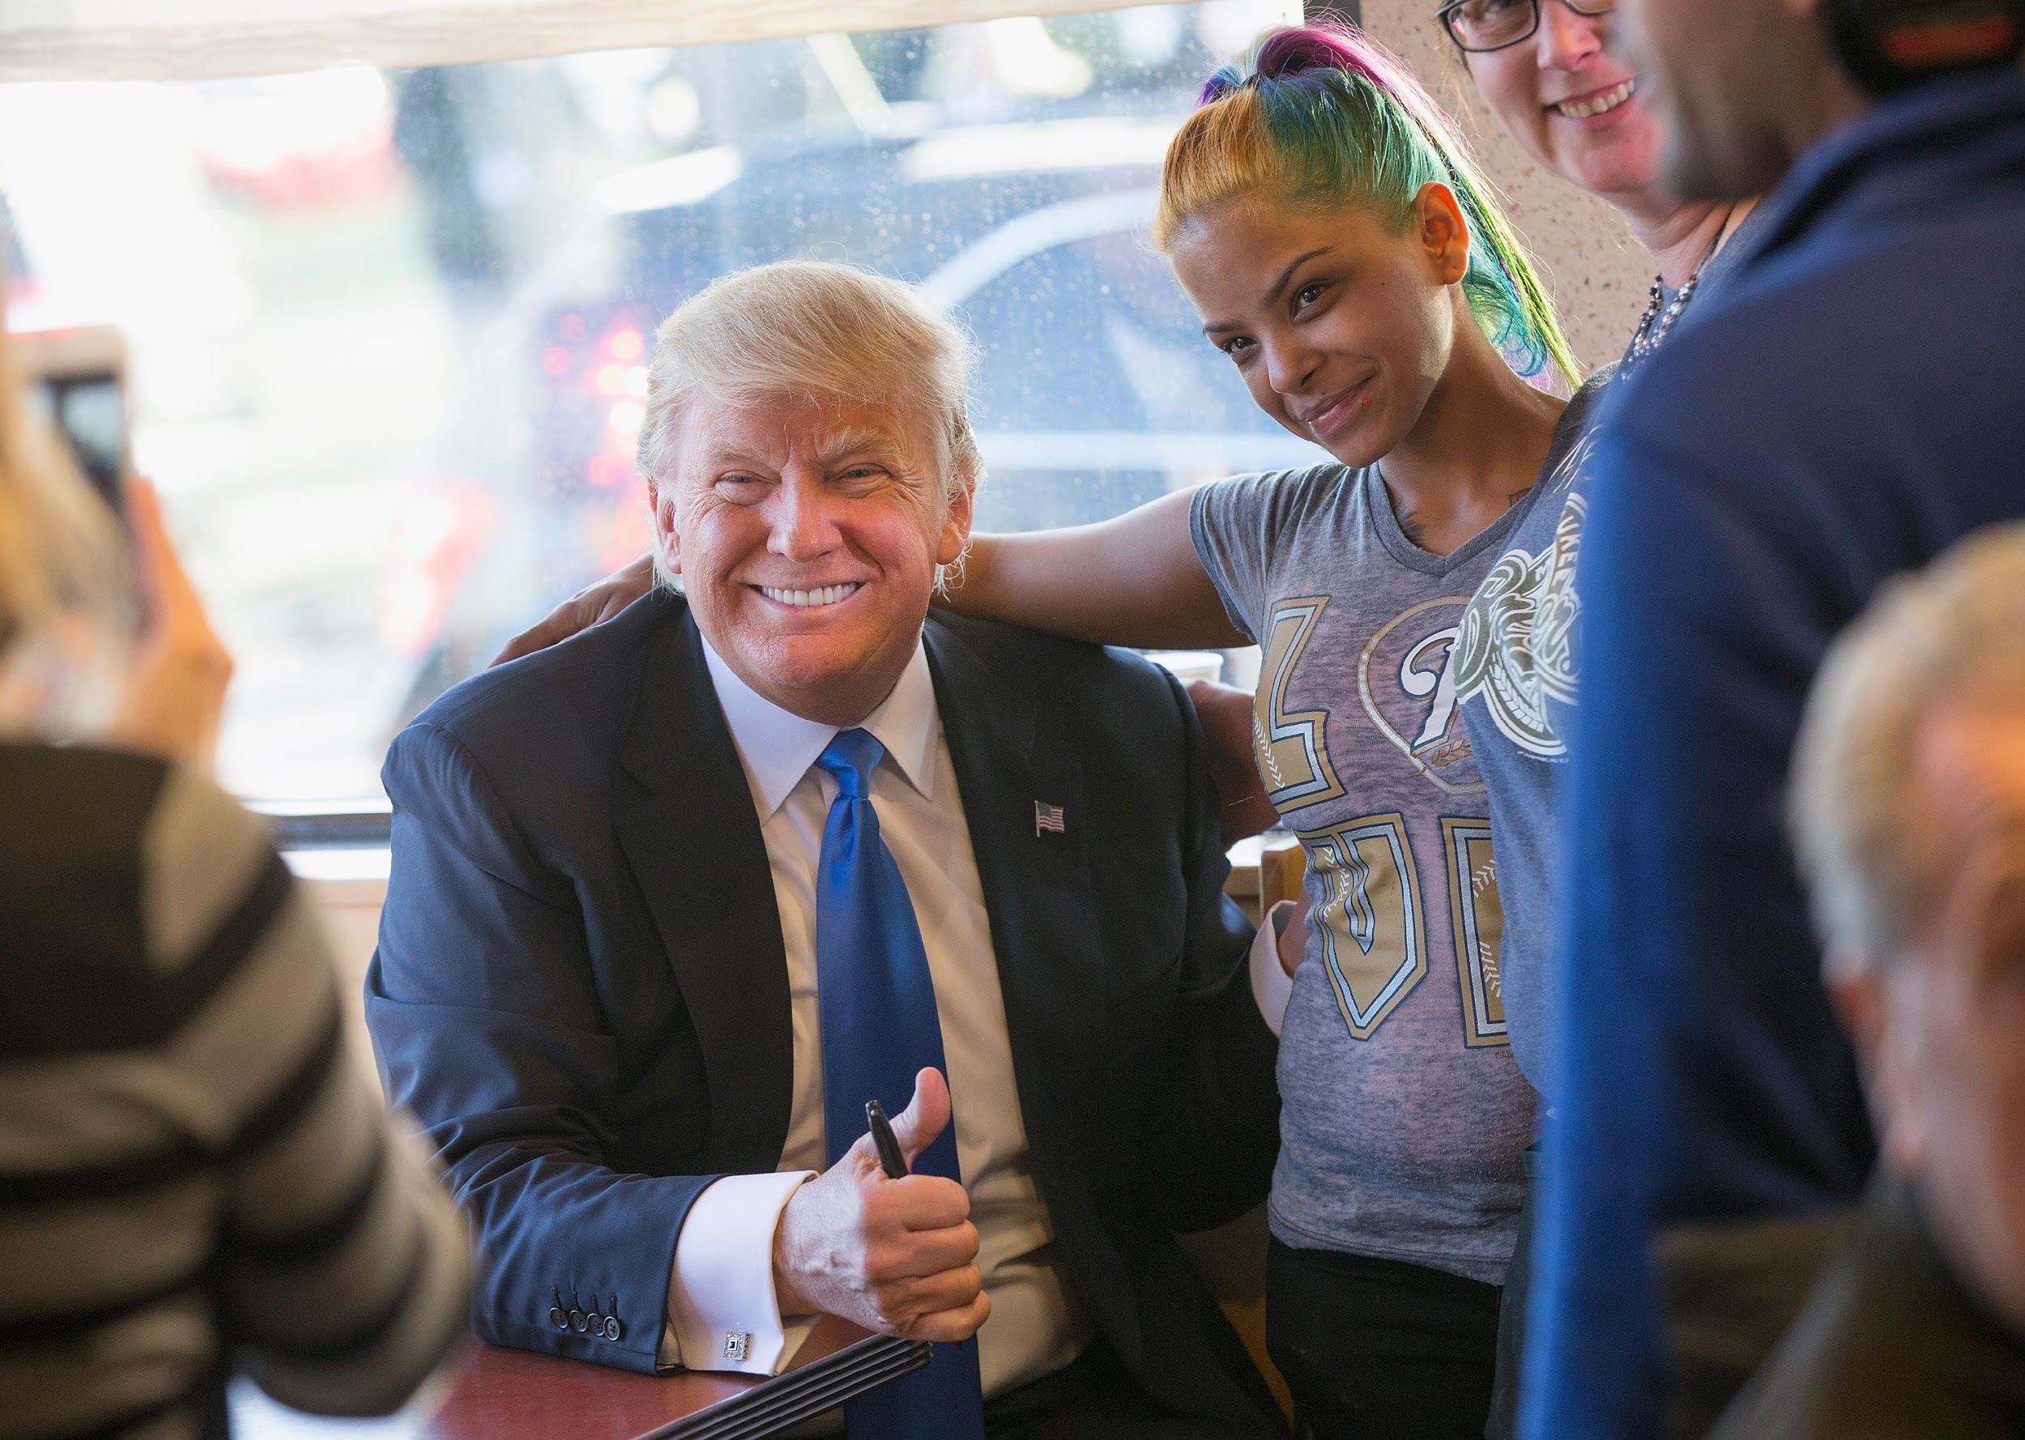
Donald Trump
Notes:
The sight of a major presidential candidate walking into a local eatery and asking ordinary people for their support is something that the media finds difficult to pass up. Here, Donald Trump is shown interacting with patrons at a Wauwatosa, Wisconsin, diner during the 2016 primary campaign. Although Trump met only a few dozen people at the diner, the number who saw pictures like this in their newspaper or viewed the video footage on TV was far, far greater.

Slide 7
The Development of Media Politics
Virtually no press at time of founding
Franklin Roosevelt invented media politics
Cozy relationship until 1960s
Vietnam War and Watergate
Investigative journalism
News coverage of presidential candidates now less favorable
Notes:
While there was virtually no press at the founding the media now plays a profoundly important role in American politics. It was President Franklin Roosevelt who virtually invented media politics. Up until the 1960s politicians and the press had a relatively cozy relationship. This meant, for example, that a politician's personal life was off limits as were questions about his health.
The Vietnam War and the Watergate scandal increases skepticism and cynicism press. And gave rise so what's now known as investigative journalism. In his analysis of media coverage of presence campaign since 1960 Thomas Patterson has argued that is coverage of presidential candidates apps become increasingly less favorable.

Slide 8
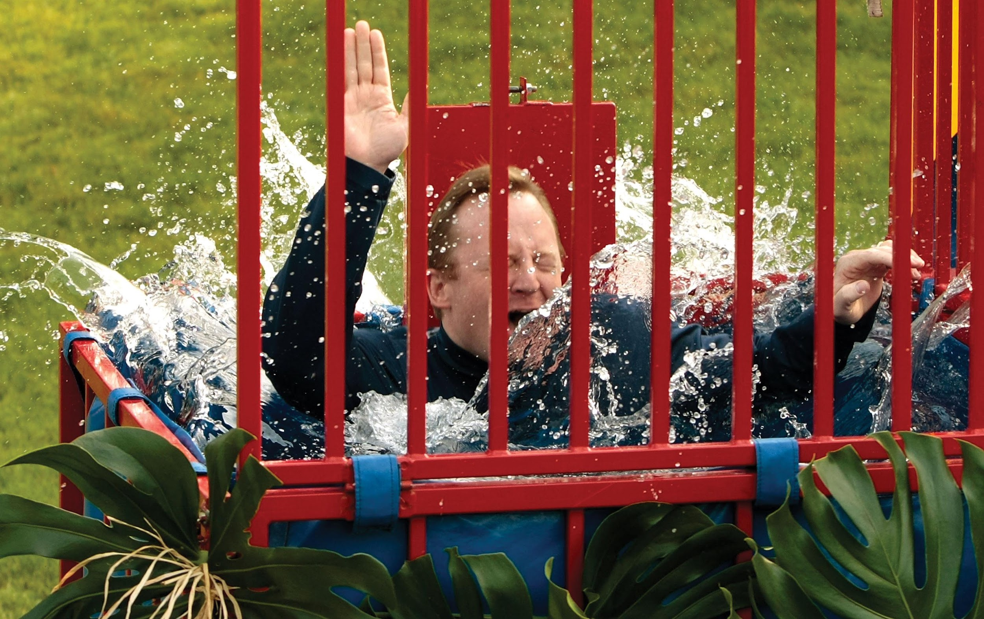
White House Dunk Tank
Notes:
The White House Press Secretary battles daily with the press corps, as correspondents attempt to obtain ever more information while the president’s spokesperson tries to control the news agenda and spin stores in the administrations favor. Obama's Press Secretary Robert Gibbs offered to give members of the press the chance to dunk him in a tank at the annual White House luau one year. Four reporters stepped up to take a shot at dunking Gibbs and two succeeded in dunking him in the tank.

Slide 9
The Print Media
Newspapers and a free press
Newspaper readers better informed
Yet circulation declines
Online news
How to make money?
Notes:
The First Amendment guarantee of freedom of the press gave newspapers the ability to air government's dirty laundry, which they've done since the first daily newspaper began in 1783.

Slide 10
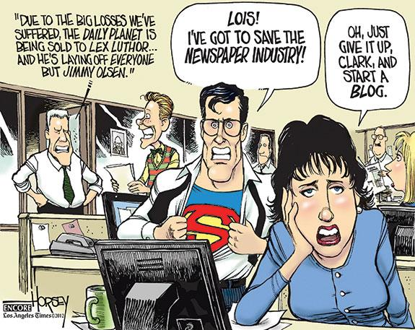
Political Cartoon
Notes:
In recent years, almost all newspapers have had to cut staff writers substantially, and some newspapers have gone out of business entirely.

Slide 11
The Emergence of Radio and Television
Radio – 1930s
Television – post-WWII
Cable television – 1980s
Internet – 1990s
End of the golden age of network news

Slide 12
Government Regulation of Electronic Media
Federal Communications Commission (FCC) 1934
Prevents monopolies
Stations must serve public interest
Fair treatment rule
Equal time rule
Fairness doctrine abolished in late 1980s
Notes:
In 1934, Congress created the Federal Communications Commission to regulate use of the airwaves. The FCC prevents monopolies by limiting the number of stations owned by one company. This regulation isn't very stringent. No single owner can control more than 35% of the broadcast market, but that's a sizable chunk. The FCC also ensures that all stations serve the public interest, although it is rare for a station to lose its license for failing to do so.

Slide 13
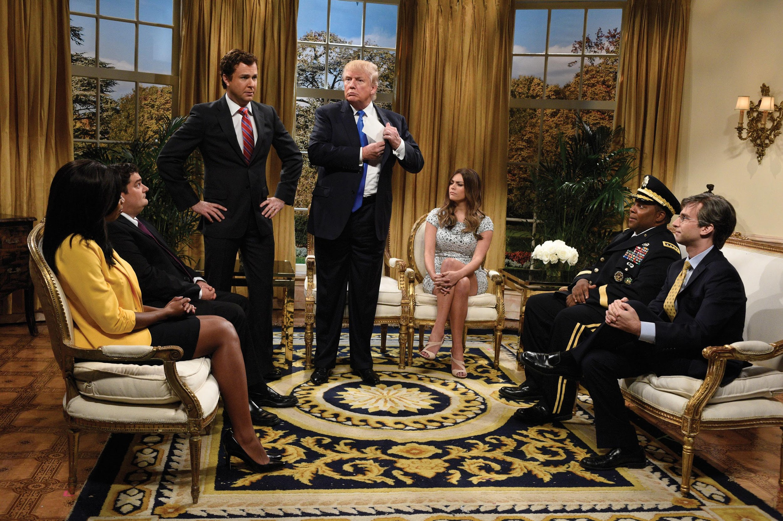
Donald Trump on Saturday Night Live
Notes:
When Donald Trump hosted "Saturday Night Live” in the fall of 2015, as shown in this photo, five of the Republican presidential candidates asked for equal time under the rules set forth by the Federal Communications Commission. NBC complied with this request, giving these candidates time on the network, though not on “Saturday Night Live.”

Slide 14
From Broadcasting to Narrowcasting: The Rise of Cable and Cable News
A general audience no more
Changing usage patterns
Narrowcasting
Potential to disseminate information
Selective exposure
Infotainment
Ideological content
Reduction of quality
Notes:
The first major networks used the term "broadcast" because they meant their programs, including those on government and politics, to appeal to a broad audience. But cable TV changed that. With channels that specialize in cooking, golf, history, and other topics, stations are now engaged in narrowcasting, which is programming targeted to a specific, narrow interest.
The media is now full of ideologically charged programming which has led to selective exposure and what many political scientists argue is an overall reduction in the quality of programming.

Slide 15
Journal Prompt 7.1: From Broadcasting to Narrowcasting: The Rise of Cable and Cable News
What do you think have been the major consequences of the transition from broadcasting to narrowcasting? Do you think this change has been good or bad for democracy in America?

Slide 16
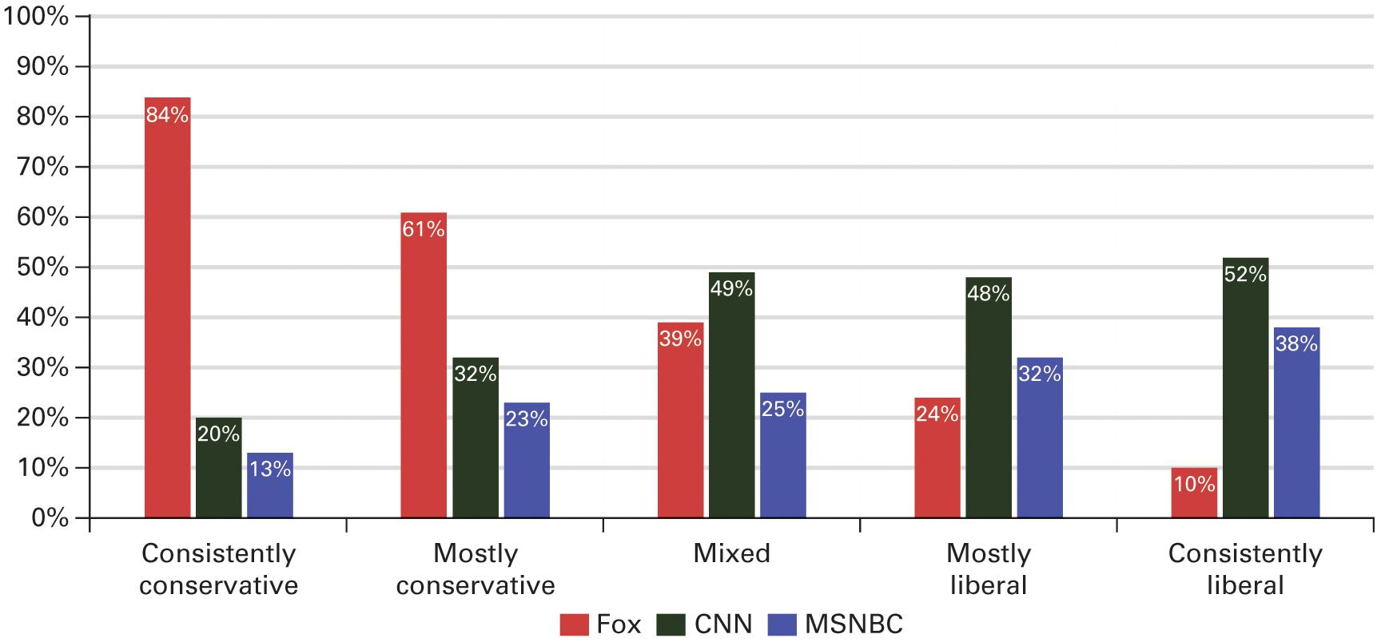
Figure 7.1 How the Audiences of Cable News Channels A are Polarized by Political Ideology
Source: 2014 Pew Research Center Survey data.
Notes:
In 2014, the Pew Research Center classified survey respondents’ ideology depending on how they responded to 10 policy questions. As you can see from the graph below, conservatives and liberals differed widely in terms of which cable news channels they watched.

Slide 17
The Impact of the Internet
Information at your fingertips
Pop culture over politics
Internet facilitates communication in all directions
Changes the nature of political campaigns
Blogs
Notes:
The Internet makes it much easier for Americans to be politically informed. A quick Internet search will reveal how your representatives voted on policy issues that are important to you. Yet Americans remain unlikely to take advantage of this opportunity to obtain political information. Data on search engine usage shows that people are much more likely to search for information about pop culture than politics, and traffic on political information sites is much lower than on entertainment sites. The Internet allows for multidirectional communication and has been used by political campaigns as well as political activists to shape and influence politics. Blogs have given the general public a forum to express their political views and potentially reach as wide an audience as a professional journalist. But the reality is that it's easy to post on a blog but much harder to generate substantial readership, which means that professionals who write for a recognized news outlet still have an advantage.

Slide 18
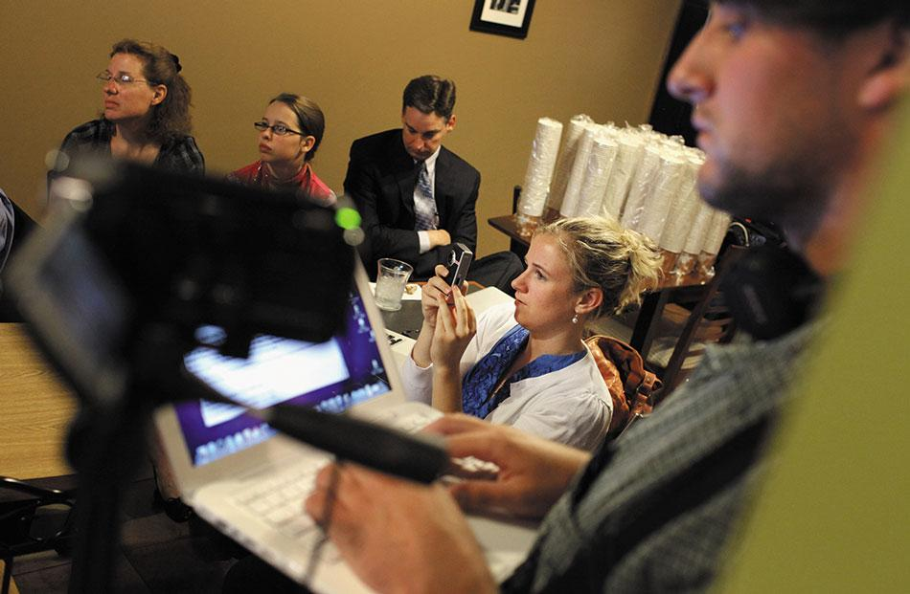
Blogs
Notes:
Blogs are playing an increasingly important role in the reporting of political news. In 2005, 23-year-old Garrett Graff, who was writing a blog about the news media in Washington, became the first person to receive a White House press pass for the specific purpose of writing a blog. Here, bloggers cover a candidate speech during the 2012 presidential primary campaign.

Slide 19
Private Control of the Media
Private vs. public ownership
Private more common in United States
Public more common abroad
Freedom of the press varies
Profit orientation
Advertising revenue
Decline of foreign news reporting
Notes:
America has a diverse array of media outlets, most of which are privately owned. The few public broadcasting outlets attract only low ratings. In contrast, most other countries have major TV networks that are publicly owned.
Freedom of the press gives journalists in the U.S. the ability to criticize government, and most other democracies carefully guard press freedom even on publicly owned networks. But freedom of the press is rare in non-democratic regimes, such as China, where the government closely controls what the media can say about it.
Public networks are free to serve the public interest without worrying about the size of their audience. But this is not the case with private media.
Although private media have nearly complete control over their content, they need to turn a profit. Advertising revenue supports most media. Therefore, the main objective of media is to get the largest possible audience.
This profit orientation has led to changes in political reporting. Foreign news reporting has declined. Foreign bureaus are expensive to operate, and the public has shown little interest in foreign news. What implications does a lack of foreign news have for American political culture?

Slide 20
Learning Objective 7.2
List the major criteria that determine which news stories receive the most media attention.

Slide 21
Reporting the News
Finding the News
Presenting the News
Bias in the News
Notes:
Because only the unusual and unexpected are newsworthy, the news gives a distorted view of political events, one that tends to trivialize them and avoid discussion of important issues. When the president attends a state dinner, it is not news, but when the president throws up on the Japanese prime minister, it is talked about all over the news for days. Whatever critical policy issues may be at stake fall by the wayside.
This happens because news reporting is a business. In their pursuit of high ratings, networks dumb down their shows and strive to make them entertaining, not informative. The quest for profit, not a mission to educate the public, defines what's newsworthy.

Slide 22
Finding The News
Beats
Trial balloons
Symbiotic relationship
Pulitzer Prize–winning journalism
Notes:
Reporters are often assigned to cover certain areas of government, such as Congress or the White House. These ongoing assignments are known as a beat.
When politicians want to get a story out, they feed it to the media in the form of a trial balloon, which is a leak designed to gauge public reaction.
Journalists rely on politicians to give them news and politicians rely on journalists to get their message out; politicians and journalists enjoy a symbiotic relationship. But sometimes government restricts journalistic access to prevent unfavorable news getting out, usually during wartime. When this happens, journalists are quick to cry censorship and call the public's attention to it.
Occasionally, political reporting uncovers a gross miscarriage of justice, such as an illegal pollution dump, corruption, or an innocent prisoner sitting on death row. Such stories can lead the government to act to fix the situation. They can also lead to a Pulitzer Prize in journalism.

Slide 23
Presenting the News
Skimming off the cream
10-second sound bites
Complex policy issues ignored
Politicians can't present issues
Politicians can avoid issues
Presidents rebuffed
Shunted to cable
Notes:
Television news must fit into short segments or sound bites, ensuring that coverage is superficial, often little more than headlines. Complex policy issues such as Medicare reform cannot be given meaningful treatment in such brief time frames.
Politicians cannot present issues to the public when their 20-minute speeches are edited down to 10-second sound bites. While this is frustrating for them, it also helps them avoid addressing issues and lets them focus on photo opportunities and other image-making but substance-free endeavors.
Presidents used to be able to count on major network coverage of their speeches, but now such coverage is shunted to cable news, and a smaller audience.

Slide 24
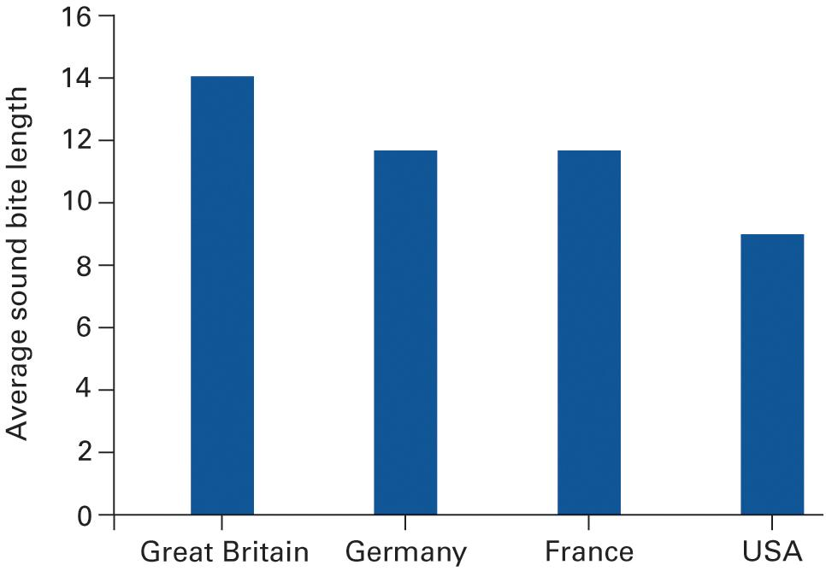
Figure 7.2 The Length of Candidate Sound Bites in Four Countries (in seconds)
Source: Frank Esser, “Dimensions of Political News Cultures: Sound Bite and Image Bite News in France, Germany, Great Britain, and the United States,” The International Journal of Press/Politics (2008): 401–428.
Notes:
Two factors appear to be at work in limiting candidates’ on-air time in advanced industrialized democracies. first, technological advancements in editing have made it quite easy to cut political statements into small tidbits. And, second, networks usually feel that, to keep their audience, brief sound bites are best—lest people change to another channel.

Slide 25
Bias in the News
Do the media have a liberal bias?
Backgrounds of journalists
Bias toward stories that draw an audience
Visual stimulation: no talking heads
Notes:
The media are often accused of having a liberal bias. Studies have shown no systematic bias to the left or right, but it is undeniable that journalists themselves are more likely to be liberal than conservative, and that most news outlets are based in cities.
The one bias that is seen in the news is toward stories that will draw a bigger audience. News outlets strive to be entertaining, not informative, and the public is drawn to stories that involve conflict, violence, disaster, or scandal. Stories must also have visual appeal. Viewers tend to change the channel if they see only a talking head on the screen. This emphasis on violence and chaos gives people a certain impression of the world in general, and politics in particular.

Slide 26
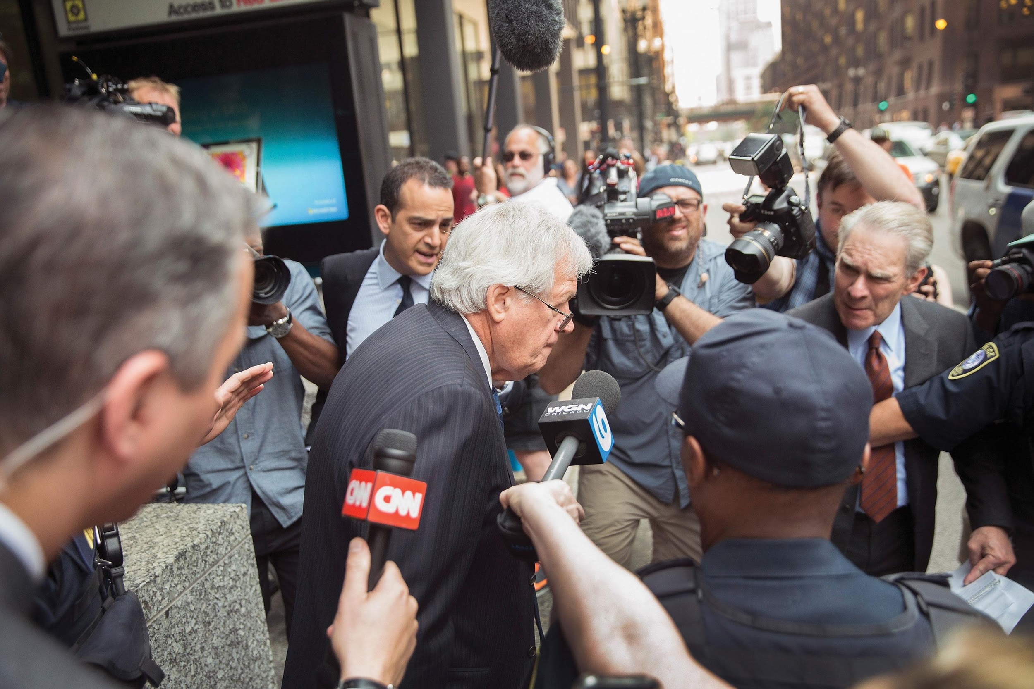
Dennis Hastert
Notes:
The clearest and most consistent bias in the news is the focus on sensational stories. When former Speaker of the House Dennis Hastert (R-IL) was indicted for falsifying financial transactions in an attempt to evade scrutiny for past crimes alleging sexual abuse, the media focused a bright light on the story, as evidenced by the crowd of cameras and reporters around him in this photo of Hastert after entering the federal courthouse in Chicago.

Slide 27
Journal Prompt 7.2: Bias in the News
How biased do you think major coverage of political news is? What are some of the sources of bias? Do you think it would be better if more reporting were strictly objective?

Slide 28
Learning Objective 7.3
Analyze the impact of the media on public opinion and political behavior.

Slide 29
The News and Public Opinion
How influential are the media?
Agenda-setting effect
Sets criteria by which public evaluates leaders
Emphasizes one event over another
Focuses on misstatements
Notes:
It's difficult to measure the impact of news stories on public opinion. The effect of any one story is hard to separate from the cumulative effects of dozens of news stories, and from other sources of information.
Scholars haven't traced much of a direct impact between media and how people vote, but they've found that the media affect what issues the public thinks about. That is, the media play an important role in setting the political agenda.

Slide 30
Table 7.1 Stories Citizens Have Tuned In and Tuned Out (1 of 3)
Story | % Following Closely
The explosion of the space shuttle Challenger in 1986 | 80
Terrorist attacks on the World Trade Center and Pentagon in 2001 | 74
Impacts of hurricanes Katrina and Rita in 2005 | 73
Los Angeles riots in 1992 | 70
Rescue of baby Jessica McClure from a well in 1987 | 69
School shootings at Columbine High School in Colorado in 1999 | 68
Iraq’s invasion of Kuwait in 1990 | 66
Earthquake in Haiti 2010 | 60
Start of hostilities against Iraq in 2003 | 57
Supreme Court decision on flag burning in 1989 | 51
Notes:
Since 1986, the monthly survey of the Pew Research Center for the People & the Press has asked Americans how closely they have followed major news stories. As one would expect, stories involving disaster or human drama have drawn more attention than have complicated issues of public policy. A representative selection of Pew findings is presented here. The percentage in each case is the proportion who reported following the story “very closely.”

Slide 31
Table 7.1 Stories Citizens Have Tuned In and Tuned Out (2 of 3)
Story | % Following Closely
Killing of Osama Bin Laden in a raid by U.S. forces in 2011 | 50
Passage of Obama’s health care reform bill in 2010 | 49
Arrest of O. J. Simpson in 1994 | 48
Obama’s decision to send 30,000 additional troops to Afghanistan in 2009 | 43
The partial shutdown of the federal government in 2013 | 43
Presidential election outcome in 2000 | 38
Sex abuse scandal involving Penn State coaches Joe Paterno and Jerry Sandusky in 2011 | 34
Impeachment trial of President Clinton in the Senate in 1999 | 31
How the rollout of Obamacare was going in 2013 | 26
Notes:
Since 1986, the monthly survey of the Pew Research Center for the People & the Press has asked Americans how closely they have followed major news stories. As one would expect, stories involving disaster or human drama have drawn more attention than have complicated issues of public policy. A representative selection of Pew findings is presented here. The percentage in each case is the proportion who reported following the story “very closely.”

Slide 32
Table 7.1 Stories Citizens Have Tuned In and Tuned Out (3 of 3)
Story | % Following Closely
Confirmation of Sonia Sotomayor to the Supreme Court in 2009 | 22
Obama decision to reject the Keystone oil pipeline in 2015 | 22
Supreme Court’s Citizens United decision in 2010 | 18
Hillary Clinton’s use of a private email account as Secretary of State in 2015 | 17
Ethnic violence in the Darfur region of Sudan in 2003 | 16
Passage of the Communications Deregulation bill in 1996 | 12
FDA’s proposal to severely restrict trans fats in foods in 2013 | 10
Source: Pew Research Center for the People & the Press.
Notes:
Since 1986, the monthly survey of the Pew Research Center for the People & the Press has asked Americans how closely they have followed major news stories. As one would expect, stories involving disaster or human drama have drawn more attention than have complicated issues of public policy. A representative selection of Pew findings is presented here. The percentage in each case is the proportion who reported following the story “very closely.”

Slide 33
Learning Objective 7.4
Describe how politicians use the media to communicate with the electorate.

Slide 34
Policy Entrepreneurs and Agenda Setting
Policy agenda
Many issues compete for attention from government
Interest groups, parties, politicians, agencies, all push their priorities
Policy entrepreneurs
Political activists depend upon the media
Protests attract coverage
Notes:
The political agenda is the set of issues to which the public and the government are paying attention at a given time. Many groups are pushing for their priorities to get onto the political agenda.
People who invest capital to open a business are known as entrepreneurs, and political activists who invest political capital to get their ideas on the political agenda are known as policy entrepreneurs. Political activists try to use the media to bring public attention to their issues.
It isn't only political elites who have access to the media. Protests by the poor and downtrodden attract media coverage as well. One thing that activists can't control is the slant to the coverage, that is, whether it will show their cause in a good light for public consumption.

Slide 35
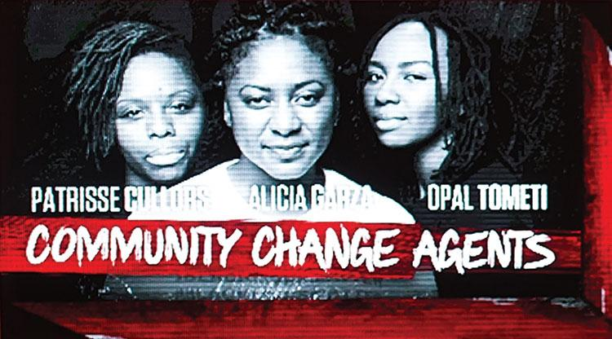
BlackLivesMatter
Notes:
The group BlackLivesMatter has recently drawn a loss of media attention. Activist members of the group have often used dramatic images to draw attention to the issue of police brutality in their local area.

Slide 36
Learning Objective 7.5
Assess the impact of the mass media on the scope of government and democracy in America.

Slide 37
Understanding the Mass Media
The Media and the Scope of Government
Individualism and the Media
Democracy and the Media
Notes:
The media link policymakers and the public. They are the public's source of information about government. So how the media portray what the government's doing becomes critical to public perception. The same act of government can be perceived by the public as a failure or a success depending solely upon how it's portrayed in the media.

Slide 38
The Media and the Scope of Government
Media as watchdog
Press criticism does more good than harm
Reporters hold negative views of public officials
Media as skeptic
Constrains government
Focus on injustice encourages enlargement of government
Notes:
The media's role as watchdog keeps the behavior of politicians in check, and a majority of Americans think this is a good thing. Reporters themselves tend to have a negative view of public officials as self-serving, hypocritical, lacking integrity, and focused exclusively on reelection. They see debunking politicians as a critical part of their job.
Since the media treat every new policy proposal and government program with skepticism, they constrain the scope of government. Yet at the same time the media highlight problems and injustices and ask what the government's going to do about them. Portraying the government as responsible for solving every problem has the effect of enlarging the scope of government.

Slide 39
Individualism and the Media
TV furthers individualism
No need for intermediaries
Candidates can reach individual voters
TV focuses on individuals
Personality important
Focus on executive branch
Notes:
Television gives the public the opportunity to evaluate political candidates directly. Individual voters can get an "up close and personal" view of each candidate to help guide their voting decisions. This direct line of communication removes the need for political parties or social groups as aids in decision-making.
However, TV's focus on individuals means that personality is more important than substance for political candidates. It also means that the media cover the president more than they cover Congress or the Supreme Court.

Slide 40
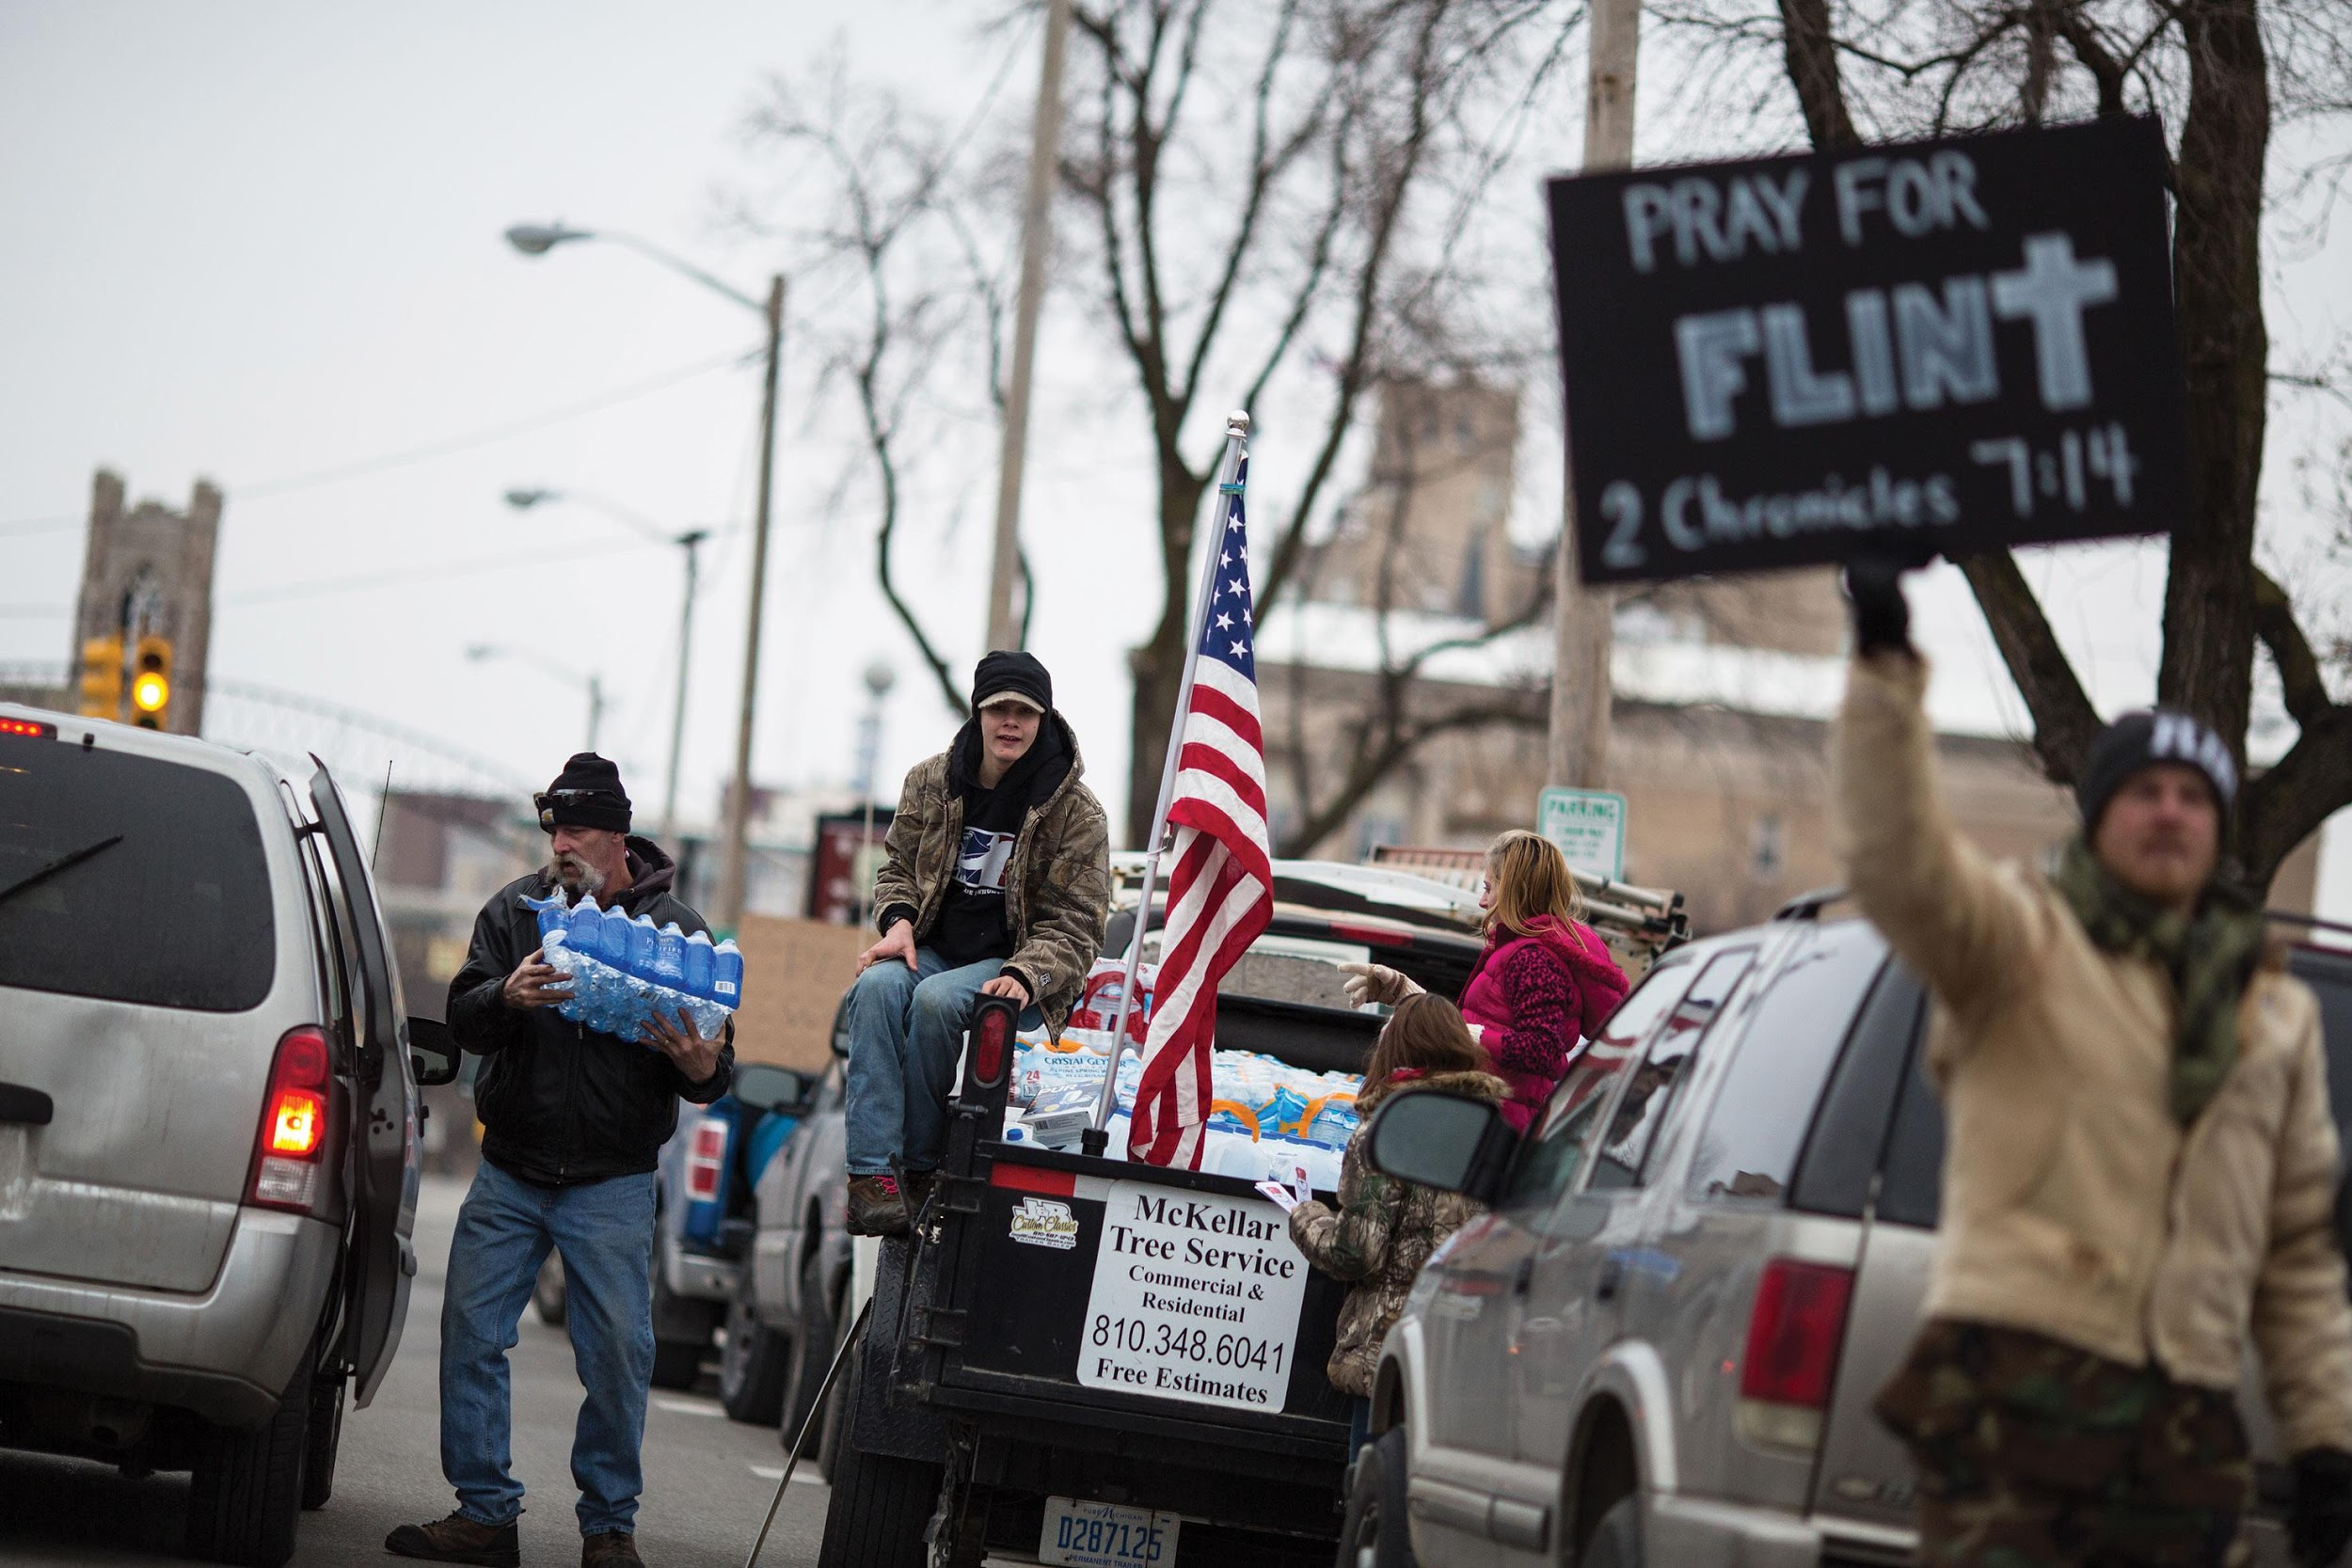
Flint Michigan
Notes:
The crisis over contaminated drinking water in Flint, Michigan, drew much attention in 2016. Here, local activists in Flint are shown handing out bottled water to residents. Images such as this led to the declaration of a federal state of emergency to address the need to get a clean and reliable supply of drinking water to the citizens of Flint.

Slide 41
Democracy in the Media
"Information is the fuel of democracy"
But more info does not equal more competence
Superficial by demand
Profit motive again
Public appetite shapes choices
Notes:
With the amount of information available to citizens today, you'd think that political competence would be greatly increased. That is, citizens in the American democracy should be better equipped to make rational policy decisions. Yet this clearly isn't the case.
The media respond to criticism of the superficiality of their coverage by pointing out that they provide what the public wants. Their motive is profit, which means appealing to the largest possible audience. They say that if the public demanded serious, in-depth news programs, they would certainly provide such programs. It's the public's appetite for entertainment over substance, they say, that keeps the coverage limited and superficial.

Slide 42
Shared Writing 7
In the United States, news is conveyed through a mass media system driven by the need to make a profit as opposed to an obligation to provide a public service. What do you think are some of the consequences of the American media's profit-driven reporting of the news? Try to give some examples based on current events in your answer.

Slide 43
Photo Credits
Chapter 7
194: Photo by Scott Olson/Getty Images; 196: Chip Somodevilla/Getty Images News/Getty Images; 197: © Tribune Content Agency, LLC. All Rights Reserved. Reprinted with permission.; 199: Dana Edelson NBC Universal/Getty Images; 204: Chip Somodevilla/Getty Images News/ Getty Images; 209: Scott Olson/Getty Images News/Getty Images; 213: Gilbert Carrasquillo/FilmMagic/Getty Images; 214: Brett Carlsen/ Getty Images News/Getty Images; 215: Aaron Bacall/Cartoon Stock Ltd.

