Slide 1
Government in America: People, Politics and Policy
Seventeenth Edition
Chapter 6
Public Opinion and Political Action

Slide 2
Learning Objectives (1 of 2)
6.1 Identify demographic trends and their likely impact on American politics.
6.2 Explain how the agents of socialization influence the development of political attitudes.
6.3 Describe public opinion research and modern methods of polling.
6.4 Compare and contrast the principles of conservatism and liberalism

Slide 3
Learning Objectives (2 of 2)
6.5 Assess the influence of political ideology on political attitudes and behaviors.
6.6 Identify the ways that people may participate in politics.
6.7 Analyze how public opinion about the scope of government guides political behavior.

Slide 4
Learning Objective 6.1
Identify demographic trends and their likely impact on American politics.

Slide 5
The American People
The Immigrant Society
The American Melting Pot
The Regional Shift
The Graying of America
Notes:
The U.S. government spends billions of dollars on counting how many people live in the country. It isn't just a whim. The Constitution requires that a population Census be taken every ten years. The most recent Census was taken in 2010, when the Census Bureau sent forms to all 134 million U.S. households.

Slide 6
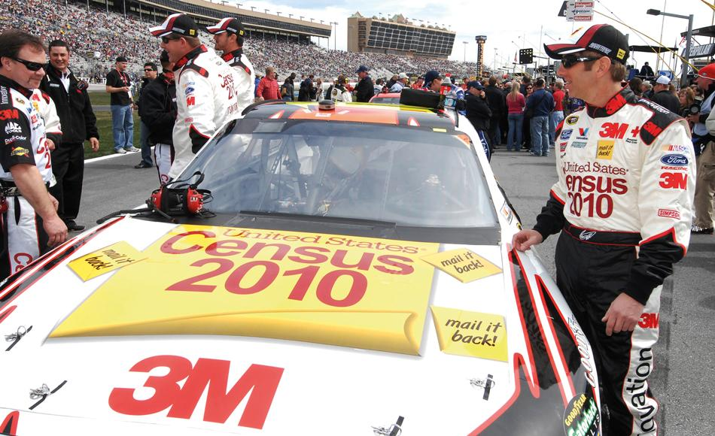
NASCAR and Census Advertising
Notes:
In an attempt to get more people to fill out their Census form, the Census Bureau advertised heavily in 2010 to try to increase public awareness of the Census and its importance. One controversial allocation of money was $1.2 million to sponsor NASCAR driver Greg Biffle during three auto races in March. Critics derided this is as an absurd use of taxpayer money. In response, Census director Robert Groves argued that millions of Americans follow NASCAR races and that an increase in the initial response to the Census of just 0.1 percent could cut the cost of conducting the Census by $8.5 million.

Slide 7
The Immigrant Society
A nation of nations
1 million legal immigrants/year
500,000 illegal immigrants/year
13% of residents foreign-born
Waves of immigration
Northwest Europe (English, Irish, Germans, and Scandinavians)
Southern and Eastern Europe (Italians, Jews, Poles, Russians, and others)
Hispanics (Cuba, Central America, and Mexico) and Asians (Vietnam, Korea, the Philippines, and elsewhere)
Notes:
The U.S. is often called a nation of immigrants. All Americans except for Native Americans are descended from immigrants. Approximately one million legal immigrants and 500,000 illegal immigrants are still arriving every year. About 13% of the current population is foreign-born.

Slide 8
The American Melting Pot (1 of 2)
Minority majority
Hispanic population growing rapidly
African Americans descended from reluctant immigrants
24% still live in poverty
Political power increasing
Political culture and assimilation
Notes:
America is often called a melting pot because of the way immigrants from all over the world assimilate into American culture. But the new term policymakers use is "minority majority."
Reluctant immigrants is a euphemism for those ancestors of African Americans who were brought to the United States as part of the slave trade.
Historically, most immigrant groups have adopted the values that make up American political culture within a few generations. There's always concern that new groups will not assimilate. This concern has been unfounded in the past, but it remains a persistent fear that leads to negative attitudes toward immigrants.

Slide 9
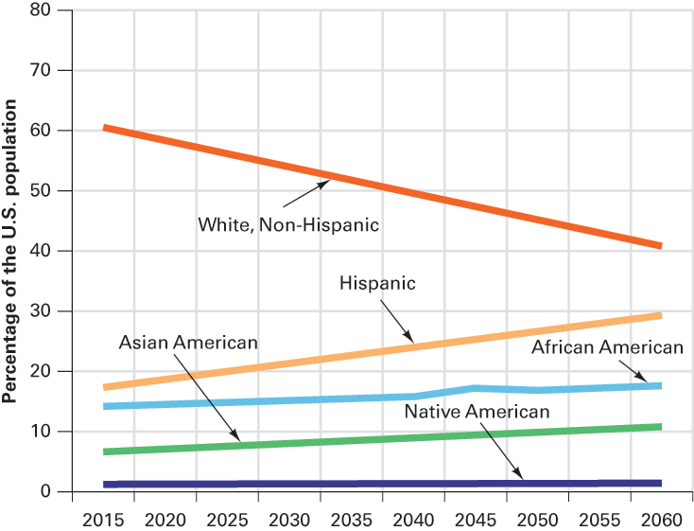
Figure 6.1 The Coming Minority Majority
Source: U.S. Census Bureau estimates.
Notes:
Based on current birth and immigration rates, the Census Bureau estimates that the demographics of the United States should change as shown in the accompanying graph. As of 2015, the Census estimated that minority groups should be in the majority for the nation as a whole sometime between 2040 and 2045. Of course, should rates of birth and immigration change, so would these estimates.

Slide 10
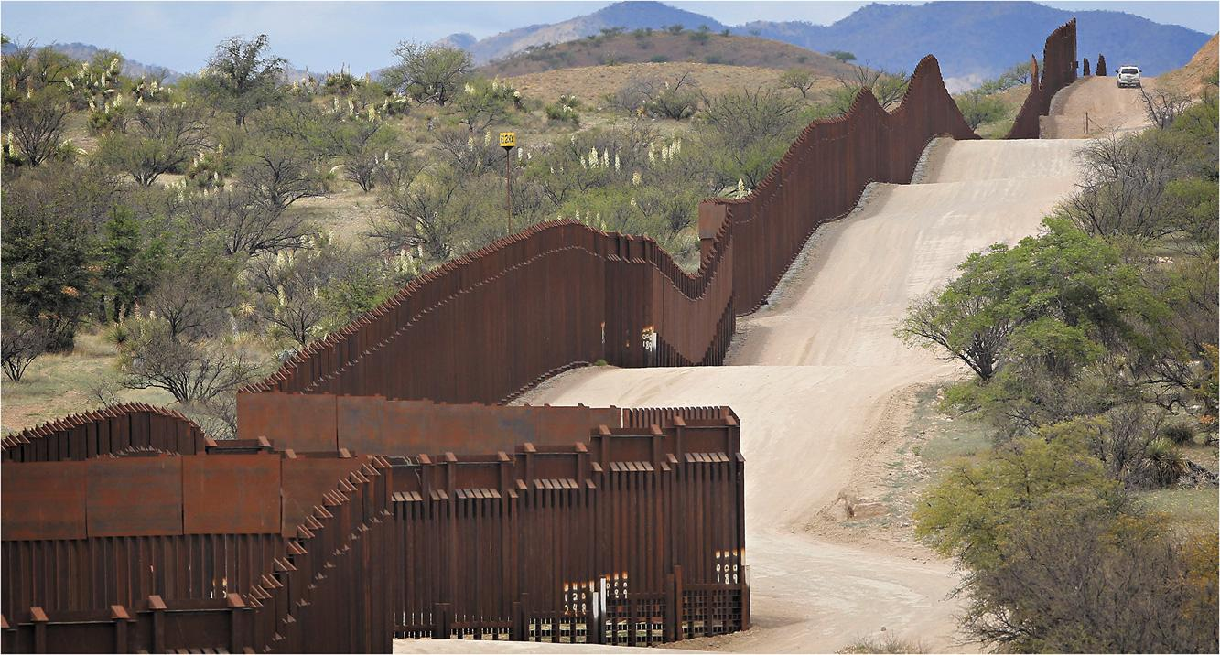
Border Fence
Notes:
During the 2016 presidential campaign, Donald Trump promised to build a wall between the United States and Mexico, arguing that current immigration enforcement was inadequate. Here, a border patrol car (at the upper right) patrols along the fence between Nogales, Arizona, and Mexico.

Slide 11
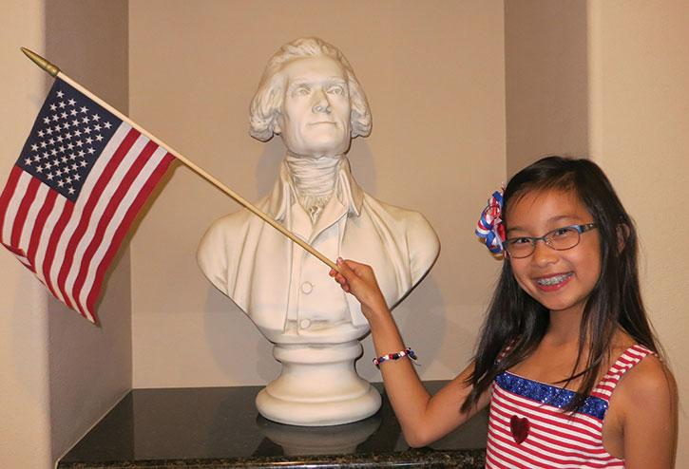
Chinese American Girl
Notes:
By the time this little Chinese American girl (born in China but now an American citizen) graduates from college, Asian Americans will represent 8 percent of the U.S. population. As the most highly educated segment of the coming “minority majority,” it is likely that they will be exercising a good deal of political power by then.

Slide 12
The Regional Shift
Northeast most populous for most of history
Demographic changes associated with political changes
Reapportionment
Once each decade, after Census
States gain and lose representatives
Notes:
The Northeast has historically been the most populous region of the country, but westward and southward migration has increased since World War II.
Demographic changes lead to political changes primarily through the reapportionment of Congressional seats following each census.

Slide 13
The Graying of America
Over-65 fastest growing age group
People living longer
Fertility rate lower
Implications for Social Security
Ratio changing
Politically-sensitive
Notes:
The population of the United States is aging. People over 65 are the fastest-growing age group, as longevity increases and fertility rates fall. This demographic shift has critical implications for the Social Security program, which is dependent on the contributions of current workers to pay out benefits to current retirees. As the ratio of workers to retirees shifts, there will be fewer workers paying into the system to support an increasing number of retirees.

Slide 14
Learning Objective 6.2
Explain how the agents of socialization influence the development of political attitudes.

Slide 15
How Americans Learn About Politics: Political Socialization
The Process of Political Socialization
Political Learning over a Lifetime
Notes:
How do Americans acquire their political viewpoints? The process of developing one's political orientation is called political socialization. It starts when we are very young and continues throughout our lifetimes.

Slide 16
The Process of Political Socialization
The family
Central role
Time and emotional commitment
The mass media
The new parent
Age gap in following politics
School
Forming civic virtue
Notes:
The civics and U.S. history classes that you take in school are only the tip of the iceberg as far as political socialization goes. The most influential learning is informal, through attitudes you pick up and absorb.

Slide 17
Political Learning over a Lifetime
Increasing participation with age
Party identification strengthens
Political behavior is learned
Notes:
Political socialization is most pronounced in our childhood and young adult years but it continues throughout our lives. Political participation increases dramatically with age, and party identification solidifies. Political behavior is learned behavior, and this learning slows down but never stops.

Slide 18
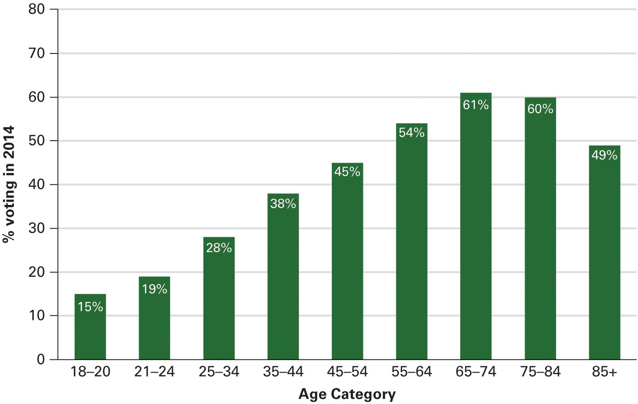
Figure 6.2 Turnout Increases with Age
Source: Authors’ analysis of 2014 Census Bureau data.
Notes:
In the 2014 congressional elections, as in most midterm elections, the relationship between age and turnout was particularly pronounced, as you can see in this figure. because today’s young adults lean in the liberal direction, political analysts concluded that the low turnout rate of young people cost the Democrats a substantial number of seats in the House and Senate in 2014.

Slide 19
Learning Objective 6.3
Describe public opinion research and modern methods of polling.

Slide 20
Measuring Public Opinion and Political Information
How Polls Are Conducted
The Role of Polls in American Democracy
What Polls Reveal About Americans' Political Information
The Decline of Trust in Government
Notes:
We have just discussed how Americans form their political opinions. We have also established that public opinion is supposed to guide public policy in a democracy. But how do we know what the public's opinion is on political issues? How do we even know which political issues are important to the public?

Slide 21
How Polls Are Conducted
Sample
Random sampling
Sampling error
Random-digit dialing
Cell phones
Internet polling
Notes:
It would be extremely expensive and time-consuming to poll every American, so polls use a small sample of the population instead. In order for the views of the sample to accurately reflect the views of the population as a whole, the sample must be completely random. That is, everyone must have an equal chance of being polled. When the opinions of a random sample of 1,500 Americans are polled, researchers can be reasonably confident that their views represent the views of the whole population, and their degree of confidence can be quantified.

Slide 22
The Roll of Polls in American Democracy
Polling as a tool for democracy: pros and cons
Gauge opinion between elections
Following rather than leading
Pandering or shaping?
Exit polls
Affect election results
Question wording
Notes:
Polling enables political candidates to learn what promises to make and what policies to support or distance themselves from. More importantly, polling enables elected officials to gauge public opinion between elections. Polls showing public support, or lack thereof, for a bill can determine how legislators will vote on it. Polling increases the role of public opinion in democratic government, but critics charge that it causes politicians to follow rather than lead.

Slide 23
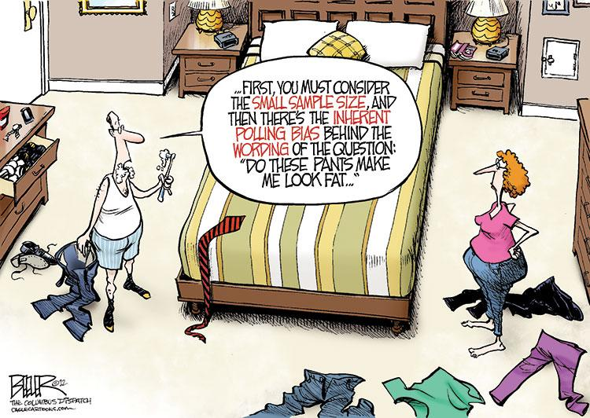
Polling in America
Notes:
The wording of a question can bias the answers in surveys, just as is often the case in everyday conversations.

Slide 24
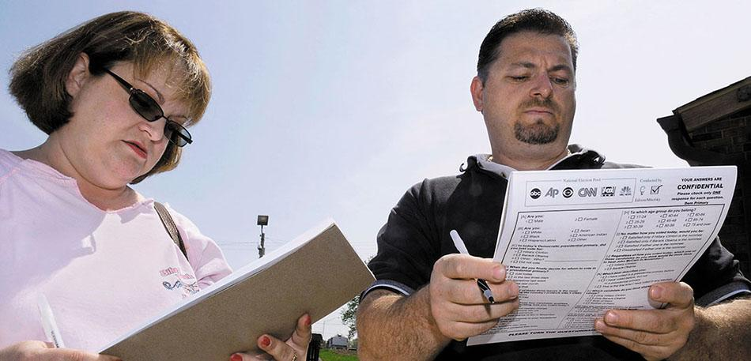
Exit Polling
Notes:
In exit polls, voters are interviewed just after they have voted. These polls are used by the media to project election results as soon as the polls are closed, as well as to help the media understand what sorts of people have supported particular candidates.

Slide 25
What Polls Reveal About Americans’ Political Information
Americans are uninformed
Jeffersonian faith in wisdom of common people unfounded
Young people most uninformed
Who is responsible for the ill-informed electorate?
Is it the schools' fault?
Is it the media's fault?
Paradox of mass politics
Notes:
Americans are grossly uninformed about politics and about the world around them in general. Jefferson's supposed faith in the wisdom of the common people was unfounded. He was correct that education gives them better capacity as citizens, but education alone is not enough to create an informed electorate.

Slide 26
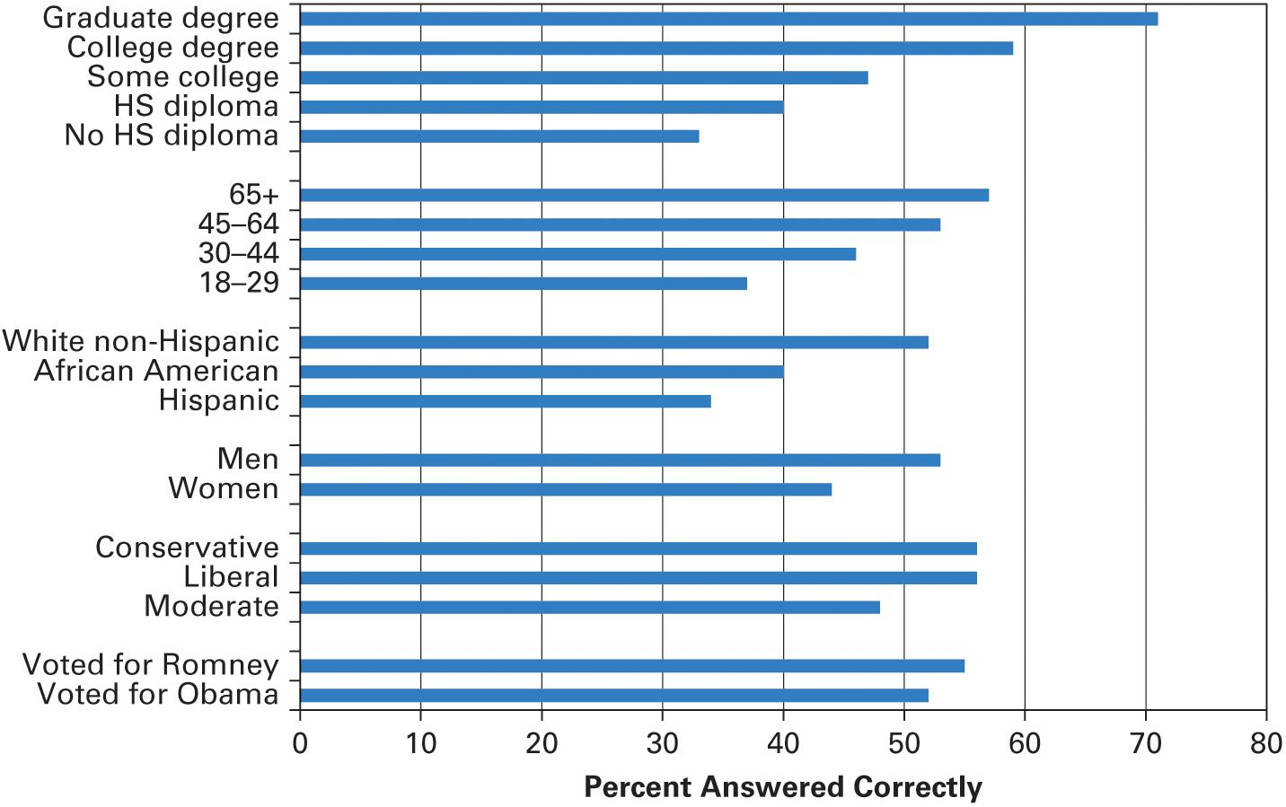
Figure 6.3 How Political Knowledge Varies According to Demographic and Political Factors
Source: Authors’ analysis of the 2012 American National Election Study.
Notes:
In the American National Election Study of 2012, twelve factual questions were asked of a representative sample of the American public. The average respondent got 5.8 correct, or about 48 percent. Who knows the most about politics in America? Demographic differences explain a lot of the variation in political knowledge, as you can see in the figure below. In contrast, political differences generally do not predict differences in political knowledge nearly as well as demographics. If you think that people who don’t agree with you about politics are just sorely lacking in knowledge, the data displayed here will probably come as a surprise to you.

Slide 27
The Decline of Trust in Government
The great slide
Vietnam War
Watergate
Economy/Iran hostage crisis
Is public cynicism good?
Negative effect on programs for poor
Notes:
At the midpoint of the twentieth century, nearly three-quarters of Americans trusted the government to do the right thing. Thirty years later, in 1980, that figure was only 25%. What caused this decline in trust? The Vietnam War, the Watergate scandal, and the economic and hostage crises of the 1970s all took a massive toll on public trust in government. There was a brief uptick in public trust after 9/11, but overall this decline seems to be permanent.

Slide 28
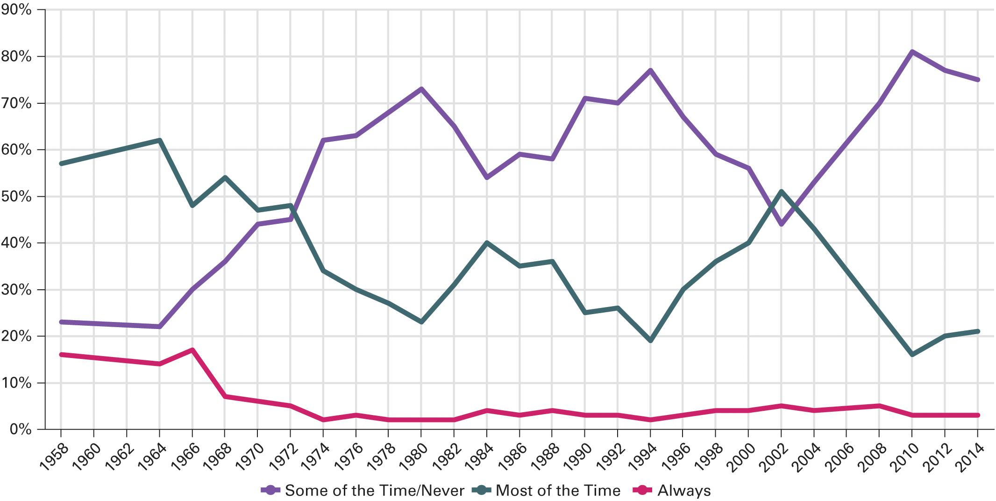
Figure 6.4 The Decline in the Trust of Government 1958–2014
Sources: Authors analysis of 1958–2012 American National Election Study Data. As there were no election studies for 2006, 2010, and 2014, we have used the following sources for those years: December 2006 Pew Research Center poll; February 5–10, 2010 New York Times/CBS News Poll; February 2014 Pew Research Center poll.
Notes:
This graph shows how people have responded over time to the following question: how much of the time do you think you can trust the government in Washington to do what is right—just about always, most of the time, or only some of the time? When this question was written in 1958, survey researchers could not imagine that anyone would respond “never,” so the traditional wording of the trust in government question omits this option. In 2014, about 7 percent of respondents volunteered that they never trusted the government.

Slide 29
Journal Prompt 6.3: How Polls Are Conducted
What are some of the best practices one should look for in a poll in order to establish that its results are reasonably accurate? What type of poll do you think is best and why would you choose this type?

Slide 30
Learning Objective 6.4
Compare and contrast the principles of conservatism and liberalism.

Slide 31
What Americans Value: Political Ideologies (1 of 2)
Ideologies help to organize how we think about politics
Two main American ideologies are liberal and conservative
37% of Americans identify as conservative
24% of Americans identify as liberal
Notes:
A political ideology is a coherent set of values and beliefs about public policy. The two main political ideologies in the United States are liberal and conservative. Most Americans aren't ideologically consistent, and hold some liberal and some conservative views.

Slide 32
Table 6.1 How to Tell a Liberal from a Conservative (1 of 2)
 | Liberals | Conservatives
Foreign Policy
Military spending | Believe we should spend less | Believe we should maintain peace through strength
Use of force | Less willing to commit American troops to action overseas | More likely to support American military intervention around the world
Social Policy
Abortion | Support “freedom of choice” | Support “right to life”
Prayer in schools | Are opposed | Are supportive
Affirmative action | Favor | Oppose
Notes:
Liberal and conservative —these labels are thrown around in American politics as though everyone knows what they mean. Here are some of the political beliefs likely to be preferred by liberals and conservatives. This table, to be sure, is oversimplified.

Slide 33
Table 6.1 How to Tell a Liberal from a Conservative (2 of 2)
 | Liberals | Conservatives
Economic Policy
Scope of government | Support regulation of the market, on the grounds that it is in the public interest | Favor free-market solutions, on the grounds that regulation is not in the public interest
Taxes | Want to tax the rich more in order to make taxation more progressive | Want to cut taxes for everyone in order to stimulate economic growth
Spending | Want to spend more on benefits for the needy | Want to limit spending on the poor to no more than absolutely necessary
Crime
How to cut crime | Believe government should address the problems that cause crime | Believe that government needs to get tougher with criminals
Defendants’ rights | Believe we should guard those rights carefully | Believe that guarding those rights all too often means letting criminals off the hook
Notes:
Liberal and conservative —these labels are thrown around in American politics as though everyone knows what they mean. Here are some of the political beliefs likely to be preferred by liberals and conservatives. This table, to be sure, is oversimplified.

Slide 34
What Americans Value: Political Ideologies (2 of 2)
Ideologies vary among groups
Young people tend to be more liberal
African Americans tend to be more liberal
Women tend to be more liberal (gender gap)
Financial status and religion affect ideology
Social class is less predictive than it used to be
Religiosity is more important than religious denomination
Notes:
In general groups with more political clout tend to be more conservative than groups that have been shut out of power. This helps explain the support of a liberal ideology by a wide range of groups, particularly African Americans. The ideological differences between men and women has resulted in a gender gap as a regular pattern with women supporting Democrats in elections.

Slide 35
Learning Objective 6.5
Assess the influence of political ideology on political attitudes and behaviors.

Slide 36
The Influence of Political Ideology on Political Behavior
Types of voters
Ideologues
Group benefits
Nature of the times
No issue content
Ideology of limited importance
The relationship between ideology and the vote is far from perfect.
Notes:
A classic study of voting habits, called The American Voter, divided voters into four types. "Ideologues" make a connection between their beliefs and a candidates' policy positions, such as voting for Republicans because they favor lower taxes or smaller government, or voting for Democrats because they favor stronger regulations or liberal social policies.

Slide 37
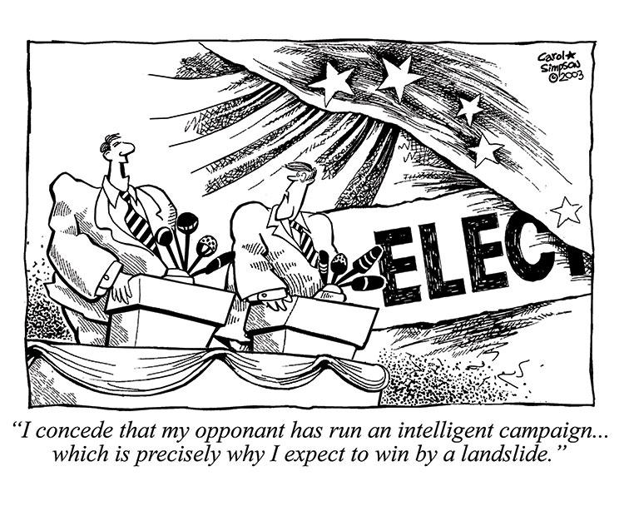
Political Cartoon
Notes:
Cartoonists often make fun of how successful candidates appeal to the lowest common denominator in the American electorate. In 2016, Hillary Clinton’s speeches were pitched at an eighth-grade reading level whereas Donald Trump’s were pitched at a fourth-grade level.

Slide 38
Journal Prompt 6.5: The Influence of Political Ideologies on Political Behavior
What are the key differences between liberals and conservatives in terms of their views on public policy? Why do these differences matter so much in policymaking?

Slide 39
Learning Objective 6.6
Identify the ways that people may participate in politics.

Slide 40
How Americans Participate in Politics
Conventional Participation
Protest as Participation
Class, Inequality, and Participation
Notes:
When you think of political participation, voting is probably the first activity that leaps to mind. But it's far from the only form of political participation open to Americans. Citizens can participate in political caucuses, write to their legislative representatives, file lawsuits, and stage marches, rallies, and demonstrations.

Slide 41
Conventional Participation
Conventional participation
Voting
Running for office
Collecting signatures for a petition
Unconventional participation
Protesting
Civil disobedience
Violence
Notes:
Voting is the most common form of political participation, and the only one to have experienced a decline in recent years. Other conventional forms of political participation include running for office, working on and donating to campaigns, signing petitions, and contacting government officials. Americans have become increasingly involved in these other forms of conventional political participation.

Slide 42
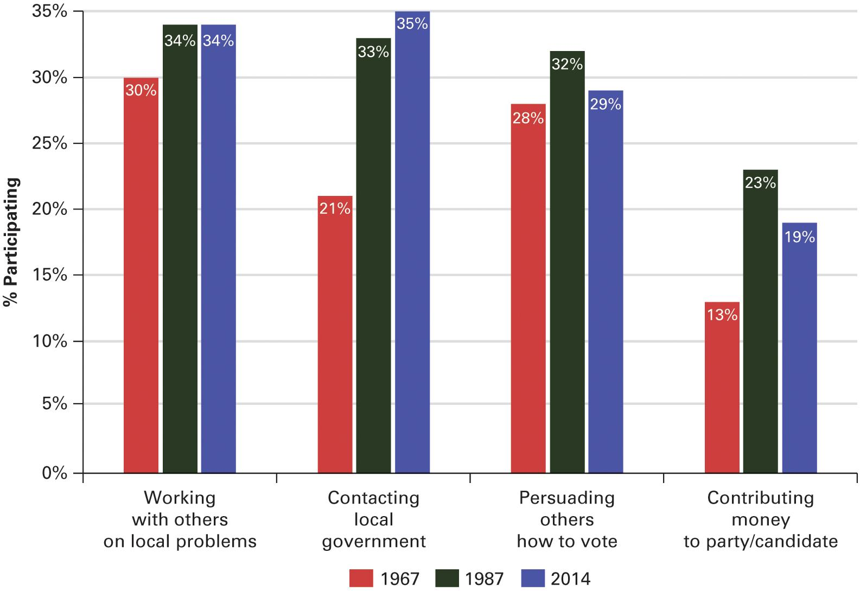
Figure 6.5 Political Participation Other Than Voting, 1967–2014
Sources: Authors’ analysis of the 2014 and 1987 General Social Surveys and the 1967 Political Participation in American Study.
Notes:
In the classic work titled Political Participation in America, Nie and Verba analyzed a number of measures of political participation other than voting. Four of these measures have subsequently been asked about in the 1987 and 2014 General Social Surveys using the exact same question wording. The graph below shows the results from these three surveys over a 47-year period, demonstrating that political participation in America has generally increased over time.

Slide 43
Protest as Participation
Drawing attention
Protests attract the media
Rare
Civil disobedience
Violence

Slide 44
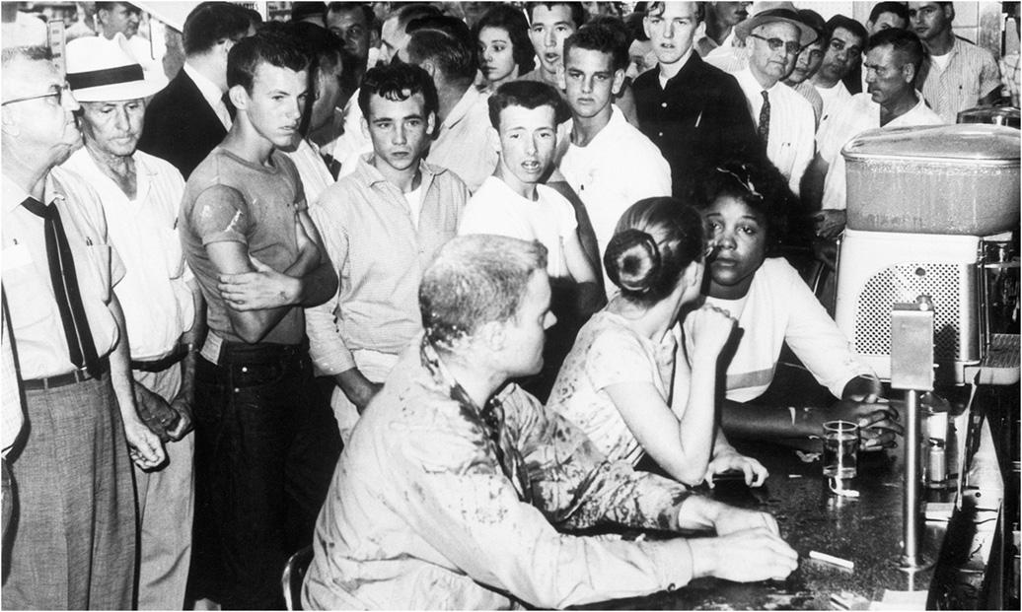
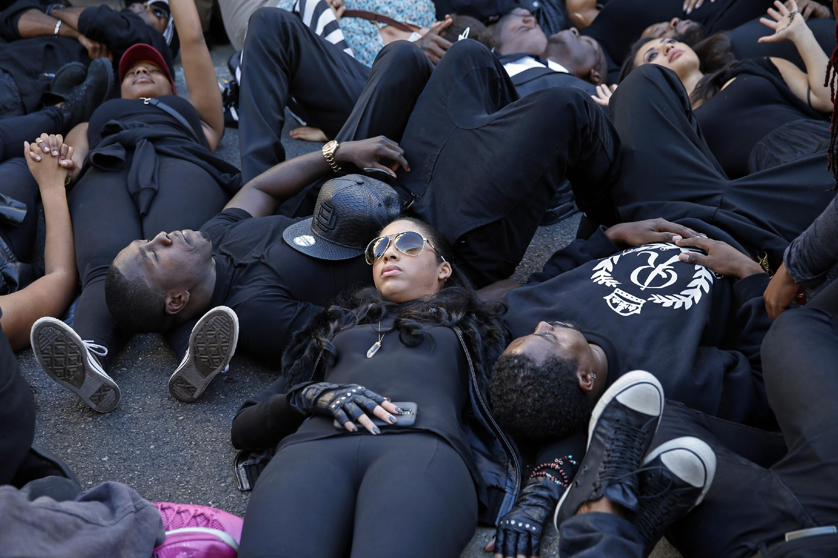
Nonviolent Civil Disobedience
Notes:
Nonviolent civil disobedience was one of the most effective techniques of the civil rights movement in the American South during the early 1960s. Young African Americans sat at “whites only” lunch counters to protest segregation. Following in their footsteps, BlackLivesMatter activists have also practiced civil disobedience to draw attention to questions of racial justice in the 21st century.

Slide 45
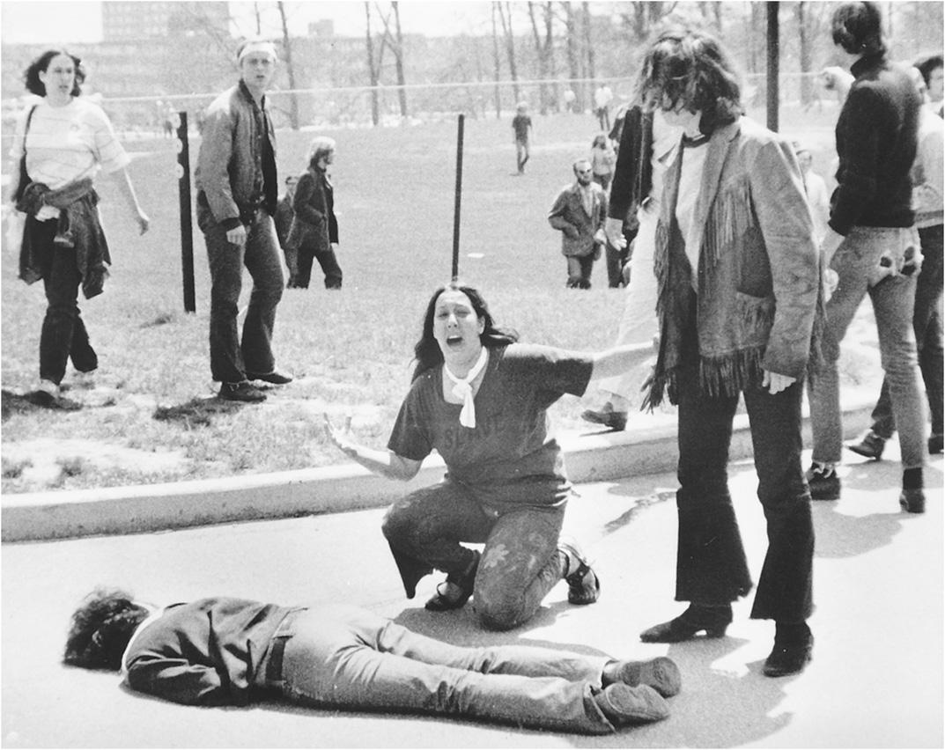
Kent State
Notes:
Perhaps the best-known image of American political violence from the Vietnam War era: A student lies dead on the Kent State campus, one of four killed when members of the Ohio National Guard opened fire on anti–Vietnam War demonstrators.

Slide 46
Class, Inequality, and Participation
Higher socio-economic status = higher participation rates
Minorities vote at nearly equal levels
What are the policy implications of lower political participation?
Notes:
We've noted that America is a diverse nation, and different groups participate in politics at unequal rates. Across the board, the higher a person's socio-economic status, the more likely that person is to engage in some form of political participation.

Slide 47
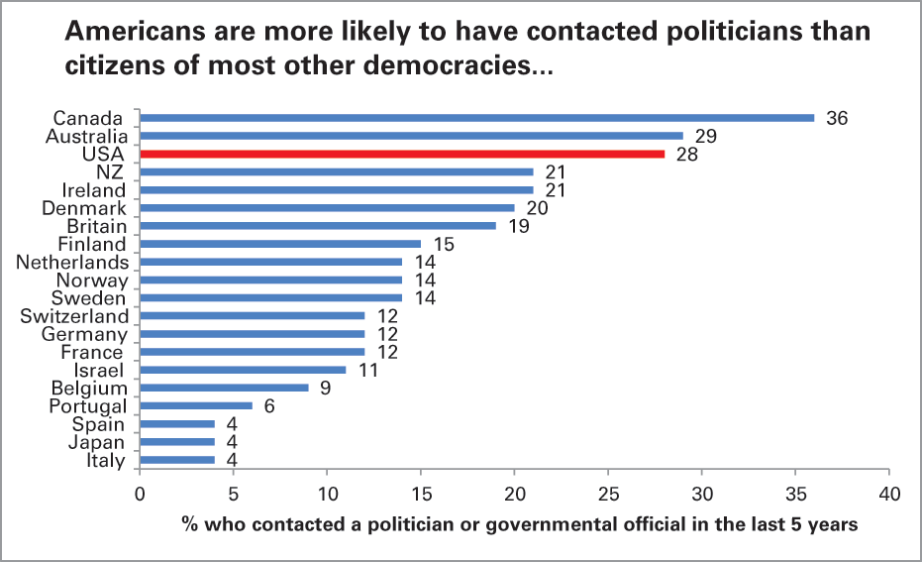
Figure 6.6 Conventional and Unconventional Political Participation (1 of 2)
Source: Authors’ analysis of the Comparative Study of Electoral Systems, module 2 (2001–2006).
Notes:
In a cross-national survey of political behavior in 20 established democracies, citizens were asked whether they had engaged in a variety of forms of political participation over the past five years. Whereas Americans were among the most likely to engage in the conventional mode of contacting politicians, they were among the least likely to engage in protest demonstrations.
Do you think the fact that Americans are more likely to contact politicians than protest is a good sign for American democracy, showing that people are largely content with conventional channels of transmitting public opinion to policymakers?
Do you think that when many people engage in political protest, this indicates that citizens are frustrated and discontented with their government, or is it likely just a reflection of political passion and involvement?

Slide 48
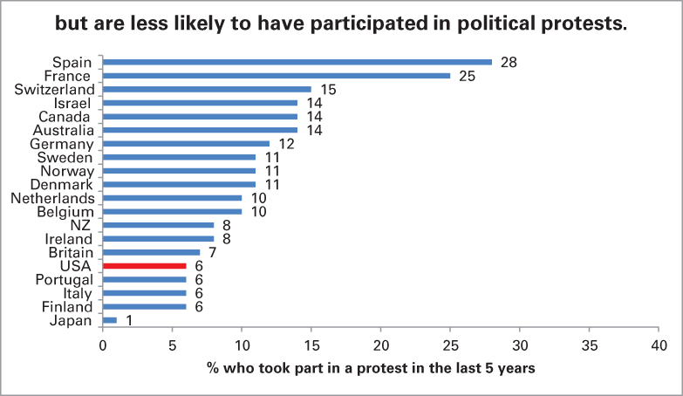
Figure 6.6 Conventional and Unconventional Political Participation (2 of 2)
Source: Authors’ analysis of the Comparative Study of Electoral Systems, module 2 (2001–2006).
Notes:
In a cross-national survey of political behavior in 20 established democracies, citizens were asked whether they had engaged in a variety of forms of political participation over the past five years. Whereas Americans were among the most likely to engage in the conventional mode of contacting politicians, they were among the least likely to engage in protest demonstrations.
Do you think the fact that Americans are more likely to contact politicians than protest is a good sign for American democracy, showing that people are largely content with conventional channels of transmitting public opinion to policymakers?
Do you think that when many people engage in political protest, this indicates that citizens are frustrated and discontented with their government, or is it likely just a reflection of political passion and involvement?

Slide 49
Learning Objective 6.7
Analyze how public opinion about the scope of government guides political behavior.

Slide 50
Understanding Public Opinion and Political Action
Public Attitudes Toward the Scope of Government
Democracy, Public Opinion, and Political Action
Notes:
People outside the United States tend to believe that public opinion determines political policy in America because of our democratic system. But there are limits to the role that public opinion plays in the shaping of policy. We have seen that some of these limits stem from low rates of political participation, from lack of political knowledge, and the tendency of politicians to try to shape, more than respond to, public opinion.

Slide 51
Public Attitudes Toward the Scope of Government
Should government do more or less?
In peacetime, most Americans say "less"
But public opinion is complex and inconsistent
Symbolic conservatives
Operational liberals
Policy gridlock
Notes:
In public opinion polls more than half of the American people respond that the government should do less, that it tries to do too many things—some of which should be left up to individuals and businesses. In wartime, opinion shifts slightly, but the overall trend is that Americans want less, not more, government.

Slide 52
Democracy, Public Opinion, and Political Action
Representative democracy
Decide who governs
Is public fit to choose its leaders?
Yes and no
Notes:
Recall that in a representative democracy like the United States, citizens don't usually vote directly on policy but instead vote for representatives who will make policy for them. Given the low rates of voter turnout, Americans clearly take the ability to choose policymakers for granted. But the fact that protesters are usually intent on getting the government's attention, not overthrowing it, demonstrates that Americans are socialized to the idea of democratic government.

Slide 53
Shared Writing 6
Democratic theory presumes that in a democracy people are well informed enough to guide the policies that their government pursues. Yet much political science research in the U.S. has uncovered shockingly low levels of public information about politics. Do you think the American public is well informed enough to guide the policies of the U.S. government?

Slide 54
Photo Credits
Chapter 6
164: U.S. Census Bureau; 168: Martin P. Wattenberg; 168: Matt York/AP Images; 175: Nate Beeler/The Columbus Dispatch/Cagle Cartoons, Inc.; 176: Chris Fitzgerald/CandidatePhotos/The Image Works;177: Pat Bagley/Salt Lake Tribune/Cagle Cartoons, Inc.; 183: © CartoonWork, Courtesy of Estelle Carol and Robert Simpson; 185: Bettmann/Getty Images; 186: John Filo/ Premium Archive/Getty Images; 186: Patrick T. Fallon/ Reuters

