Slide 1
Government in America: People, Politics and Policy
Seventeenth Edition
Chapter 5
Civil Rights and Public Policy

Slide 2
Learning Objectives (1 of 2)
5.1 Differentiate the Supreme Court’s three standards of review for classifying people under the equal protection clause.
5.2 Trace the evolution of protections of the rights of African Americans and explain the application of nondiscrimination principles to issues of race.
5.3 Relate civil rights principles to progress made by other ethnic groups in the United States.
5.4 Trace the evolution of women’s rights and explain how civil rights principles apply to gender issues.

Slide 3
Learning Objectives (2 of 2)
5.5 Summarize the struggles for civil rights of older Americans, persons with disabilities, and LBGT Americans.
5.6 Trace the evolution of affirmative action policy and assess the arguments for and against it.
5.7 Establish how civil rights policy advances democracy and increases the scope of government.

Slide 4
Learning Objective 5.1
Differentiate the Supreme Court’s three standards of review for classifying people under the equal protection clause.

Slide 5
The Struggle for Equality
Conceptions of Equality
The Constitution and Inequality
Notes:
The United States was founded on the idea that "all men are created equal," and the struggle for equality has been a persistent theme in U.S. history. Slaves longed for freedom, and, later, African Americans strived for equality. Women of all races fought for equality with men, and economically disadvantaged people have struggled for economic opportunities. Homosexuals, senior citizens, and the disabled are some of the more recent groups to make their voices heard in the fight for equal treatment.

Slide 6
Conceptions of Equality
What does equality mean?
Not sameness
Not equal rewards or results
Equality of opportunity
Inalienable rights
Notes:
What does equality mean? It doesn't mean that we are all alike, nor does it mean that we are all entitled to equal rewards or results in life. Equality in the United States means two things. The first is that everyone is born with inalienable rights. The second meaning, which flows from those inalienable rights, is that everyone is entitled to equality of opportunity.

Slide 7
The Constitution and Inequality
Fourteenth Amendment (1868)
Equal protection of the laws
Standards of review
Reasonable
Inherently suspect classifications
Race and ethnicity
Compelling public interest
No other way to accomplish purpose of law
Intermediate scrutiny
Gender
Substantial relationship to purpose
Notes:
The Constitution does not mention equality, but it implies equality by refusing to limit the guaranteed rights to any specific group.

Slide 8
Table 5.1 Standards of Review for Classifications under the Equal Protection Clause
Basis of Classification | Standard of Review | Applying the Test
Race and ethnicity | Inherently suspect— difficult to meet | Is the classification necessary to accomplish a compelling governmental goal? Is it the least restrictive way to achieve that goal?
Gender | Intermediate scrutiny— moderately difficult to meet | Does the classification bear a substantial relationship to an important governmental goal?
Other (age, wealth, etc.) | Reasonableness— easy to meet | Does the classification have a rational relationship to a legitimate government goal?
Notes:
The Supreme Court has three standards of review for evaluating whether a classification in a law or regulation is constitutionally permissible. Most classifications must bear only a rational relationship to some legitimate governmental purpose. The burden of proof is on anyone challenging such classifications to show that they are not reasonable, but arbitrary. At the other extreme, the burden of proof is on the rule maker. Racial and ethnic classifications are inherently suspect, and courts presume that they are invalid and uphold them only if they serve a compelling public interest and there is no other way to accomplish the purpose of the law. The courts make no presumptions about classifications based on gender. Such laws must bear a substantial relationship to an important governmental purpose, a lower threshold than serving a compelling public interest.

Slide 9
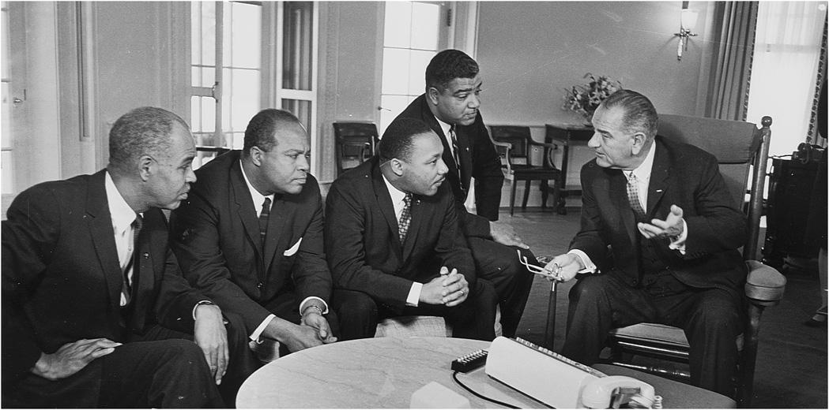
MLK Meets with President Johnson
Notes:
The African American struggle for equality paved the way for women and other minorities to organize movements for their civil rights. Here, civil rights leaders Roy Wilkins, James Farmer, Dr. Martin Luther King Jr., and Whitney Young meet with President Lyndon B. Johnson.

Slide 10
Learning Objective 5.2
Trace the evolution and protections of the rights of African Americans and explain the application of nondiscrimination principles to the issues of race.

Slide 11
African Americans’ Civil Rights
Slavery
Reconstruction and Segregation
Equal Education
The Civil Rights Movement and Public Policy
Voting Rights
Notes:
Racial discrimination is rooted in the era of slavery, and persisted in a long period of segregation, especially in the South, into the middle of the twentieth century.

Slide 12
Slavery
250 years of legal slavery
Plantation owners had political influence
Dred Scott v. Sandford (1857)
Slaves had no legal rights – chattel
Invalidated Missouri Compromise
End of slavery
Union victory in Civil War
Thirteenth Amendment (1865)
Notes:
Slave ownership was legal in America for about 250 years. During this time, the economy of the South was based on this unpaid labor. Plantation owners became wealthy and politically influential, and used their power to ensure that laws were favorable to slave owners.

Slide 13
Reconstruction and Segregation (1 of 2)
The first ten years
Strict federal control of South
African American men held office
Jim Crow laws
Segregation
Cradle to grave
Ku Klux Klan
Notes:
During the first decade after the Civil War, the federal government closely controlled the Southern states to make sure they complied with Reconstruction requirements. Some African American men even held office during this period.

Slide 14
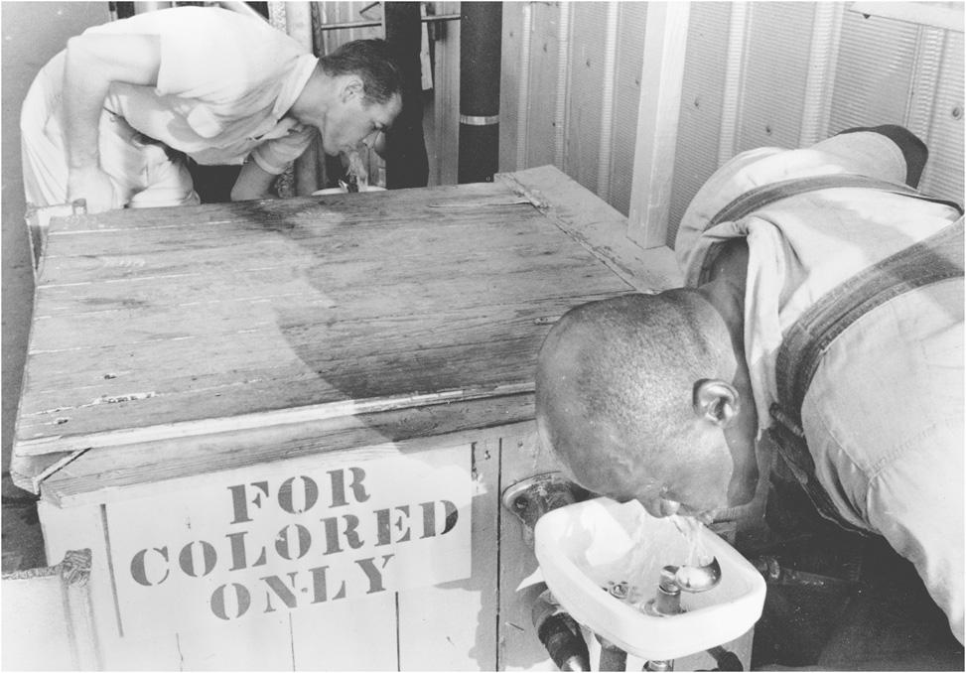
Segregated Water Fountain
Notes:
In the era of segregation, Jim Crow laws, such as those requiring separate drinking fountains for African Americans and whites, governed much of life in the South.

Slide 15
Reconstruction and Segregation (2 of 2)
Plessy v. Ferguson (1896)
Separate ok as long as it is equal
Private sector free to discriminate
Notes:
During this era, African Americans got no help from the courts. When Homer Plessy challenged segregated railway carriages, the Court ruled, in Plessy v. Ferguson, that separate facilities were not unconstitutional provided they were equal.

Slide 16
Equal Education
Higher education
McLaurin v. Oklahoma State Regents (1950)
Sweatt v. Painter (1950)
Elementary and secondary education
Brown v. Board of Education (1954)
Separate inherently unequal
Overturned Plessy
De jure versus de facto discrimination
Notes:
Education is the key to equality of opportunity, so civil rights advocates devoted their initial efforts to desegregating schools.

Slide 17
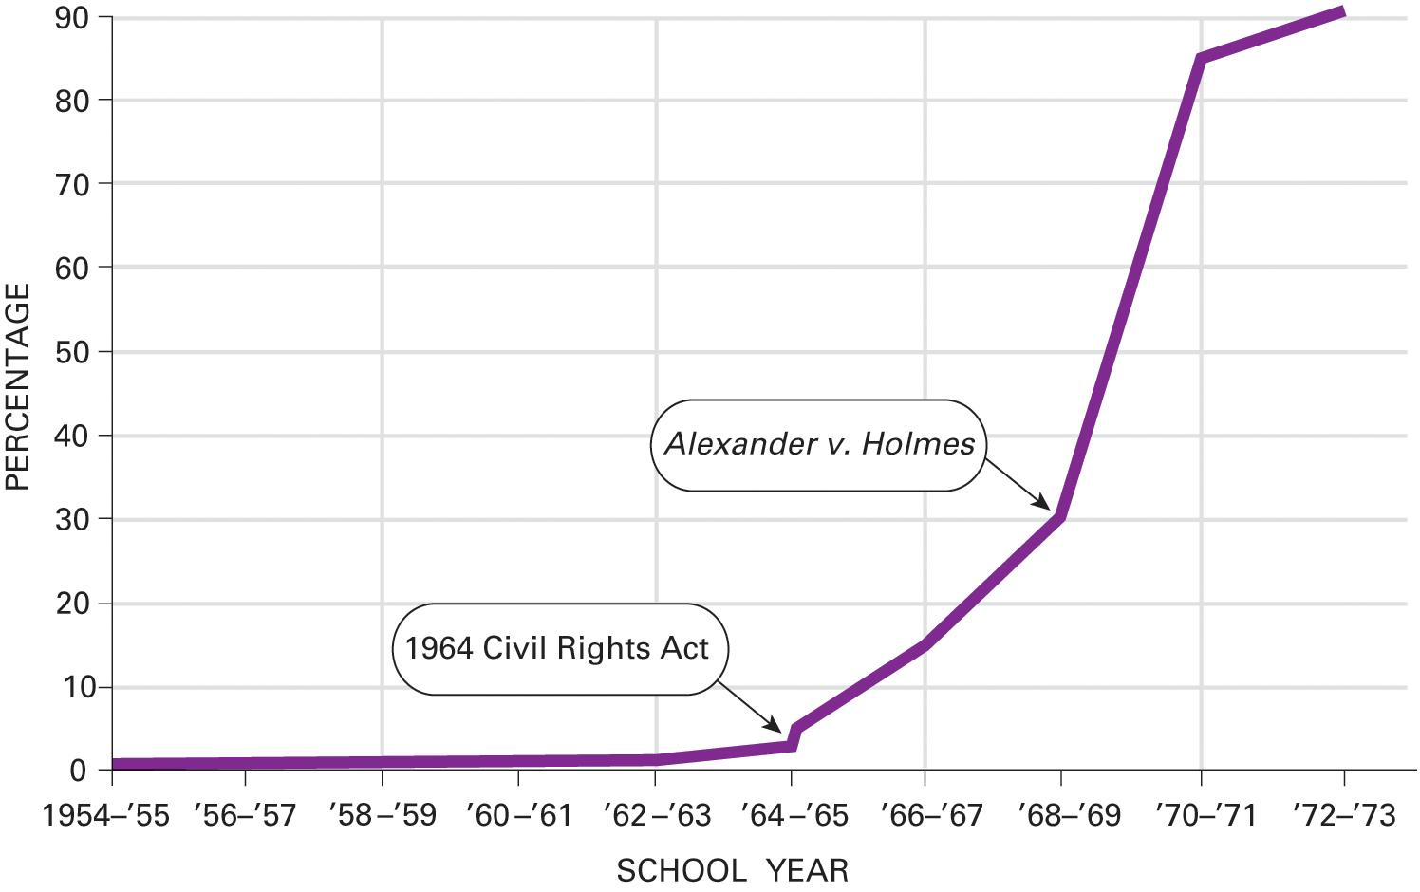
Figure 5.1 Percentage of Black Students Attending School with Any Whites in Southern States
Source: Data from Lawrence Baum.
Notes:
Despite the Supreme Court’s decision in Brown v. Board of Education in 1954, school integration proceeded at a snail’s pace in the South for a decade. Most Southern African American children entering the first grade in 1955 never attended school with white children. Things picked up considerably in the late 1960s, however, when the Supreme Court insisted that obstruction of implementation of its decision in Brown must come to an end. The figure is based on elementary and secondary students in 11 Southern states—Virginia, North Carolina, South Carolina, Georgia, Alabama, Mississippi, Louisiana, Texas, Arkansas, Tennessee, and Florida.

Slide 18
The Civil Rights Movement and Public Policy
Both black and white activists
Nonviolent civil disobedience
Television key to success
Civil Rights Act of 1964
Private sector discrimination illegal
Created EEOC
Discrimination in housing
Notes:
The civil rights movement attracted not only black advocates for their own rights but whites as well. These activists used nonviolent means to petition for equality.

Slide 19
Voting Rights (1 of 2)
Evading the Fifteenth Amendment
Literacy tests
Grandfather clause
Poll taxes
White primaries
Barriers fall
Twenty-fourth Amendment (1964)
Harper v. Virginia State Board of Elections (1966)
Voting Rights Act of 1965
Notes:
Despite the Fifteen Amendment's guarantee of voting rights for African Americans, southern states effectively kept African Americans out of the voting booth for the next century. They used poll taxes and literacy tests. A grandfather clause exempted anyone whose grandfather could vote in 1860, when slaves couldn't vote.

Slide 20
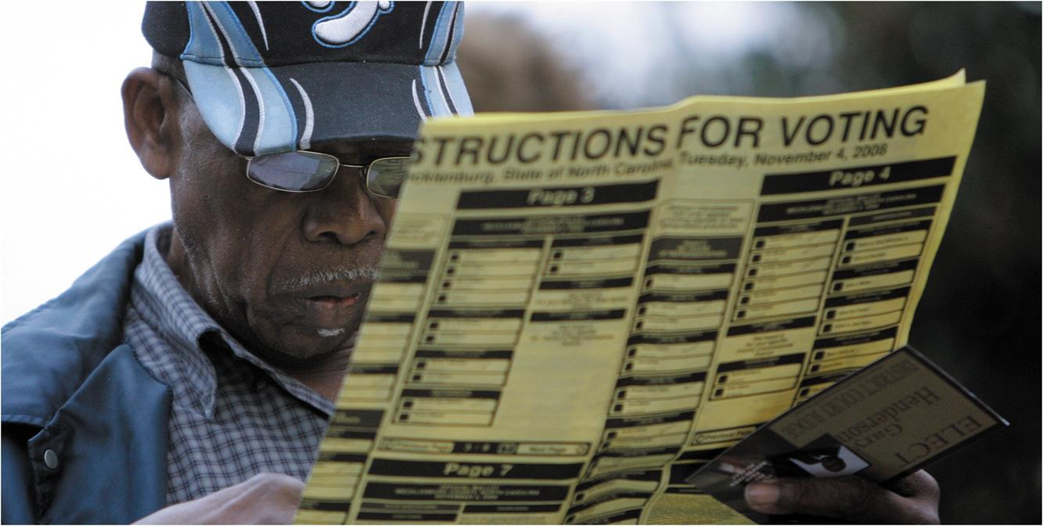
Voting Rights (2 of 2)
Notes:
The Voting Rights Act of 1965 produced a major increase in the number of African Americans registered to vote in Southern states. Voting also translated into increased political clout for African Americans.

Slide 21
Learning Objective 5.3
Relate civil rights principles to progress made by other ethnic groups in the United States.

Slide 22
The Rights of Other Minority Groups
Native Americans
Hispanic Americans
Asian Americans
Arab Americans and Muslims
Notes:
Soon, America will have a minority majority. In some states, minorities already outnumber the white population. Other minorities besides African Americans have faced discrimination, and the civil rights laws for which African Americans fought have benefited them as well.

Slide 23
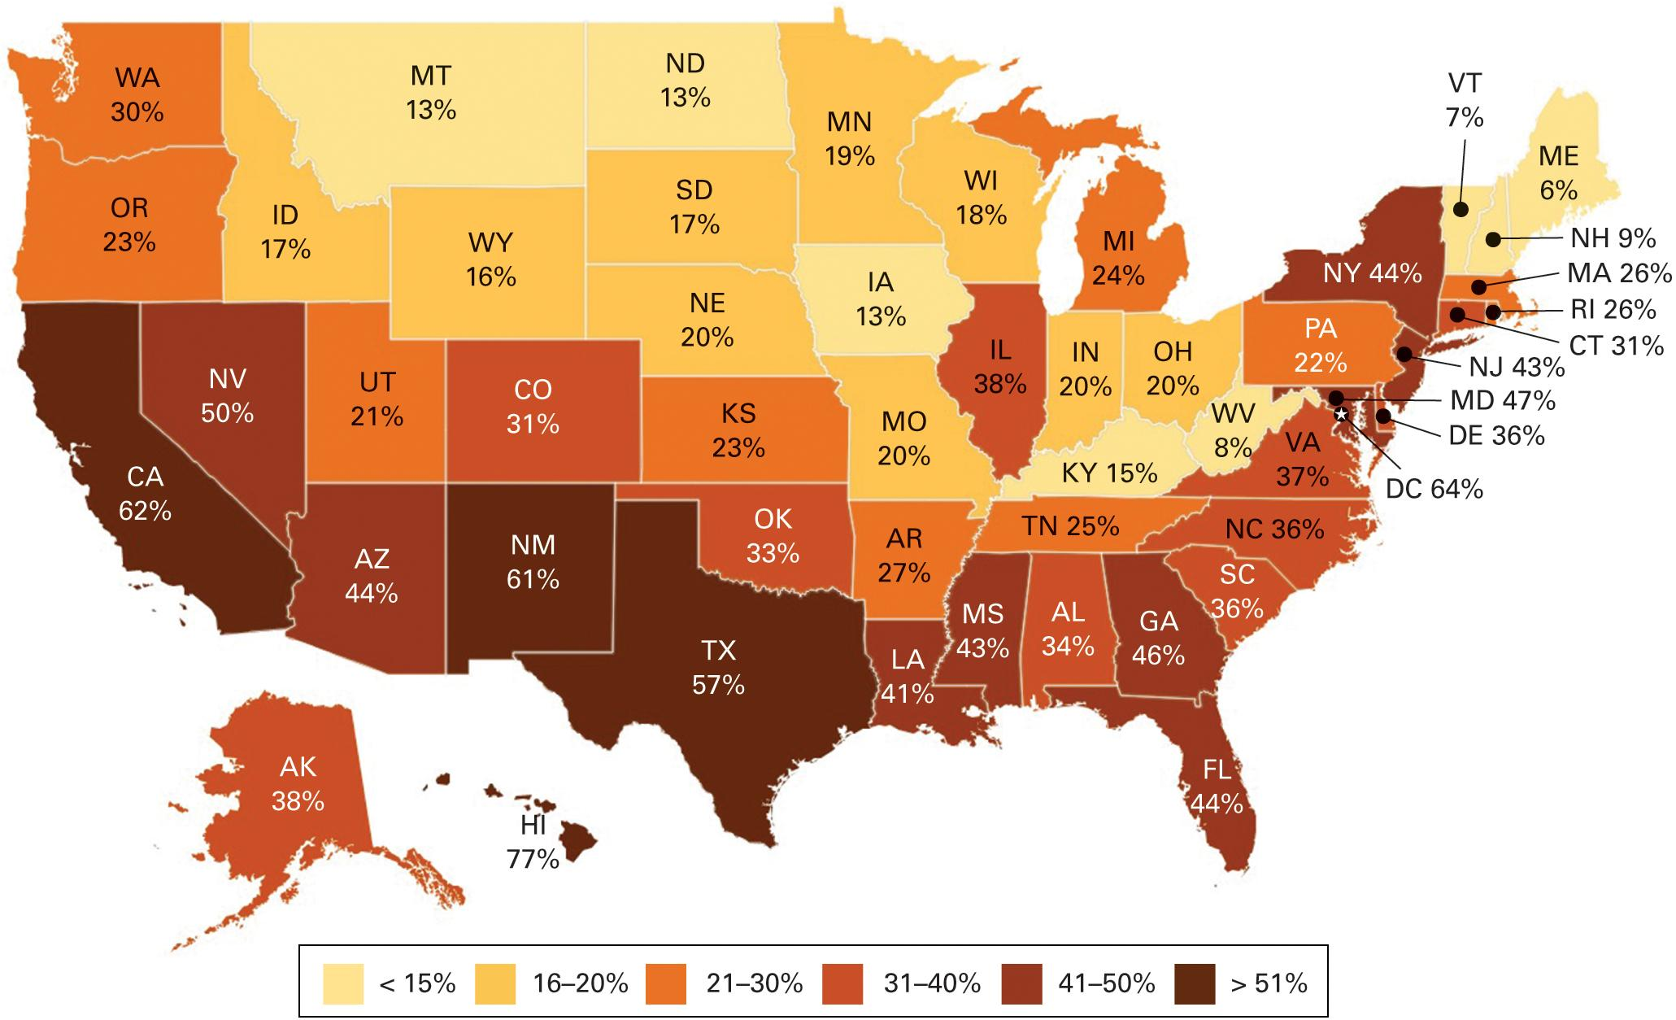
Figure 5.2 Minority Population By State
Source: U.S. Census Bureau, 2016.
Notes:
The country's minority population has now reached over 123 million, including about 55 million Hispanic Americans and 42 million African Americans. Minorities make up approximately 38 percent of all Americans. Nearly half of all the children under 18 are from minority families. This map shows minorities as a percentage of each state's population. Hawaii has the largest minority population at 77 percent, followed by the District of Columbia (64 percent), California (62 percent), New Mexico (61 percent), and Texas (57 percent). In eight other states—Arizona, Florida, Georgia, Maryland, Mississippi, Nevada, New Jersey, and New York—minorities make up at least 40 percent of the population.

Slide 24
Native Americans (1 of 2)
Oldest minority group
6.6 million
History of poverty, discrimination
Reservations
Dawes Act of 1887
1924: citizenship
Notes:
Native Americans and Native Alaskans inhabited the continent before European colonists arrived. Today, about 6.6 million Americans claim to have at least some Native American or Native Alaskan ancestry.

Slide 25
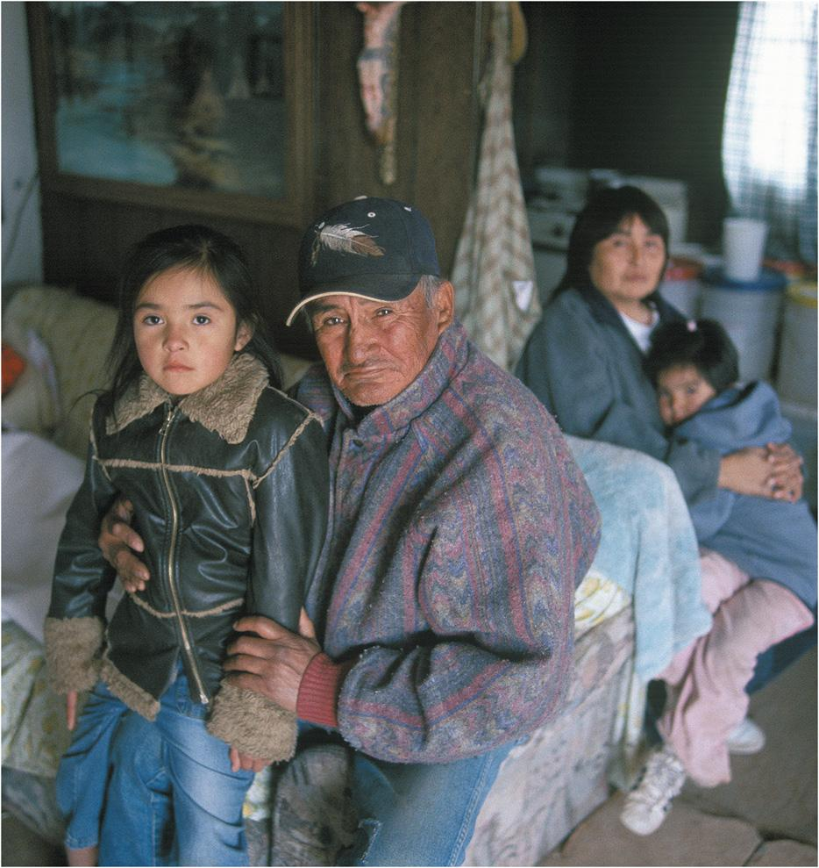
Native Americans (2 of 2)
Notes:
Despite some progress, many Native Americans, such as these grandparents and their grandchildren, continue to suffer poverty and ill health.

Slide 26
Hispanic Americans (1 of 2)
Largest minority group
55 million/17% of population
New Mexico, Texas, California
Discrimination
Hernandez v. Texas (1954)
Illegal immigrants
Children can attend public schools
No consensus on national policies
Notes:
Hispanics are the largest minority group. There are currently more than 55 million Hispanics in the United States, concentrated in the southwestern states.
The problem of illegal immigration is focused on Hispanics because they make up the majority of illegal immigrants today. The Court has ruled that the children of illegal immigrants cannot be excluded from public schools, but Congress can't agree on national policies to deal with Hispanics who are in the country illegally. States have begun enacting their own policies to combat illegal immigration, at times in violation of federal law.

Slide 27
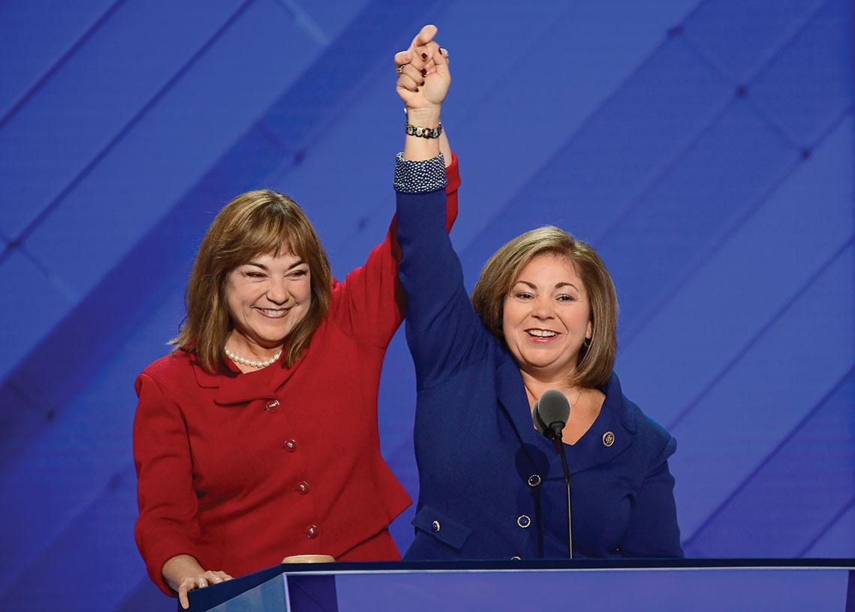
Hispanic Americans (2 of 2)
Notes:
Their growing numbers have made Hispanic Americans the largest minority group in the United States. Their political power is reflected in the two dozen Hispanic members of the U.S. House of Representatives, such as Loretta and Linda Sanchez of California, the first set of sisters to serve simultaneously in Congress.

Slide 28
Journal Prompt 5.3: Hispanic Americans
Hispanics are the largest ethnic group in the United States, yet there are relatively few Hispanics in Congress. Why do you think that is?

Slide 29
Asian Americans
Fastest-growing minority group
20 million/6% of population
Discrimination in education, jobs, housing, and in naturalization
Korematsu v. United States (1944)
World War II internment camps constitutional
Apology/payments
Notes:
Asian Americans are the fastest-growing minority group, although they currently make up only 6% of the population. They have faced the same discrimination in education, jobs, and housing as other minorities, and also unique difficulties with naturalization.

Slide 30
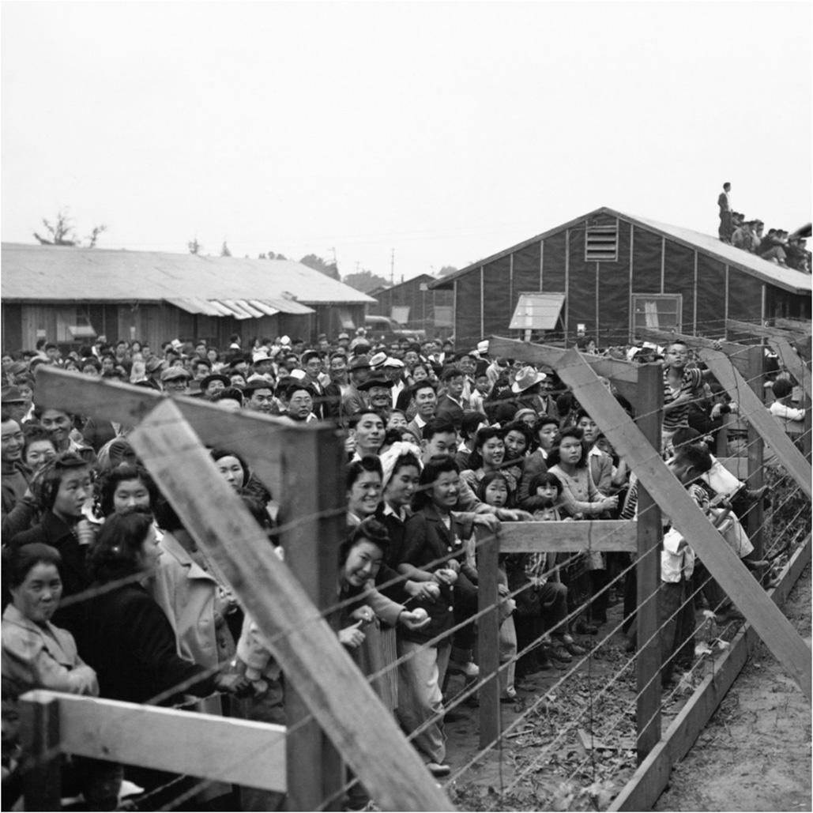
Japanese Internment Camp
Notes:
One of the low points in the protection of civil rights in the United States occurred during World War II when more than 100,000 Americans of Japanese descent were moved to internment camps.

Slide 31
Arab Americans and Muslims
Most-feared minority
3.5 million Arabs/6 million Muslims
Bias-related attacks since 9/11
Discrimination
Illegal detentions
Habeas corpus rights
Notes:
About 3.5 million Americans of Arab ancestry and about 6 million Muslims live in the United States. Not all Arabs are Muslim and not all Muslims are Arabs. Since the terrorist attacks of 9/11, these groups have been the victims of bias-related crimes, from vandalism to murder, and they have faced increasing discrimination in employment and housing.

Slide 32
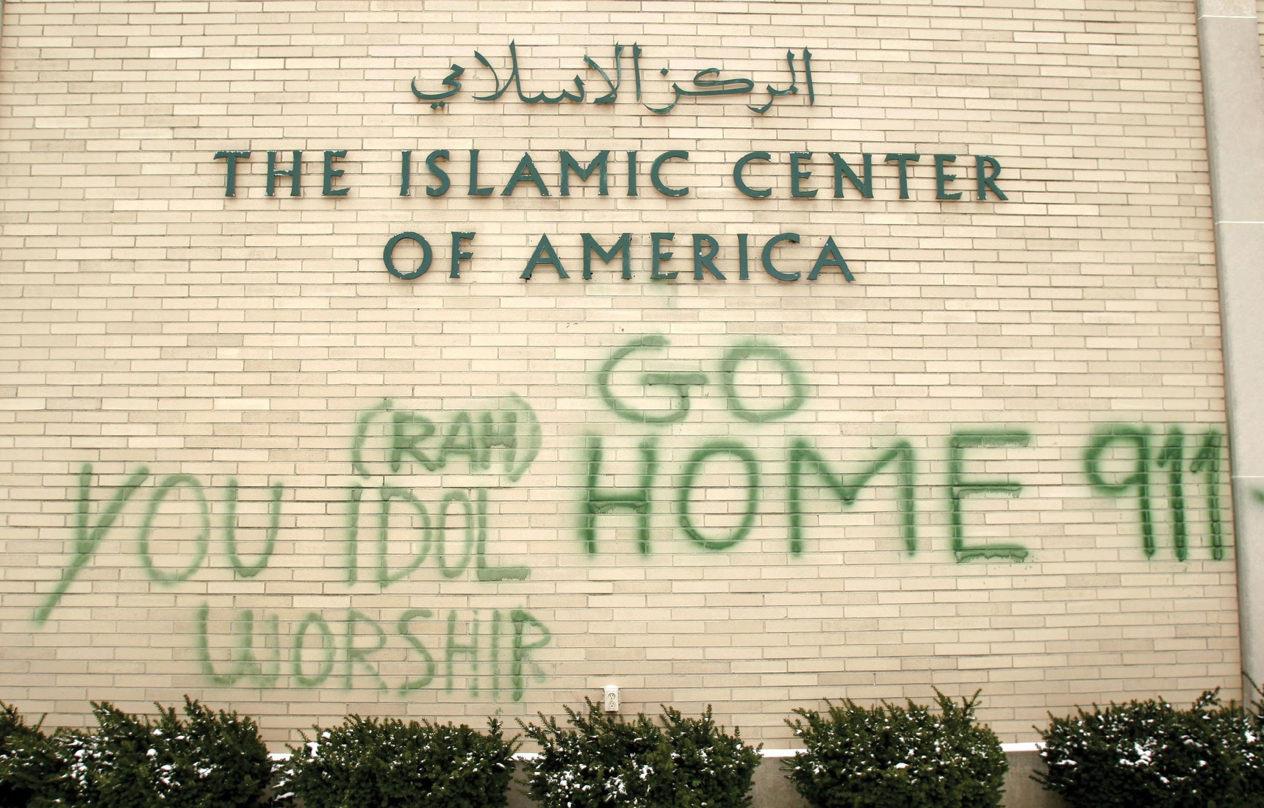
Islamic Center
Notes:
The association of terrorism with Arabs and Muslims puts peace-loving Arab and Muslim Americans at risk of discrimination, threats, and even bodily harm.

Slide 33
Learning Objective 5.4
Trace the evolution of women’s rights and explain how civil rights principles apply to gender issues.

Slide 34
The Rights of Women
The Battle for the Vote
The "Doldrums": 1920–1960
The Second Feminist Wave
Women in the Workplace
Sexual Harassment
Notes:
The first women's rights activists were former abolitionists. Women could not vote, attend most educational institutions, or enter most professions. Married women had it even worse, since coverture laws denied them the right to sign contracts or to sell property. They were considered the property of their husbands and had no separate legal identity.

Slide 35
The Battle for the Vote
Seneca Falls Declaration of Sentiments and Resolutions (July 19, 1848)
Like Declaration of Independence
Only one signer lived to vote
Nineteenth Amendment (1920)
Western states in vanguard
Notes:
The first women's rights convention, held in Seneca Falls, New York, in 1848, culminated in a document that resembled the Declaration of Independence. The Seneca Falls Declaration was a list of grievances against the tyranny of men. It took another 72 years of activism by suffragists before the Nineteenth Amendment was passed, giving women the constitutional right to vote. Only one of the signers of the Seneca Falls Declaration lived long enough to vote.

Slide 36
The “Doldrums”: 1920–1960
Voting rights only first step to equality
Disagreement on other goals
Social feminists
Paternal protectionism rather than equality
Equal Rights Amendment (ERA)
Seen as threat to family
Notes:
Getting the right to vote was only the first step on a long road to equality for women. Women are still far from achieving full equality and an end to both de jure and de facto discrimination. One of the reasons women have yet to achieve full equality is that the women's movement suffers from considerable internal disagreement on goals.

Slide 37
The Second Feminist Wave
Civil rights and feminism
Parallels seen again
Reed v. Reed (1971)
Craig v. Boren (1976)
National Organization for Women (NOW)
Equal Rights Amendment (ERA)
Defeated again
Notes:
A new women's movement grew out of the civil rights movement of the 1950s and 1960s. Many took up the cause of civil rights for minorities and saw parallels to discrimination that they faced as women.

Slide 38
Women in the Workplace
Wage Discrimination and Comparable Worth
Employment
Education
Military Service
Notes:
The traditional family structure of male breadwinner and female homemaker has been disappearing. Most married women, and indeed most mothers, work outside the home. There are an increasing number of single mothers. These new living and working arrangements have led to demand for new public policies to acknowledge and accommodate them.

Slide 39
Wage Discrimination and Comparable Worth
Wage discrimination persists
83 cents for every dollar men earn
The Equal Pay Act of 1963
Notes:
One of the most persistent aspects of gender inequality in the United States is wage discrimination. Women are paid far less than men for the same job, earning about 83 cents for each dollar men earn. The Equal Pay Act of 1963 makes it illegal to pay different wages to men and women if they perform equal work in the same workplace.

Slide 40
Employment
Congressional progress on women’s employment rights.
Banned gender discrimination in employment
Cannot exclude pregnancy/childbirth from healthcare plans
Shifted the burden of proof in hiring practices to employers
Supreme Court and women’s employment rights
Notes:
Congress has made some important progress on the rights of women the area of employment. The 1964 Civil Rights Act banned gender discrimination in employment. The protections offered by this lot have been expanded several times.
The Supreme Court has also acted against gendered summation in employment and business activity. For example they have avoided laws and rules by moving jobs to arbitrary hate and weight requirements. In addition women have also been protected from being required to take mandatory pregnancy leave.

Slide 41
Female Astronauts
Notes:
In recent years, women have entered many traditionally male-dominated occupations. Here astronauts Peggy Wilson and Pam Melroy meet in the International Space Station.

Slide 42
Education
Title IX of the Education Act
Forbids gender discrimination in federally subsidized education programs (colleges and universities)
Includes athletics
Single gender schooling?
The VMI case
Notes:
Title IX of the Education Act of 1972 forbids gender discrimination in federally subsidized education programs including athletics.
In 1996 the Supreme Court declared that Virginia's exclusion of women from educational police at the state-funded Virginia Military Institute (VMI) violated women's rights equal protection of law.

Slide 43
Military Service
Controversial
Women serve in every branch
15% of active duty armed forces
Allowed in academies since 1975
Gender differences in military
Only men must register for draft
Notes:
Women have served in all branches of the U.S. armed forces since World War II. Now, women comprise 15% of the active duty military and compete for promotions with men, having been allowed into all service academies since 1975. In 2015 the secretary of defense lifted the ban on women in combat.

Slide 44
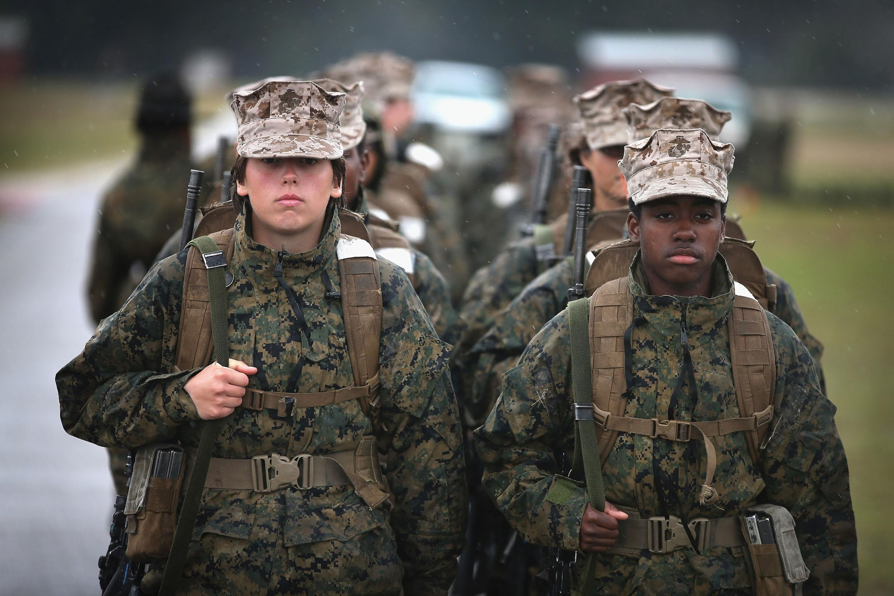
Women Soldiers
Notes:
Women, such as these soldiers, are playing increasingly important roles in the military.

Slide 45
Sexual Harassment
Sexual harassment in the workplace
Form of gender discrimination forbidden by Civil Rights Act of 1964
Retaliation prohibited
Prevalent in male-dominated fields
Huge problem in military
Notes:
Sexual harassment in schools and workplaces is forbidden by the Civil Rights Act of 1964. It is considered a form of gender discrimination. Defining sexual harassment has been challenging, but the Court has said that the law is violated when a reasonable person would perceive the workplace environment to be hostile or abusive.

Slide 46
Learning Objective 5.5
Summarize the struggles for civil rights of older Americans, persons with disabilities, and LBGT Americans.

Slide 47
Other Groups Active Under the Civil Rights Umbrella
Civil Rights and the Graying of America
Civil Rights and People with Disabilities
LGBT Rights
Notes:
As you've seen with regard to civil rights for African Americans and other minorities, policies that protect rights for one group can be applied to other groups. In this section, we consider some other groups that have appealed to the Fourteenth Amendment's equal protection clause to end discrimination that they face in education, employment, housing, medical care, and other areas.

Slide 48
Civil Rights and the Graying of America
Aging population
46 million over 65/15% of population
5.5 million over 85 and growing
Social Security
65 arbitrary age
Never meant to be adequate income
Age discrimination
Limited protection in law
Notes:
The U.S. population is aging. Today, 15% of the population is over 65, and people in their eighties are the fastest-growing age group.

Slide 49
Civil Rights and People with Disabilities
Direct and indirect discrimination
Public accommodations inaccessible
Legal protections
Rehabilitation Act of 1973
Education of All Handicapped Children Act of 1975
Americans with Disabilities Act of 1990
Notes:
"Once, blacks had to ride at the back of the bus. We can't even get on the bus." So reads a slogan for disabled activists. Although the disabled have faced overt discrimination throughout U.S. history, much of the discrimination they endure has been through lack of access to public and private facilities.

Slide 50
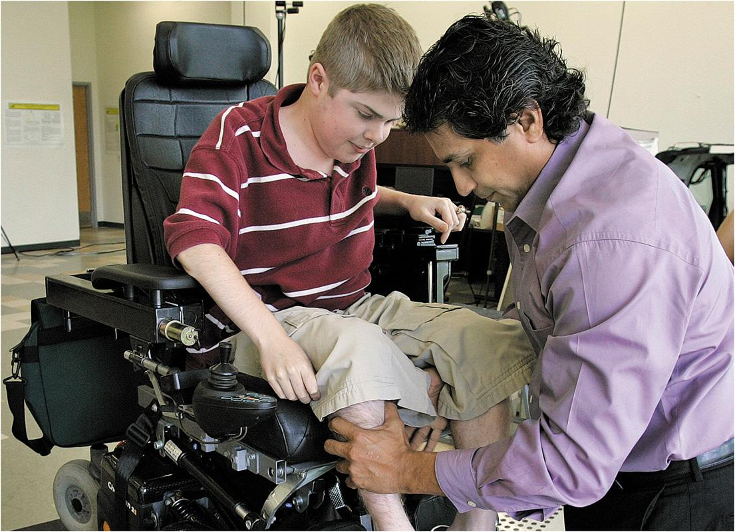
Disabled Student
Notes:
In recent decades, public policy has focused on integrating the disabled, such as this college student being fitted with an all-terrain wheelchair, to participate more fully in society.

Slide 51
LGBT Rights
Toughest battle for equality
Homophobia and violence
Gay rights movement
Stonewall 1969
Bowers v. Hardwick (1986)
Boy Scouts
Lawrence v. Texas (2003)
Don't ask, don't tell
Same-sex marriage
Notes:
Gays and lesbians represent every racial and ethnic group and social class, and they number in the millions, yet they face one of the toughest struggles for equality.

Slide 52
Journal Prompt 5.5: LGBT Rights
One of the most interesting political developments in recent years has been the rapid change in public opinion regarding same gender marriage. What do you think accounts for this change?

Slide 53
Learning Objective 5.6
Trace the evolution of affirmative action policy and assess the arguments for and against it.

Slide 54
Affirmative Action (1 of 2)
Redressing past discrimination
Equality of results
Quotas and special rules
Controversial
Notes:
Affirmative action involves giving precedence to applicants who are members of groups that were previously discriminated against, such as women and minorities, for jobs, promotions, and admission to educational programs.

Slide 55
Affirmative Action (2 of 2)
Regents of the University of California v. Bakke (1978)
Adarand Constructors v. Pena (1995)
Parents Involved in Community Schools v. Seattle School District No. 1 (2007)
Notes:
When a white applicant was denied admission to a medical school that allowed minorities with lower test scores to be admitted over more qualified white applicants to fill minority quotas, the white applicant sued on Fourteenth Amendment grounds. He claimed discrimination based on race. The applicant won a partial victory. In Regents of the University of California v. Bakke, the Court ruled that racial quotas are unconstitutional, although it stopped short of saying that the university could not use race as a criterion for admission.
The Adarand decision in 1995 held that federal programs classifying people by race, even if that classification is for benign purposes, should be presumed to be unconstitutional.
In Parents Involved in Community Schools v. Seattle School District No.1 (2007), the Court agreed that the school district’s use of race in their voluntary integration plans violated the tax guarantee and therefore was unconstitutional.

Slide 56
Learning Objective 5.7
Establish how civil rights policy advances democracy and increases the scope of government.

Slide 57
Understanding Civil Rights and Public Policy
Civil Rights and Democracy
Civil Rights and the Scope of Government
Notes:
As noted at the beginning of the chapter, the only mention of equality in the Constitution comes in the Fourteenth Amendment's requirement that states deny to no one the "equal protection of the laws." All civil rights progress is based on those five words. Ensuring and enforcing civil rights has implications for democracy and the scope of government.

Slide 58
Civil Rights and Democracy
Equality basic principle of democracy
One citizen, one vote
Conflict with individual liberty
Favors majority rule
Minorities can threaten majorities
Women 51% of population
African American majorities in southern states during segregation
The power of the vote
Notes:
Equality is a basic principle of democracy. Everyone gets one vote because we are all equal. Equality can sometimes conflict with another important democratic principle, such as individual liberty. If everyone has an equal vote in a democracy, the majority can vote to strip minorities of rights.

Slide 59
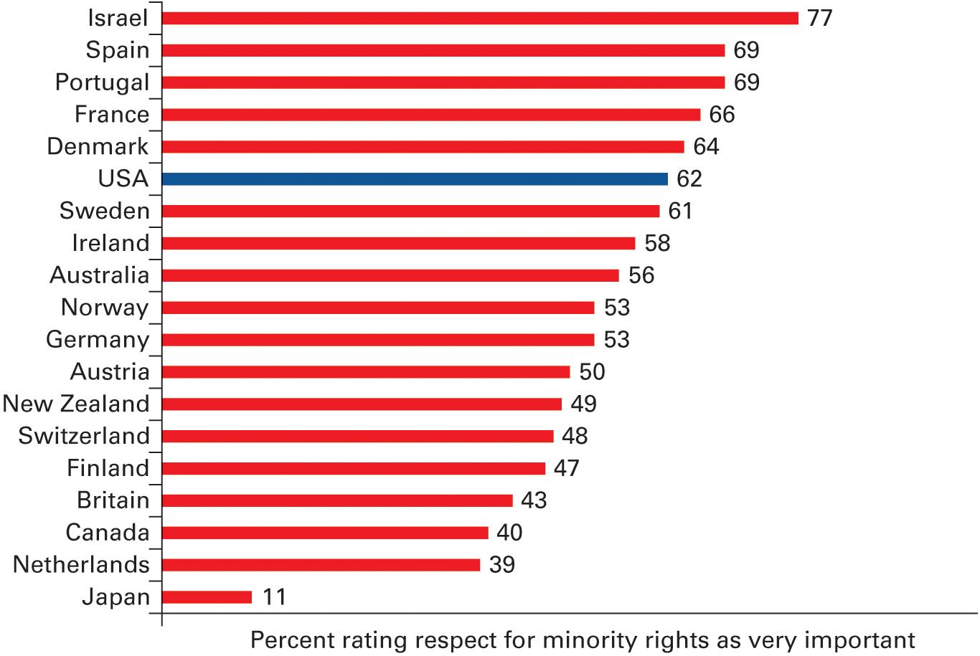
Figure 5.3 Respect for Minority Rights
Source: Author’s analysis of 2004 International Social Survey Program data.
Notes:
Americans rate the importance of protection of minority rights relatively highly compared to other
democracies.
Survey Question: There are different opinions about people’s rights in a democracy. On a scale of 1 to 7, where 1 is not at all important and 7 is very important, how important is it that government authorities respect and protect rights of minorities?
Why do you think that Americans tend to strongly believe in protection of minority rights?

Slide 60
Civil Rights and the Scope of Government
What about limited government?
Issues Founders could not envision
Government not exactly limited when it discriminated
Notes:
The Founders envisioned a government much more limited than the one we have today, yet the policies that uphold civil rights are necessary to hold the nation together and to deal with issues that the Founders could not have imagined. They made the Constitution flexible for precisely this reason.

Slide 61
Shared Writing 5
There is no question that some minority groups have suffered from discrimination. There is also no question that most applicants for universities or jobs have not been responsible for this discrimination. Is it possible to help minorities without hurting innocent members of groups who have not suffered discrimination?

Slide 62
Photo Credits
Chapter 5
133: AP Images; 134: Bettmann/Corbis/Getty Images; 139: Chuck Burton/AP Images; 141: Alison Wright/ Corbis Documentary/Getty Images; 143: Ron Sachs/dpa/picture-alliance/Newscom; 144: Library of Congress/Corbis Historical/VCG/Getty Images; 145: Bill Pugliano/Getty Images; 148: NASA; 149: Scott Olson/Getty Images News/ Getty Images; 153: Chris O’Meara/AP Images; 155: Tom Cheney/The New Yorker Collection/The Cartoon Bank

