Slide 1
Government in America: People, Politics and Policy
Seventeenth Edition
Chapter 4
Civil Liberties and Public Policy

Slide 2
Learning Objectives (1 of 2)
4.1 Trace the process by which the Bill of Rights has been applied to the states.
4.2 Distinguish the two types of religious rights protected by the first Amendment and determine the boundaries of those rights.
4.3 Differentiate the rights of free expression protected by the First Amendment and determine the boundaries of those rights.
4.4 Describe the rights to assemble and associate protected by the First Amendment and their limitations.

Slide 3
Learning Objectives (2 of 2)
4.5 Describe the right to bear arms protected by the Second Amendment and its limitations.
4.6 Characterize defendants’ rights and identify issues that arise in their implementation.
4.7 Outline the evolution of a right to privacy and its application to the issue of abortion.
4.8 Assess how civil liberties affect democratic government and how they both limit and expand the scope of government.

Slide 4
Learning Objective 4.1
Trace the process by which the Bill of Rights has been applied to the states.

Slide 5
The Bill of Rights
The Bill of Rights—Then and Now
The Bill of Rights and the States
Notes:
At first, most freedoms in the Bill of Rights applied only to the citizen's relationship with the federal government. Now, however, through the process of incorporation, most of the Bill of Rights applies to the citizen's relationship with state and local governments.

Slide 6
The Bill of Rights— Then and Now
Popular support
Added to Constitution by popular demand
Rights supported more in theory than practice
Civil liberties are not absolute
Limitations
Balanced against other values
Notes:
The Bill of Rights was added to the Constitution by popular demand. The abuses of the British government were still fresh in the minds of the colonists, and they did not want their new government to be able to arrest people without cause or jail newspaper editors because of what they published.

Slide 7
Table 4.1 The Bill of Rights (1 of 4)
Amendment I—Religion, Speech, the Press, Assembly, Petition
Congress shall make no law respecting an establishment of religion, or prohibiting the free exercise thereof; or abridging the freedom of speech, or of the press; or the right of the people peaceably to assemble, and to petition the Government for a redress of grievances.
Amendment II—Right to Bear Arms
A well regulated Militia, being necessary to the security of a free State, the right of the people to keep and bear Arms, shall not be infringed.
Amendment III—Quartering of Soldiers
No Soldier shall, in time of peace be quartered in any house, without the consent of the Owner, nor in time of war, but in a manner to be prescribed by law.
Notes:
These amendments were passed by Congress on September 25, 1789, and ratified by the states on December 15, 1791.

Slide 8
Table 4.1 The Bill of Rights (2 of 4)
Amendment IV—Searches and Seizures
The right of the people to be secure in their persons, houses, papers, and effects, against unreasonable searches and seizures, shall not be violated, and no Warrants shall issue, but upon probable cause, supported by Oath or affirmation, and particularly describing the place to be searched, and the persons or things to be seized.
Amendment V—Grand Juries, Double Jeopardy, Self-Incrimination, Due Process, Eminent Domain
No person shall be held to answer to a capital, or otherwise infamous crime, unless on a presentment or indictment of a Grand Jury, except in cases arising in the land or naval forces, or in the Militia, when in actual service in time of war or public danger; nor shall any person be subject for the same offense to be twice put in jeopardy of life or limb; nor shall be compelled in any criminal case to be a witness against himself, nor be deprived of life, liberty, or property, without due process of law; nor shall private property be taken for public use, without just compensation.
Notes:
These amendments were passed by Congress on September 25, 1789, and ratified by the states on December 15, 1791.

Slide 9
Table 4.1 The Bill of Rights (3 of 4)
Amendment VI—Criminal Court Procedures
In all criminal prosecutions, the accused shall enjoy the right to a speedy and public trial, by an impartial jury of the State and district wherein the crime shall have been committed, which district shall have been previously ascertained by law, and to be informed of the nature and cause of the accusation; to be confronted with the witnesses against him; to have compulsory process for obtaining witnesses in his favor, and to have the Assistance of Counsel for his defence.
Amendment VII—Trial by Jury in Common-Law Cases
In Suits at common law, where the value in controversy shall exceed twenty dollars, the right of trial by jury shall be preserved, and no fact tried by a jury, shall be otherwise re-examined in any Court of the United States, than according to the rules of the common law.
Notes:
These amendments were passed by Congress on September 25, 1789, and ratified by the states on December 15, 1791.

Slide 10
Table 4.1 The Bill of Rights (4 of 4)
Amendment VIII—Bails, Fines, and Punishment
Excessive bail shall not be required, nor excessive fines imposed, nor cruel and unusual punishments inflicted.
Amendment IX—Rights Retained by the People
The enumeration in the Constitution, of certain rights, shall not be construed to deny or disparage others retained by the people.
Amendment X—Rights Reserved to the States
The powers not delegated to the United States by the Constitution, nor prohibited by it to the States, are reserved to the States respectively, or to the people.
Source: The U.S. Constitution, the Ten Amendments
Notes:
These amendments were passed by Congress on September 25, 1789, and ratified by the states on December 15, 1791.

Slide 11
The Bill of Rights and the States
First Amendment
Applied to federal government only
States had own bills of rights
Barron v. Baltimore (1833)
Fourteenth Amendment
Gitlow v. New York (1925)
Due process clause
Incorporation doctrine
Not all rights incorporated
Notes:
Originally, the Bill of Rights applied to the federal government only. Note that the First Amendment reads, "Congress shall make no law…." State constitutions had their own bills of rights, and Americans had a different view about what states and the federal government should be allowed to do.

Slide 12
Table 4.2 The Incorporation of the Bill of Rights (1 of 4)
Date of Incorporation | Amendment | Right | Case
1925 | First | Freedom of speech | Gitlow v. New York
1931 | First | Freedom of the press | Near v. Minnesota
1937 | First | Freedom of assembly | De Jonge v. Oregon
1940 | First | Free exercise of religion | Cantwell v. Connecticut
1947 | First | Establishment of religion | Everson v. Board of Education
1958 | Frist | Freedom of association | NAACP v. Alabama
1963 | First | Right to petition government | NAACP v. Button
2010 | First | Right to bear arms | McDonald v. Chicago
Notes:
This table lists the year that each right has been incorporated, and the case. Note that the Fourteenth Amendment was ratified in 1868 and incorporation began in 1925. Which rights have not been incorporated?

Slide 13
Table 4.2 The Incorporation of the Bill of Rights (2 of 4)
Date of Incorporation | Amendment | Right | Case
Not Incorporatedª | Third | No quartering of soldiers
1949 | Fourth | No unreasonable searches and seizures | Wolf v. Colorado
1961 | Fourth | Exclusionary rule | Mapp v. Ohio
1897 | Fifth | Guarantee of just compensation | Chicago, Burlington, and Quincy RR v. Chicago
1964 | Fifth | Immunity from self-incrimination | Mallory v. Hogan
1969 | Fifth | Immunity from double jeopardy | Benton v. Maryland
Not Incorporated | Fifth | Right to grand jury indictment
ªThe quartering of soldiers has not occurred under the Constitution.
Notes:
This table lists the year that each right has been incorporated, and the case. Note that the Fourteenth Amendment was ratified in 1868 and incorporation began in 1925. Which rights have not been incorporated?

Slide 14
Table 4.2 The Incorporation of the Bill of Rights (3 of 4)
Date of Incorporation | Amendment | Right | Case
1932 | Sixth | Right to counsel in capital cases | Powell v. Alabama
1948 | Sixth | Right to public trial | In re Oliver
1963 | Sixth | Right to counsel in felony cases | Gideon v. Wainwright
1965 | Sixth | Right to confrontation of witnesses | Pointer v. Texas
1966 | Sixth | Right to impartial jury | Parker v. Gladden
1967 | Sixth | Right speedy trial | Klopfer v. North Carolina
1967 | Sixth | Right to jury trial for serious crimes | Washington v. Texas
Notes:
This table lists the year that each right has been incorporated, and the case. Note that the Fourteenth Amendment was ratified in 1868 and incorporation began in 1925. Which rights have not been incorporated?

Slide 15
Table 4.2 The Incorporation of the Bill of Rights (4 of 4)
Date of Incorporation | Amendment | Right | Case
1968 | Sixth | Right to jury trial for serious crimes | Duncan v. Louisiana
1972 | Sixth | Right to counsel for all crimes involving jail terms | Argersinger v. Hamlin
Not incorporated | Seventh | Right to jury trial in civil cases
1962 | Eighth | Freedom from cruel and unusual punishment | Robinson v. California
Not incorporated | Eighth | Freedom from excessive fines or bail
1965 | Ninth | Right of privacy | Griswold v. Connecticut
Notes:
This table lists the year that each right has been incorporated, and the case. Note that the Fourteenth Amendment was ratified in 1868 and incorporation began in 1925. Which rights have not been incorporated?

Slide 16
Learning Objective 4.2
Distinguish the two types of religious rights protected by the First Amendment and determine the boundaries of those rights.

Slide 17
Freedom of Religion
The Establishment Clause
The Free Exercise Clause
Notes:
The First Amendment contains two provisions restricting government intrusion into religious beliefs.

Slide 18
The Establishment Clause (1 of 4)
Education
Religious activities in public schools
School prayer
Evolution
Public displays
Notes:
Many nations have a national religion, and tolerance for the practice of other religions varies considerably. Since many of the colonists who came to America were fleeing religious persecution, it was especially important to them that the government not be able to establish a national religion.

Slide 19
The Establishment Clause (2 of 4)
Education
Lemon v. Kurtzman (1971)
Aid to parochial schools
Lemon Test
Zelman v. Simmons-Harris (2002)
Vouchers are constitutional
Notes:
Should federal aid money go to private parochial schools? What if most of those schools happen to be Catholic? Is that showing favoritism to the Catholic church? The Supreme Court considered the constitutionality of aid to parochial schools in the 1971 case Lemon v. Kurtzman. The Court's ruling in this case developed a three-part test, known as the Lemon Test, to determine if aid is constitutional. The aid must have a secular legislative purpose, must have a primary effect that neither advances nor inhibits religion, and must not foster excessive government "entanglement" with religion.

Slide 20
The Establishment Clause (3 of 4)
Religious activities in public schools
Equal access for religious groups
Scholarships and instruction
School prayer
Most controversial issue
Notes:
In a series of cases over the past thirty years, the Supreme Court has ruled that public schools and universities that permit student groups to use their facilities or rent them out must provide equal access to religious groups. They also must fund religious student magazines if they provide funds for secular ones.

Slide 21
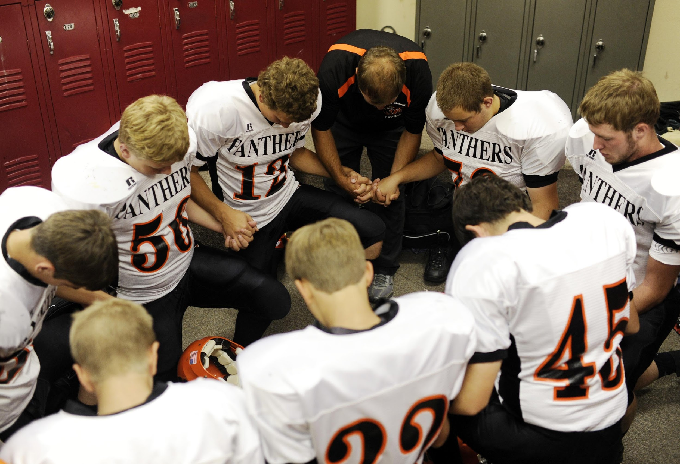
School Prayer
Notes:
One of the most controversial issues regarding the First Amendment's prohibition of the establishment of religion is prayer in public schools. Although students may pray on their own, school authorities may not sponsor or encourage prayer. Some schools violate the law, however.

Slide 22
The Establishment Clause (4 of 4)
Evolution
Creationism
Trying again with "intelligent design"
Public displays
Advancing religion versus legitimate historical purpose
Holiday decorations
Notes:
Fundamentalist and evangelical Christians have tried to oust the teaching of evolution from public school science classrooms and replace it with the religious doctrine of creationism. The Court has consistently overturned state laws requiring teachers to teach creationism or prohibiting the teaching of evolution.

Slide 23
The Free Exercise Clause
Belief versus practice
Not all practices protected
Cannot violate rights of others
Example case of the Amish
Discrimination in employment
Strict scrutiny
Compelling state interest
Narrowly tailored
Notes:
The free exercise clause pertains to the right of individuals to practice the religion of their choice. When religious practices violate societal norms and laws, the issue of free exercise comes before the courts. People have the right to believe whatever they want, but that doesn't give them the right to put their beliefs into practice if they violate certain laws or the rights of others. For example, the free exercise clause doesn't protect your right to kill someone if your religious beliefs dictate human sacrifice. But most issues before the Supreme Court are more subtle.

Slide 24
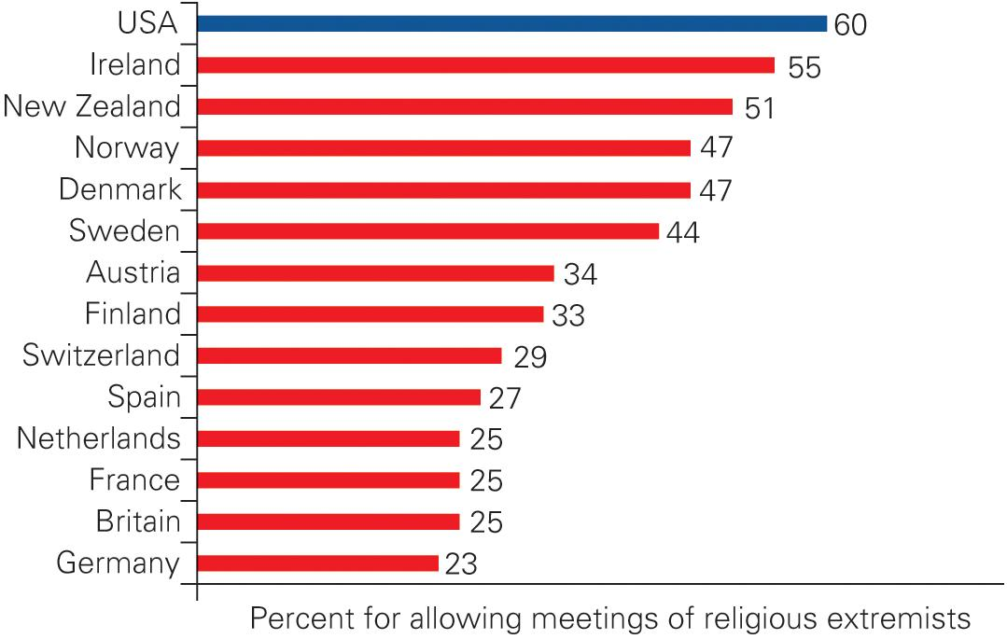
Figure 4.1 Tolerance for the Free Speech Rights of Religious Extremists
Source: Author’s analysis of 2008 International Social Survey Program data.
Notes:
Despite 9/11, Americans are more tolerant of the free speech rights of religious extremists than are people in other democracies with developed economies.
Survey Question: There are some people whose views are considered extreme by the majority. Consider religious extremists, that is, people who believe that their religion is the only true faith and all other religions should be considered enemies. Do you think such people should be allowed to hold public meetings to express their views?

Slide 25
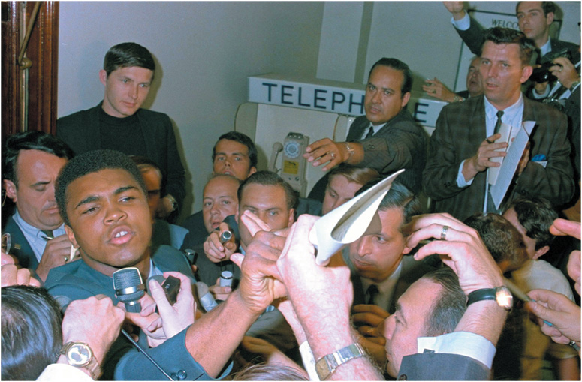
Mohammad Ali
Notes:
Cassius Clay was the world heavyweight boxing champion before he converted to Islam, changed his name to Muhammad Ali, and was drafted during the war in Vietnam. Arguing that he opposed war on religious grounds, he refused to join the army. The federal government prosecuted him for draft dodging, and he was stripped of his title. In 1971, the Supreme Court overturned his conviction for draft evasion. He is pictured here at the Houston induction center in 1967.

Slide 26
Learning Objective 4.3
Differentiate the rights of free expression protected by the First Amendment and determine the boundaries of those rights.

Slide 27
Freedom of Expression (1 of 2)
Prior Restraint
Free Speech and Public Order
Obscenity
Libel and Slander
Notes:
We've just learned that freedom of conscience in the United States is absolute. Americans can believe whatever they want, and are only limited in how they put their beliefs into practice. Just as freedom to practice one's beliefs is limited, so is the freedom to express them. Most forms of speech are permissible, but the Courts have defined certain forms of speech as exempt from Constitutional protection. To paraphrase Supreme Court Justice Oliver Wendell Holmes, you can't shout "fire" in a crowded theater.

Slide 28
Freedom of Expression (2 of 2)
Symbolic Speech
Free Press and Fair Trials
Commercial Speech
Regulation of the Public Airwaves
Campaign Spending

Slide 29
Prior Restraint
Near v. Minnesota (1931)
Unconstitutional censorship
Does not apply to students
Exception for national security
Notes:
Prior restraint is another term for censorship. Prior restraint occurs when a government forbids the publication of material in advance, rather than ruling on its legality afterward.

Slide 30
Free Speech and Public Order (1 of 2)
Schenck v. United States (1919)
Wartime trade-offs
"Clear and present danger" standard
Dangerous or merely inconvenient?
Anticommunism
Smith Act (1940) prosecutions
"Imminent lawless action" standard
Brandenburg v. Ohio (1969)
Notes:
The Supreme Court has been sympathetic to limits on free speech during wartime in the name of national security. Such limits are set for the sake of preserving public order and preventing people who are opposed to the war from hindering the war effort.
As we've discussed, the Court allowed the prosecution of people who were accused of being communists. In later years, as in the case of Brandenburg, the Court narrowed its interpretation, finding that it's permissible to advocate the violent overthrow of the government in the abstract as long as doing so does not incite anyone to "imminent lawless action."

Slide 31
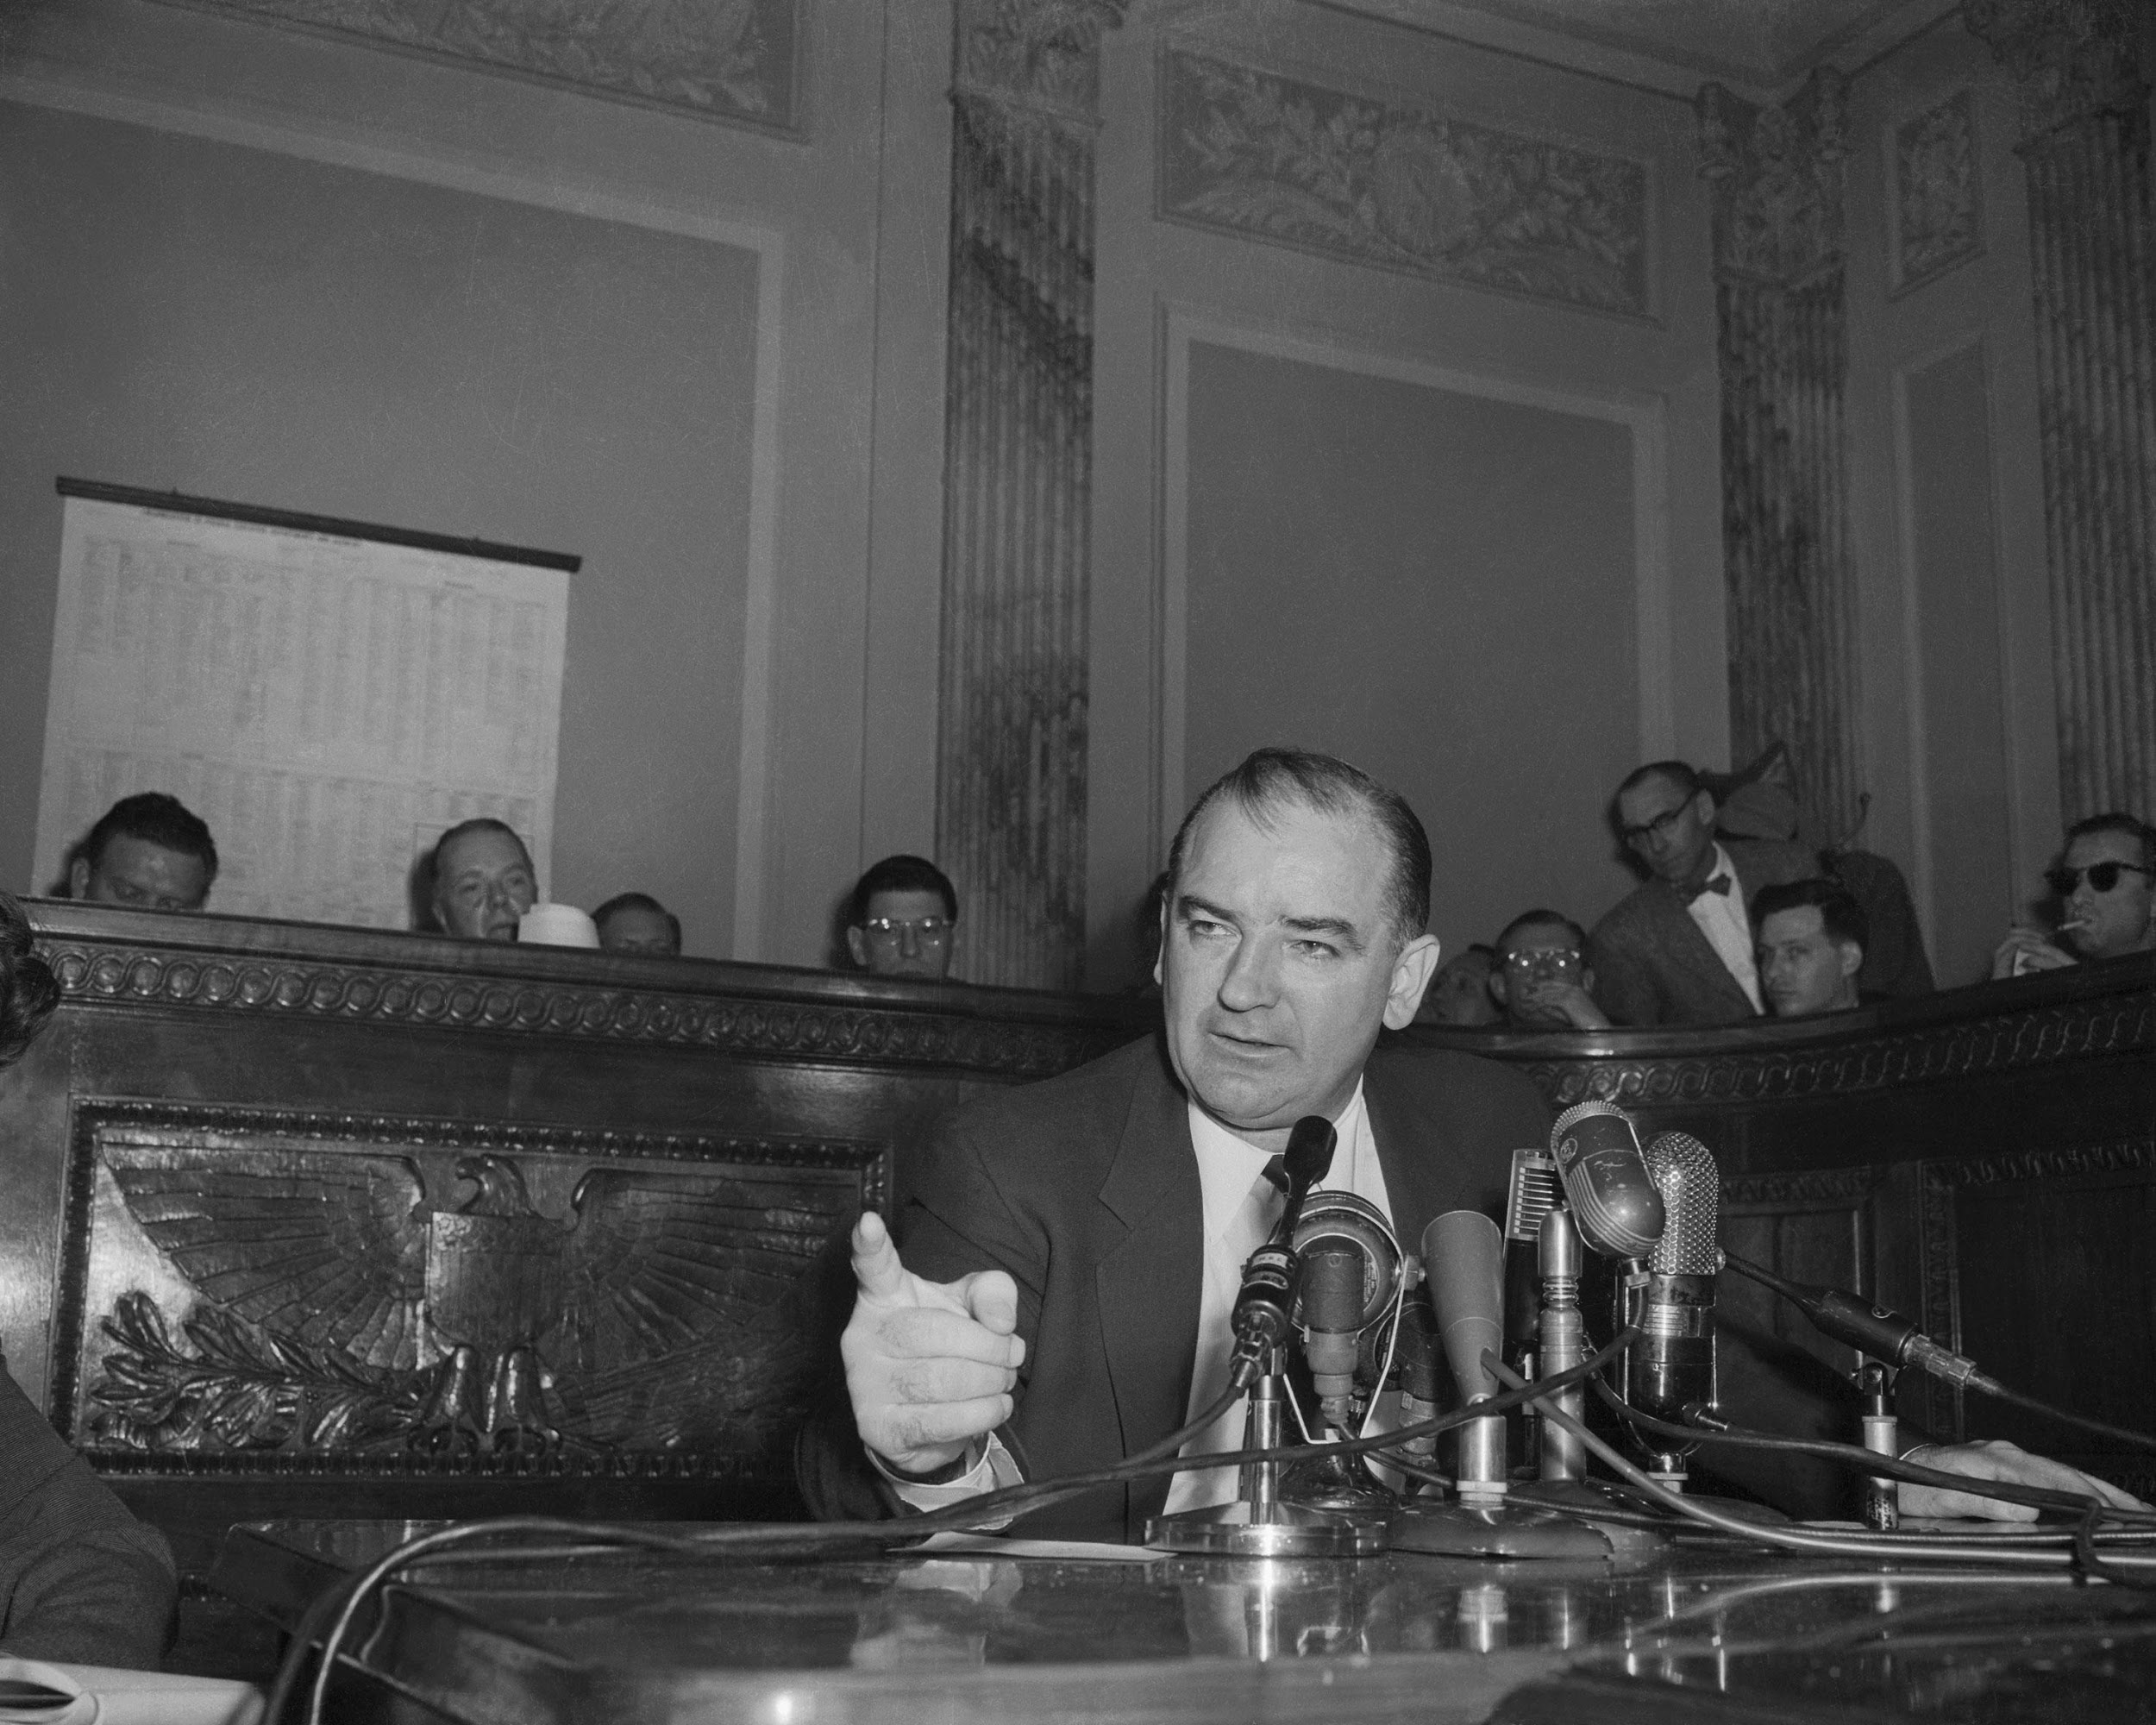
Senator Joseph McCarthy
Notes:
The prevailing political climate often determines what limits the government will place on free speech. During the early 1950s, Senator Joseph McCarthy's persuasive—if unproven—accusations that many public officials were communists created an atmosphere in which the courts placed restrictions on freedom of expression—restrictions that would be unacceptable today.

Slide 32
Obscenity
Roth v. United States (1957)
Obscenity not constitutionally protected
But what is obscene?
Miller v. California (1973)
Appeals to prurient interest
Patently offensive
Lacking serious literary or artistic value
Average people/local standards
Regulating adult content
Notes:
The Supreme Court ruled in Roth v. United States that obscenity is not constitutionally protected, but defining what is obscene has proven elusive. Standards vary from place to place and from time to time. A group of citizens couldn't look at the same book or movie or painting and agree on whether it was great art or obscenity.

Slide 33
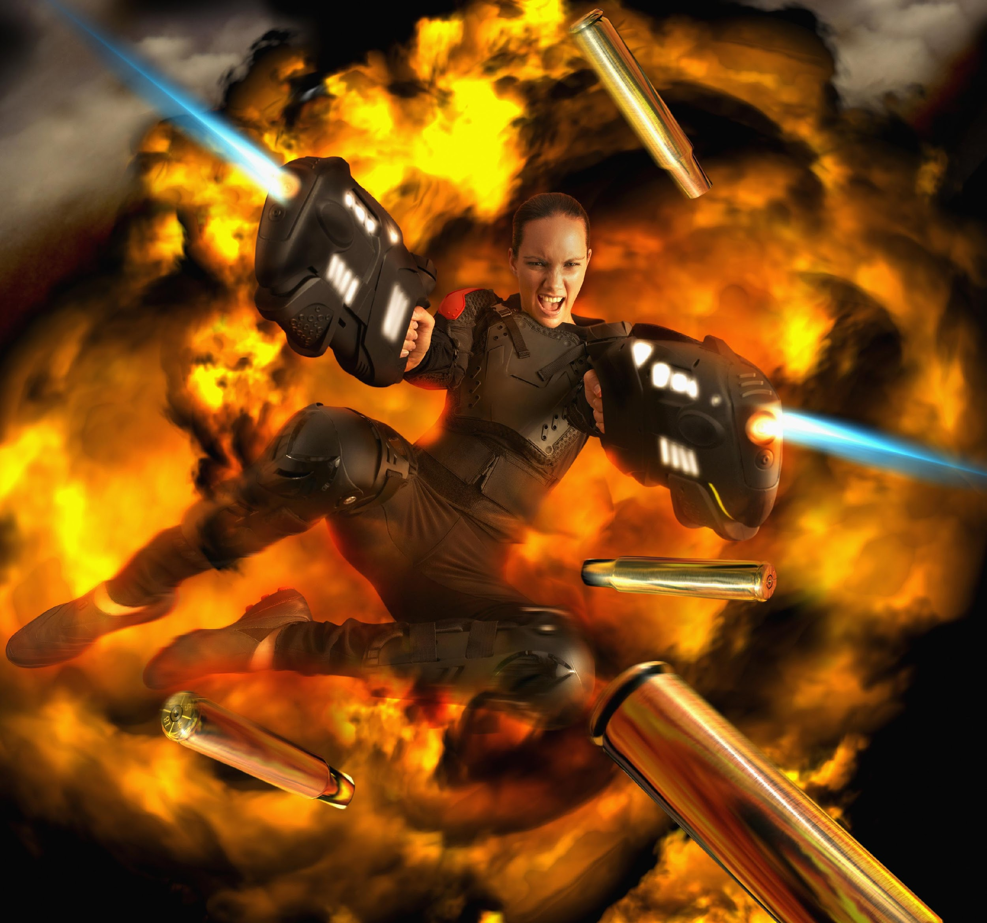
Violent Video Games
Notes:
Many people are concerned about the impact of violent video games on children. Although government can regulate depictions of some sexual material, it cannot regulate depictions of violence.

Slide 34
Libel and Slander
Defamation
Libel = written
Slander = spoken
Standards for conviction high
Public figures
New York Times v. Sullivan (1964)
Intentionally malicious
Private individuals
Defamatory falsehood
Negligence
Notes:
Malicious false statements that damage a person's reputation aren't protected speech. Written defamation is called libel. Spoken defamation is called slander. Both offenses can be prosecuted, but the standards for conviction are high.

Slide 35
Journal Prompt 4.3: Libel and Slander
Many people complain about dishonest politicians. Is it possible to require political figures to be truthful?

Slide 36
Symbolic Speech
Examples of symbolic speech
Wearing an armband
Burning the U.S. flag
Marching in a parade
Limitations
Burning draft cards
Threats
Notes:
Symbolic speech is action that expresses an opinion. The Supreme Court has ruled that symbolic speech is protected by the First Amendment in the same way as spoken or written speech. One famous decision in favor of symbolic speech included the Court's ruling that students had the right to wear black armbands to protest the Vietnam War. Other decisions ruled that state laws prohibiting flag burning are unconstitutional, and that organizers of a parade are free to exclude groups, such as gays and lesbians, from participating because a parade is a form of protected speech.

Slide 37
Free Press and Fair Trials
Can press coverage compromise the right to a fair trial?
Courts have not upheld restrictions
Trials are public
Sequestering juries
Zurcher v. Stanford Daily (1978)
Journalists cannot withhold evidence
Subject to search warrants
Notes:
Defendants in court cases sometimes argue that negative press coverage of their case threatens their right to a fair trial. And there's certainly evidence that the opinions of the public as to the guilt or innocence of the accused are shaped by the media. But the Court has been largely unsympathetic to these claims, preferring to keep information—and trials themselves—open to the public.

Slide 38
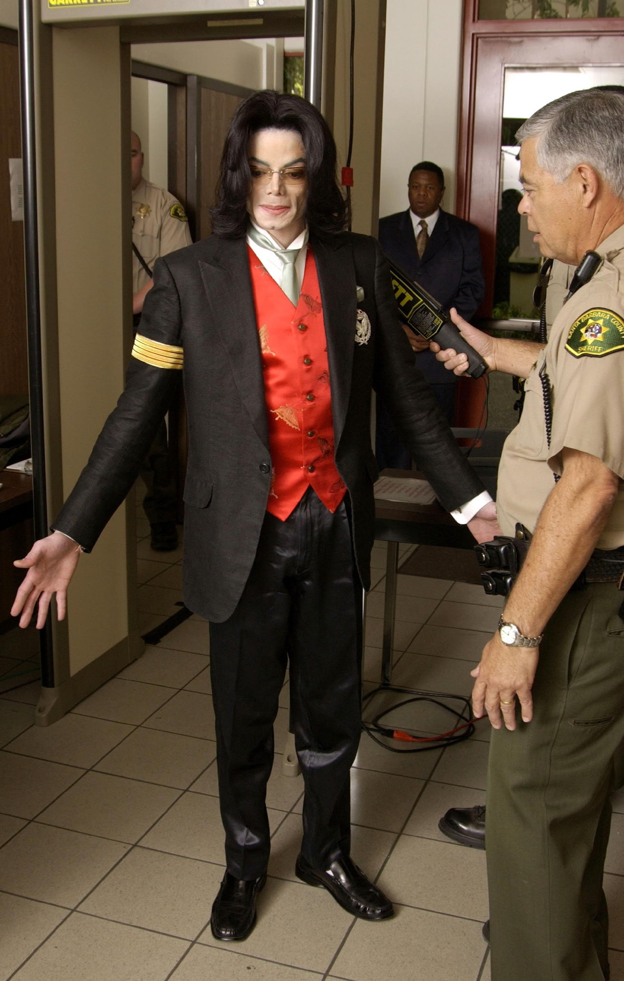
Michael Jackson
Notes:
The conflicting rights of free press and fair trials provide a dilemma for the courts. Here, Michael Jackson arrives in the Santa Barbara County courthouse in California for his trial on charges of molesting children. The trial received an enormous amount of press coverage, most of it critical of Jackson.

Slide 39
Commercial Speech and Regulation of the Public Airwaves
Advertising
Federal Trade Commission (FTC)
No false claims
Prohibitions on advertising legal services
Federal Communications Commission (FCC)
Licensing and regulations
Not applicable to cable and satellite
Notes:
Commercial speech, such as advertising, is regulated by the FTC. This agency decides what goods can be advertised where, and determines the limits of the content. Advertisers cannot make false claims about what their products can do, but they have leeway in what is implied by the advertisement. The courts have struck down state laws preventing advertising of goods and services such as casino gambling that are legal in the state.

Slide 40
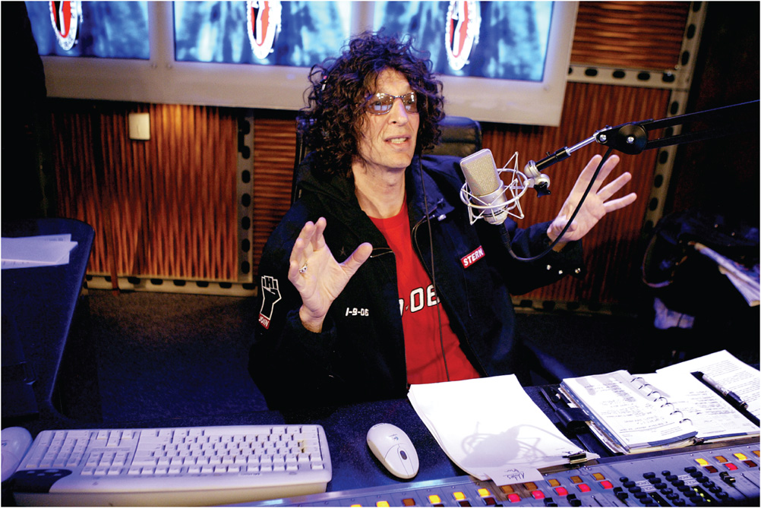
Howard Stern
Notes:
Although the Supreme Court ruled in Roth v. United States that obscenity is not protected by the First Amendment, determining just what is obscene has proven difficult. Popular radio personality Howard Stern pressed the limits of obscenity rules when he worked for radio stations using the public airwaves. Ultimately, he moved to satellite radio, where the rules are much less restrictive.

Slide 41
Campaign Spending
Election Campaign Act of 1971
Buckley v. Valeo (1976)
Spending money to influence elections is protected speech
McCain-Feingold Act (2002)
Banned soft money contributions
Banned certain advertising
Citizens United v. Federal Election Commission (2010)
Notes:
The limits of the use of money in political campaigns have been tested on free speech grounds. In 1971, Congress attempted to limit the influence of money by passing the Election Campaign Act which, among other things, limited campaign contributions to candidates. In 1976, in the case of Buckley v. Valeo, the Supreme Court invalidated parts of this law, arguing that spending money to influence elections is a form of protected speech.

Slide 42
Learning Objective 4.4
Describe the rights to assemble and associate protected by the First Amendment and their limitations.

Slide 43
Freedom of Assembly
Right to Assemble
Right to Associate
Notes:
Freedom to assemble is often overlooked. Freedoms of speech and of the press, not to mention religion, are usually debated more often. But freedom of assembly is the basis for forming interest groups, as well as exercising speech rights to petition the government and protest for redress of grievances.

Slide 44
Right to Assemble
The literal right to assemble
Time, place, and manner restrictions
Permits
Protest verging on harassment
Notes:
The First Amendment protects the literal right to assemble; to gather together as a group to make a statement. Because this freedom can conflict with other societal values the government is allowed to place reasonable limits, called time, place, and manner restrictions, on the freedom of assembly. It should also be noted that no group can simply hold a spontaneous demonstration anytime, anywhere, and in any way it chooses. Usually groups must apply to local city government for a permit and post a bond of a few hundred dollars as a security deposit.
Protests that verge on harassment tests the balance between freedom and order in American society. If a pro-life advocate protests outside and abortion clinic and seeks to shame or harass clients into staying away there is a conflict of rights; the protester’s freedom of assembly against the client’s right to obtain an abortion.

Slide 45
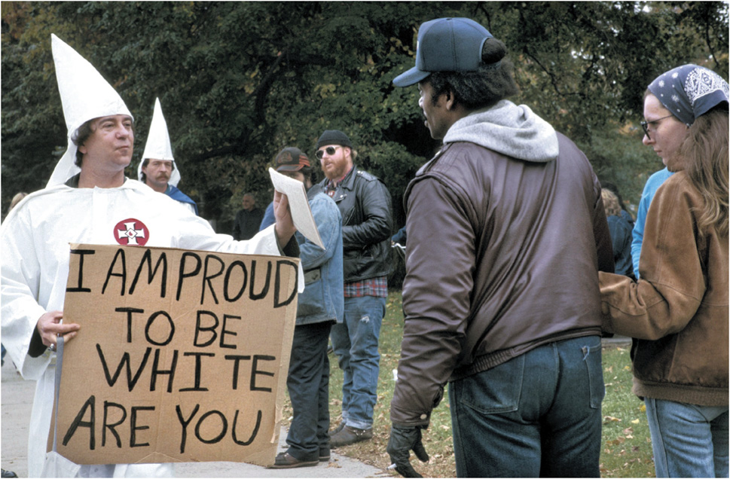
Ku Klux Klan
Notes:
White supremacists and people opposing them square off. The Supreme Court has generally upheld the right of any group, no matter how controversial or offensive, to peaceably assemble, as long as the group's demonstrations remain on public property.

Slide 46
Right to Associate
NAACP v. Alabama (1958)
Membership lists protected
Military recruiters
Public schools cannot prohibit them
Notes:
The right to associate with like-minded people is constitutionally protected. When a group is interested in political change, government is sometimes curious to get its hands on group membership lists. In 1958, the Court ruled that Alabama had no right to force the NAACP to turn over its membership list.

Slide 47
Learning Objective 4.5
Describe the right to bear arms protected by the Second Amendment and its limitations.

Slide 48
The Right to Bear Arms
Controversial right
Subject to national, state, and local restrictions
National Rifle Association (NRA)
State militias or individuals?
District of Columbia v. Heller (2008)
McDonald v. Chicago (2010)
Notes:
The Second Amendment right to bear arms is one of the most controversial constitutional rights. Opponents of gun control, represented by one of the most powerful interest groups, the NRA, argue that virtually every national, state, or local gun law is unconstitutional. Proponents argue that the Second Amendment is meant to apply to the right of states to create militias, not the right of individual citizens to arm themselves to the teeth.

Slide 49
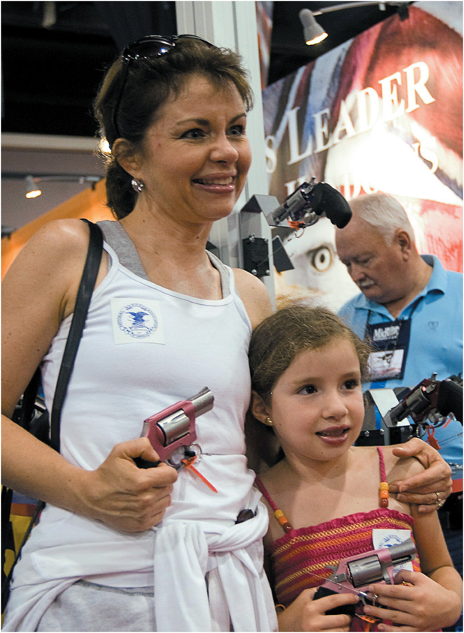
Meeting of the NRA
Notes:
This mother and daughter attending the annual meeting of the National Rifle Association are enjoying the right to bear arms. This right is not absolute, however.

Slide 50
Learning Objective 4.6
Characterize defendants’ rights and identify issues that arise in their implementation.

Slide 51
Defendants’ Rights
Searches and Seizures
Self-Incrimination
The Right to Counsel
Trials
Cruel and Unusual Punishment
Notes:
Persons accused of crimes in the United States enjoy a range of constitutional protections to prevent the abuse of government power. If you're accused of a crime, you're protected from unreasonable and unwarranted search and seizure of your person and property. Illegally obtained evidence can't be used against you, and you're not required to be a witness against yourself. You have the right to legal counsel to represent you, and the right to a speedy and public trial by a jury of your peers.

Slide 52
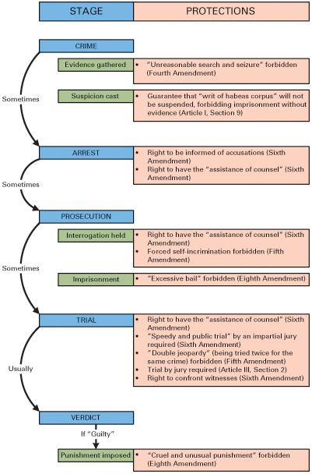
Figure 4.2 The Constitution and the Stages of the Criminal Justice System
Notes:
Although our criminal justice system is complex, it can be broken down into stages. The Constitution protects the rights of the accused at every stage.

Slide 53
Searches and Seizures
Fourth Amendment
Probable cause
Search warrants
Various cases, lots of exceptions
Exclusionary rule
Mapp v. Ohio (1961)
The war on terrorism
USA Patriot Act (2001)
Notes:
The Fourth Amendment provides protection against unreasonable searches and seizures. In practice, this means that the authorities must have a good reason to suspect a crime in order to ask a judge for a warrant to search a person or place. In practice, the circumstances of apprehending criminals have led to the Court upholding warrantless searches in various cases, and making lots of exceptions to the need for a warrant.

Slide 54
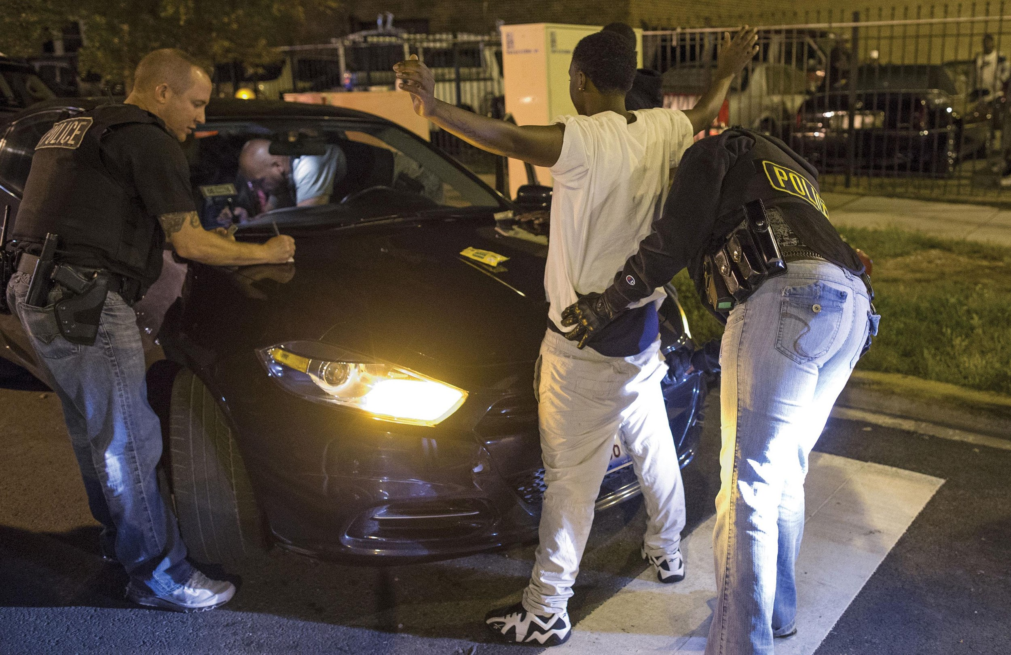
Chicago Police Search
Notes:
Determining the limits of the protection against unreasonable search and seizure has occupied the Supreme Court for decades. Here Chicago police officers search a vehicle and a woman.

Slide 55
Self-Incrimination
Fifth Amendment
Burden of proof on prosecution
Miranda v. Arizona (1966)
Right to remain silent
Knowledge that what you say can be used against you
Right to an attorney present during questioning
Right to have an attorney provided if you cannot afford one
Notes:
The Fifth Amendment protection against self-incrimination means that the burden of proof is on the prosecution. If you are accused of a crime, you cannot be compelled to testify against yourself, nor are you required to proclaim your innocence. You are innocent until the state proves that you're guilty, without your assistance in that endeavor.

Slide 56
Criminal Rights
Notes:
One of the most important principles of constitutional law is that defendants in criminal cases have rights. Probable cause and/or a search warrant are required for a legal search for and seizure of incriminating evidence. Here, as required by Miranda v. Arizona, police officers read a suspect his rights.

Slide 57
The Right to Counsel and Trials (1 of 2)
Sixth Amendment right to attorney
Gideon v. Wainwright (1963)
State must provide attorney for indigent
Habeas corpus
Not held without charge
Speedy and public trial by impartial jury
Notes:
The Sixth Amendment guarantees the right to counsel in federal courts. But most trials happen in state courts and most defendants cannot afford an attorney. It was not until 1932 that this right was incorporated, and the state required to pay for an attorney for the indigent, and then only for capital crimes. In 1963, in the famous case of Gideon v. Wainwright, the Supreme Court extended this right to anyone accused of a felony. Later rulings have extended it to almost any crime in which imprisonment could be imposed.

Slide 58
The Right to Counsel and Trials (2 of 2)
Plea bargaining
Jury size of 12 traditional
Conviction must be unanimous
Detentions and the war on terrorism
Notes:
Trials receive a lot of media coverage, and our image of the justice system is based on the adversarial process of a trial. But the reality is that fewer than 10% of criminal cases go to trial. That's because 90% of defendants plead guilty and engage in a process called plea bargaining. The defendant pleads guilty in exchange for a reduced sentence or lesser charges. Plea bargaining is a practical necessity; it saves the state time and money. Imagine if the 300,000 cases that go to trial ballooned to ten times that number. A speedy trial would be impossible and the cost of defending the accused would be too high.

Slide 59
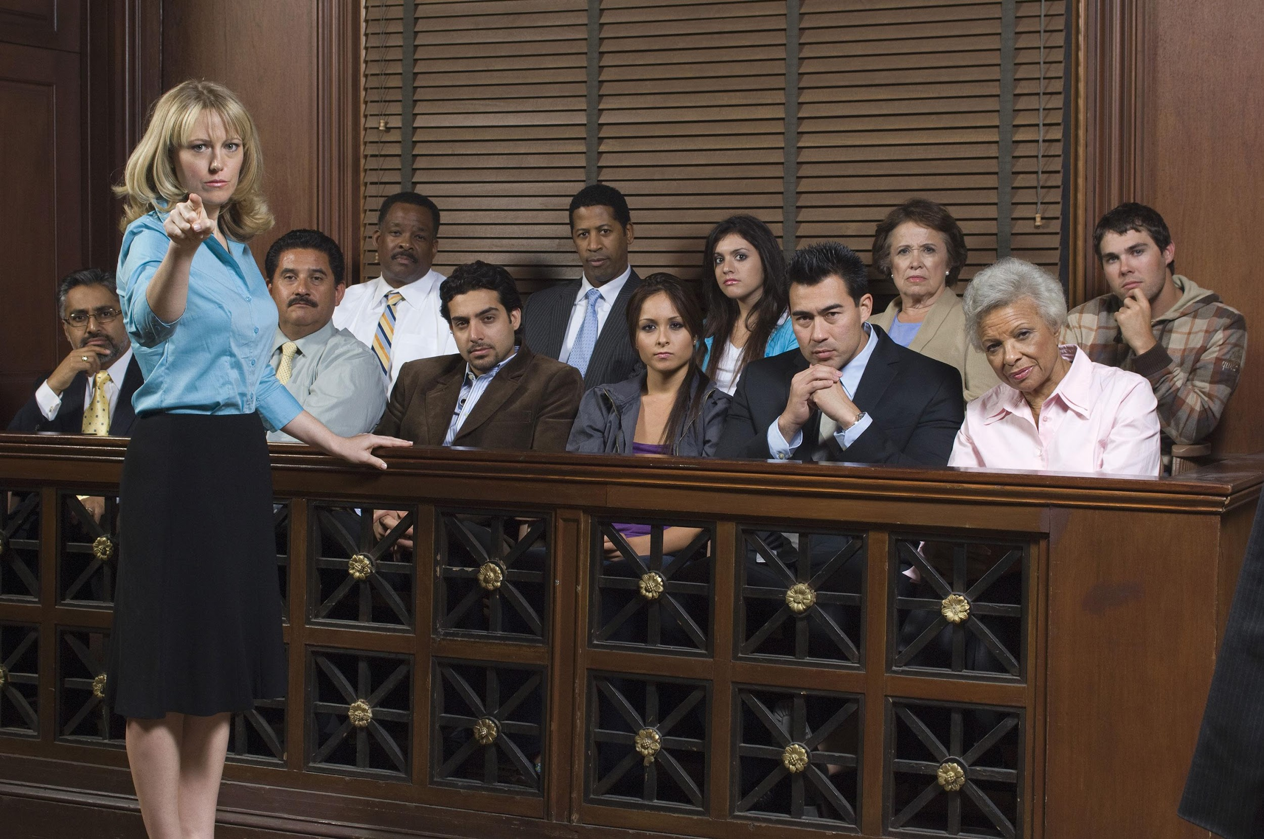
Fair Trials
Notes:
The right to a fair trial is central to our view of justice. Yet trials are relatively rare in the U.S. Most cases are decided through plea bargaining.

Slide 60
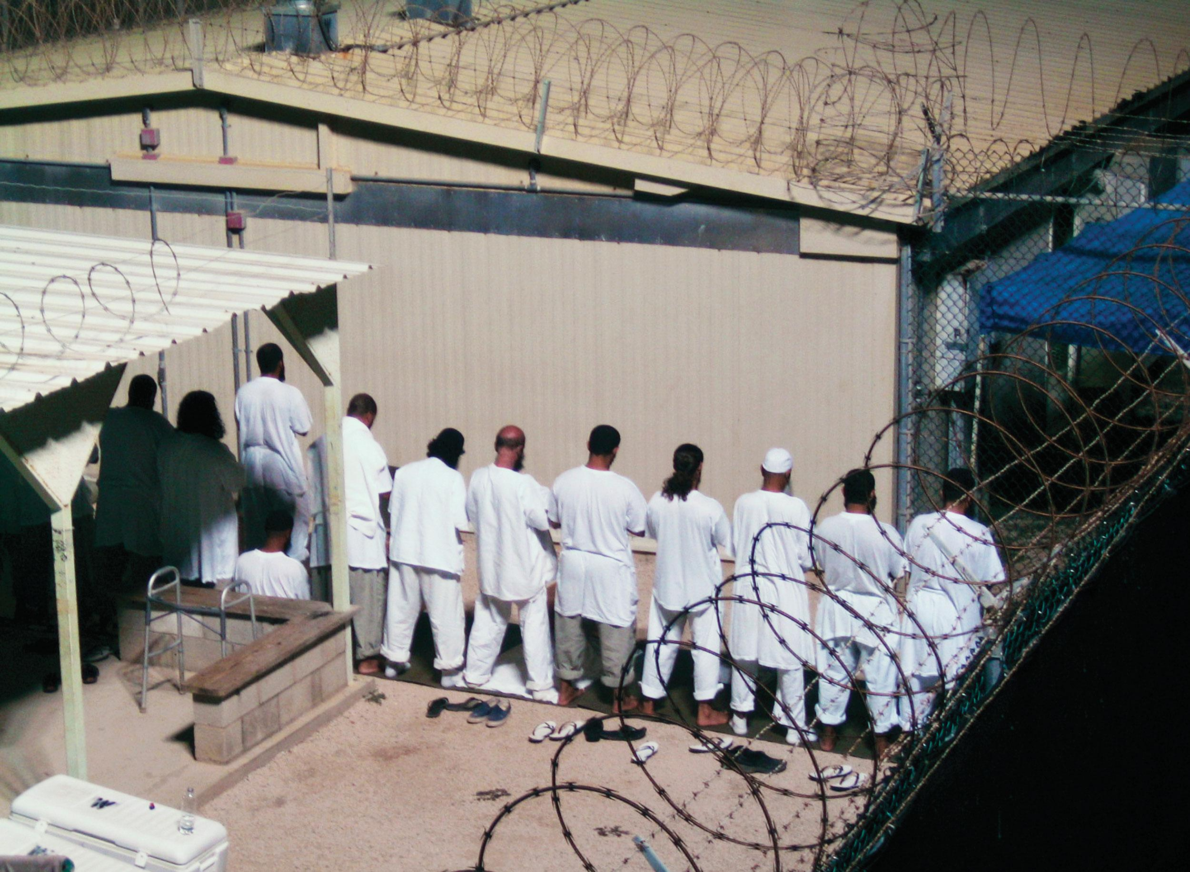
Guantanamo Bay Prisoners
Notes:
Prisoners held at the U.S. naval base at Guantánamo Bay, Cuba, present difficult issues of prisoners’ rights.

Slide 61
Cruel and Unusual Punishment
Eighth Amendment
Not defined
Incorporated in 1962
Prison overcrowding
Gregg v. Georgia (1976)
Death penalty not cruel and unusual
McCleskey v. Kemp (1987)
Notes:
The Constitution forbids cruel and unusual punishment, but it does not define it. It's up to the sensibilities of the age. The Supreme Court has ruled that overcrowded prison conditions can constitute cruel and unusual punishment, as is a sentence of life in prison for a juvenile offender. The Court has not ruled that the death penalty is in itself cruel and unusual punishment, but has upheld restrictions on its use, such as barring the execution of the mentally ill, the mentally retarded, and juveniles.

Slide 62
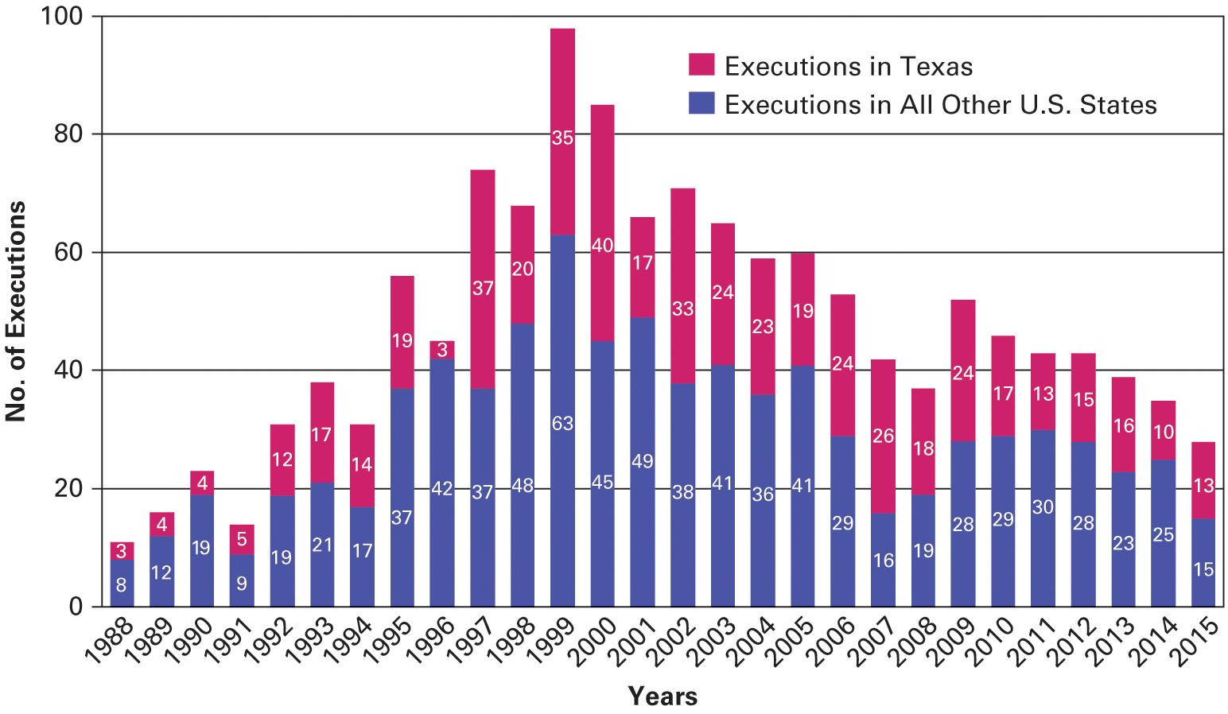
Figure 4.3 The Decline of Executions
Sources: Death Penalty Information Center; Texas Execution Information Center.
Notes:
Supreme Court decisions, new DNA technology, and perhaps a growing public concern about the fairness of the death penalty have resulted in a dramatic drop in the number of death sentences—from 98 in 1999 to 28 in 2015. Texas led the nation in executions, representing 46 percent of the national total in 2015. Texas prosecutors and juries are no more apt to seek and impose death sentences than those in other states that have the death penalty. however, once a death sentence is imposed there, prosecutors, the courts, the pardon board, and the governor are united in moving the process along.

Slide 63
Journal Prompt 4.6: Cruel and Unusual Punishment
Most convicted criminals negotiate a lighter sentence in their plea bargaining. Would it be possible to make criminals pay the full penalty for their crimes?

Slide 64
Learning Objective 4.7
Outline the evolution of a right to privacy and its application to the issue of abortion.

Slide 65
The Right to Privacy
Is There a Right to Privacy?
Controversy over Abortion
Notes:
The Framers of the Constitution were far-sighted in anticipating the needs of the growing republic, but they could not have imagined today's controversies concerning wiretapping, surrogate motherhood, abortion, or Internet pornography. These issues hinge on a supposed right to privacy that is inferred from other constitutional rights.

Slide 66
Is There a Right to Privacy?
How privacy is implied in Constitution
Religion: Right to exercise private beliefs
Search and seizure: Right to privacy in your home
Right to be left alone
Griswold v. Connecticut (1965)
Court states right to privacy implied
Notes:
The word "privacy" is never mentioned in the Constitution, but it is clearly implied by other rights. The right to freedom of religion implies a right to exercise private beliefs. The prohibition against unreasonable searches and seizures implies an expectation of privacy at home, as does the prohibition against seizing private property without due process. At its heart, privacy is the right to be left alone.

Slide 67
Controversy over Abortion
Roe v. Wade (1973)
Prohibits state bans on abortion
Balancing test
State interest in protecting women's health
State interest in protecting prenatal life
Planned Parenthood v. Casey (1992)
From "strict scrutiny" to "undue burden"
Notes:
One of the most famous and controversial cases in Supreme Court history concerns the application of the implied right to privacy to the issue of abortion. In 1973, in the case of Roe v. Wade, the Court ruled that the right to privacy protects a woman's decision to terminate a pregnancy but that this right is not absolute.
The Supreme Court found that the state has a legitimate interest in protecting women's health and prenatal life, so as a pregnancy progresses and the fetus becomes more viable, states can enact increasingly stringent restrictions on abortion.
Abortion is common; 22% of all pregnancies end in abortion, and more than a million abortions are performed each year. However, the procedure remains controversial and is always on the political agenda.
The Court's 1992 decision in Planned Parenthood v. Casey made it easier for states to place restrictions on abortion services by stating that such restrictions were unconstitutional only if they placed an "undue burden" on a woman seeking an abortion.

Slide 68
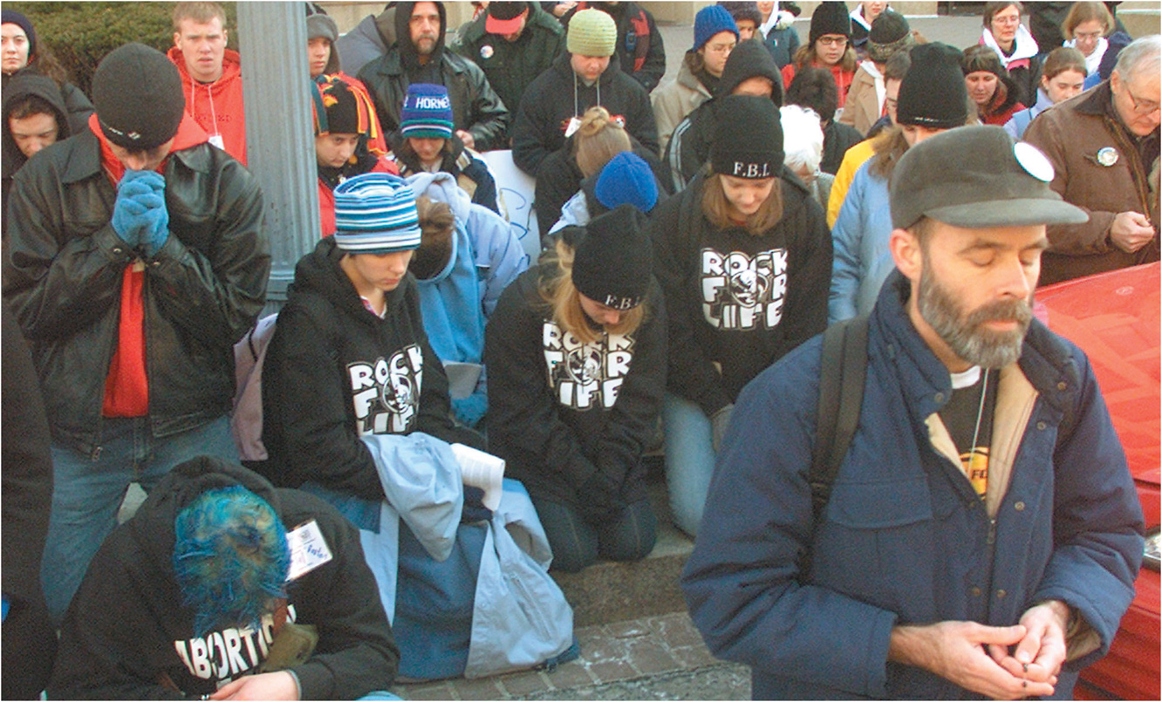
Undue Burden Protests
Notes:
Abortion is perhaps the nation's most divisive issue, raising strong emotions on both sides of the debate. Here pro-life activists pray across the street from the Washington, D.C., offices of Planned Parenthood, an organization that provides reproductive services, health care, and abortions to many low-income women.

Slide 69
Learning Objective 4.8
Assess how civil liberties affect democratic government and how they both limit and expand the scope of government.

Slide 70
Understanding Civil Liberties
Civil Liberties and Democracy
Civil Liberties and the Scope of Government
Notes:
The government of the United States is democratic, meaning that it's run by officials who are elected by the people and empowered by them to make decisions. These officials are accountable to the people through the democratic process.

Slide 71
Civil Liberties and Democracy
Democracy depends upon freedom of expression
Need information to make decisions
Majority rule versus minority rights
Elites have protected minorities
Notes:
First Amendment freedoms of speech, press, and assembly are essential to the functioning of a democratic regime. Without access to information, citizens cannot make intelligent decisions.

Slide 72
Civil Liberties and the Scope of Government
Liberty and individualism prevail
Cannot hide from vast government
Technology enables more intrusion
Irony that more government is needed to provide more protection
Notes:
The American cultural values of respect for liberty and individualism are displayed in the civil liberties protections in the Constitution.

Slide 73
Shared Writing 4
The right to privacy is not specifically mentioned in the Constitution. Would we enjoy the same degree of privacy protection if the Supreme Court had not held that the Constitution implies a right to privacy?

Slide 74
Photo Credits
Chapter 4
087: Brandi Simons/AP Images; 091: Hyoung Chang/The Denver Post/Getty Images; 094: AP Images; 098: Bettmann/Getty Images; 100: Colin Anderson/Blend Images/ Getty Images; 102: Joshua Gates Weisberg/Pool/ Getty Images; 104: Stringer/Getty Images Entertainment/ Getty Images; 106: Jean-Yves Rabeuf/The Image Works; 108: Robert Mankoff/The New Yorker Collection/The Cartoon Bank; 109: Chris Keane/Reuters; 112: Jim Young/ Reuters; 115: Terry J Alcorn/E+/Getty Images; 117: bikeriderlondon/Shutterstock; 119: Deborah Gembara/ Reuters; 123: Brendan McDermid/Reuters

