Slide 1
Government in America: People, Politics and Policy
Seventeenth Edition
Chapter 3
Federalism

Slide 2
Learning Objectives (1 of 2)
3.1 Define federalism and contrast it with alternative ways of organizing a nation.
3.2 Characterize the types of nations typically associated with federalism.
3.3 Outline the constitutional basis for the division of power between the national and state governments, the establishment of national supremacy, and states’ obligations to each other.

Slide 3
Learning Objectives (2 of 2)
3.4 Characterize the shift from dual to cooperative federalism and the role of fiscal federalism in intergovernmental relations today.
3.5 Explain the consequences of federalism for diversity in public policies among the states.
3.6 Assess the impact of federalism on democratic government and the scope of government.

Slide 4
Learning Objective 3.1
Define federalism and contrast it with alternative ways of organizing a nation.

Slide 5
Defining Federalism
What is federalism?
Unitary government
Power given to central government
Intergovernmental relations
Confederation
Weak national government and power given to states
Notes:
Federalism is a way of organizing a nation so that two or more levels of government have formal authority over the same area and people. If you are a citizen of Vermont, for example, you have to obey both Vermont state laws and federal laws. Both the state and federal governments receive their authority directly from the Constitution, not from each other.

Slide 6
Table 3.1 Authority Relations in Three Systems of Government
 | Unitary | Confederate | Federal
Central government | Holds primary authority Regulates activities of states | Limited powers to coordinate state activities | Shares power with states
State government | Few or no powers Duties regulated by central government | Sovereign Allocates some duties to central government | Shares power with central government
Citizens | Vote for central government officials | Vote for state government officials | Vote for both state and central government officials
Notes:
As we see in this table, the power relationship between the central government and subunits is different in unitary, confederate, and federal systems.

Slide 7
Learning Objective 3.2
Characterize the types of nations typically associated with federalism.

Slide 8
Why Federalism?
Very few countries use federalism
Large in size and/or population
Diversity
All federal systems are democracies
Not all democracies are federal systems
Notes:
There is considerable diversity among the countries that have federal systems. Large states both in terms of population and geography seem to favor the decentralized administration of governmental services provided by federalism. Ethnic diversity seems to play a role in the choice of federalism as well although many incredibly diverse states use unitary systems. All federal systems are democracies (with the qualification of Russia which is more authoritarian than democratic in recent years) but federalism is not a prerequisite for democratic government.

Slide 9
Table 3.2 Countries with Federal Systems (1 of 2)
Nation | Population | Area (in Thousands of square miles) | Diversity (Ethnic, Linguistic, and Religious) | Democracy
Argentina | 43,431,886 | 1, 068 | Low | Yes
Australia | 22,751,014 | 2968 | Low | Yes
Austria | 8,665,550 | 32 | Low | Yes
Brazil | 204, 259, 812 | 3,286 | Medium | Yes
Canada | 35, 099,836 | 3,852 | High | Yes
Germany | 80,854,408 | 138 | Low | Yes
India | 1,251,695,584 | 1,269 | High | Yes
Malaysia | 30,513,848 | 127 | High | Yes
Mexico | 121,736,809 | 762 | Low | Yes
Notes:
Why might a federal system be useful for a country with a large area or population or for a country with large ethnic minority groups? How might the United States be different if it had a unitary system rather than a federal system?

Slide 10
Table 3.2 Countries with Federal Systems (2 of 2)
Nation | Population | Area (in Thousands of square miles) | Diversity (Ethnic, Linguistic, and Religious) | Democracy
Switzerland | 8,121,830 | 16 | Medium | Yes
United States | 321, 368,864 | 3,718 | Medium | Yes
Source: Central Intelligence Agency, The World Factbook, 2016
Notes:
Why might a federal system be useful for a country with a large area or population or for a country with large ethnic minority groups? How might the United States be different if it had a unitary system rather than a federal system??

Slide 11
Learning Objective 3.3
Outline the constitutional basis for the division of power between national and state governments, the establishment of national supremacy, and states’ obligations to each other.

Slide 12
The Constitutional Basis of Federalism
The Division of Power
National Supremacy
States' Obligations to Each Other
Notes:
So, why did the Framers choose federalism as the system of government? Most citizens felt a strong loyalty to their states, more than they did toward a national government.

Slide 13
The Division of Power (1 of 2)
States retained many powers
Organize local governments and elections
Ratify constitutional amendments
Equal representation in Senate
Notes:
Even though the states could see that they needed a stronger central government, there were limits to the powers that they would concede. The Constitution did not need to specify all state powers; states simply retained all powers that were not expressly forbidden.

Slide 14
The Division of Power (2 of 2)
Federal obligations to states
Cannot divide states
Cannot tax interstate exports
Protect states against invasion
Overlapping responsibilities
Notes:
The federal government has certain obligations to the states. It cannot subdivide them nor tax interstate exports. It must protect them against invasion and violence.

Slide 15
Table 3.3 Some Powers Denied to States by the Constitution
Economic | Individual Rights | Foreign Affairs
Tax imports or exports | Grant titles of nobility | Enter into treaties
Coin money or issue paper money | Pass bills of attainder | Declare war
Impair the obligations of contracts | Pass ex post facto laws | Raise or maintain military forces
 | Abridge citizens’ privileges and immunities
 | Deny due process of law
 | Deny equal protection of law
 | Impose poll taxes
 | Deny right to vote because of race, gender, or age
Notes:
State constitutions guarantee many basic rights. However, few Americans would feel comfortable with only state protections for their liberties. The Bill of Rights in the U.S. Constitution is the ultimate legal defense of freedom.

Slide 16
National Supremacy (1 of 3)
Which level should do what?
Debates over areas of policy responsibility
Supremacy clause
The Civil War
The struggle for racial equality
The Tenth Amendment
The Eleventh Amendment
Notes:
Although the division of power may sound clear enough at first, American history has been a tug-of-war over which level of government should legislate in various policy areas.

Slide 17
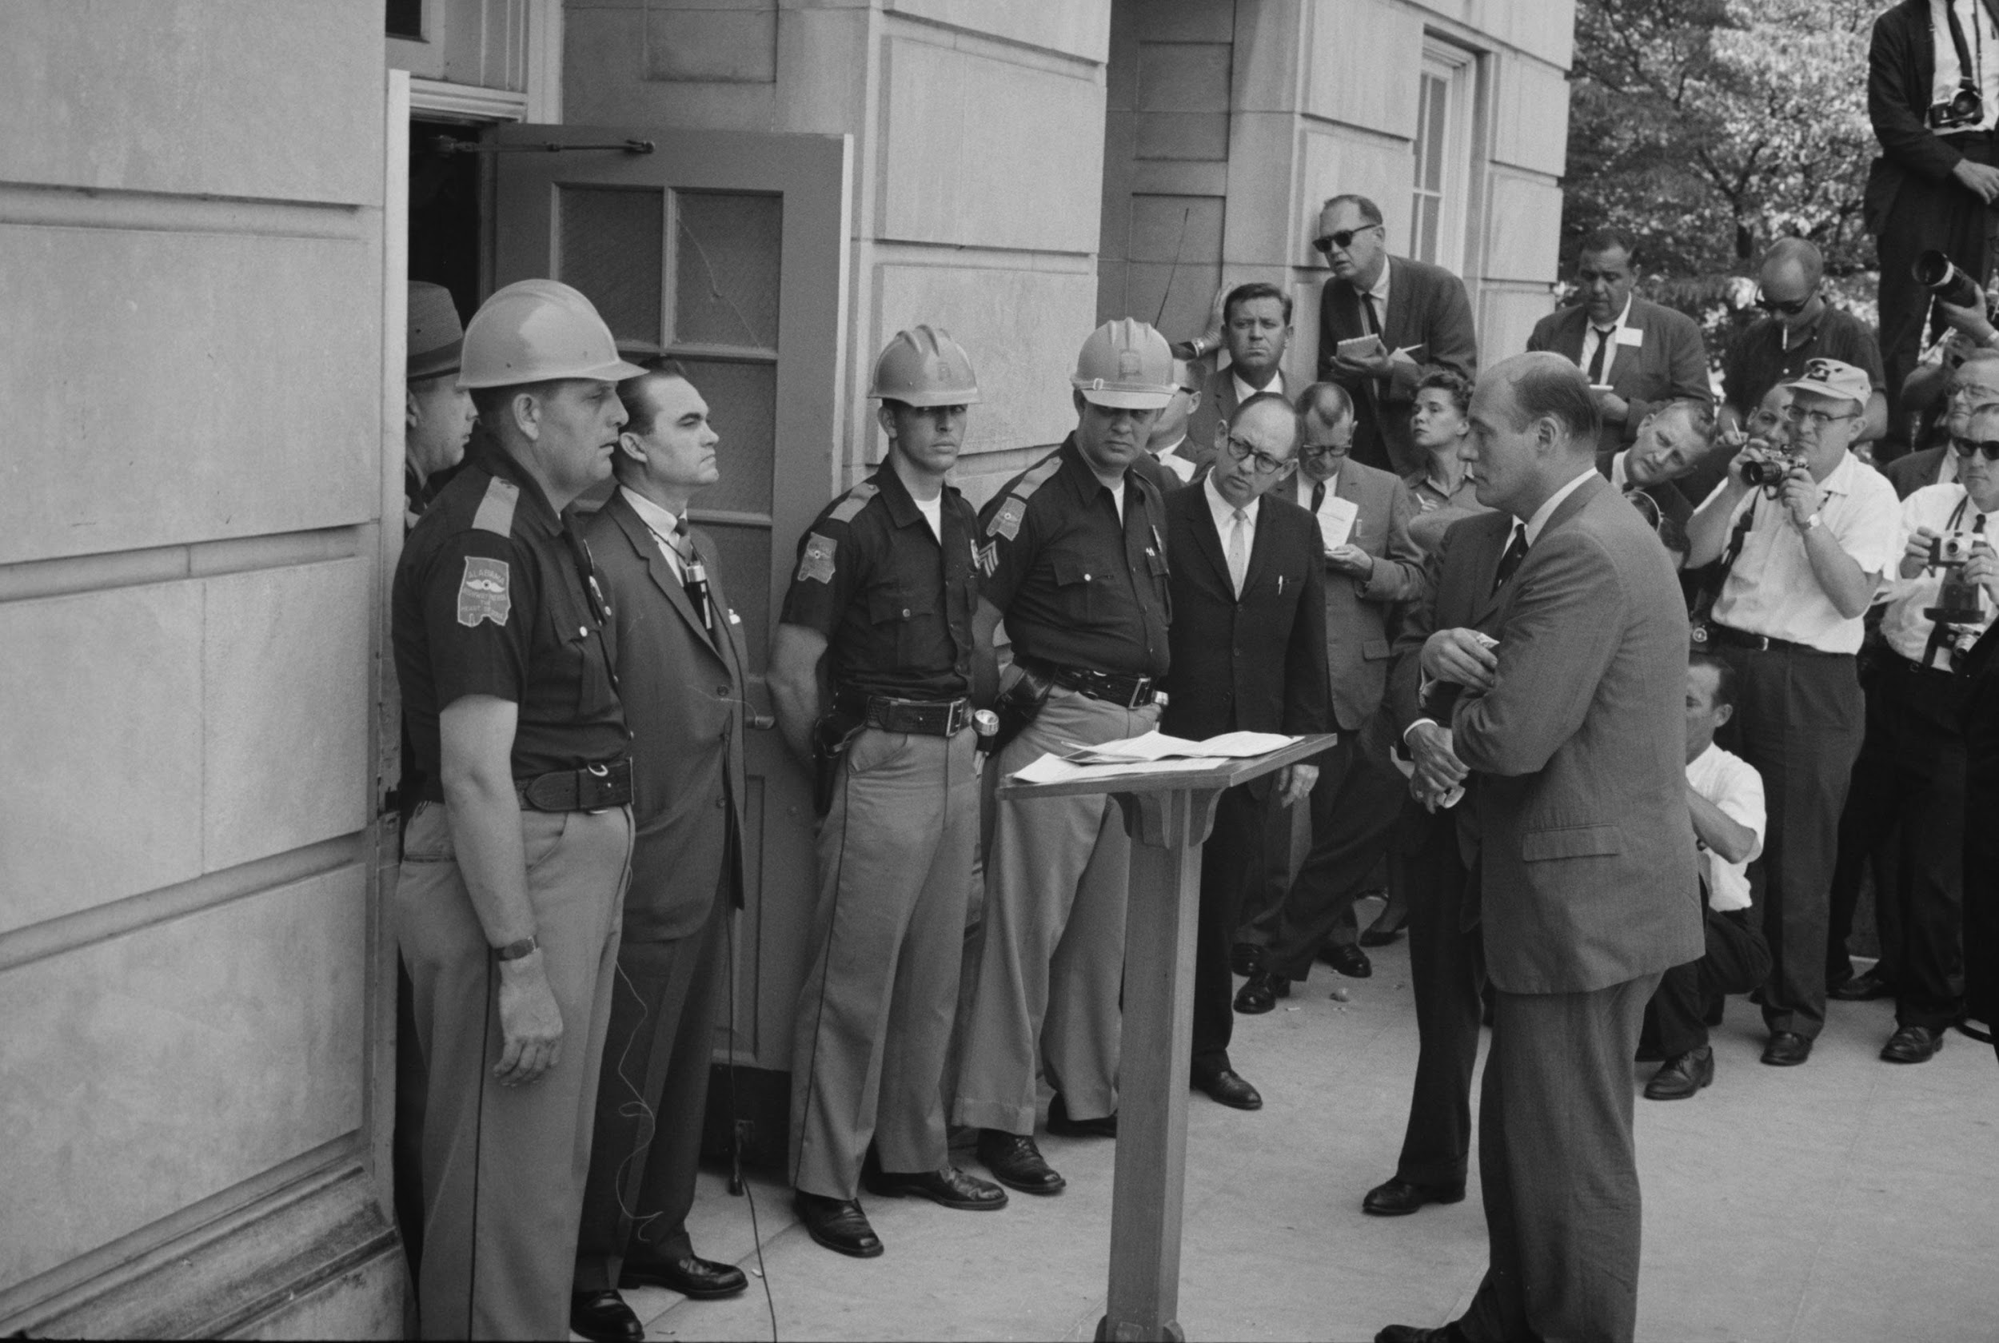
Wallace and Segregation
Notes:
In 1963, Alabama Governor George Wallace made a dramatic stand at the University of Alabama to resist integration of the all-white school. Federal marshals won this confrontation, and since then the federal government in general has been able to impose national standards of equal opportunity on the states.

Slide 18
National Supremacy (2 of 3)
Implied powers
McCulloch v. Maryland (1819)
Enumerated powers
Implied powers
Elastic clause
Notes:
Some of the powers of the national government are clearly enumerated in the Constitution. Other powers are implied from the so-called elastic clause. This clause authorizes Congress to make all laws that are "necessary and proper" to carry out its enumerated functions.

Slide 19
Supremacy Clause and Immigration
Notes:
The supremacy clause allows the national government to preempt state laws if it is acting within its legal sphere. Immigration policy is one example. In this photograph, undocumented immigrants are being repatriated to their home country by U.S. Immigration and Customs
Enforcement, a federal agency.

Slide 20
National Supremacy (3 of 3)
Commerce power
Gibbons v. Ogden (1824)
Promote economic development
Regulate the economy
Expansion then retraction
Notes:
Although the Constitution gives Congress the power to regulate commerce, American courts have struggled to define "commerce." The Court's opinion in Gibbons v. Ogden defined commerce so broadly as to encompass virtually any commercial activity. After the Industrial Revolution when Congress sought to use its commerce powers to regulate worker health and safety, the Court said that the power to regulate interstate commerce did not extend so far. When the Great Depression placed new demands on the national government, the Court reluctantly allowed considerable expansion of Congress's regulatory power.

Slide 21
States’ Obligations to Each Other (1 of 2)
Full faith and credit
Extradition
Privileges and immunities
Notes:
The Constitution requires states to return a person charged with a crime in another state to that state for trial or imprisonment, a practice called extradition.

Slide 22
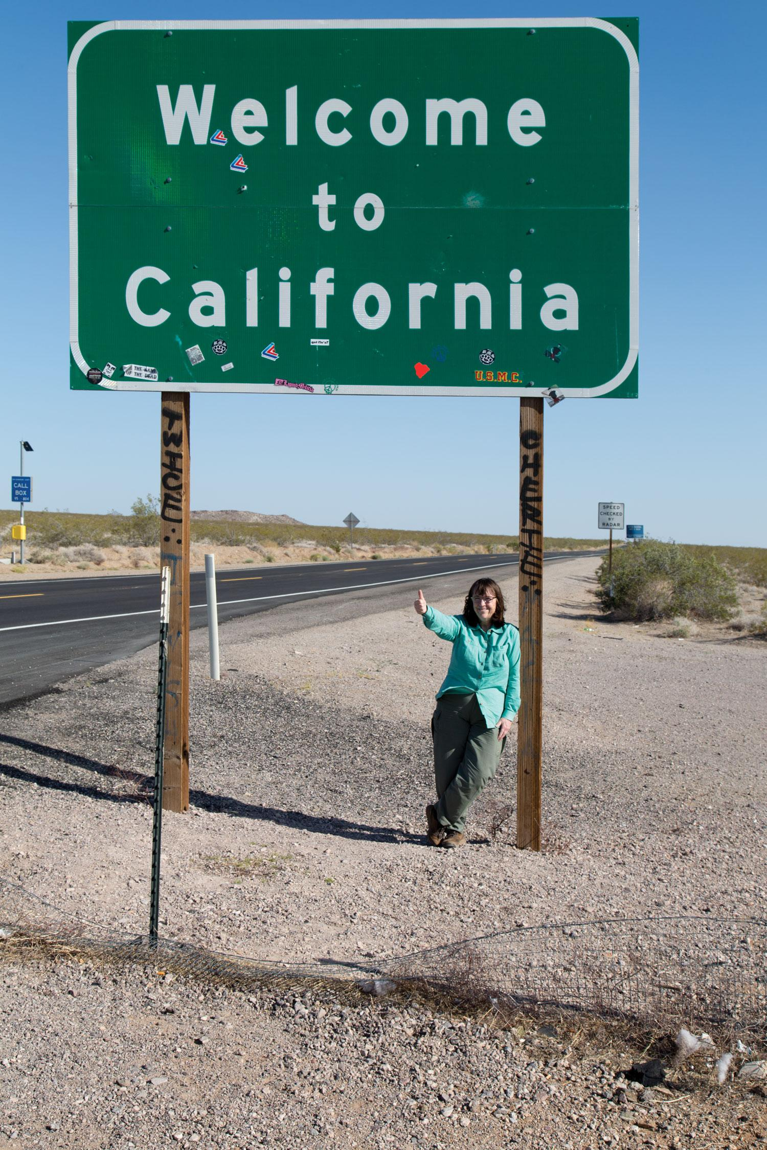
States’ Obligations to Each Other (2 of 2)
Notes:
Because of the full faith and credit clause of the Constitution, drivers’ licenses issued by one state are valid in every state. People are also entitled to most of the benefits—and subject to most of the obligations—of citizenship in any state they visit, thanks to the privileges and immunities clause.

Slide 23
Journal Prompt 3.3: Protecting Rights
Basic rights are at the core of American government. What would be the consequences if we had to rely on states to protect our rights?

Slide 24
Learning Objective 3.4
Characterize the shift from dual to cooperative federalism and the role of fiscal federalism in intergovernmental relations today.

Slide 25
Intergovernmental Relations
From Dual to Cooperative Federalism
Devolution?
Fiscal Federalism
Notes:
Over the years, power has gradually shifted from states to the federal government. Through categorical and block grants, the federal government provides state and local governments with substantial portions of their budget. It uses this leverage to influence policy by attaching conditions to receiving the grants.

Slide 26
From Dual to Cooperative Federalism (1 of 2)
Dual federalism
Separate spheres of authority
Layer cake
Interpret federal power narrowly
Cooperative federalism
Shared costs
Federal guidelines
Shared administration
Notes:
In dual federalism, the federal government and the states each have spheres of sovereign authority, like a layer cake. Proponents are inclined to interpret federal power narrowly.

Slide 27
From Dual to Cooperative Federalism (2 of 2)
Cooperative federalism in action
Schools
Highways and state alcohol laws
Notes:
States are responsible for most public policies dealing with social, family, and moral issues. The Constitution does not give the national government the power to pass laws that directly regulate drinking ages, for example, but it can influence the states by making federal money contingent on adopting certain policies, such as raising the state drinking age to 21, in line with national prerogatives.

Slide 28
Interstate Highways
Notes:
Cooperative federalism began during the Great Depression of the 1930s and continues into the twenty-first century. The federal government provides much of the funding for interstate highways, for example, but also attaches requirements that states must meet.

Slide 29
Devolution?
Party divide on federalism
Democrats favor national government
Republicans favor states
Devolution since Reagan
Loosening federal regulations
1994 Congress
Harnessing federal government power
Notes:
In simplistic terms, the Democratic party tends to favor federal government power to advance national policies of health, safety, and social welfare. By contrast, the Republican party has traditionally favored a weaker national government to allow states to handle these responsibilities without government regulations.

Slide 30
Fiscal Federalism (1 of 2)
The grant system
Categorical grants
Specific purpose
Crossover sanctions
Crosscutting requirements
Project grants
Formula grants
Notes:
Fiscal federalism is the term used to describe federal grants-in-aid that are a key part of cooperative federalism. There are two main types of federal grants. Categorical grants can only be used for specific purposes, and they often have strings attached, such as nondiscrimination provisions.

Slide 31
Fiscal Federalism (2 of 2)
The grant system
Block grants
Categorical grants
The scramble for federal dollars
The mandate blues
Notes:
Block grants are much less restrictive and generally only specify the policy area in which they are to be used, such as education or health care. States prefer block grants because they give them more discretion in how to allocate the funds.
Categorical grants must be used for a specific purposes, or categories of spending.

Slide 32
Policy Impact
Notes:
Policies of the federal government may have major impacts on core policies of state and local governments, like elementary and secondary education, and determine how much is spent on these policies.

Slide 33
Journal Prompt 3.4: Fiscal Federalism
What would be the consequence of the national government balancing its budget by cutting grants to state and local governments and asking these governments to pay their own way?

Slide 34
Learning Objective 3.5
Explain the consequences of federalism for diversity in public policies among the states.

Slide 35
Diversity in Policy
Diversity in public opinion reflected
Policy innovation facilitated
Diversity has its downside
Notes:
Federalism allows for considerable diversity among the states in their policies. One state can have the death penalty if its citizens favor it, and another state can abolish it if its citizens take a different view.

Slide 36
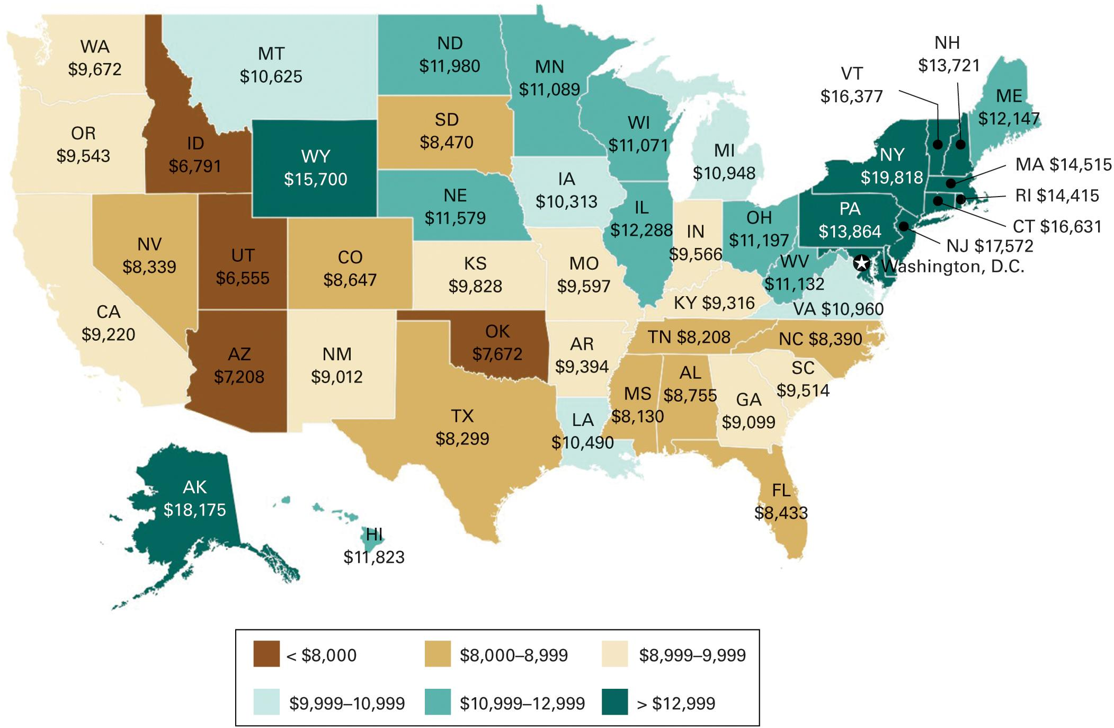
Figure 3.2 State and Local Spending on Public Education
Source: U.S. Department of Commerce, United States Census Bureau, Public Education Finances: 2013. The data are for 2013.
Notes:
A downside of the public policy diversity fostered by federalism is that the resources for public services vary widely from state to state. This map shows the great variation among the states in the money spent on children in the public schools. Can we say there is equal opportunity in the United States when the quality of education varies so much between states?

Slide 37
Learning Objective 3.6
Assess the impact of federalism on democratic government and the scope of government.

Slide 38
Federalism and Democracy (1 of 2)
Contributions to democracy
Decentralizes politics
Disputes resolved at lower levels of government
Majorities can be heard at state level
More opportunities for participation
Losing elections less painful
Notes:
The federal system was designed by the Framers in part to avoid tyranny of the majority. In addition, it has contributed to democracy in several ways.

Slide 39
Federalism and Democracy (2 of 2)
Detriments to democracy
Electoral College
Thwarting national majorities
Notes:
The detriment of the Electoral College is illustrated by the Hillary Clinton’s failure to win the presidency in spite of winning the popular vote by more than a 2 percent margin.

Slide 40
Table 3.4 The Number of Governments in America
Government Levels | Number of Governments
U.S. Government | 1
States | 50
Counties | 3,031
Municipalities | 19,519
Townships or towns | 16,360
School districts | 12,880
Special districts | 38,266
Total | 89,055
Source: U.S. Department of Commerce, U.S. Census Bureau, Census of Governments, 2014.
Notes:
The sheer number of separate governments in America is staggering.

Slide 41
Federalism and the Scope of the National Government
Why national government grew
Economic intervention
Industrialization
Quotas
Subsidies
Preventing monopolies
Occupational health and safety
Urbanization
Housing
Social welfare
Notes:
The federal government has always been involved in economic regulation but economic policies increased exponentially after industrialization. The federal government, for example, has instituted quotas on foreign imports of automobiles and steel to protect U.S. industries from competition. They have also subsidized faltering industries, such as airlines and railroads. It has passed laws to prevent monopolies and protect the health and safety of workers. The urbanization that accompanied industrialization created social and economic problems that were also addressed through policies at the federal level, such as welfare, environment, and transportation.

Slide 42
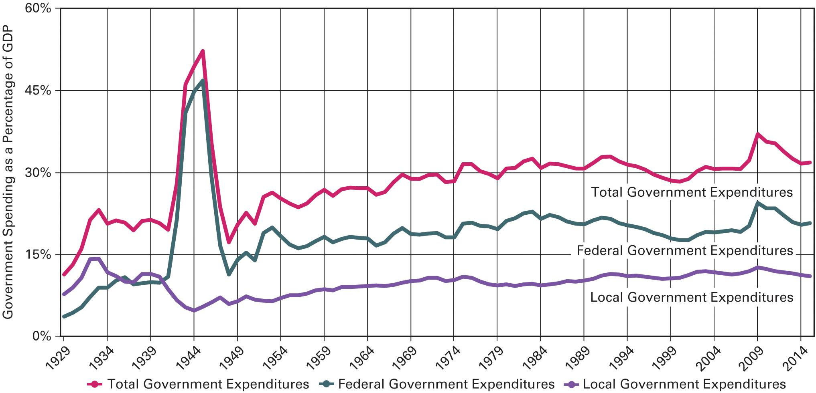
Figure 3.3 Fiscal Federalism: The Size of the Public Sector
Source: Office of Management and Budget, Budget of United States Government, Fiscal Year 2017: Historical Tables (Washington, DC: US Government Printing Office), 2016, Table 14.3.
Notes:
The federal government’s spending as a percentage of GDP has increased steadily since the end of World War II. Recent decades have not seen much increase in spending as a percentage of GDP on the part of either the federal government or state governments. In 2009, however, federal spending increased substantially in response to the economic crisis.

Slide 43
Shared Writing 3
Should the national government devolve responsibility for health care, environmental protection, and other major policy areas to the states?

Slide 44
Photo Credits
Chapter 3
063: Library of Congress Prints and Photographs Division [LC-DIG-ppmsca-04294]; 066: John Moore/Getty Images News/Getty Images; 067: Library of Congress Prints and Photographs Division [LC-DIG-highsm-20973]; 070: © chungking/Fotolia; 074: A 1949 Herblock Cartoon, © The Herb Block Foundation; 076: AntonioDiaz/Fotolia

