Slide 1
Government in America: People, Politics and Policy
Seventeenth Edition
Chapter 1
Introducing Government In America

Slide 2
Learning Objectives
1.1 Identify the key functions of government and explain why they matter.
1.2 Define politics in the context of democratic government.
1.3 Assess how citizens can have an impact on public policy and how policies can impact people.
1.4 Identify the key principles of democracy and outline theories regarding how it works in practice and the challenges democracy faces today.
1.5 Outline the central arguments of the debate in America over the proper scope of government.

Slide 3
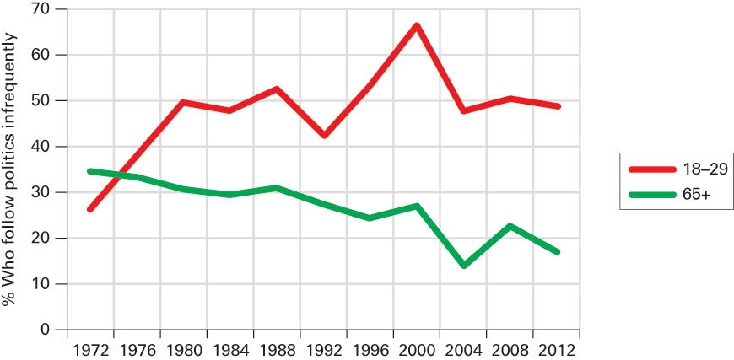
Figure 1.1 Political Apathy Among Young and Old Americans 1972–2012
Source: Authors’ analysis of 1972 and 2012 National Election Studies data.
Notes:
In every presidential election from 1972 to 2012, the American National Election Studies has asked a cross-section of the public how often they follow what’s going on in government and public affairs. Below we have graphed the percentage who said they followed politics on an infrequent basis. Lack of political interest among young people hit a record high during the 2000 campaign between Bush and Gore, when over two-thirds said they rarely followed public affairs. Since then, political interest among young people has recovered somewhat; however, compared to senior citizens, they are still much more likely to report low political interest.

Slide 4
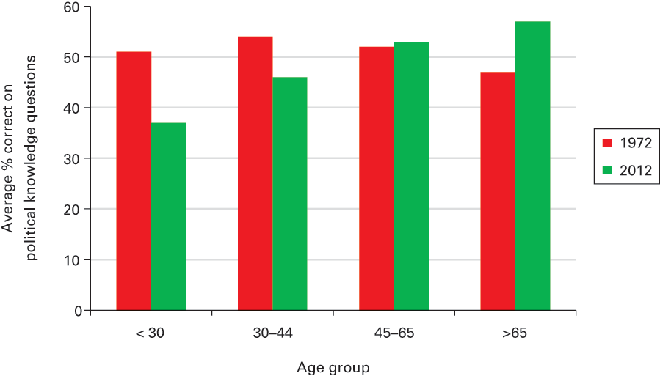
Figure 1.2 Age and Political Knowledge, 1972 and 2012
Source: Authors’ analysis of 1972 and 2012 National Election Studies data.
Notes:
This figure shows the percentage of correct answers to five questions in 1972 and twelve questions in 2012 by age group. In 1972, the relationship between age and political knowledge was basically flat: each age group displayed roughly the same level of information about basic political facts, such as which party currently had more seats in the House of Representatives. By 2012, the picture had changed quite dramatically, with young people being substantially less likely to know the answer to such questions than older people.

Slide 5
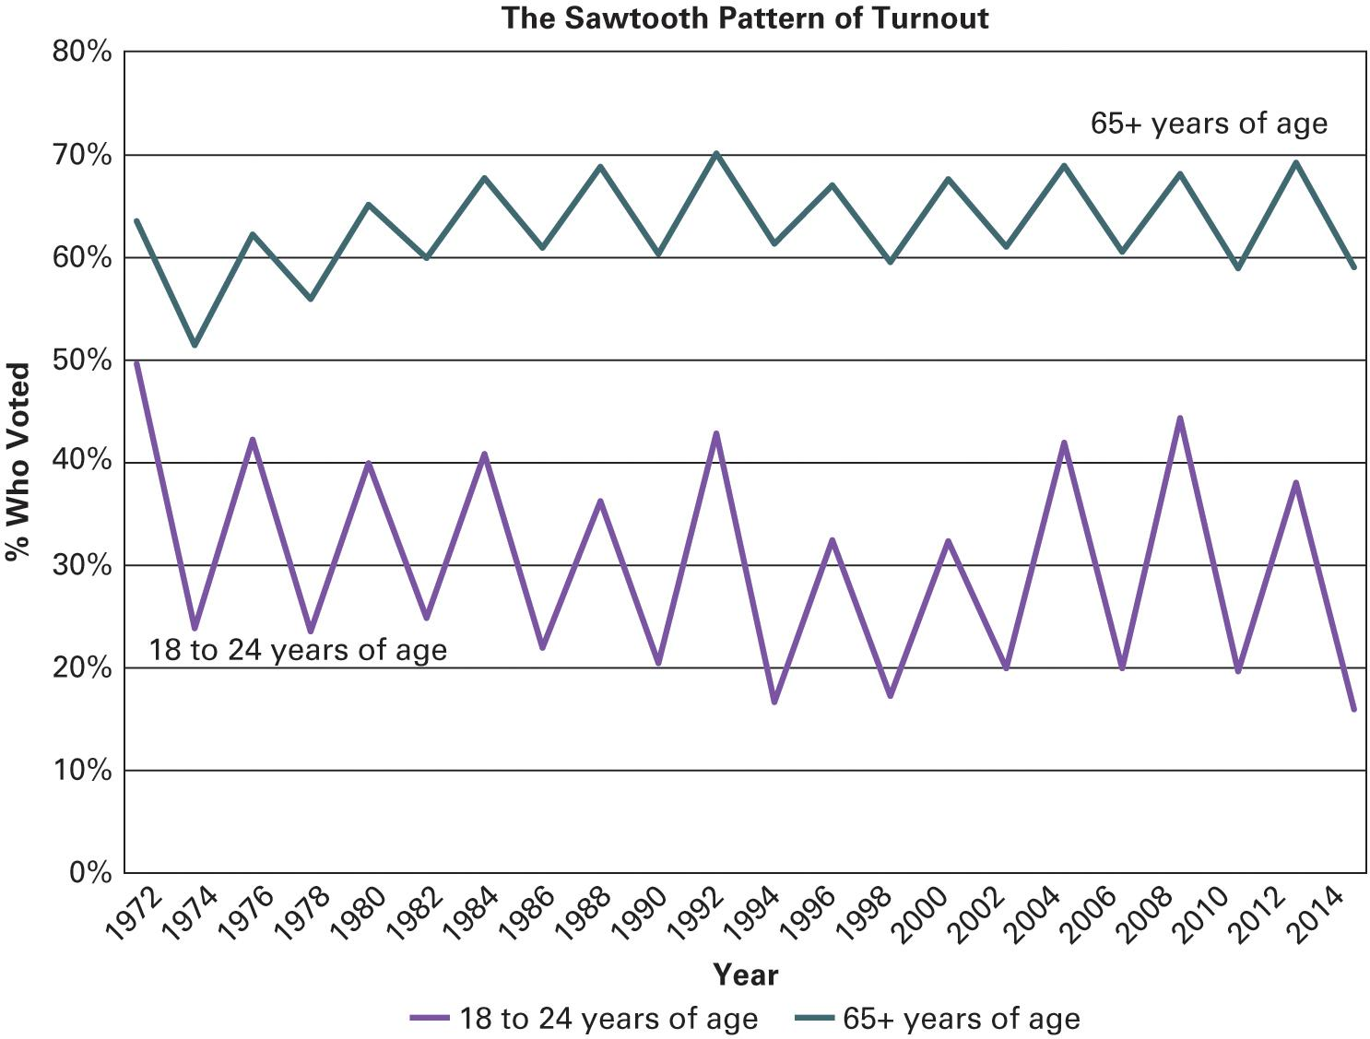
Figure 1.3 Election Turnout Rates of Young and Old Americans 1972–2014
Source: U.S Census Bureau Current Population Surveys
Notes:
This graph shows the turnout gap between young and old Americans in all presidential and midterm elections from 1972 through 2014. The sawtooth pattern of both lines illustrates how turnout always drops off between a presidential election and a midterm congressional election (e.g., from 2012 to 2014). The ups and downs in the graph are much more evident among young people because they are less interested in politics and hence less likely to be regular voters. In 2008, turnout among young people rose to the highest level since 1972, spurred by a surge of participation by minority youth. Record rates of turnout were set by young African Americans, who for the first time had a higher turnout rate than young whites, and by young Hispanics and Asian Americans. The 2010 election, however, saw a sharp drop-off in youth turnout. Some of these young voters came back to the polls in 2012, but by 2014 the turnout rate of young people fell to a new low of just 16 percent.

Slide 6
Learning Objective 1.1
Identify the key functions of government and explain why they matter.

Slide 7
Government
What is government?
How should we govern?
What should government do?
Maintain a national defence.
Provide public goods and services.
Preserve order.
Socialize the young.
Collect taxes.
Notes:
Government is the institutions that make public policy decisions for a society. What are these institutions in the United States?

Slide 8
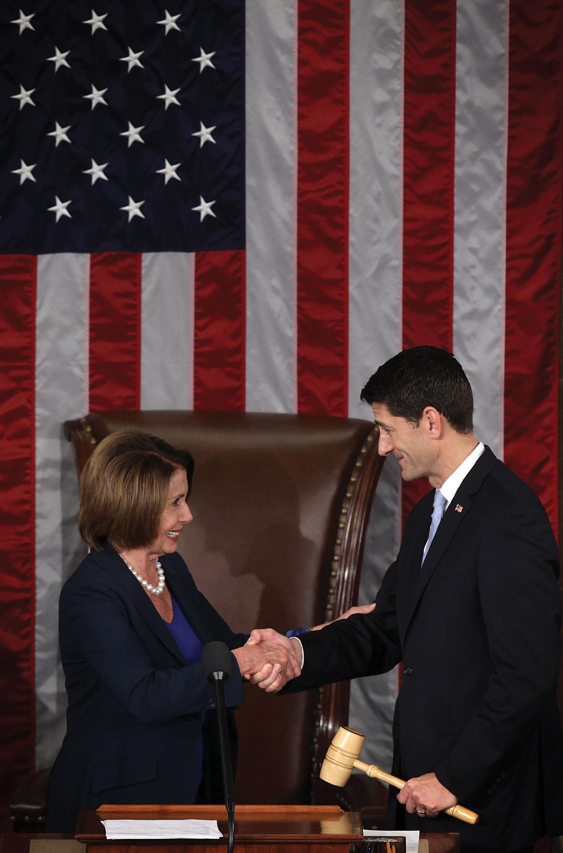
Transfer of Power
Notes:
Power is transferred peacefully in the United States via elections, with the losing side gracefully accepting the legitimacy of the result. In October 2015, incoming Speaker of the House, Paul Ryan (R-WI) accepted the gavel and a handshake from House Minority Leader Nancy Pelosi (D-CA), who would have been elected Speaker had her party been in the majority.

Slide 9
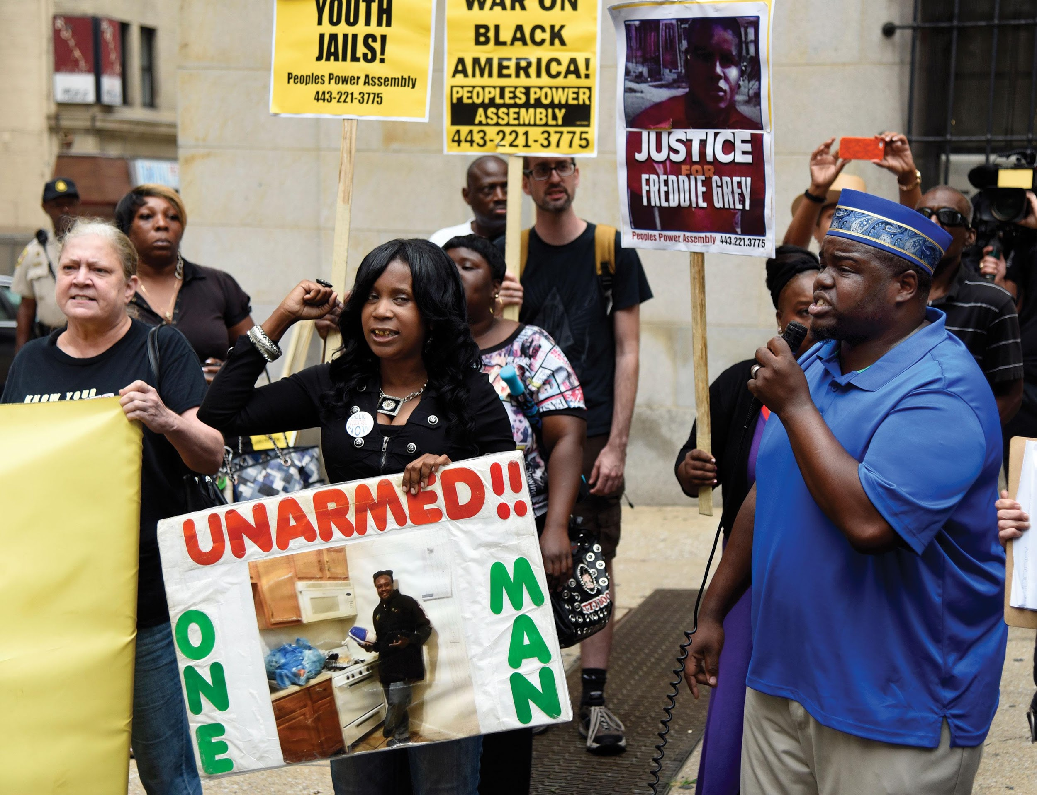
Maintaining Order
Notes:
One of the basic functions of any government is maintaining order. In 2015, after rioting broke out in Baltimore, Maryland, after the tragic death of Freddie Gray, the National Guard had to be called in to restore peace in the city. Once order was restored, it was then possible for peaceful protests to resume, as portrayed in this photo.

Slide 10
Learning Objective 1.2
Define politics in the context of democratic government.

Slide 11
Politics
What is politics?
Who gets what, when, and how
Political participation
More than just voting
Single-issue groups
e.g., abortion
Notes:
Politics determines whom we select as our governmental leaders and what policies these leaders pursue. Or, more succinctly, politics is who gets what, when, and how.
Voting is not the only way to get involved in politics.

Slide 12
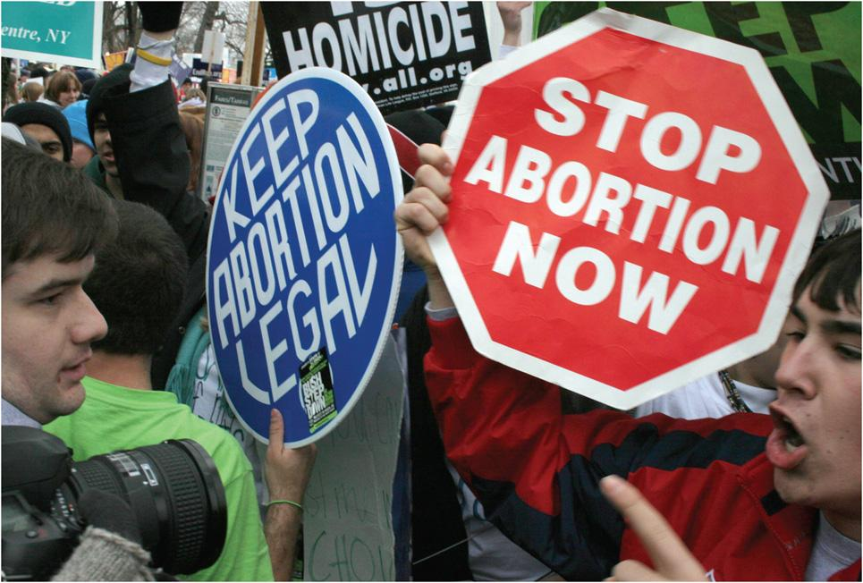
Abortion Rally
Notes:
Pro-life and pro-choice groups are single-minded and usually uncompromising. Few issues stir up as much passion as whether abortion should be permitted and, if so, under what conditions.

Slide 13
Learning Objective 1.3
Assess how citizens can have an impact on public policy and how policies can impact people.

Slide 14
The Policymaking System
People Shape Policy
Policies Impact People
Notes:
The policymaking system is in effect a cycle. Citizens' interests and concerns are transmitted through political parties and elections, interest groups, and the media. These concerns shape the government's policy agenda. Congress, the presidency, and the courts choose the issues on the agenda they will address. The policies that are made, such as laws, executive orders, regulations, and court judgments, then influence people's lives.

Slide 15
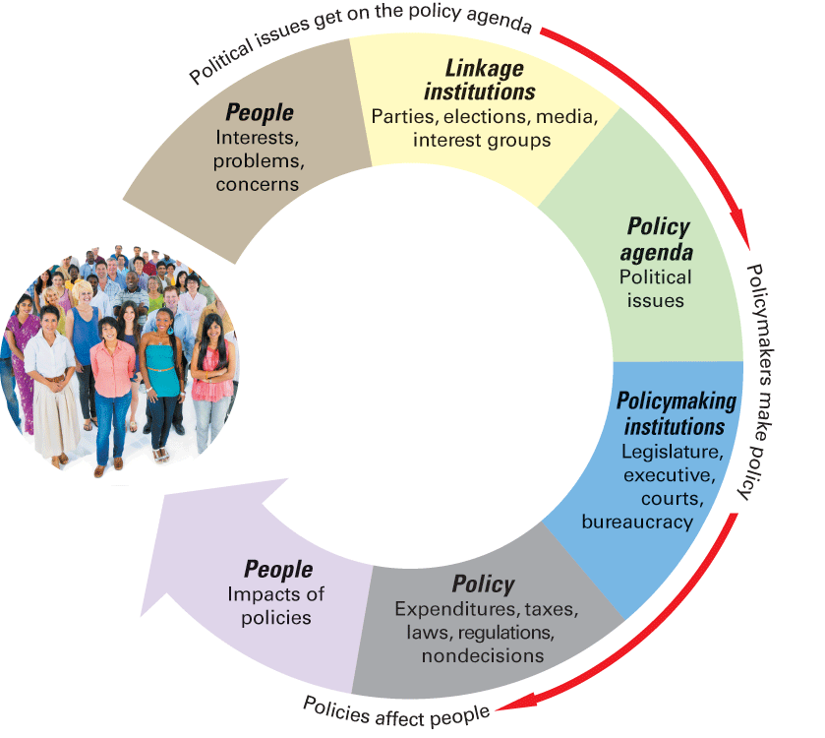
Figure 1.4 The Policymaking System
Notes:
In the policymaking system, people’s concerns get transmitted to linkage institutions. The issues that they choose to address form the policy agenda. Political institutions then make decisions in the form of policies. Policies, in turn, affect people.

Slide 16
People Shape Policy
Linkage institutions
Policy agenda
Political issue
Policymaking institutions
Congress
Presidency
Courts
Notes:
Every decision that government makes is public policy, and there are many forms that policy can take. Once policies are made and implemented, they should be effective; that is, they should address whatever problem they were designed to solve. Policy impacts are the effects that a policy has on people and on society's problems. To be effective, a policy must have a goal, such as cutting crime or ensuring clean water.

Slide 17
Table 1.1 Types of Public Policies
Type | Definition | Example
Congressional statute | Law passed by Congress | The Affordable Care Act is passed, requiring everyone to either obtain health care coverage or pay a fine.
Presidential action | Decision by president | American jets bomb ISIS targets in Syria.
Court decision | Decision by Supreme Court or other court | Supreme Court rules that same sex couples have a constitutional right to marry.
Budgetary choices | Legislative enactments of taxes and expenditures | The federal budget resolution is enacted
Regulation | Agency adoption of regulation | The Environmental Protection Agency issues new emission control guidelines for automobiles.
Notes:
This table lists five types of public policies. Which government institution makes each type?

Slide 18
Journal Prompt 1.3: The Policymaking System
How do people affect public policy within the policymaking system? Why is the policy agenda so important to the policymaking system?

Slide 19
Learning Objective 1.4
Identify the key principles of democracy and outline theories regarding how it works in practice and the challenges democracy faces today.

Slide 20
Democracy in America
Traditional Democratic Theory
Three Contemporary Theories of American Democracy
Challenges to Democracy
American Political Culture and Democracy

Slide 21
Traditional Democratic Theory (1 of 2)
Key principles of the democratic process (according to Dahl)
Equality in voting
Effective participation
Enlightened understanding
Citizen control of the agenda
Inclusion
Notes:
According to traditional democratic theory, the ideal democracy is characterized by "one person, one vote," equal opportunities to participate, freedom of speech and the press, citizen control of the policy agenda, and inclusion.

Slide 22
Traditional Democratic Theory (2 of 2)
Majority rule and minority rights
Representation
Notes:
As previously mentioned, an ideal democratic process should satisfy certain criteria, including equality in voting, which means one person, one vote, effective participation, by which we mean that all citizens have an equal chance to influence the policy agenda, enlightened understanding, which is predicated upon free speech and a free press, citizen control of the policy agenda, and inclusion, which we take to mean access to citizenship for all residents of a democratic nation.

Slide 23
Three Contemporary Theories of American Democracy
Pluralism
Groups of minorities working together
Elitism
Power is held by the wealthy
Hyperpluralism
Too many groups try to control policy
Notes:
Pluralism is the theory that groups with shared interests influence public policy through organized efforts. The National Rifle Association (NRA) is an example of an interest group. Pluralists claim that no group can dominate because all have equal access to institutions of decision making. Is this true? Pluralism depends upon interest group participation. Are Americans joiners?
Hyperpluralism offers a different critique of pluralism and is effectively pluralism gone sour. In this theory groups are so strong that government’s ability to make policy is weakened.

Slide 24
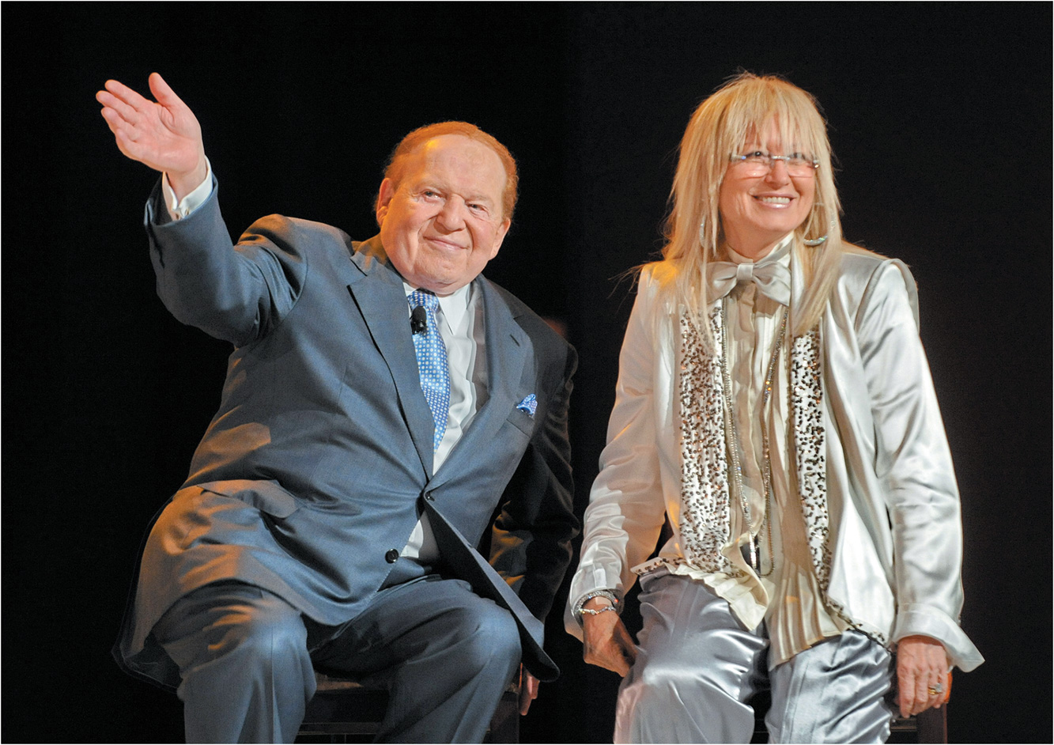
Super PAC Contributions
Notes:
The influence of the wealthy on politics has drawn increasing public attention in recent years, as billionaires like Sheldon and Miriam Adelson (shown here) have made multimillion-dollar contributions to Super PACs that supported particular presidential candidates. With their net worth of over $31 billion, a $10 million contribution from the Adelsons was equivalent to the average family with a net worth of $171,000 spending $55.

Slide 25
Challenges to Democracy
Increased complexity of issues
Limited participation in government
Escalating campaign costs
Diverse political interests
Policy gridlock
Notes:
Traditional democratic theory holds that ordinary citizens have the good sense to reach political judgments and that government has the capacity to act on those judgments. But is that still true today when policy issues are so complex that they require intensive technical knowledge to make well-informed decisions?

Slide 26
American Political Culture and Democracy
Political culture based on American creed
Liberty
Egalitarianism
Individualism
Laissez-faire
Populism
Notes:
Americans are diverse but the political culture binds us together. This set of values is widely shared, regardless of ancestry religion or heritage.
Egalitarianism in the United States involves equality of opportunity and absence of formal class distinction such as titles of nobility. Americans have never been equal in terms of condition.
Individualism is the belief that people should get ahead on their own, without assistance or interference from government. It stems from the fact that immigrants came to the New World to flee oppressive governments.

Slide 27
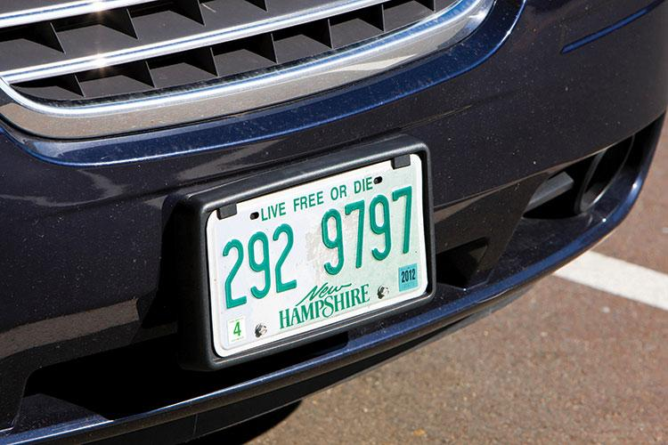
New Hampshire License Plate
Notes:
One of the fundamental values that most Americans cherish is that of liberty. The state of New Hampshire has even gone so far to place a slogan to this effect on all the automobile license plates in the state.

Slide 28
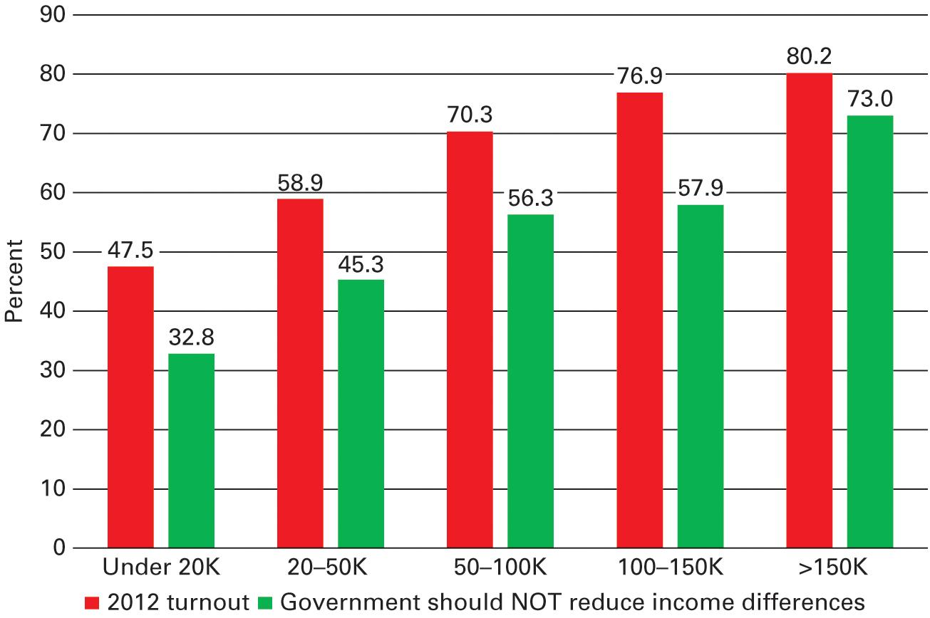
Figure 1.5 How Policymaking on Economic Inequality Is Shaped by Patterns of Political Participation
Sources: U.S. Census Bureau Data on voter turnout and author’s analysis of the 2012 American National Election Study.
Notes:
The green bars in the graph below show that as family income rises, people are much more likely to think that the government should NOT reduce income differences. The red bars show that turnout in presidential elections also rises along with family income. thus, policymakers are bound to pay more attention to the views of people who oppose taking government action to reduce income differences. This pattern is probably further reinforced by the fact that a disproportionate percentage of campaign contributions come from high-income Americans.

Slide 29
Learning Objective 1.5
Outline the central arguments of the debate in America over the proper scope of government.

Slide 30
The Scope of Government in America (1 of 2)
How Active Is American Government?
Notes:
One of the most important issues facing modern American democracy is the proper scope of government. Politicians constantly debate whether the scope of government responsibilities is too vast, just about right, or not comprehensive enough. This debate concerns whether the goals that are agreed to be important are best achieved through government action or rather through means other than government.

Slide 31
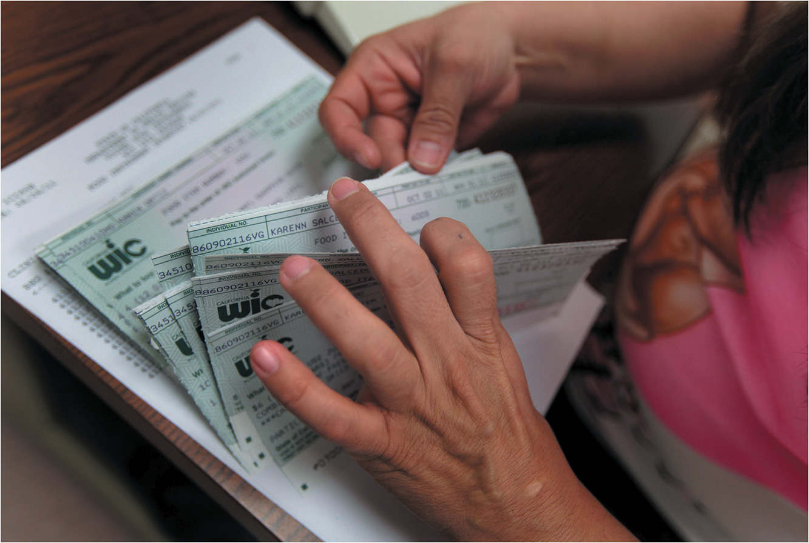
The Scope of Government in America (2 of 2)
Notes:
The Women, Infants, and Children (WIC) program is just one of many federal programs that provides support for individuals with low income. Here, a worker in Los Angeles organizes WIC vouchers, which currently go to about 9 million women, infants, and children under the age of 5. Supporters of such programs argue that they provide a much-needed safety net, enabling people to get by during hard times. Critics see these programs as expanding the scope of government too much and as often encouraging a dependency that actually perpetuates poverty.

Slide 32
How Active Is American Government?
Gross domestic product (GDP)
Government spends 1/3
Government employs 24 million people
Americans expect government to solve problems
Unemployment, terrorism, illegal immigration, energy, education, lack of access to health care
Notes:
The gross domestic product is the total value of all goods and services produced annually by the United States. The federal government spends about one-third of this, or $3.7 trillion a year, implementing public policies, and it employs about 24 million Americans.

Slide 33
Shared Writing 1
Consider carefully President Obama’s speech on economic inequality that you watched earlier in the chapter along with the slideshow, “How Policymaking on Economic Inequality Is Shaped by Patterns of Political Participation,” which reveals that high-income Americans take part in politics much more often than those with low incomes. Putting it all together, you can see the difficulty for policymakers in pursuing policies that address the condition of economic inequality. Upper-income individuals are the most opposed to such policies. And their voices are most clearly heard via the various forms of political participation. Do you think this is a major problem for democracy or not? Why do you think so? If you think it is a problem, what, if anything, do you think can be done about this situation?

Slide 34
Photo Credits
Chapter 1
006: Rhona Wise/AFP/Getty Images; 007: Alex Wong/Getty Images News/Getty Images; 008: Barbara Haddock Taylor/Baltimore Sun/AP Images; 009: Karen Bleier/AFP/Getty Images; 010: Rawpixel.com/ Fotolia; 015: Roslan Rahman/AFP/Getty Images; 017: Mario Kuhnke/ imageBROKER/Alamy Stock Photo; 020: Aurelia Ventura/La Opinion/ Newscom

